Slide 1
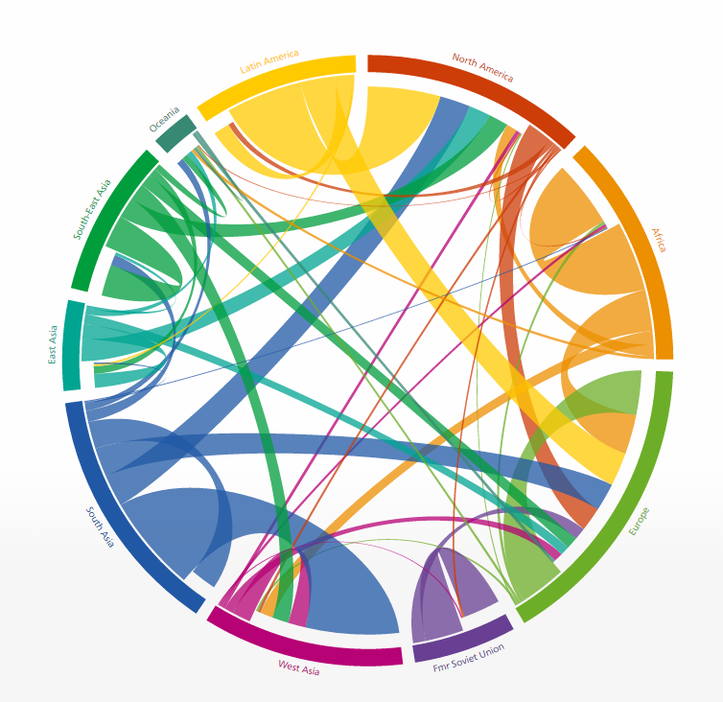
Global flow of people

Slide 2
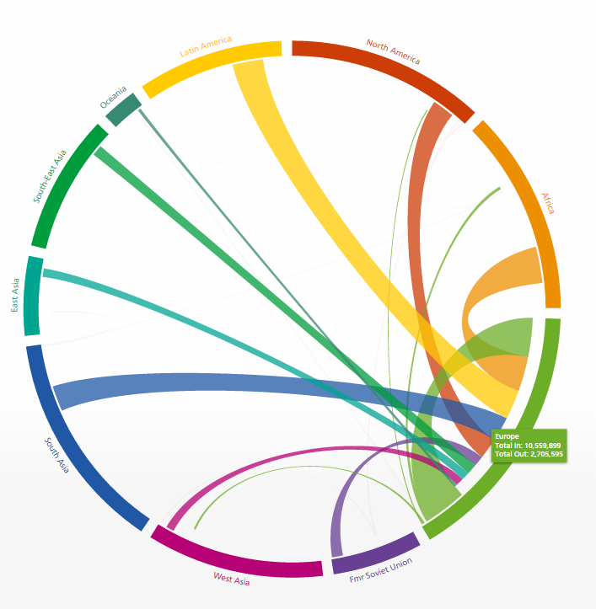
Insights
Flows from developing to developed countries
More people moving to different continents

Slide 3
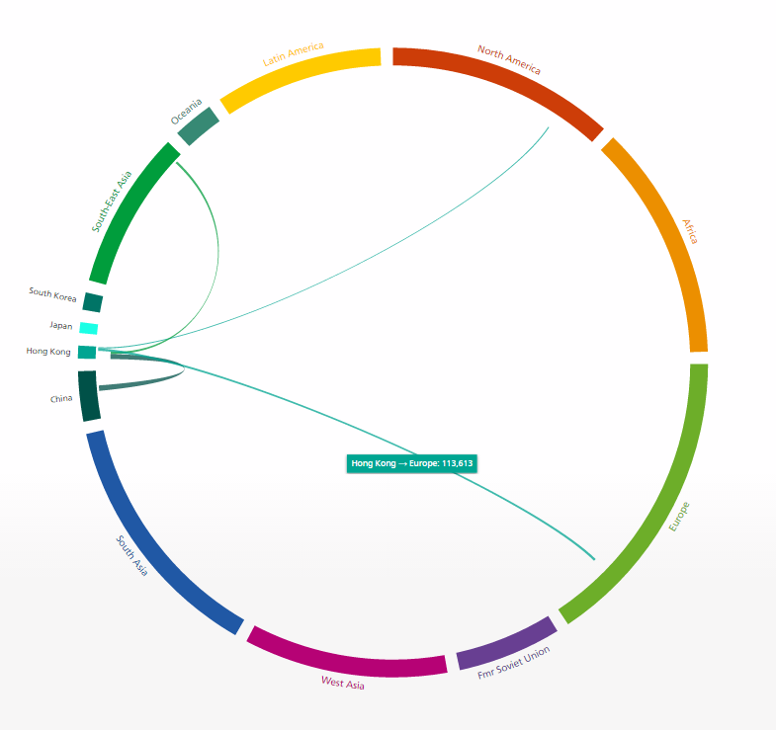
Big picture to smaller scope
Major destination & source of migration at Hong Kong

