Slide 1
Data Science Project
10/17/2016

Slide 2
Goal of the Project:
Company XYZ is a food delivery company. They have been relying significantly on online ads.
At the moment, they are running 40 different ad campaigns and would like to understand their performance.

Slide 3
Specific Tasks:
Identify the 5 best ad groups
Predict how many ads will be shown on Dec, 15 for each campaign
Cluster ads into 3 groups based on the trend of avg_cost_per_click

Slide 4
Data Exploration:
Data Shape: (2115,7)
Missing Values
Outlier

Slide 5

Task 1: Identify the 5 Best Ad Groups
Metric:
CRT = $\frac{Clicks}{Impressoin}$ * 100%
Measures how many people see your ads and whether they engage with the ads

Slide 6
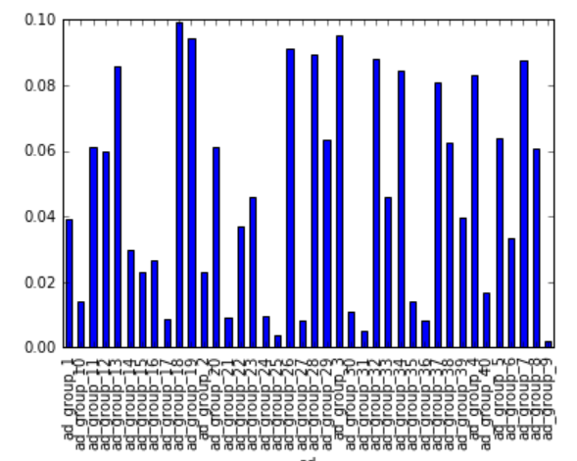
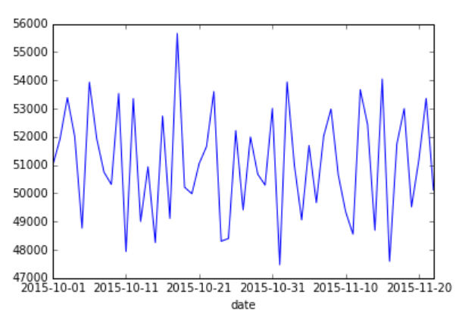
Pros & Cons:

Slide 7
Task 2:Predict #of ads to be shown on Dec, 15
Data type
Cross-sectional
Time series
Panel data

Slide 8
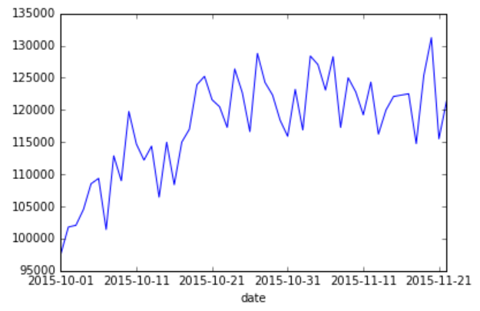
Plot Series Data

Slide 9
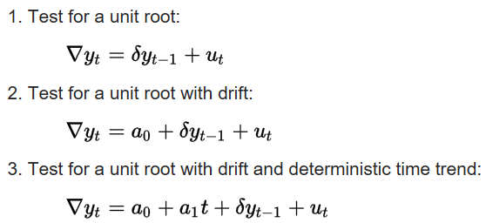
Statistical Tests Performed:
Augmented Dickey–Fuller test
adf=sm.tsa.adfuller(ads_s, maxlag=None, regression='nc', autolag='AIC', store=False, regresults=False)

Slide 10
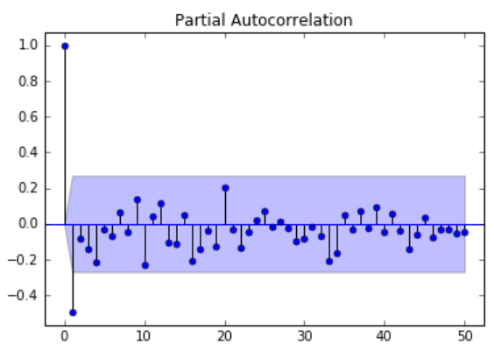
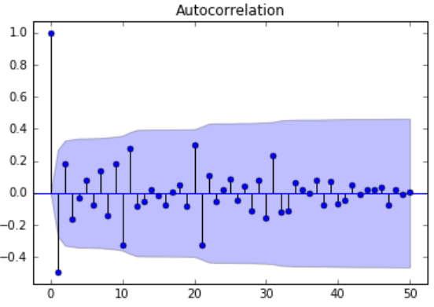
Check for Autocorrelations:

Slide 11
Model Selection:
Criteria:

Slide 12

Model Selection:
ARIMA(p,d,q): x13_arima_select_order
Perform automatic seasonal ARIMA order identification using x12/x13 ARIMA
AMRM(p,q): arma_order_select_ic

Slide 13
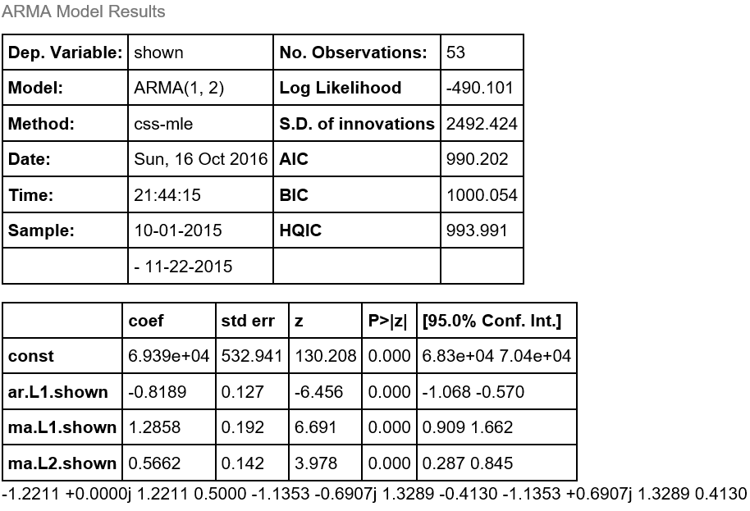
Model Output:

Slide 14

Model Performance:
In sample fit:
P-value
εt ~$N{(μ,σ}^{2}), iid$
Mean Absolute Error
Out of Time Prediction

Slide 15
Potential Improvement:
Data transformation
ARCH/GARCH
VAR

Slide 16

Task 3: Cluster ads into 3 groups
Pearson Correlation Coefficient
$ρ=\frac{Cov(\text{avg}\text{_}\text{cost}\text{_}\text{per}\text{_}\text{click}\text{, }\text{days}\text{_}\text{past}\text{)}}{σ_{\text{avg}\text{_}\text{cost}\text{_}\text{per}\text{_}\text{click}}σ_{\text{days}\text{_}\text{past}}}$
Scipy
stats.pearsonr (avg_cost_per_click, days_past)

Slide 17
Q & A:

Slide 18

Thank you!

