Slide 1




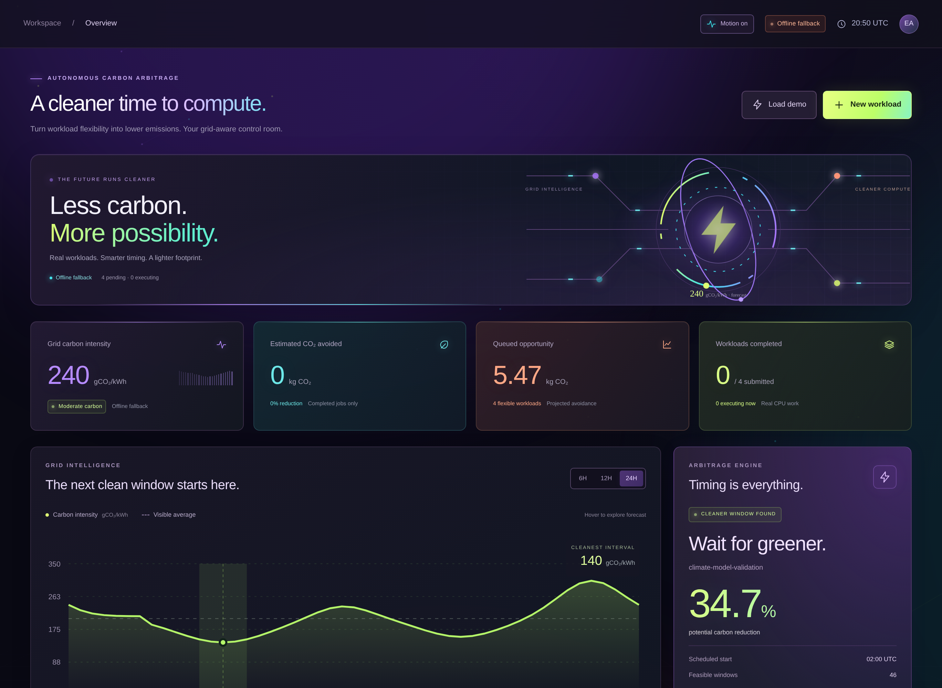
VINHACK 2026 · GRAVITAS ’26 · CLIMATE TECH AND RESILIENCE
ECO-ARB
Compute with the grid.
A carbon-aware scheduler that moves deferrable compute to the cleanest half-hour the electricity grid will offer before your deadline — and proves the work actually ran.
TEAM
TRACK
TYPE
VNAK - 753
Climate Tech and Resilience
Software
TEAM MEMBERS
S KRISHIYKEISHAV
VAISHNAV CHANDRA KUMAR
Live control room · real UK National Grid forecast, real execution
ANUWIN SARAVANAN
NAVINRAJ A
Notes:
ECO-ARB by team VNAK-753. Batch jobs have deadlines, not start times. We move them to the cleanest window and prove the work ran.

Slide 2
01 · THE PROBLEM
Right work. Wrong hour.
Deferrable compute runs the instant it is submitted, on whatever electricity happens to be in the wires. Carbon intensity of the UK grid swings four to five times across a single day, so identical work emits wildly different amounts for one reason only — when it started.
60–350 gCO₂/kWh
4–5× difference
44% avoided
Range the UK grid moves through within one ordinary day.
Same job, same energy, same output — decided purely by start time.
Measured by our own engine on a real 9 kWh, 45-minute job.
WHO EXPERIENCES IT
WHAT TODAY’S TOOLS MISS
Platform, DevOps and research-computing teams running nightly builds, CI pipelines, model training, backups and simulation sweeps.
Cloud and data-centre operators under emissions-reporting obligations.
Grid operators and the public — demand that ignores supply forces dirtier plant online at peak.
Schedulers optimise latency, queue depth and cost. None of them optimise carbon.
Carbon dashboards report emissions after the fact — they measure, they do not act.
Carbon-aware options that do exist shift jobs between regions, which needs multi-region infrastructure most teams simply do not have.
Theme fit — Climate Tech and Resilience: cuts real emissions with no new hardware and no change to the job itself, while pulling demand toward renewable surplus, which is exactly what a resilient grid needs.
VNAK - 753 · ECO-ARB
2 / 6
Notes:
Deadline, not start time. The grid swings 4-5x a day and nobody schedules around it.

Slide 3
02 · THE SOLUTION
Treat the deadline as the only constraint.
You give ECO-ARB a job, an energy budget and a deadline. It decides when that job runs — and then actually runs it.
01
02
03
04
05
06
Submit
>
Forecast
>
Enumerate
>
Decide
>
Execute
>
Prove
Job, kWh, duration, deadline
24h UK grid curve, 48 slots
Every window that can be optimal
RUN now, or WAIT until T
Real CPU work at the chosen time
Chained SHA-256 receipt
THE APPROACH
CORE CAPABILITIES
VALUE TO THE USER
Nobody cares when a nightly build runs, only that it is done by morning.
So we treat start time as free and the deadline as fixed.
Carbon over a fixed-width window is piecewise-linear in start time, so the optimum sits at a breakpoint — a finite, enumerable set.
Live National Grid forecast ingest, with provenance on every slot.
Provably optimal window search, not sampling.
Real workload execution with a verifiable hash receipt.
Continuous re-planning — a deferred job moves if the forecast improves.
Preview mode that scores a job without queueing it.
Same work, same deadline, same output — up to 44% less CO₂.
No hardware change, no cloud migration, no edit to the job itself.
Every number on screen is labelled real, derived or modelled.
Deadline is never missed: a job with no room to defer simply runs now.
VNAK - 753 · ECO-ARB
3 / 6
Notes:
Deadline is the constraint. Breakpoint enumeration gives provable optimality.

Slide 4
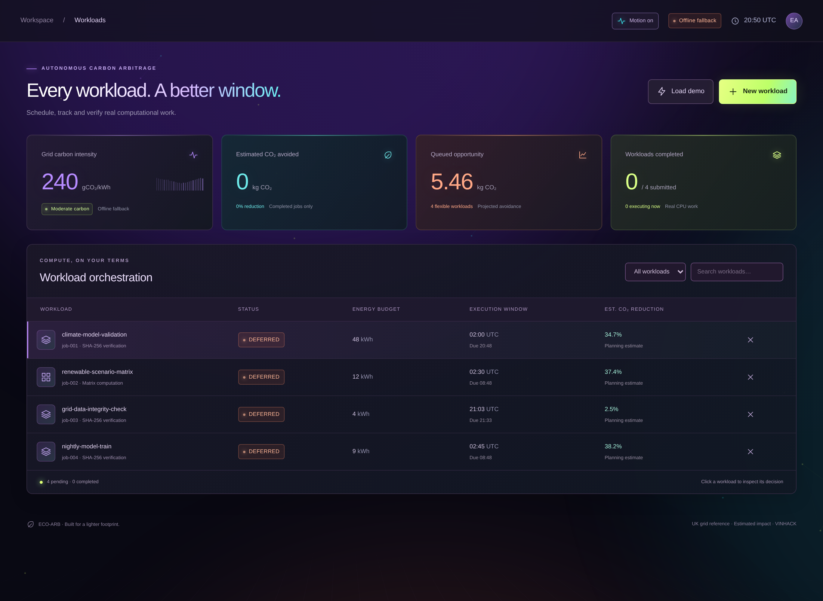
03 · USER EXPERIENCE
From submit to receipt.
ENTRY
DECIDE
TRACK
WATCH
OUTCOME
New workload
>
Preview
>
Queue
>
Re-plan
>
Receipt
Name, kWh, duration, deadline
See the window before committing
Deferred jobs with their windows
Plan updates as the forecast moves
Hash chain, independently verified
DESIGN DECISIONS THAT MATTER
Every figure carries its provenance — real, derived or modelled — on screen, not in a footnote.
Every decision ships a plain-English reason, so the user never has to trust a bare percentage.
Preview is non-mutating: you can score a job without committing it to the queue.
Time compression is labelled at all times, and never speeds up the workload itself.
Accessibility: ARIA labels throughout, and CI fails the build on any mobile overflow or JavaScript runtime error.
Queue view — four deferred workloads, each with its chosen execution window and estimated reduction
VNAK - 753 · ECO-ARB
4 / 6
Notes:
Preview before commit. Provenance on every number. Plain-English reasons.

Slide 5
04 · HOW IT WORKS
Small system, sharp edges.
REACT 19 + VITE
FASTAPI
DECISION ENGINE
APSCHEDULER
EXECUTOR
Control room UI
>
REST API, 15 routes
>
Breakpoint search
>
Dispatch + worker pool
>
Real CPU workload
polls /api/state at 1.5s
validates, scores, serves
returns RUN or WAIT
fires at the chosen time
writes a hash receipt
EXTERNAL DATA
TECH STACK
UK National Grid Carbon Intensity API · GET /intensity/fw24h · 48 half-hour forecast slots · no API key · cached, with an offline fallback curve so a demo survives without internet.
Python 3.11 · FastAPI · APScheduler · Pydantic v2 · httpx · React 19 · Vite 8 · Tailwind v4 · pytest · Playwright · GitHub Actions CI
TECHNICAL CHOICES, AND WHY
Breakpoint enumeration, not sampling
Fractional-slot energy weighting
Carbon over a window is piecewise-linear, so ~100 candidates cover every possible optimum. Provable, and still instant.
A 45-minute job is charged 15 minutes of one slot and 30 of the next — never two full half-hours.
Virtual clock with re-anchoring
Real workload + chained SHA-256
Lets a demo replay a full day in four minutes without the clock ever jumping or losing continuity.
Execution is verifiable rather than simulated; the receipt is recomputed independently on request.
REPOSITORY github.com/krishiyswim23-swagger/ECO---ARB 29 backend tests · end-to-end Playwright smoke · CI green
VNAK - 753 · ECO-ARB
5 / 6
Notes:
Repo link on screen. 29 tests, Playwright smoke, CI green.

Slide 6
05 · NOVELTY, IMPACT & SCALABILITY
Provably optimal. Honestly reported.
WHAT IS DISTINCTIVE
IMPACT & METRICS
HOW IT SCALES
Time-shifting, not region-shifting — works on a single machine in a single region.
Provable optimality: we enumerate every window that can be optimal, and can show the proof.
Execution is verifiable, not simulated — a cryptographic receipt per job.
Radical honesty: real, derived and modelled figures are separated on screen.
carbon_saved_pct and baseline vs optimal gCO₂, recorded per job.
Cumulative kg CO₂ avoided across completed workloads.
Share of submitted jobs successfully deferred.
Deadline-miss rate — zero by construction; an infeasible job runs immediately.
Observed: 34–44% reduction across the demo workload set.
Any region publishing an intensity forecast — the engine is curve-agnostic.
Drops in as a Kubernetes admission controller or a CI runner plugin.
Extends to regional grids, embodied carbon and data-centre PUE.
The same search optimises price, so cost arbitrage comes free.
Beyond the hackathon: a scheduling primitive — deadline, not start time.
THE PROOF — WHY “EVERY WINDOW” MATTERS
Our first engine only tried windows starting on a half-hour boundary. On a grid curve of 100, 10, 200 gCO₂/kWh with a 45-minute, 1 kWh job:
A start-aligned search straddles the clean slot instead of sitting inside it. We found this in our own code, fixed it, and pinned it with a regression test — brute-forcing every minute of the horizon now agrees with the engine exactly.
Start-aligned search → run at 12:00 = 70 gCO₂ (0% saved)
True optimum → wait to 12:15 = 40 gCO₂ (43% saved)
VNAK - 753 · ECO-ARB
6 / 6
Notes:
The 43% counterexample: we found a correctness bug in our own optimizer and can prove it is gone.

