Slide 1
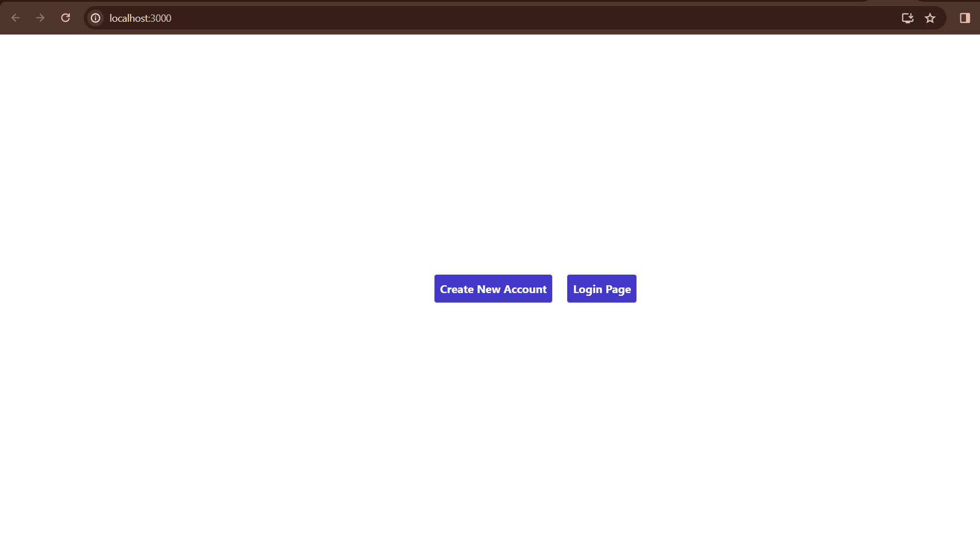
CRUD (Create Read Update Delete)
Submitted By:-
Himanshu(2110990617)
Harsh Jain(2110990559)

Slide 2
ABOUT
A CRUD (Create, Read, Update, Delete) backend project is a common type of web application that focuses on performing these fundamental operations on data. Here are some key points about CRUD backend projects:
Purpose:
CRUD operations are the basic functions for managing data in a database.
The backend handles requests from the frontend and interacts with the database to perform these operations.
Database Interaction:
The backend communicates with a database (e.g., MySQL, PostgreSQL, MongoDB) to store and retrieve data.
CRUD operations correspond to the following actions:
Create (C): Inserting new records into the database.
Read (R): Retrieving and fetching existing records from the database.
Update (U): Modifying existing records in the database.
Delete (D): Removing records from the database.

Slide 3
Some More Points About the Project
RESTful API:
CRUD operations are often exposed through a RESTful API (Representational State Transfer) endpoints.
Each CRUD operation is mapped to specific HTTP methods:
Create: POST
Read: GET
Update: PUT or PATCH
Delete: DELETE
Validation and Error Handling:
Input data should be validated before processing CRUD operations to ensure data integrity.
Proper error handling mechanisms should be implemented to handle scenarios like database errors, validation failures, etc.

Slide 4
Security And Control
Security:
Implement authentication and authorization to control access to CRUD operations.
Protect against common security vulnerabilities like SQL injection, cross-site scripting (XSS), and cross-site request forgery (CSRF).
Concurrency Control:
Implement mechanisms to handle concurrent access to data to avoid conflicts and ensure data consistency.
Techniques like optimistic locking or pessimistic locking may be employed.

Slide 5
Monitoring And Scalability
Logging and Monitoring:
Implement logging to capture information about CRUD operations for debugging and auditing purposes.
Set up monitoring to track the performance and health of the CRUD backend.
Scalability:
Design the CRUD backend to be scalable, allowing it to handle increased loads by employing techniques like load balancing and database sharding.

Slide 6
Testing And Deployment
Testing:
Implement unit tests, integration tests, and end-to-end tests to ensure the reliability of CRUD operations.
Perform testing for various scenarios, including edge cases and error conditions.
Documentation:
Provide comprehensive documentation for the API, including details on endpoints, request/response formats, and any authentication/authorization requirements.
Deployment:
Deploy the CRUD backend in a secure and scalable environment, considering factors like server configuration, containerization, and deployment orchestration.

Slide 7
THANK YOU
………………………………

