Slide 1
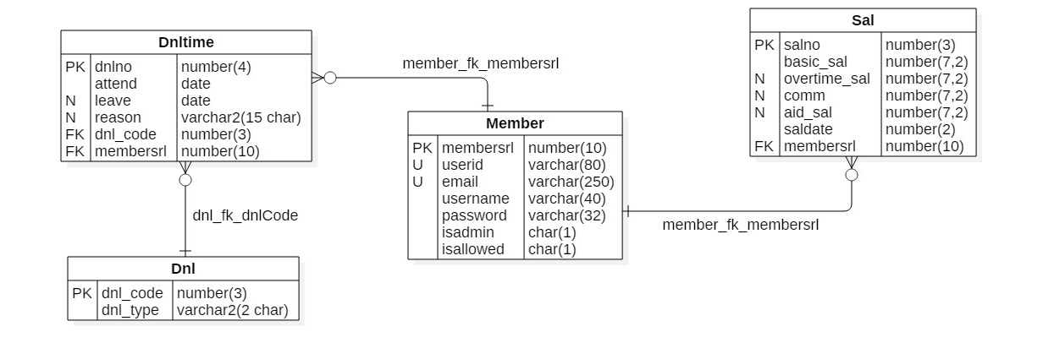
MEMBER & SALARY & WORKTIME

Slide 2
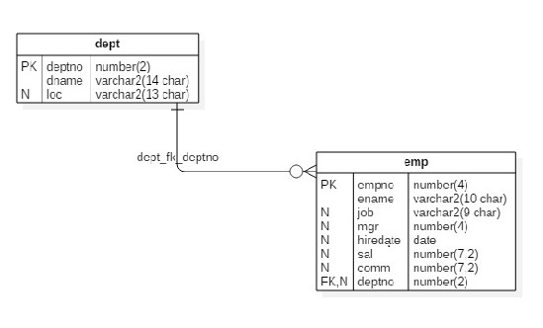
DEPARTMEMT& EMPLOYEE

Slide 3
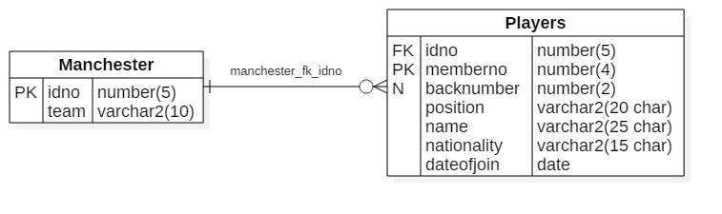
MANCHESTER & PLAYERS

Slide 4
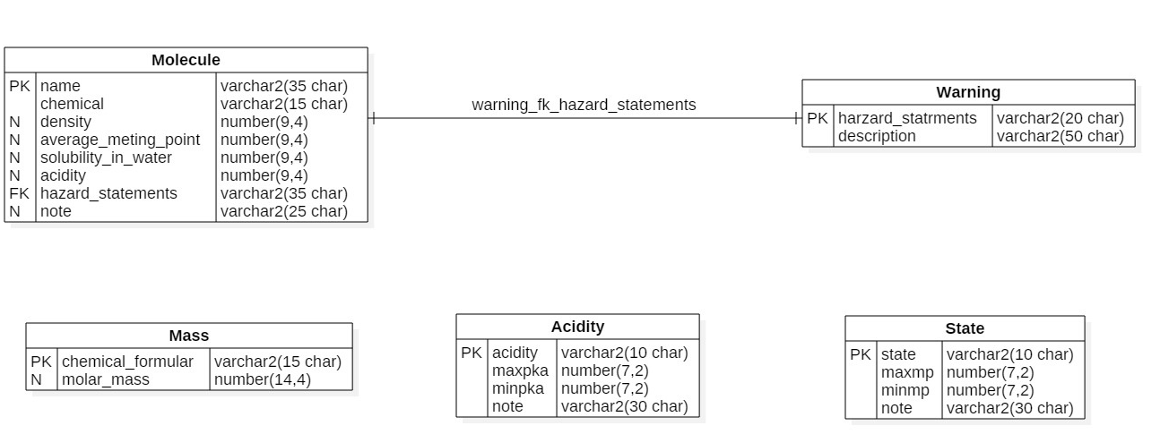
MOLECULR DATA

Slide 5
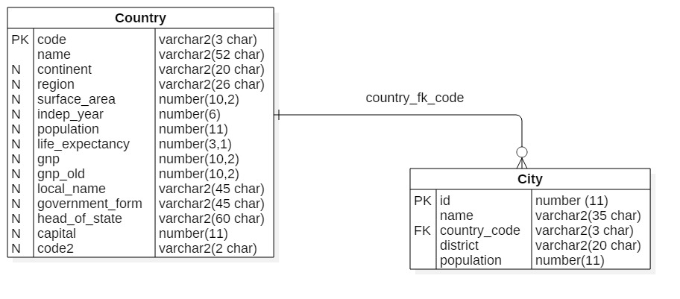
COUNTRY & CITY

