Slide 2
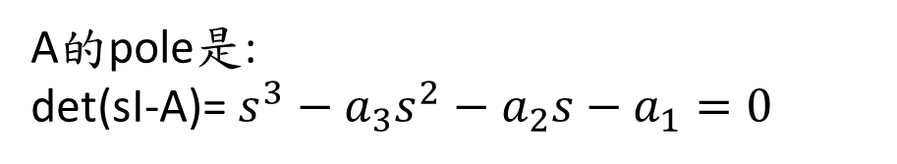
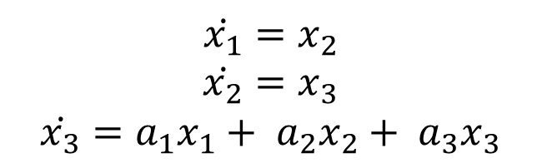
Final 1:
$$\dot{x_{1}}=x_{2}$$
$$\dot{x_{2}}=x_{3}$$
$$\dot{x_{3}}=a_{1}x_{1}+ a_{2}x_{2}+ a_{3}x_{3}$$
A的pole是:
det(sI-A)=$s^{3}−a_{3}s^{2}−a_{2}s−a_{1}=0$

Slide 3
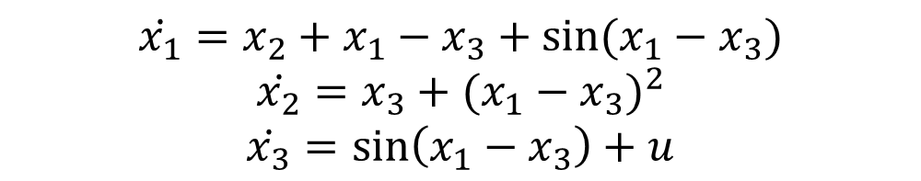
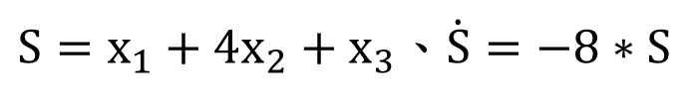
Final 2:
$$\dot{x_{1}}=x_{2}+x_{1}−x_{3}+sin⁡(x_{1}−x_{3})$$
$$\dot{x_{2}}=x_{3}+{(x_{1}−x_{3})}^{2}$$
$$\dot{x_{3}}=\sin\left(x_{1}−x_{3}\right)+u$$
$S=x_{1}+4x_{2}+x_{3}$、$\dot{S}=−8∗S$

Slide 4
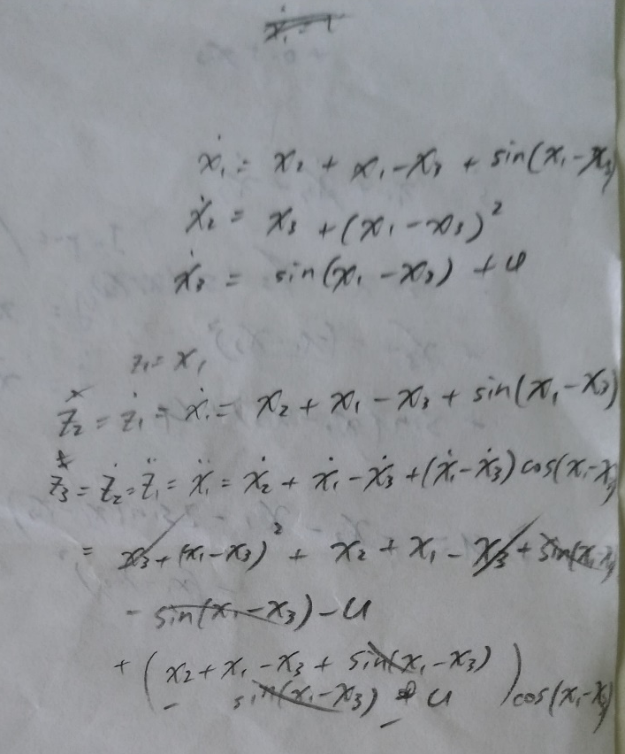
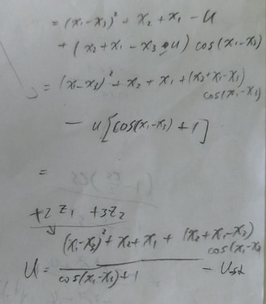
Final 2:
z1_dot = 1*z2
z2_dot = 100*z1+99*z2

Slide 5
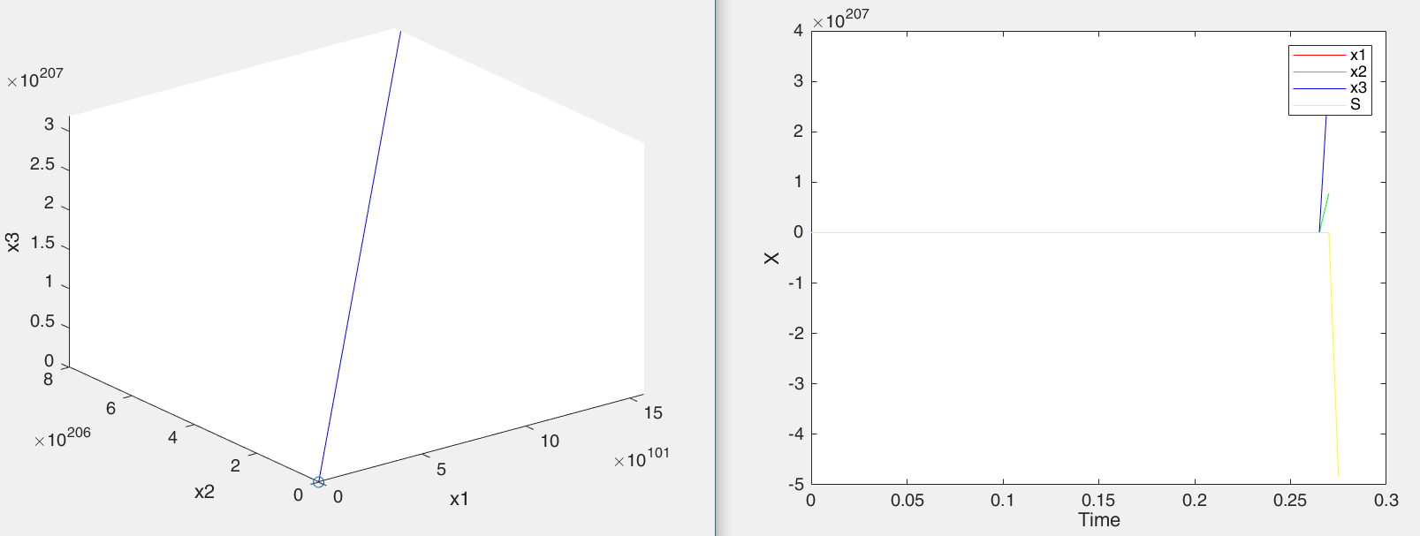
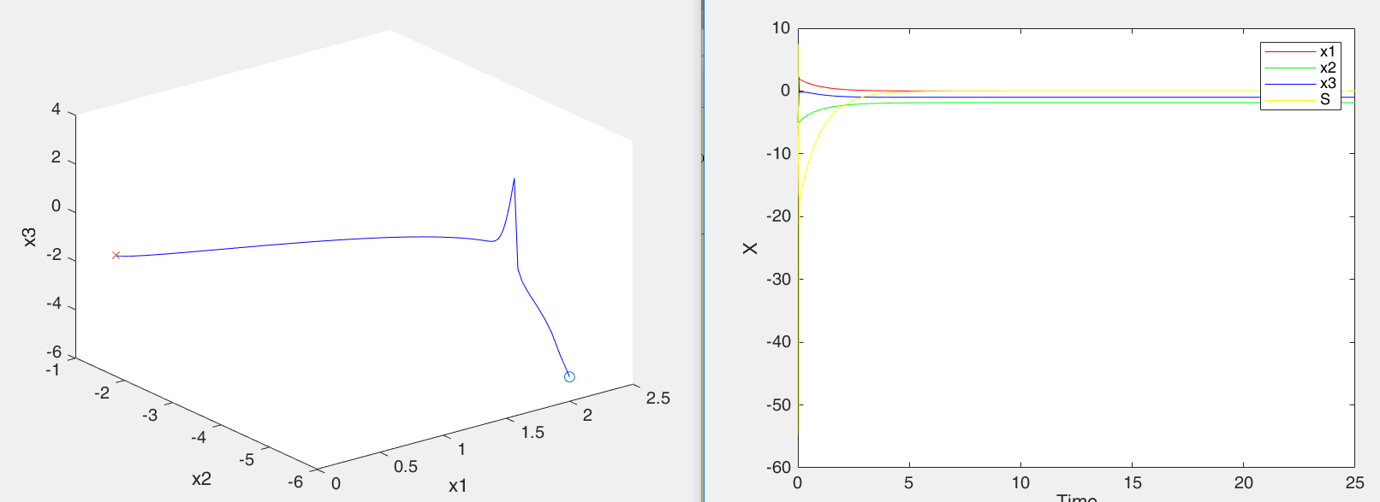
Final 2:
x = [8 -6 -5]';
x = [2 -6 -5]';

Slide 6
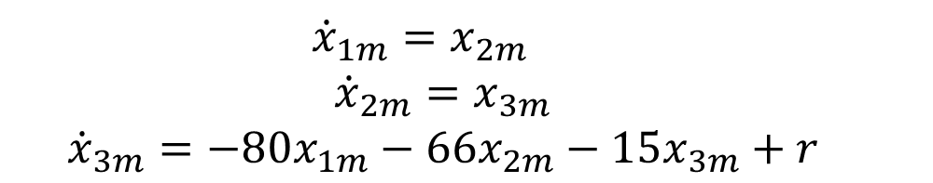

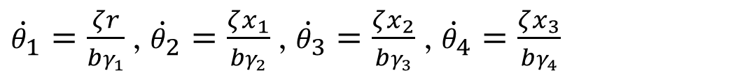
Final 3:
$$\dot{x_{1}}=x_{2}$$
$$\dot{x_{2}}=x_{3}$$
$$\dot{x_{3}}=−12x_{1}−4x_{2}−3x_{3}+u$$
$${\dot{x}}_{1m}=x_{2m}$$
$${\dot{x}}_{2m}=x_{3m}$$
$${\dot{x}}_{3m}=−80x_{1m}−66x_{2m}−15x_{3m}+r$$
${\dot{θ}}_{1}=\frac{ζr}{bγ_{1}}$,${\dot{θ}}_{2}=\frac{ζx_{1}}{bγ_{2}}$,${\dot{θ}}_{3}=\frac{ζx_{2}}{bγ_{3}}$,${\dot{θ}}_{4}=\frac{ζx_{3}}{bγ_{4}}$
$$u=θ_{1}∗r+θ_{2}∗x_{1}+θ_{3}∗x_{2}+θ_{4}∗x_{3}$$

Slide 7
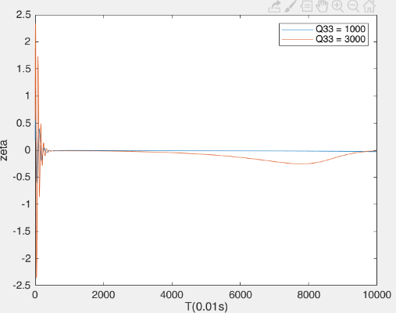
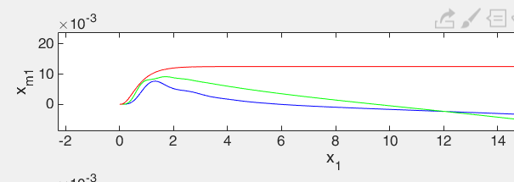
Final 3:

Slide 8
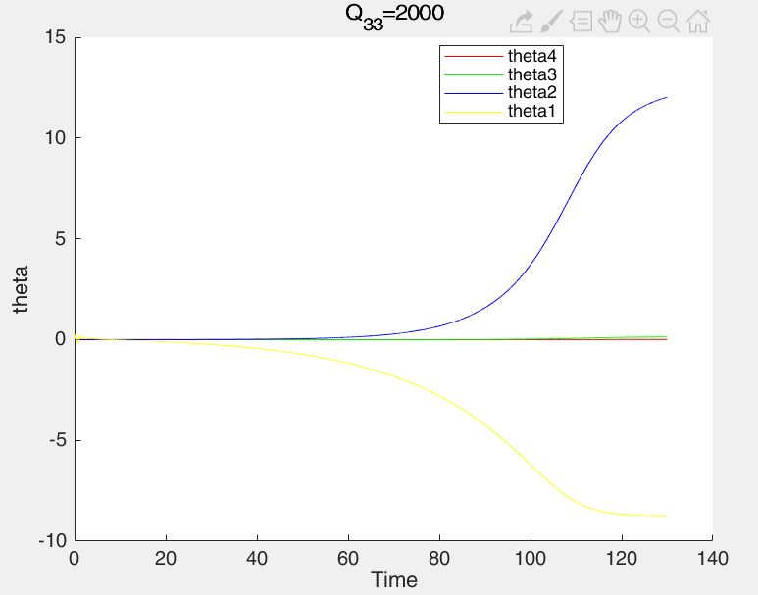

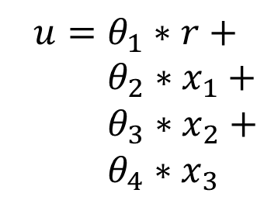

Final 3:
$$\dot{x_{1}}=x_{2}$$
$\dot{x_{2}}=x_{3}$
$$\dot{x_{3}}=\left(−12+θ_{2}\right)x_{1}+$$
$(−4{+θ_{3})x}_{2}+$
$\left(−3+θ_{4}\right)x_{3}+$
$$(bθ_{1})r$$
$$u=θ_{1}∗r+$$
$θ_{2}∗x_{1}+$
$θ_{3}∗x_{2}+$
$θ_{4}∗x_{3}$

Slide 9
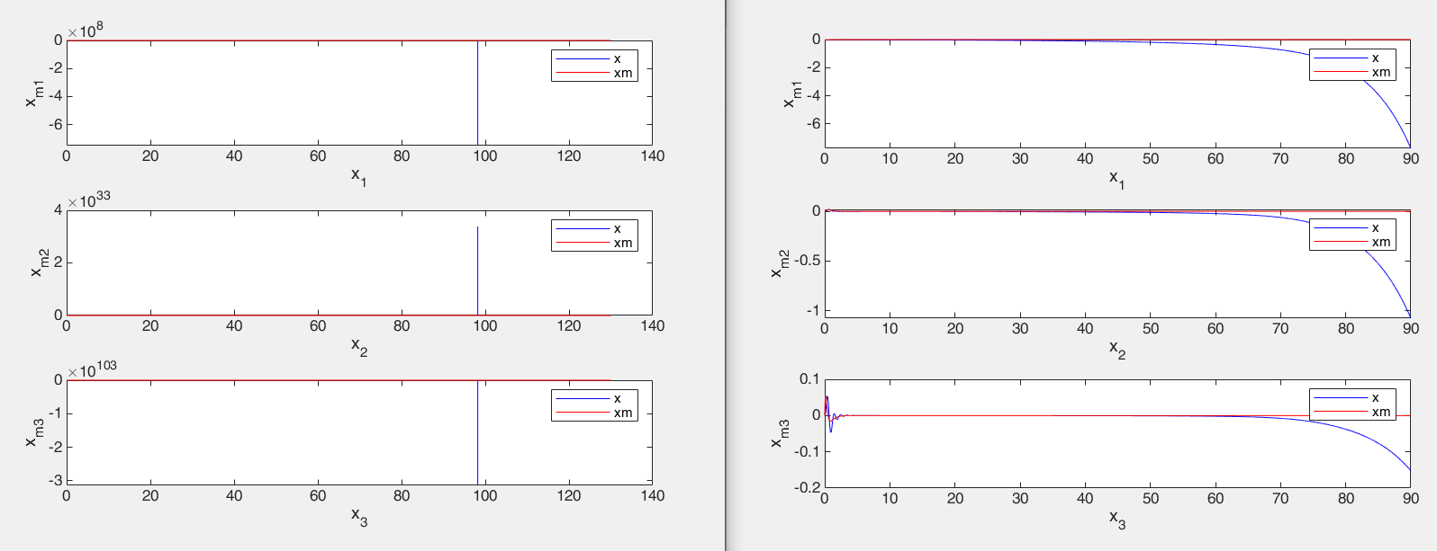
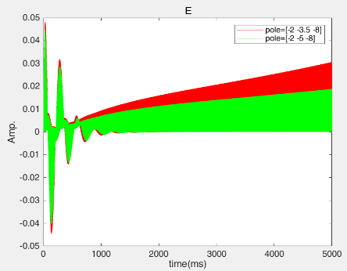
Final 3:
pole=[-2 -3.5 -8]的狀態圖 比較不同狀態的誤差

Slide 10
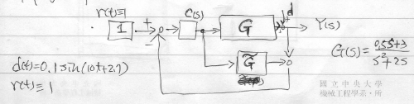
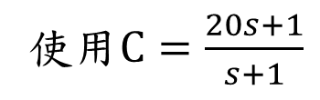
Final 4:
使用$C=\frac{20s+1}{s+1}$

Slide 11
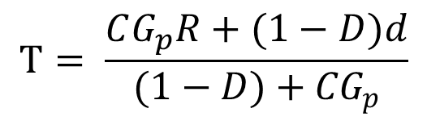
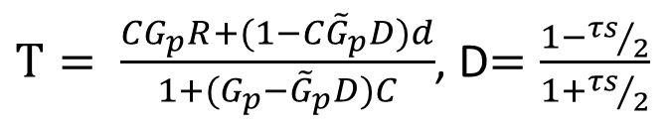
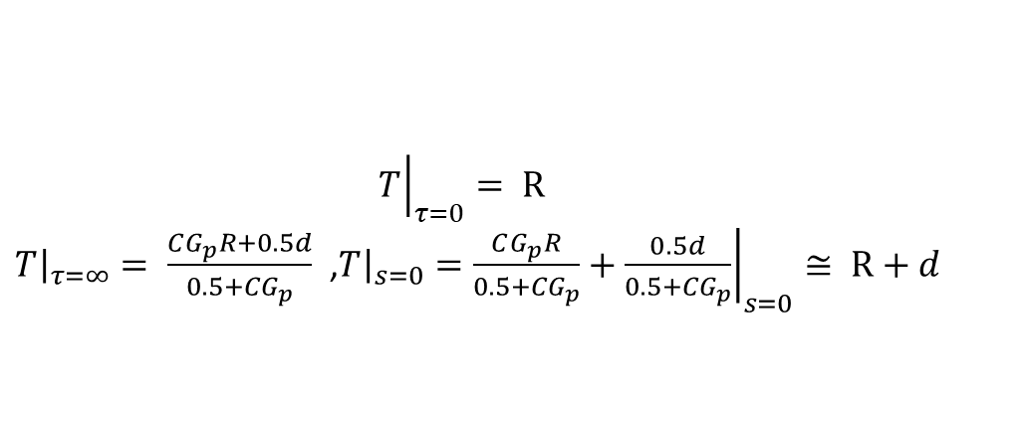
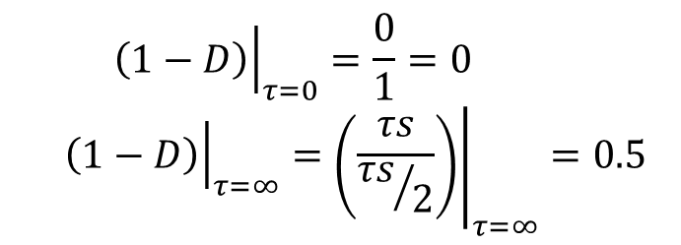
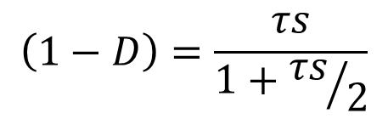
Final 4:
$T= \frac{CG_{p}R+(1−C{\tilde{G}}_{p}D)d}{1+(G_{p}−{\tilde{G}}_{p}D)C}$, D$=\frac{1−{τs}/2}{1+{τs}/2}$
$$T= \frac{CG_{p}R+(1−D)d}{(1−D)+{CG}_{p}}$$
$$\left(1−D\right)=\frac{τs}{1+{τs}/2}$$
$${\left.\left(1−D\right)\right|}_{τ=0}=\frac{0}{1}=0$$
$${\left.\left(1−D\right)\right|}_{τ=∞}={\left.\left(\frac{τs}{{τs}/2}\right)\right|}_{τ=∞}=0.5$$
$${\left.T\right|}_{τ=0}= R$$
${\left.T\right|}_{τ=∞}= \frac{CG_{p}R+0.5d}{0.5+{CG}_{p}}$ ,${\left.T\right|}_{s=0}={\left.\frac{CG_{p}R}{0.5+{CG}_{p}}+\frac{0.5d}{0.5+{CG}_{p}}\right|}_{s=0}≅ R+d$

Slide 12
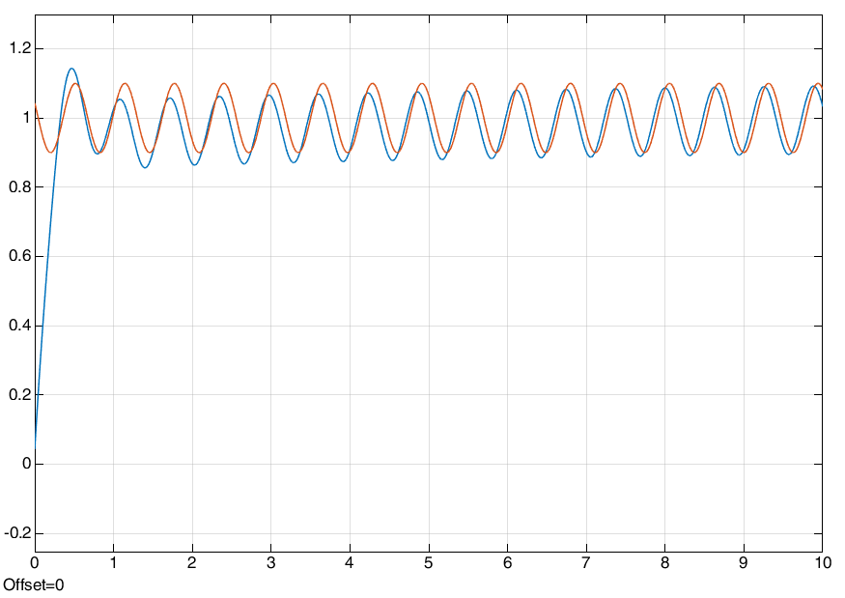
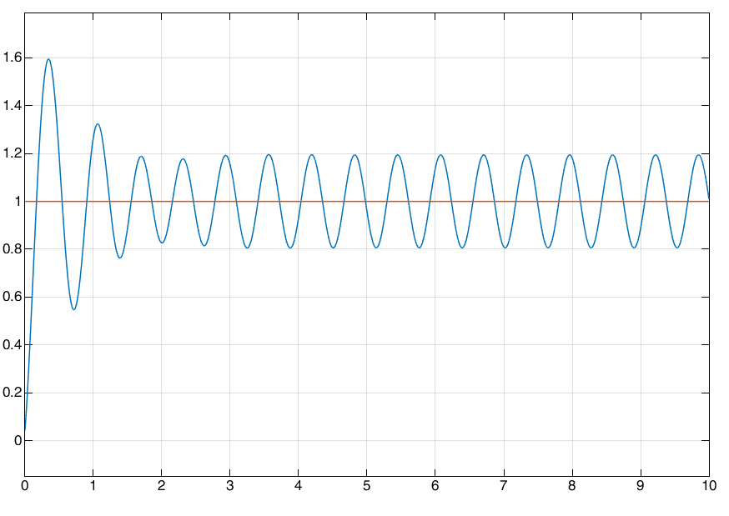
Final 4:
Tau = 20s
Tau = 0.2s

Slide 13
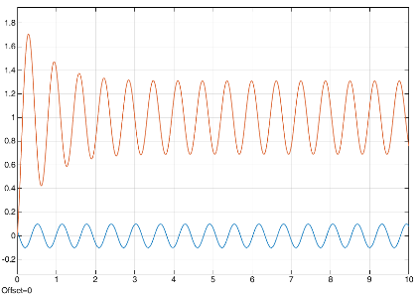
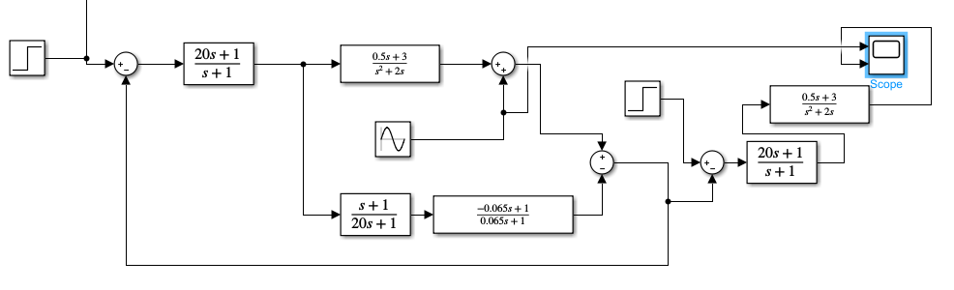
Final 4:相位問題
Tau = 0.17s

Slide 14
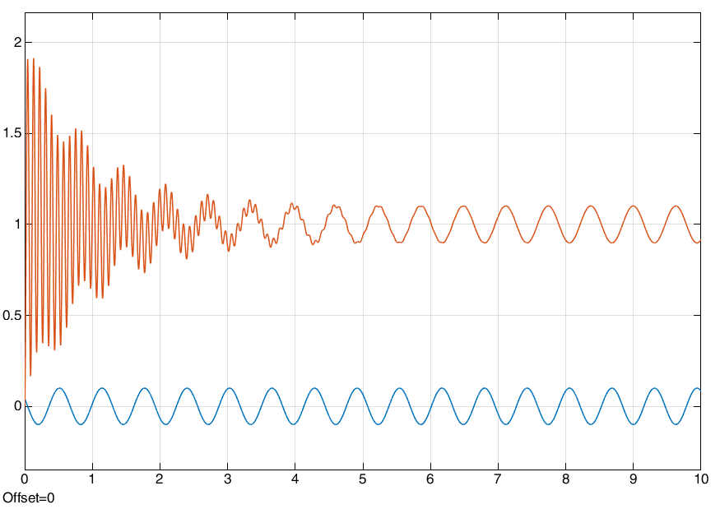
Final 4:

Slide 15
END

