Slide 1
ME5020現代控制理論
黃衍任

Slide 2
What is control?
Dynamic systems
Time respons:
Vehicles (plane, missels, car, etc) control: speed, direction, alignment
Temperature control:
Frequency response:
Radio, TV and phone

Slide 3
Class requirements
Courses
Circuits,
Automatic control,
Linear system
Ordinary differential equation (ODE)
Software
Matlab programming (*.m)

Slide 4
Software
Matlab
Help control
*.m file
Runge-Kutta approximation method

Slide 5
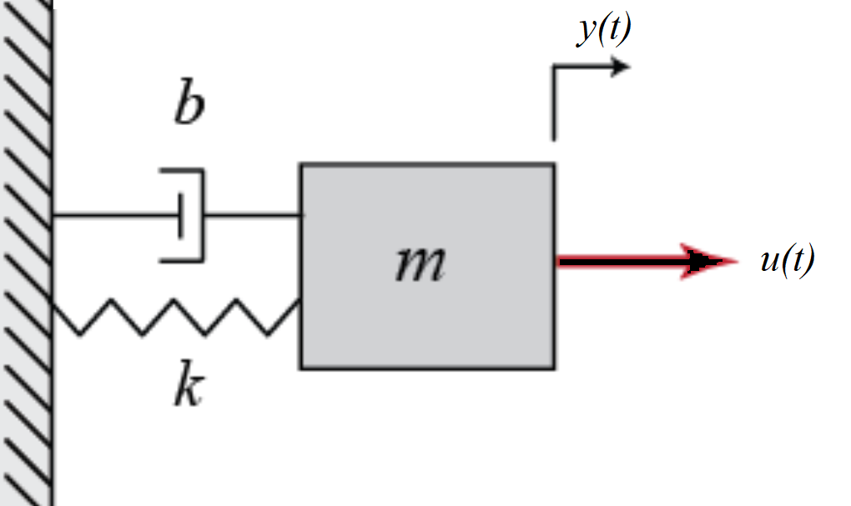
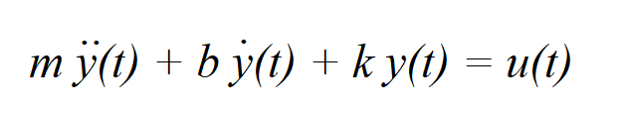
class1
Variables:
y(t) : position of the mass
u(t) : input force
Dynamic equations:

Slide 6
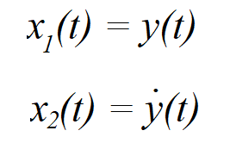
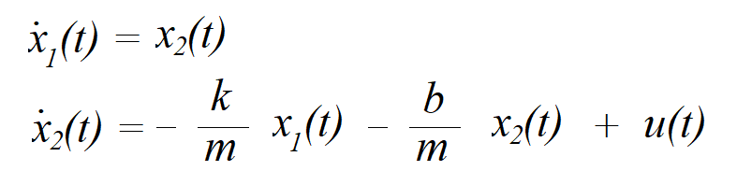
class1
1. State variables :
Define
2. State equations

Slide 7
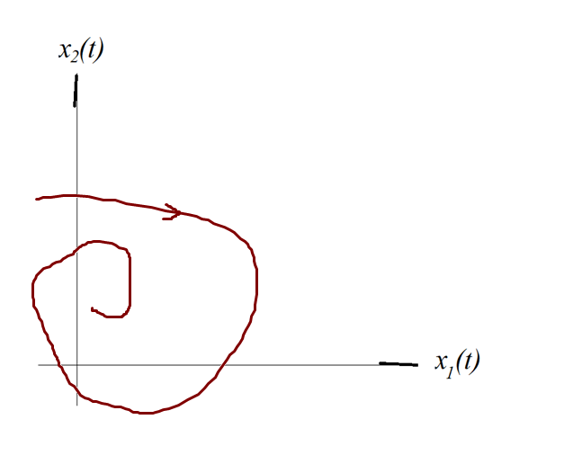
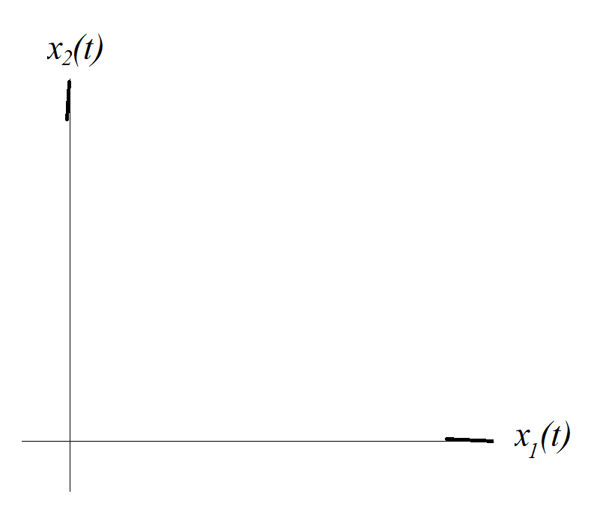
class1
3. State space
4. State portrait

Slide 8
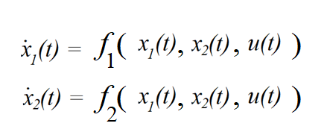
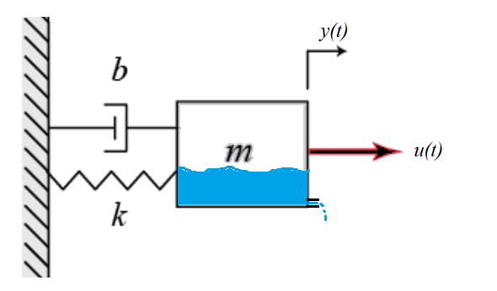
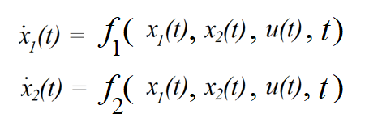
class1
5. Time invariant:
6. Time varying:

Slide 9
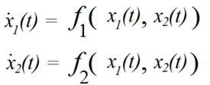
class1
7. Autonomous system
* trajectories only depend on the position of the space
* trajectories at the same position will always be the same

Slide 10

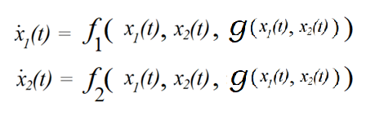
class1
8. State Feedback Control

Slide 11
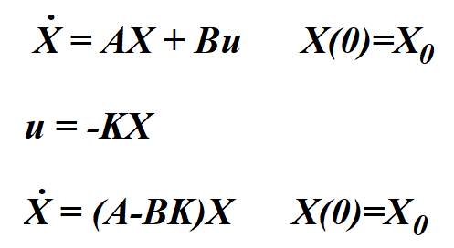
class1
Example: State Feedback Control for Linear Control System
Results: Autonomous system with initial value

Slide 12
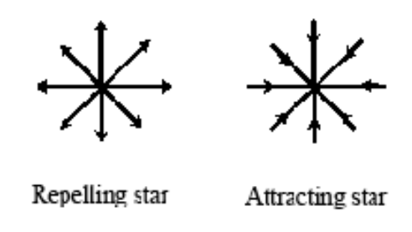
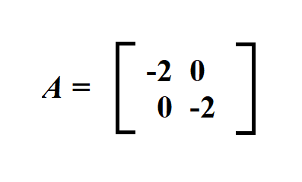
Phase portrait
Type 1 : star

Slide 13
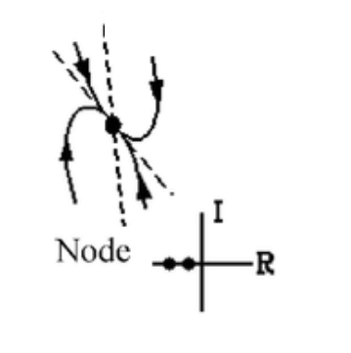
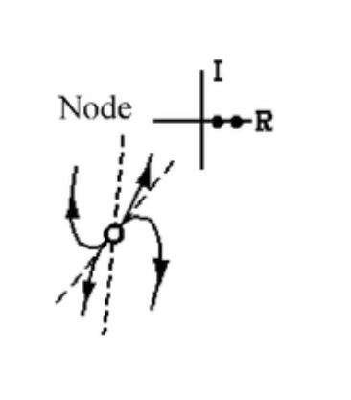
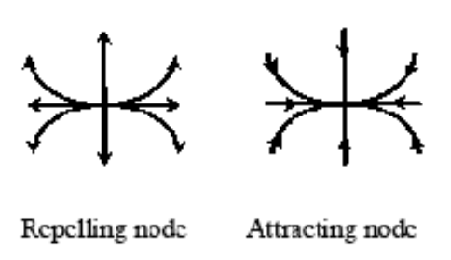
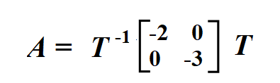
Phase portrait
Type 2 : node

Slide 14
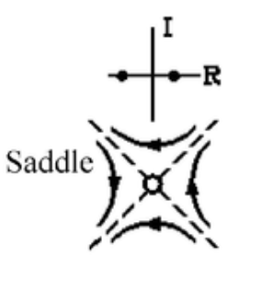
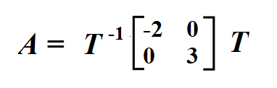
Phase portrait
Type 3 : saddle point

Slide 15
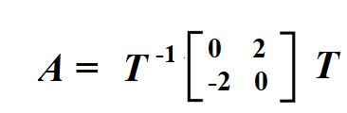
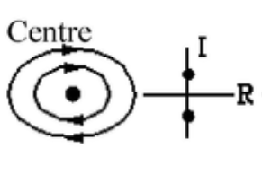
Phase portrait
Type 4: center

Slide 16
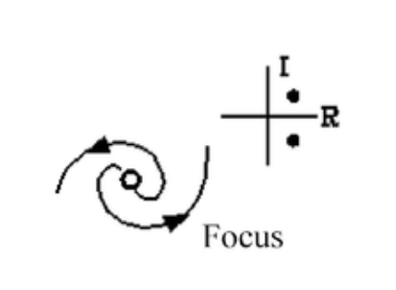
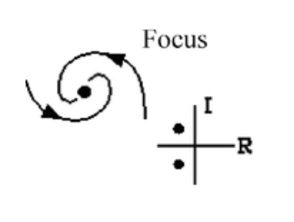
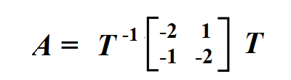
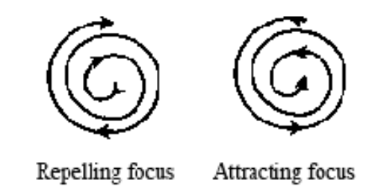
Phase portrait
Type 5: focus

Slide 20


Matlab 模擬
Consider
State equation:
How to find the history of X(t) ?
Mathematic true solution
Computer simulation

Slide 21
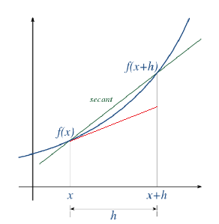


Numerical Simulation
Differential equation
Euler Method

Slide 22
Matlab 模擬
Nonlinear state equation for initial value problems:
How to find the history of X(t) ?
Mathematic true solution
Computer simulation

Slide 23
Numerical Simulation
Differential equation
Euler Method

Slide 24

Examples
Van Der Pol Oscillator
State equation:

Slide 25
function
function xNew = myFindNextPos(x,mu,delt)
xDot= zeros(size(x)); xNew = xDot;
xDot(1) = x(2);
xDot(2) = -mu*(x(1)*x(1)-1)*x(2) - x(1);
xNew(1) = x(1) + xDot(1)*delt;
xNew(2) = x(2) + xDot(2)*delt;
return;

Slide 26
x = [0., 0.4]';
x1arr=[0,0,0,0]';
x2arr=x1arr; tarr =x1arr;
delt = 0.01;
for i = 1:2000
xN = myFindNextPos(x,0.8,delt);
x1arr(i)=xN(1);
x2arr(i)=xN(2);
tarr(i) =delt*i;
x = xN;
end
figure(1); plot(x1arr,x2arr,'b');hold on;

Slide 27
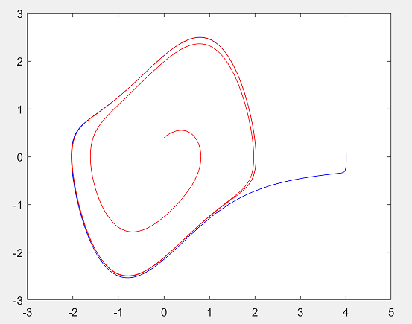
Examples
Van Der Pol Oscillator
State equation:

Slide 28
Numerical Simulation
Differential equation
Euler Method

Slide 29


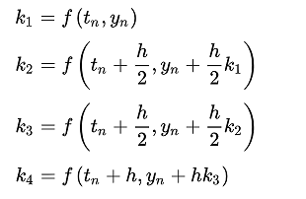
Runge-kuda method
For a differential equation
The value for next value: (that is y(to+h))
Error is order of (h^5): h: step distance

