Slide 1


Weight measuring techniques
Tribe Team
Europress-Since AI Hackaton 2026

Slide 2
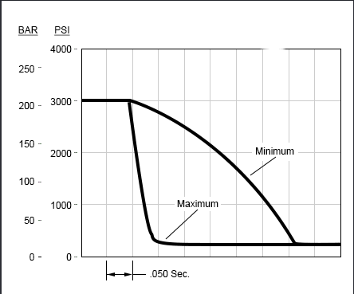

Compactor/ decompression ratio
Fully On Software
Decompression Rebound Speed
OTA Push

Slide 3
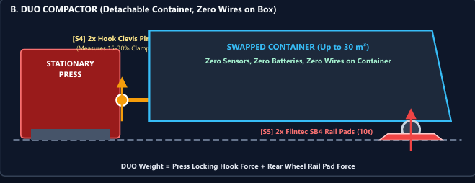
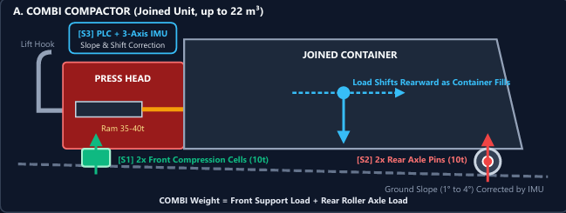

Load Cells
Heavy-duty Industrial Load Cells
Loaded On The Wheel Axle(pin)
Dynamic Tilt & Weight-transfer Model
Key Metrics: €1,195 (COMBI) / €1,235 (DUO) OEM BOM

Slide 4
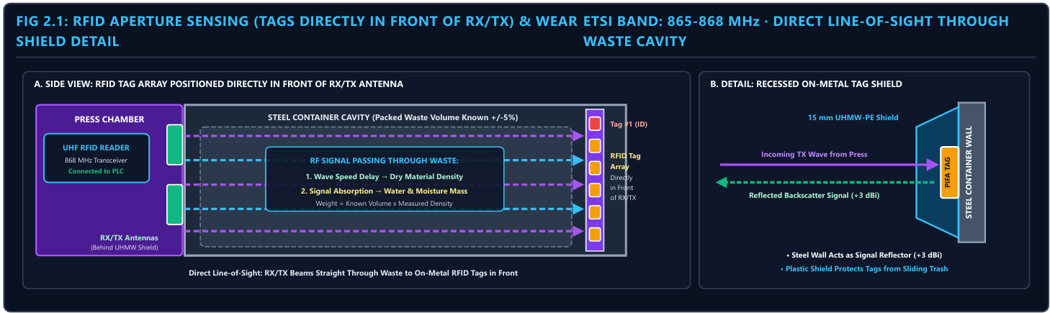
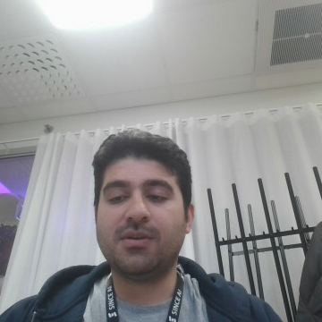
Radio frequency
Measure Weight + Moisture
RFID Arrays
Signal Backscattering System
R2B Value

Slide 5

Frozen waste check
IDEA 2
INPUT
Weight before / after pickup + calibration
CHECK
Frozen waste left inside?
RESULT
Recommend heating or service
Compare weight before and after pickup
Check against calibration records
Identify possible frozen waste left inside
Recommend heating or service

Slide 6
Recyclables in mixed waste
IDEA 3
INPUT
Weight + fill level + volume
CHECK
Recyclables in mixed waste?
Use weight, fill level and container volume
Flag possible recyclables in mixed waste
Identify sites for dedicated recycling equipment
RESULT
Site for recycling equipment

Slide 7
Shared truckload allocation
IDEA 4
INPUT
Truck total weight
CHECK
Removed mass per container
RESULT
Proportional split, total preserved
Split a shared truckload’s total weight between two containers
Split in proportion to measured removed mass
Preserve the truck total

Slide 8
Compactor density & DUO fit
IDEA 5
INPUT
Density before / after adjustment
CHECK
Throughput assessment
Compare density before and after compaction adjustments
Assess throughput
Identify non-biowaste COMBI units that may benefit from a larger DUO
RESULT
COMBI → larger DUO candidate

Slide 9
Tare error or sensor drift
IDEA 6
INPUT
Trucks + compactors + calibration
CHECK
Compare weight differences
RESULT
Tare error vs. sensor drift
Compare weight differences across trucks, compactors and calibration records
Distinguish stored truck tare errors
… from compactor sensor drift

