Slide 1


Weight measuring techniques
Tribe Team
Europress-Since AI Hackaton 2026

Slide 2
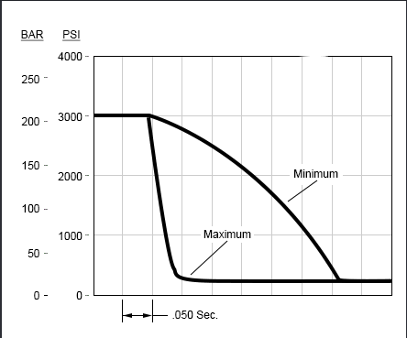

Compactor/ decompression ratio
Fully On Software
Decompression Rebound Speed
OTA Push

Slide 3
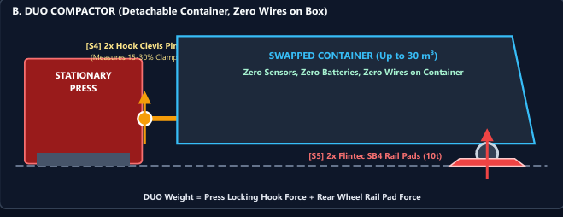
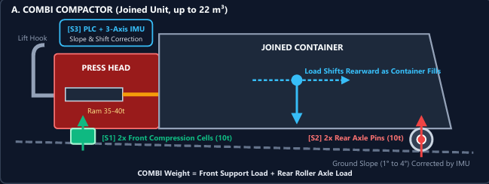

Load Cells
Heavy-duty Industrial Load Cells
Loaded On The Wheel Axle(pin)
Dynamic Tilt & Weight-transfer Model
Key Metrics: €1,195 (COMBI) / €1,235 (DUO) OEM BOM

Slide 4
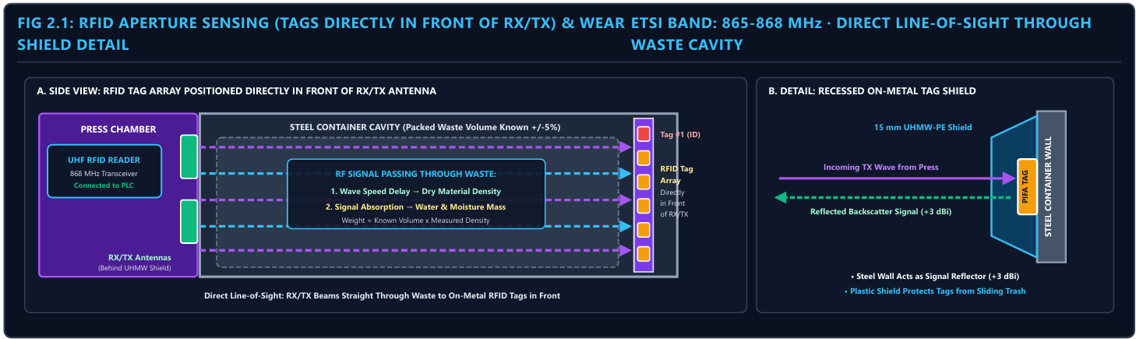
Radio frequency
Measure Weight + Moisture
RFID Arrays
Signal Backscattering System
R2B Value

