Slide 1
Physical Therapy App
By: Harsha Jagarlamudi, Sam Toma, Addison Shiu, and Adrian Liu
CSE4 2015-2016

Slide 2
Table of Contents
Slide 1 | The Problem
Slide 2 | Our Solution to the Issue
Slide 3 | Future Updates for Our App
Slide 4 | Summary of Our App
Slide 5 | References and Sources Page

Slide 3
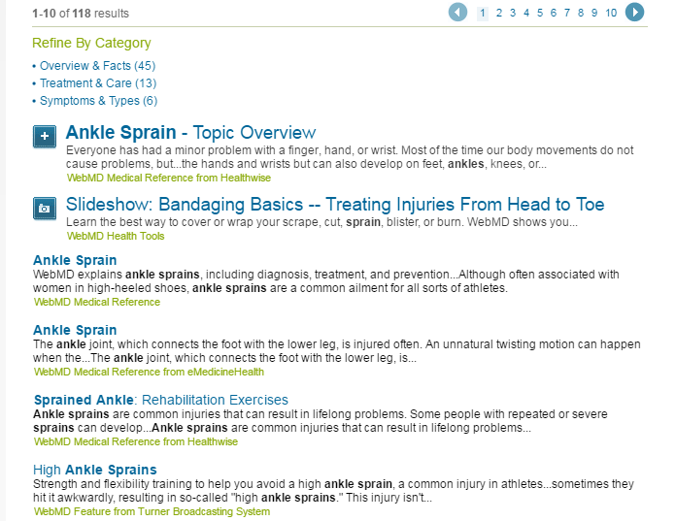
The Problem
Injuries are extremely common and are bound to happen to all of us. In the case of an injury, it is important to know how to act, but how do you figure out what to do?
Our app is designed to help people of any age answer this question for whatever injury that may arise. There are many different sources that provide long and complicated information that can be hard to understand and utilize for ourselves.
Other sources such as WebMD and WikiHow contain solutions to these problems but they are difficult to find and have very confusing information.
Image source: http://www.webmd.com/search/search_results/default.aspx?query=ankle%20sprain

Slide 4
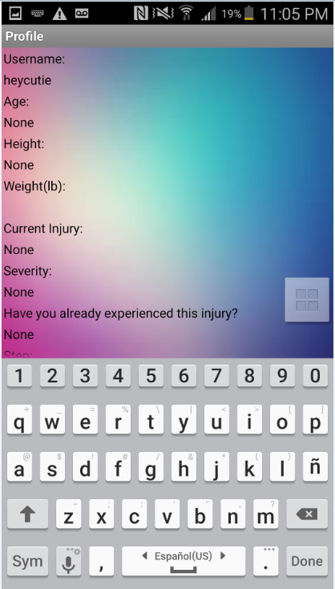
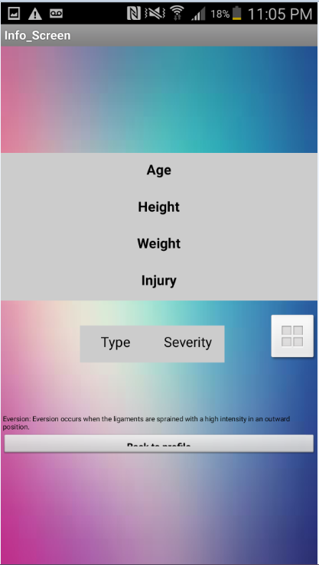
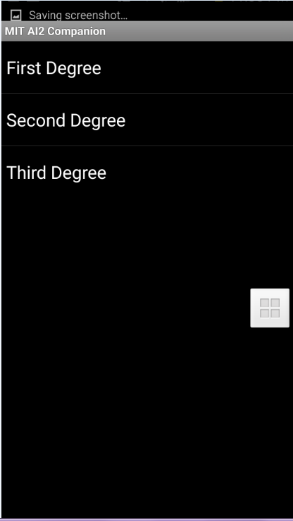

Images of app

Slide 5
Our Solution
To counter these problems, we developed an app which is simple to navigate, provides detailed information about a number of injuries and can be easily understood to suit a wide variety of people unlike the current sources.
Our app begins with asking the user to log in allowing it to track progress such as recovery from an injury.
After logging in the user can select from which type of injury that they currently have or would like to learn more about such as cuts or sprains. Upon selecting an injury, more subcategories(severity,type,age,height,weight, has it happened before) appear with a description of each which can help the user to identify their injury.
When the injury is identified, the “therapy process” button will appear, allowing the user to see what simple exercises can help them make a full recovery. It comes with a stopwatch which the user can use to monitor their exercises and tracks what step they last left off on.
In order to make sure that all of the information is correct, all of our information is derived from numerous, reliable sources.
This product is completely free and will be available for anyone to download as an app. This makes our app the most cost-efficient solution out there.

Slide 6
Future Updates
We plan to add:
Instant communication between you and your physical therapist
More detailed information and treatment on a much larger set of injuries
A model body in which you can find the different types of injuries that appear in a certain part of the body
More parameters, medical issues and pain tolerance.
Step by step videos on showing how to do the exercises.

Slide 7
App Summary
We decided to find a way to confine physical therapy into an app. We wanted to provide something that had an easy interface with a total guidebook of information to help benefit during an injury. This app is used to further enhance the user's awareness when they have a physical injury and used to track their progress and level of pain.
What Will This App Provide?
Progress, expansion and growth is key to this app.
Information and interactive guidebook.
Personal interaction, based on your current medical state. This app is customizable to your benefit.
We wanted to overcome the complicated access. So we have provided an easy accessible interface
with a start up of options that pair up with your current problem.

Slide 8
References
" Ankle Sprain." Ankle Sprain. American Orthopaedic Foot and Ankle Society, n.d. Web. 23 May 2016.
http://www.aofas.org/footcaremd/conditions/ailments-of-the-ankle/pages/ankle-sprain-.aspx
Haddad, Steven L. "Sprained Ankle-OrthoInfo - AAOS." Sprained Ankle-OrthoInfo - AAOS. N.p., n.d. Web. 23 May 2016.
http://orthoinfo.aaos.org/topic.cfm?topic=a00150
"High Ankle Sprain." Wikipedia. Wikimedia Foundation, n.d. Web. 23 May 2016.
https://en.wikipedia.org/wiki/High_ankle_sprain
"Eversion Ankle Sprain." Eversion Ankle Sprain. N.p., n.d. Web. 23 May 2016.
http://www.sportsinjuryclinic.net/sport-injuries/ankle-achilles-shin-pain/eversion-ankle-sprain
Hunter, Oregon K. "Cervical Sprain and Strain." : Background, Pathophysiology, Epidemiology. Medscape, n.d. Web. 23 May 2016.
http://emedicine.medscape.com/article/306176-overview
"Diseases and Conditions." Cleveland Clinic. The Cleveland Clinic Foundation, n.d. Web.
http://my.clevelandclinic.org/health/diseases_conditions/hic_an_overview_of_neck_and_shoulde
r_pain/hic_neck_sprain
Schubbe, Peter J. "Neck Strain: Causes and Remedies." Spine-health. N.p., 7 June 2010. Web. 23 May 2016.
http://www.spine-health.com/conditions/neck-pain/neck-strain-causes-and-remedies
"Whiplash Injury: Pain, Treatment, Symptoms, Causes, and More." WebMD. WebMD, n.d. Web. 23 May
2016.
http://www.webmd.com/back-pain/neck-strain-whiplash
"Neck Sprain-OrthoInfo - AAOS." Neck Sprain-OrthoInfo - AAOS. N.p., n.d. Web. 23 May 2016.
http://orthoinfo.aaos.org/topic.cfm?topic=A00410
"Wrist Sprains." Handcare.org. N.p., n.d. Web. 23 May 2016.
http://www.assh.org/handcare/hand-arm-injuries/wrist-sprains
Settergren, Curtis R. "Wrist Sprains-OrthoInfo - AAOS." Wrist Sprains-OrthoInfo - AAOS. Orthoinfo, Sept. 2010. Web. 23 May 2016.
http://orthoinfo.aaos.org/topic.cfm?topic=a00023
"Cuts or Lacerations Treatment: First Aid Information for Cuts or Lacerations." WebMD. WebMD,
n.d. Web. 24 May 2016.
http://www.webmd.com/first-aid/cuts-or-lacerations-treatment

