Slide 1
Comment Classification
A step towards secure social commenting.

Slide 2
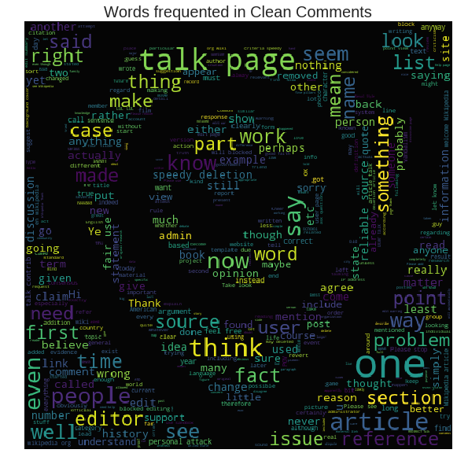
Problem Addressed :
In a world where social media is a buzz word, We are stepping towards a better and sophisticated cyber world. To contribute towards this, we have addressed the problem of toxic commenting by categorizing and scoring the comments as per their emotional aspect.

Slide 3




Pradyumna Sarode - Model Trainer
https://github.com/pradyumnasarode
pradyumnasarode01@gmail.com
9074168728

Slide 4

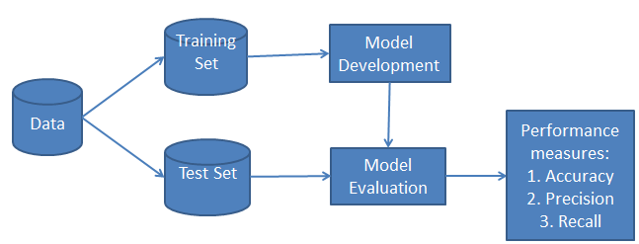
Roles and Responsibilities :
I hereby have followed Supervised Learning approach .
I have trained a model using Naive Bayes Classification for classification of various Emotions in the comment.
Extraction of word feature from the data set to pass in the classifier.
Generated a pickle file for faster access of the trained data set.

Slide 5
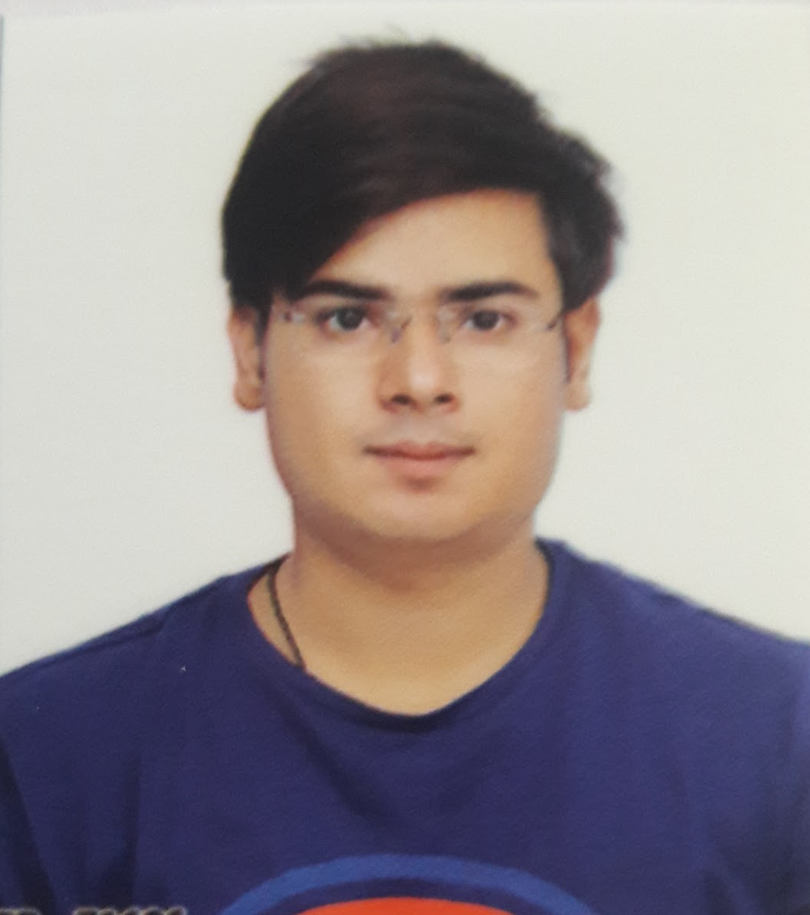
Piyush Manglani - Back-end Developer
https://github.com/piyushmanglani08
piyushmanglani08@gmail.com
7000335025

Slide 6



Roles and Responsibilities :
I have used Flask Back-end for the trained model in the Project hereby.
Used trained data from the model to show validated results by using Routing.
Managed the Github Repository.
The web app created is showing the connection between frontend template, Naive Bayes Classifier and backend.

Slide 7
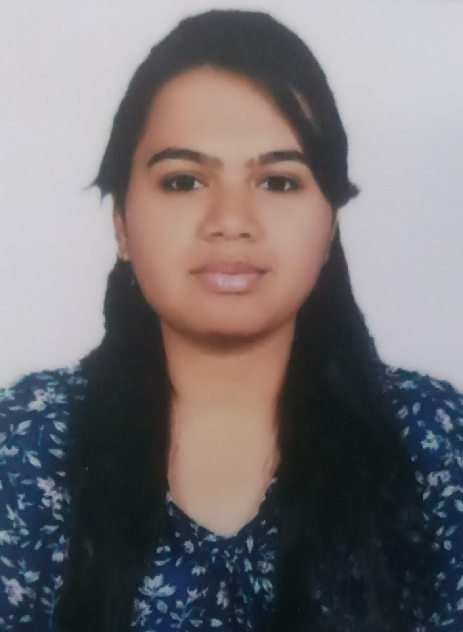
Rachna Agrawal - Data Preprocessor
https://github.com/rachnaagrawal
rachna10r@gmail.com
8962914138

Slide 8

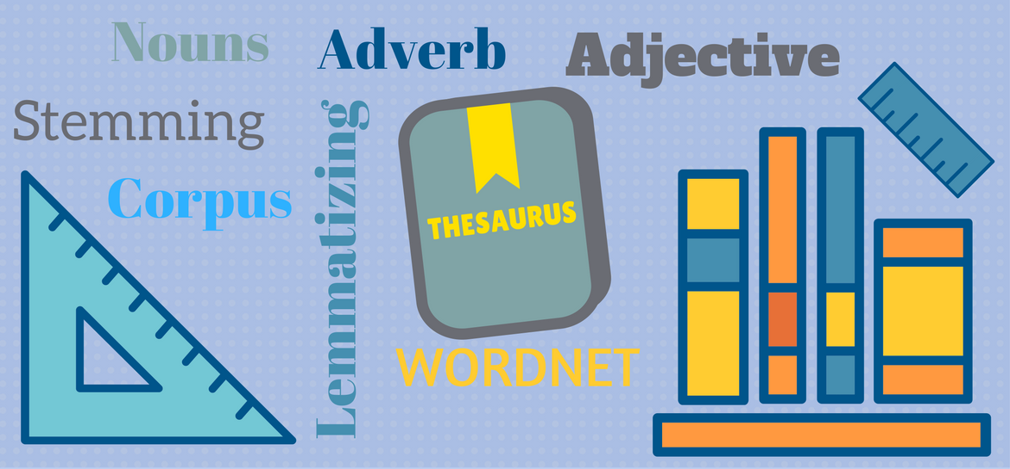
Roles and Responsibilities :
My contribution was to preprocess the dataset by cleaning the data.
I have worked on Preprocessing of Data by :
Importing Required Libraries
Tokenization
Lemmatization
Implementation of Scoring Mechanism for measuring Toxicity of a particular comment.
Used Natural Language Toolkit(NLTK) for the stemming of sentences and Lemmatization.

Slide 9
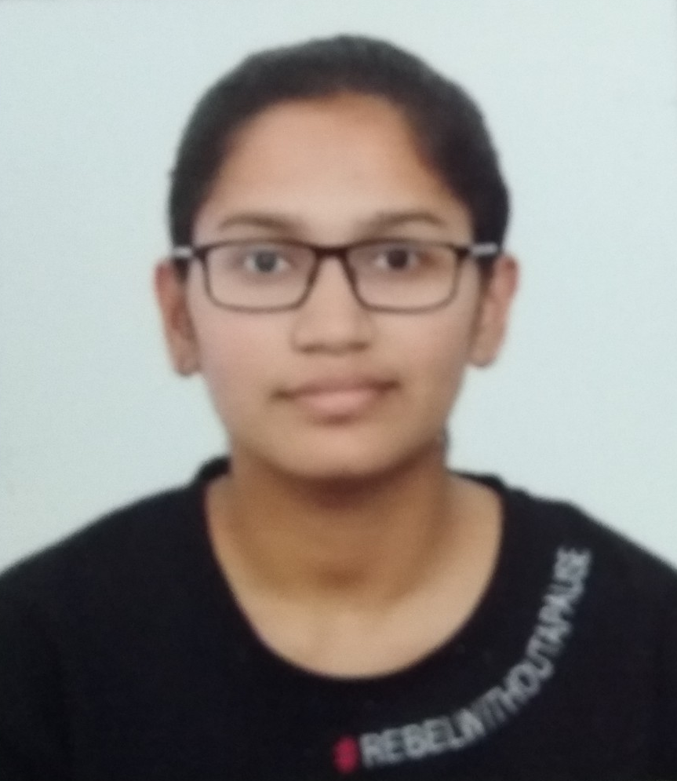
Aarti Patel - Front-end Developer
https://github.com/AARTI0909
aarti.patel0901@gmail.com
9752818352

Slide 10


Roles and Responsibilities :
My work includes creation of user-facing responsibility using HTML, Bootstrap, Jinja.
Jinja is used with flask, as it has automatic HTML escaping, which helped in preventing cross-site Scripting.
Bootstrap is used for CSS Framework, Bootstrap encourage consistency across internal tools.
Worked on model for the functionality of feature abstraction of a particular comment.

