Slide 1
CSE541
Computer Vision
Identification of lower extremity injuries from jump-landings videos: A Deep Learning Approach
AU2140066 - Harman Jani
AU2140077 - Kaival Shah
AU2140080 - Divykumar Patel
AU2140141 - Krutarth Trivedi
Group number - 8

Slide 2
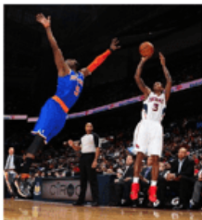
Problem Statement
Fast-paced sports raise injury risk due to altered control.
Build a real-time framework to detect jump landings error.
Using Deep Learning to detect jump landing errors.
Coaches can get actionable insights for injury prevention.
Image Courtesy: Li, H., & Che, X. (2017). Influence and injury of stop jump shot of basketball players based on kinematic fatigue. Biomedical Research-tokyo, 746-752.

Slide 3
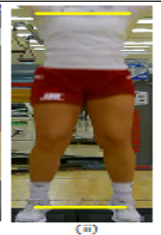
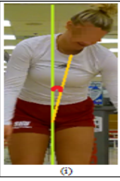
Error Images
Stance Width Error
Lateral Angle
Image Courtesy: [1]S. Sharma, S. Divakaran, T. Kaya, C. Taber, and M. Raval, “A Framework for Biomechanical Analysis of Jump Landings for Injury Risk Assessment.” Accessed: Mar. 21, 2024. [Online]. Available: https://ahduni.edu.in/site/assets/files/6912/paper_38.pdf

Slide 4
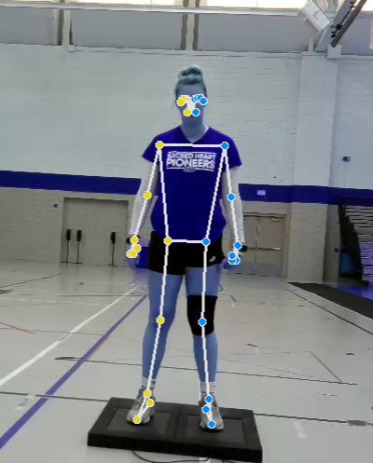
Keypoint Extraction
Keypoint extraction using MediaPipe.
Automate error detection based on extracted keypoints.
Stance Width Ratio: shoulder-to-ankle key point distance ratio.
Lateral Angle Flexion: between shoulder, hip and ankle midpoints.
Data Source: [1]S. Sharma, S. Divakaran, T. Kaya, C. Taber, and M. Raval, “A Framework for Biomechanical Analysis of Jump Landings for Injury Risk Assessment.” Accessed: Mar. 21, 2024. [Online]. Available: https://ahduni.edu.in/site/assets/files/6912/paper_38.pdf

Slide 5
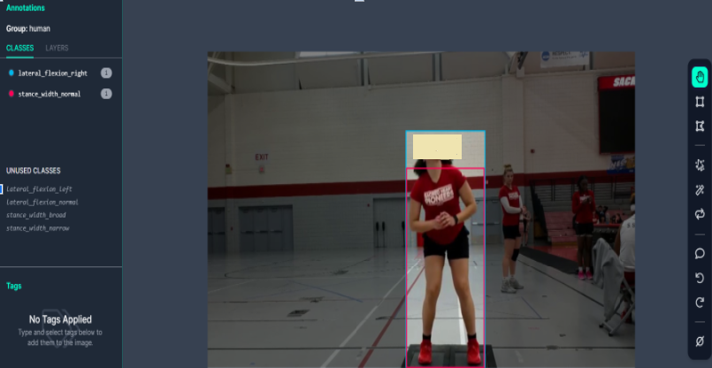
Dataset Annotation
Annotating data by labeling bounding box and error type.
Annotated classes lateral_flexion_left, Lateral_flexion_normal, Lateral_flexion_right, Stance_width_broad, Stance_width_narrow, Stance_width_normal

Slide 6
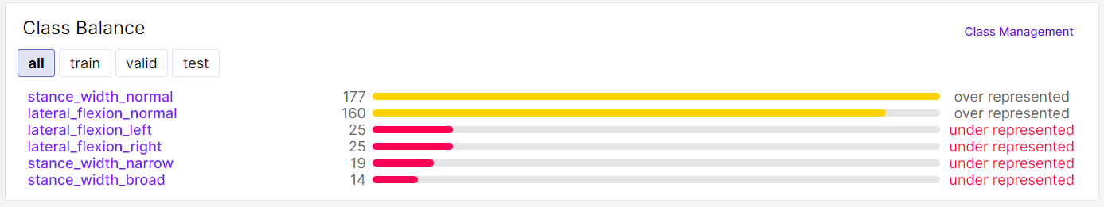
Data Imbalance
Annotated data is highly imbalanced.
Augmented data to tackle data bring data in comparable range.

Slide 7
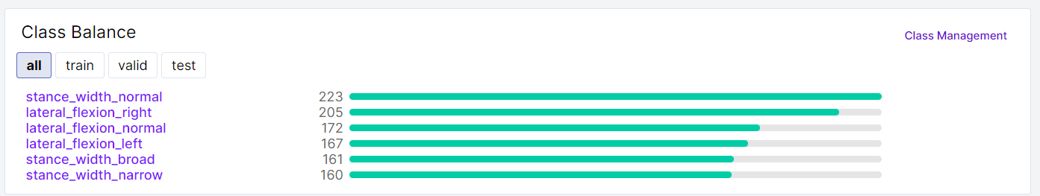
Data Augmentation
Annotated data is now balanced.
Now proceeded with training the model.

Slide 8
Model Training
Fine tune on YOLO v8 for object detection and predicting bounding box.
YOLO v8 essential blocks: Backbone, Neck, and Head.
Backbone: Feature extractor
Neck: Assembles feature pyramids by collecting feature maps from different stages of backbone.
Head: Generates output, i.e., bounding box, classification and confidence score.

Slide 9
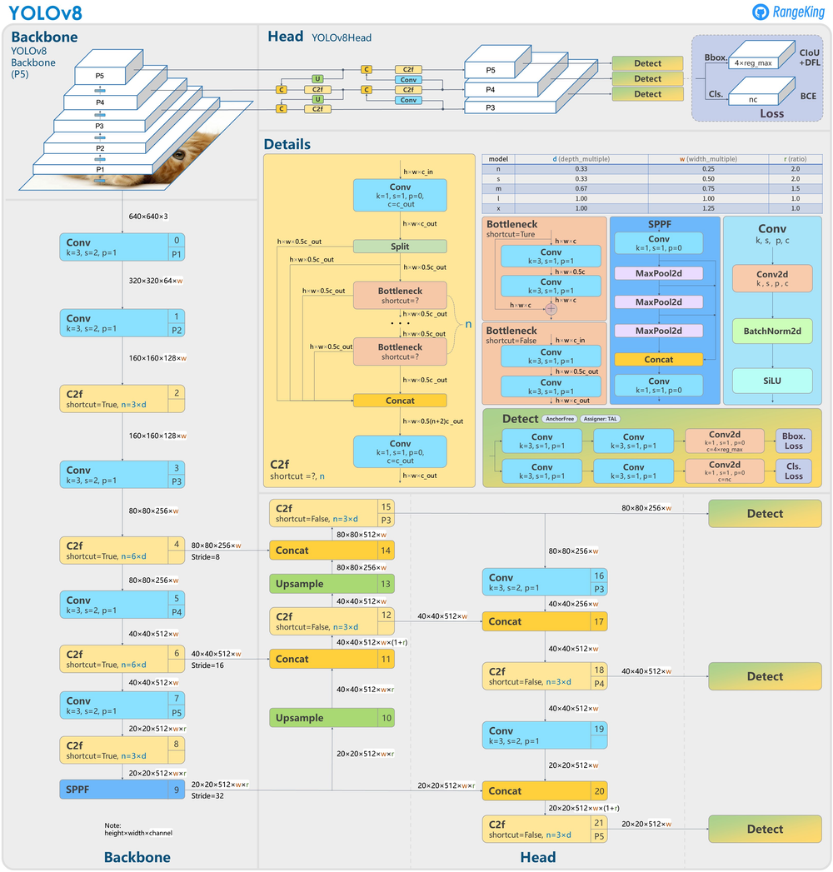
Image adapted from: https://blog.roboflow.com/whats-new-in-yolov8/ accessed on 08/04/2024.

Slide 10
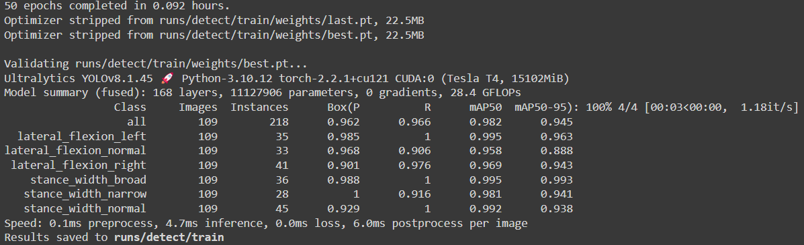
Model Training
New data in Roboflow.
Used dataset train data on YOLOv8 in Google Colab.

Slide 11
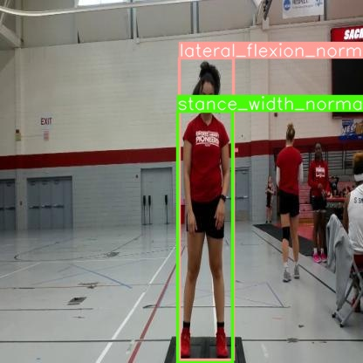
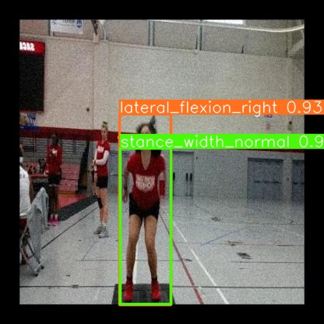
Output

Slide 12
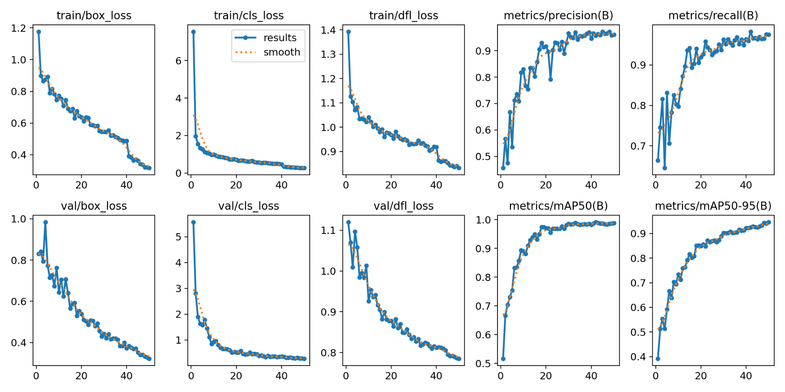
Results

Slide 13
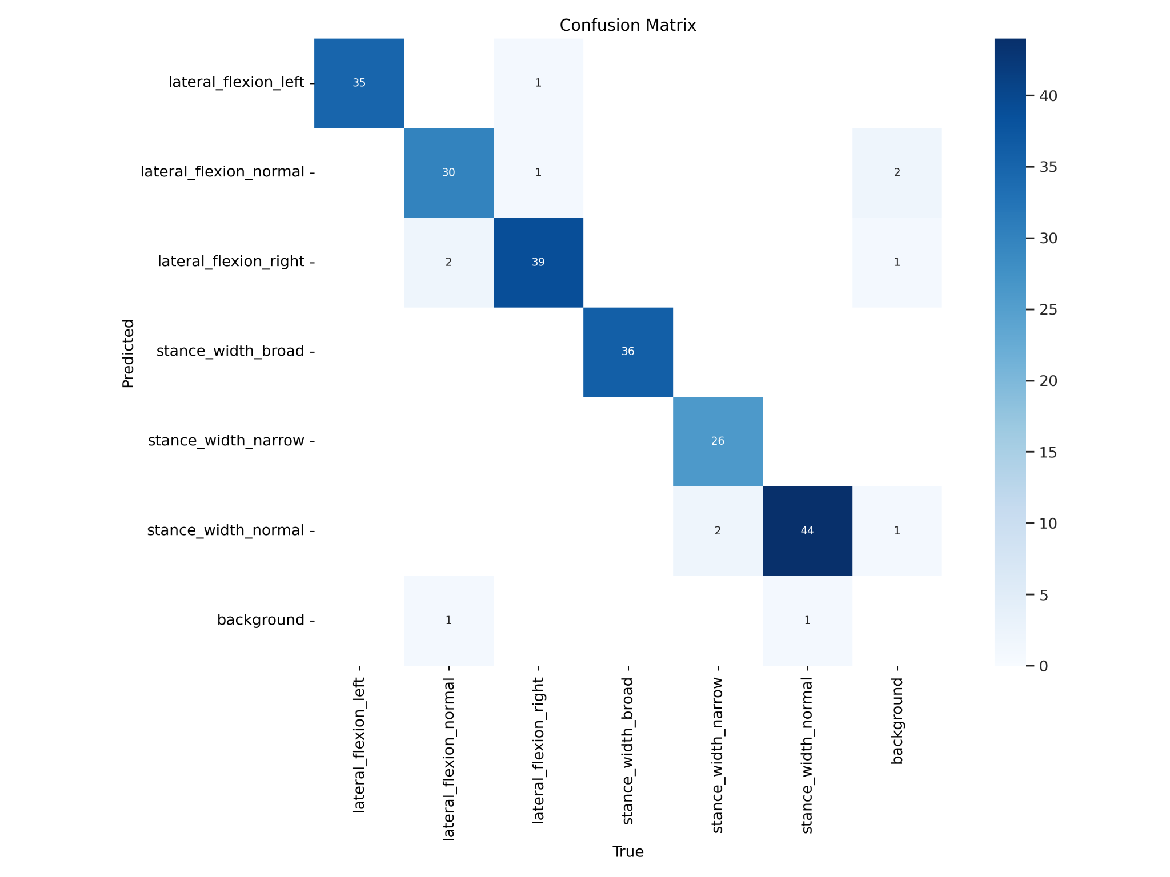
Results

Slide 14
References
S. Sharma, S. Divakaran, T. Kaya, C. Taber, and M. Raval, “A Framework for Biomechanical Analysis of Jump Landings for Injury Risk Assessment.” Accessed: Mar. 21, 2024. [Online]. Available: https://ahduni.edu.in/site/assets/files/6912/paper_38.pdf
Hébert-Losier, Hanzlíková, Zheng, Streeter, and Mayo, “The ‘DEEP’ Landing Error Scoring System,” Applied Sciences, vol. 10, no. 3, p. 892, Jan. 2020, doi: https://doi.org/10.3390/app10030892.
Ultralytics. (2024, March 13). Home. Ultralytics YOLOv8 Docs. https://docs.ultralytics.com/
Solawetz, J. (2024, February 19). What is YOLOv8? The Ultimate Guide. [2024]. Roboflow Blog. https://blog.roboflow.com/whats-new-in-yolov8

Slide 15
Thank You

