Slide 1
CSE541
Computer Vision
Identification of lower extremity injuries from jump-landings videos: A Deep Learning Approach
AU2140066 - Harman Jani
AU2140077 - Kaival Shah
AU2140080 - Divykumar Patel
AU2140141 - Krutarth Trivedi
Group number - 8
Notes:
Angular velocity measurements using non-contact magnetic and optical sensors

Slide 2
Problem Statement
Fast-paced sports raise injury risk due to altered control.
Computer vision applied to assesses jump landings efficiency.
Coaches can get actionable insights for injury prevention.

Slide 3
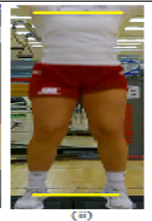
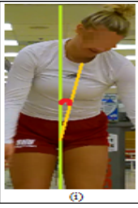
Error Images
Stance Width Error
Lateral Angle
Image Courtesy: [1]S. Sharma, S. Divakaran, T. Kaya, C. Taber, and M. Raval, “A Framework for Biomechanical Analysis of Jump Landings for Injury Risk Assessment.” Accessed: Mar. 21, 2024. [Online]. Available: https://ahduni.edu.in/site/assets/files/6912/paper_38.pdf

Slide 4
Error Detection Algorithm
2 Key parameters.
Utilized Euclidean distance for calculating shoulder-to-ankle stance ratio.
Stance ratio:
Within [0.8, 1.2] = "no error"
Less than 0.8 = "wide stance"
Greater than 1.2 = "narrow stance error"
Lateral angle within [0, 3.1] or [176.9, 180] = "no error";
Otherwise = "error". Additionally, right and left flexion.

Slide 5
Approach
Keypoint extraction using MediaPipe.
Error detection based on extracted keypoints.
Stance Width Ratio: shoulder-to-ankle key point distance ratio.
Lateral Angle Flexion: between shoulder, hip and ankle midpoints.
Data annotation using stance width ratio and lateral angle flexion.
Proposed Framework :https://shorturl.at/fhpE1

Slide 6
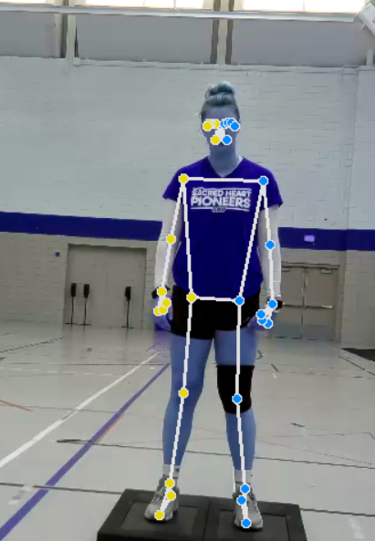
Keypoint Dataset and Error Statement
Colab Link :https://shorturl.at/ceDW1
SpreadSheet Link :
http://surl.li/rrwuj
Image Courtesy: [1]S. Sharma, S. Divakaran, T. Kaya, C. Taber, and M. Raval, “A Framework for Biomechanical Analysis of Jump Landings for Injury Risk Assessment.” Accessed: Mar. 21, 2024. [Online]. Available: https://ahduni.edu.in/site/assets/files/6912/paper_38.pdf

Slide 7
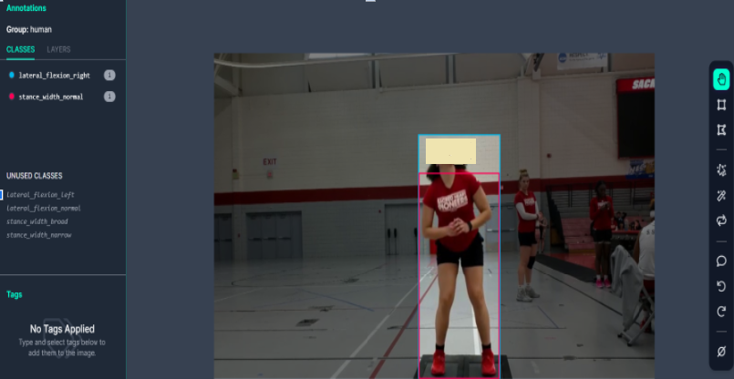
Dataset Generation
Classes
Lateral_flexion_left
Lateral_flexion_normal
Lateral_flexion_right
Stance_width_broad
Stance_width_narrow
Stance_width_normal

Slide 8
Methodology
210 Keyframes were extracted from the video. (35 sec video 6fps)
Body Key Points annotated using MediaPipe.
Coordinates required to measure lateral flexion and stance width error were extracted.
Substantially, stance width ratio and lateral flexion angle were measured and error noted.

Slide 9
Future Work
Exploring the models which can be employed to have highest accuracy
Training the model with the Annotated Images
Designing a dashboard , which will have features :
User can Input Image.
Dashboard shows the error made.

Slide 10
References
S. Sharma, S. Divakaran, T. Kaya, C. Taber, and M. Raval, “A Framework for Biomechanical Analysis of Jump Landings for Injury Risk Assessment.” Accessed: Mar. 21, 2024. [Online]. Available: https://ahduni.edu.in/site/assets/files/6912/paper_38.pdf
Hébert-Losier, Hanzlíková, Zheng, Streeter, and Mayo, “The ‘DEEP’ Landing Error Scoring System,” Applied Sciences, vol. 10, no. 3, p. 892, Jan. 2020, doi: https://doi.org/10.3390/app10030892.

Slide 11
Thank You

