Slide 1
RECENT AREAS OF AI / HYOJIN LEE
01
Travel Constraint
Extraction
Fine-tuning a small Transformer to understand
changes to a London itinerary
A 400-example dataset for structured extraction
Travel Constraint Extraction · 2026
Notes:
My project extracts travel constraints from English requests. A traveler might ask to keep a gallery visit, return earlier, and choose an indoor activity if it rains. The main task is understanding these instructions and producing structured JSON. I compare a small model before and after LoRA fine-tuning with a larger model using two examples. The itinerary interface makes the extracted conditions visible. It is a demonstration rather than a route optimizer.
Sources: Project report; https://arxiv.org/abs/2412.15115; https://arxiv.org/abs/2106.09685

Slide 2
RECENT AREAS OF AI / HYOJIN LEE
02
Task and output contract
“Keep the gallery. Be back by 19:00.
I would prefer less walking.”
Meaning | Structured output | Priority
Keep the gallery | Include the resolved place | Hard
Return by 19:00 | hotel_return <= 19:00 | Hard
Less walking | walking_amount: minimize | Soft
Missing time or walking scope requires clarification
Travel Constraint Extraction · 2026
Notes:
The input includes a reference itinerary, so the model can resolve phrases such as the gallery or the original return time. Each extracted item has a type, target, operator, value, priority, clarification flag, and weather condition. Direct instructions are hard requirements. Prefer indicates a soft preference. Less walking does not imply a numeric limit. If a time or walking scope is missing, the model should preserve that uncertainty instead of inventing an answer.
Sources: src/travel_constraints/contract.py; src/travel_constraints/output_schema.json. Table is illustrative, not a measured prediction.

Slide 3
RECENT AREAS OF AI / HYOJIN LEE
03
Data and LoRA training
400 examples
280 train / 40 validation / 80 test
100 scenarios × 4 paraphrases, grouped before splitting
Approach | Model and adaptation
Small baseline | Qwen2.5-0.5B, zero-shot
Fine-tuned small model | Same 0.5B + LoRA, rank 8, 840 steps
Larger comparison | Qwen2.5-7B, 4-bit, two training examples
AI-reviewed synthetic labels: zero human-verified records
Travel Constraint Extraction · 2026
Notes:
The dataset has one hundred reference scenarios and four paraphrases per scenario. Splitting by scenario keeps all four together. Separate wording pools remove identical request text across splits, although the task families and templates still repeat. The labels were AI-reviewed and checked automatically; none are marked human-verified. LoRA trains seven hundred thirty-three thousand parameters in the last four layers. The final CPU run completed three epochs after a GPU stability failure. Test examples were not used for training or prompt selection.
Sources: data/metadata.json; data/splits.json; experiments/training_run.json; https://arxiv.org/abs/2106.09685

Slide 4
RECENT AREAS OF AI / HYOJIN LEE
04
Held-out extraction results
Approach | Exact records | Valid JSON
0.5B baseline | 0 / 80 | 0.0%
0.5B + LoRA | 57 / 80 | 97.5%
7B two-shot | 51 / 80 | 93.8%
80 inputs in 20 groups. Strict JSON without repair. Different quantization and prompting.
Travel Constraint Extraction · 2026
Notes:
All three models received the same eighty held-out inputs and output schema. Content F1 requires matching the operator, value, and condition, while priority is scored separately. LoRA achieved F1 0.795, compared with 0.000 for the small baseline and 0.782 for the larger model. It produced 57 fully correct records out of eighty. Strict schema failures count as empty extractions. These scores describe a small synthetic benchmark. The larger model also differs in quantization and prompting, so this does not isolate parameter count.
Sources: experiments/protocol.json; experiments/results/comparison.json. F1 is constraint-content micro F1. Chart values are rounded to three decimals; full precision remains in the JSON. See report for cluster bootstrap intervals.

Slide 5
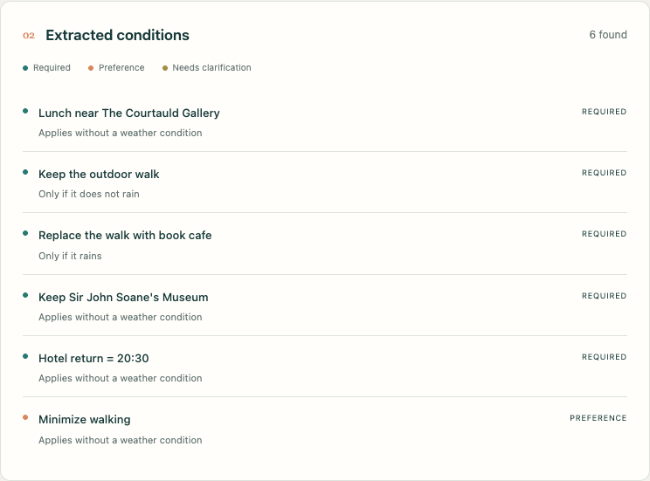
RECENT AREAS OF AI / HYOJIN LEE
05
Conditional London demonstration
Forecast or simulation
Rain
Replace the outdoor walk
with a book-cafe category
Dry
Keep the planned walk
Unknown
Keep both branches pending
Actual saved validation output. Live mode uses the published LoRA adapter.
Travel Constraint Extraction · 2026
Notes:
The interface displays an actual saved validation prediction, separate from the test set. It can also run the local LoRA model on edited text. Open-Meteo supplies London forecasts. The planner activates the rainy or dry branch, and keeps both pending when forecast coverage is missing. Simulated weather is labeled. Place candidates use attributed OpenStreetMap coordinates. Opening hours, walking routes, and business availability are not verified. The demo shows how structured language output can support a downstream application.
Sources: demo/saved_examples.json; docs/images/conditions.png; https://open-meteo.com/en/docs/ecmwf-api; https://www.openstreetmap.org/copyright. Forecast: Open-Meteo / ECMWF, CC BY 4.0. Place data: © OpenStreetMap contributors, ODbL.

Slide 6
RECENT AREAS OF AI / HYOJIN LEE
06
Limitations and next steps
0.795 F1 after LoRA fine-tuning
Measured on a controlled synthetic test set
Remaining model errors
Walking scope, time operators, and missed conditions
Next evaluation
Human-annotated requests across more scenarios
Application boundary
Illustrative edits with unverified routes and availability
github.com/hjarchivenote/travel-constraint-extraction
Travel Constraint Extraction · 2026
Notes:
The main result is a reproducible comparison, not a claim that travel planning is solved. The model still makes important mistakes with walking scope and time relations. The next step would be an independently annotated set of real requests and repeated training seeds. AI assistance was used for code, synthetic labels, experiments, and documentation, and is disclosed in the report. The repository includes the dataset, adapter, raw predictions, evaluation code, and runnable demo so that the result can be inspected.
Sources: experiments/results/error_analysis.json; project report, section 7.

