Slide 1
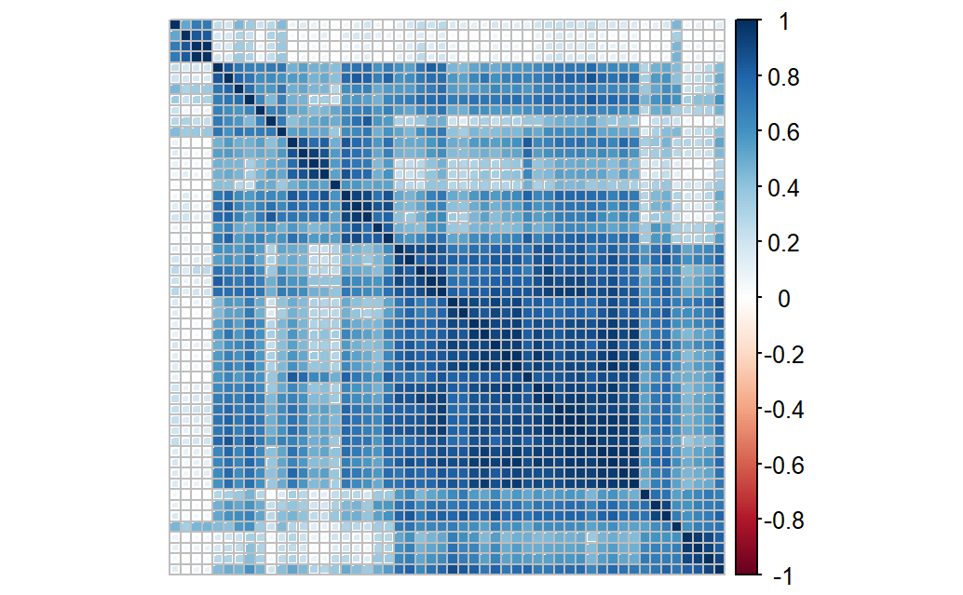
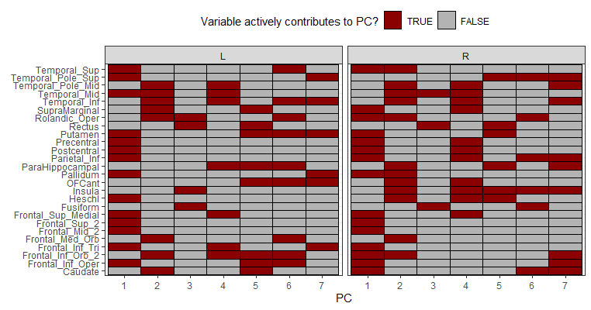
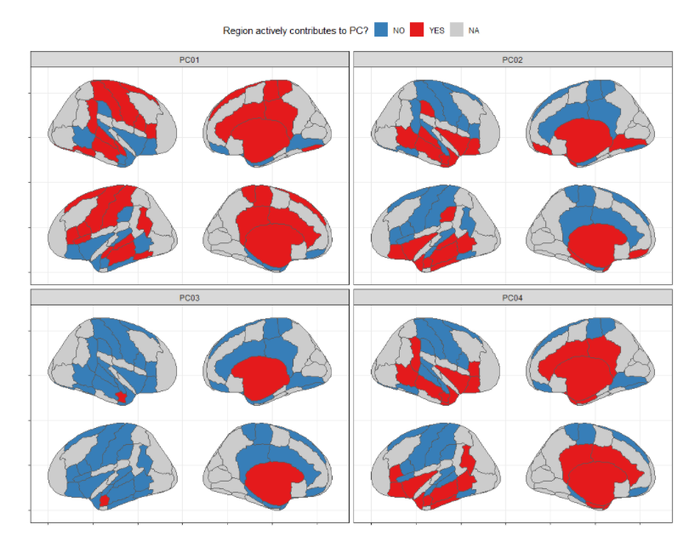
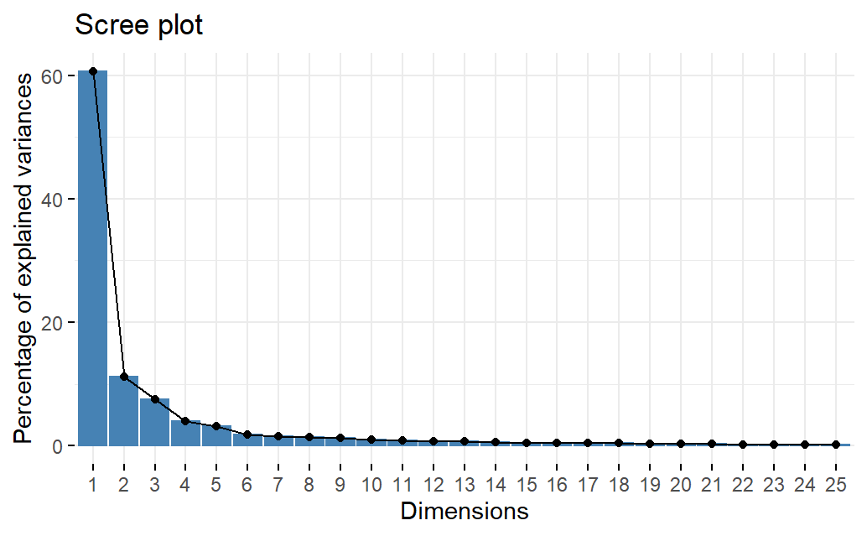
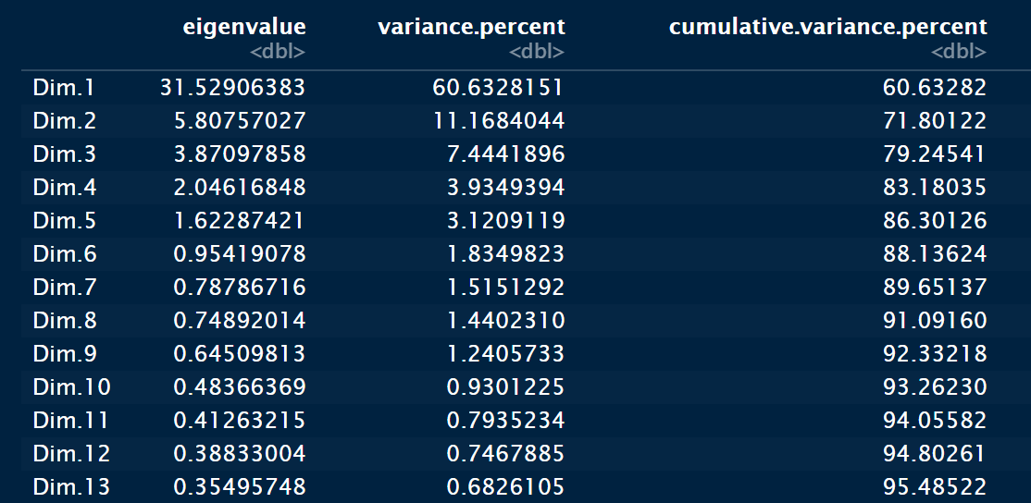
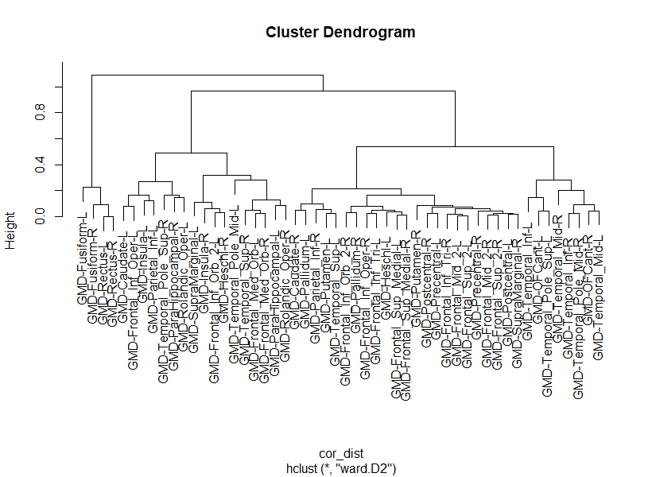
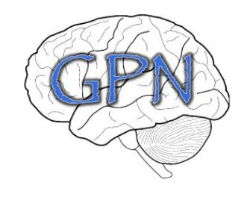
Predicting Beta-Amyloid Accumulation based on Structural Magnetic Resonance Images using Unsupervised learning techniques: an investigation of Alzheimer’s Disease
Hunsica Jayaprakash^{1,2}, Joseph Yurko^{2,3} , Howard J Aizenstein^{3,4} ,
¹Department of Computer Science, University of Pittsburgh, ²Center for Neural Basis and Cognition, ³Department of Psychiatry, University of Pittsburgh, ⁴Department of Bioengineering, University of Pittsburgh
INTRODUCTION
METHODS
RESULTS
DISCUSSION
Alzheimer’s disease (AD) is the sixth leading cause of death in the United States
Neurodegenerative disorder characterized by loss of neurons. Neurodegeneration has been associated with beta amyloid (Aβ).
Aβ is a neurotoxic protein and at abnormal levels it has been associated with a series of events that lead to network breakdown of the nervous system.
Past studies have found a strong association between Aβ accumulation and structural neurodegeneration. No studies have reported early changes in Aβ asymmetry and its effects on grey matter density based on MR imaging.
MRI Imaging
3T Siemens Trio TIM scanner with a 12-chanel head coil. Whole brain structural sequences were collected: sagittal 3D MPRAGE, axial 2D FLAIR, axial 3D T2-weighted sequences.
Grey Matter Density Volume
Grey Matter Density (GMD) is a measure of cortical volume. GMD values were extracted for each region of interest (52 regions) using Freesurfer segmentation.
Principal Component Analysis (PCA)
PCA is an unsupervised learning technique that uses dimensionality reduction to identify clusters, interactions between variables contained in the original dataset.
We performed PCA on 52 regions and found that the first 7 PCs were able to explain approximately (~90%) of the cumulative variance.
The first 7 PCs can capture approximately(~ 90% )
of the explained cumulative variance.
The correlation plot shows that certain variables or regions are highly correlated with others (3 Main groupings) thus allowing us to use dimensionality reduction to explain variances between regions
By performing PCA and showing clusters by PC scores, contributions of regions, and patterns in the individual people we can use this information to find a predictive model that can predict beta- amyloid (ex. 3D CNN)
The correlation plot shows that certain variables or regions are highly correlated with specific PCs (3 Main groupings)
Objective
Predict Beta-amyloid accumulation from magnetic resonance imaging (MRI) using unsupervised learning technique - Principal Component Analysis (PCA) to aid in fitting predictive models to estimate Beta-Amyloid.
FUTURE DIRECTIONS
Left and Right Active regions that contribute to PC (1-7)
-Perform PCA on PiB and FDG.
-Identify clusters and trends in the contribution of regions and identify demographic patterns in individuals that belong to the same cluster between the three response variables (PiB, FDG, and GMD).
-Fit a predictive model to estimate Beta-Amyloid
Participants and Data
Cross-sectional study from ongoing large center study (PI: )
n = 85 (mean age = 76.4±6.1 years)
Cognitively normal adults underwent magnetic resonance imaging (MRI) , positron emission tomography (PET) with Pittsburgh compound (PiB),and Fluorodeoxyglucose (FDG) tracers to estimate Aβ and glucose metabolism, respectively.
.
Heat Map of Active Regions in PC1-4(Lateral View) of the Brain
ACKNOWLEDGEMENTS
2RF1AG 025516 (PI: Klunk & Aizenstein). I would like to thank my mentors, Dr. Joseph Yurko and various members from the GPN lab for their technical advice on the project and research.
Hierarchical Clustering of Regions based on Correlation distance metric

