Slide 1
WIP Title
Team Pesto Pita
Jay
Leo
roy

Slide 2
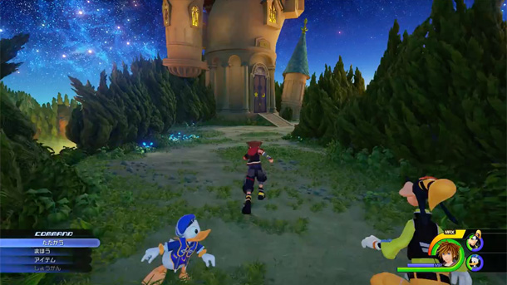
Project Concept
Third-person action role-playing game
Consists of a player avatar, enemies,
and a final boss
Hack-and-slash combat system
Intuitive camera and movement controls
Polished terrain and world environment

Slide 3
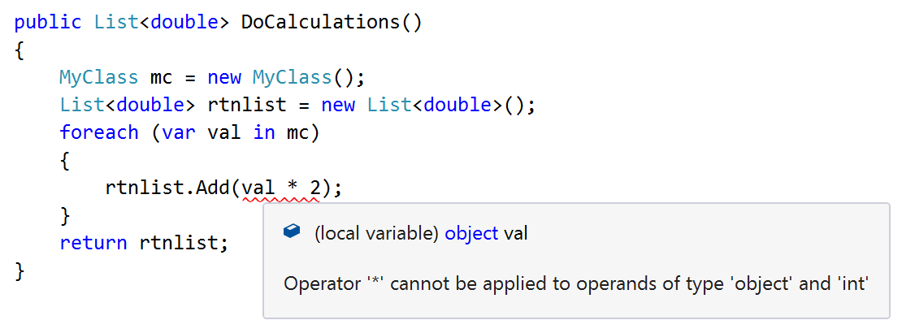
Technology
New
required
Unity Game Engine
C# language
Visual Studio (IDE)
JSON Web Tokens
React
Node & Express
MySQL

Slide 4
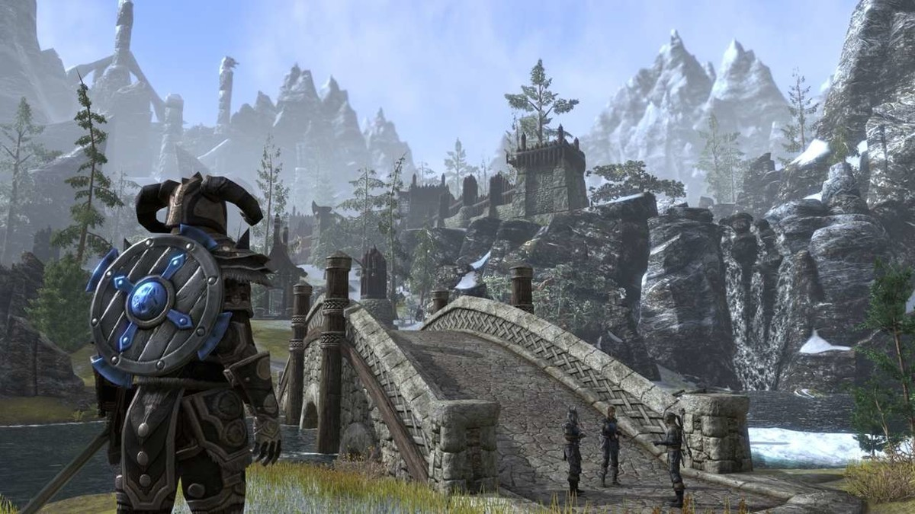
Game Ideation
Why a game?
An interesting field not explored in class
Push our prowess in learning new technology independently
Learn something that Sean doesn’t know (yet)
Because its FUN

Slide 5
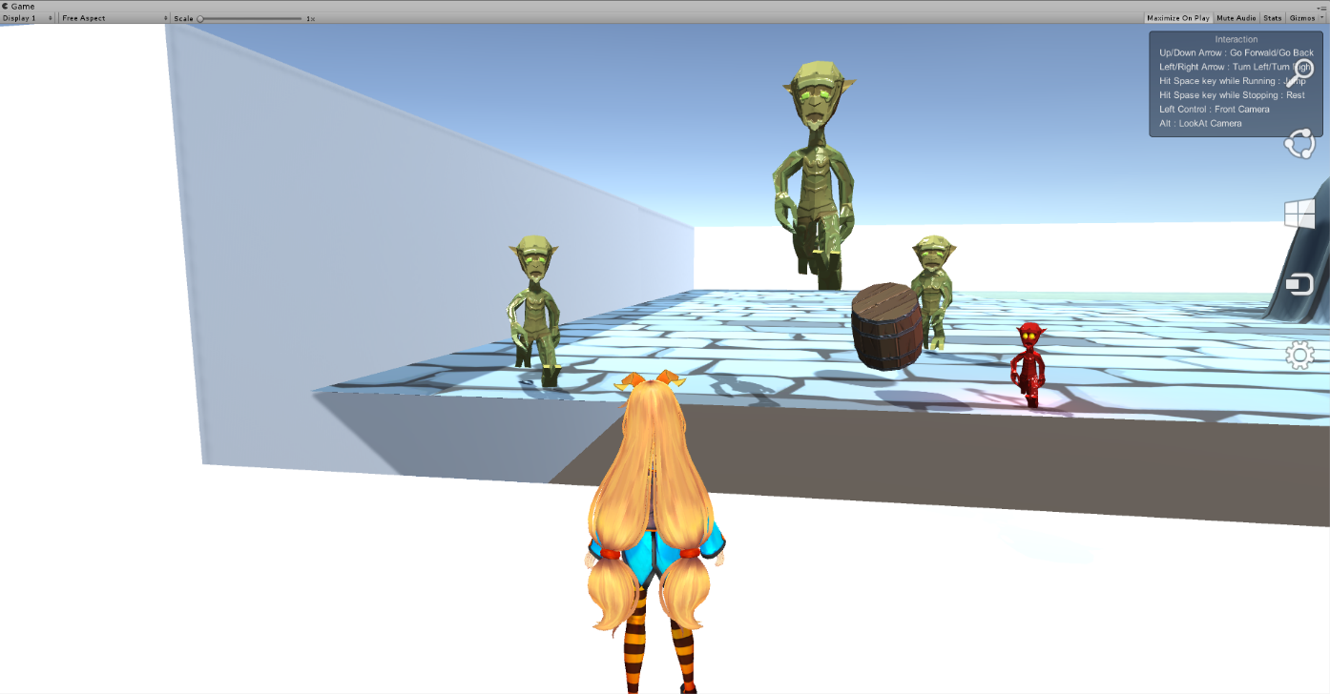
MVP
Player
Actual Gameplay
Operable player character
Jump function
Enemy
Breadcrumbs AI patterns
Variation in enemy types
Auto spawn and de-spawn

Slide 6
Work in Progress
Player
Implement attack animations
More fluid control scheme
Enemy
Health and damage
Combat
Player attack, defend, or special
Animations
Hit/Hurt boxes
Possible joystick operations
Boss implementation
Rewards on victory

Slide 7
Work in Progress
Authentication with usernames and passwords
Transition from start menu to game
Save states (https://gamedevelopment.tutsplus.com/tutorials/how-to-save-and-load-your-players-progress-in-unity--cms-20934)
Polish front-end client (what little we have of that)
Local multiplayer (if time permits)

Slide 8

Questions?

