Slide 1
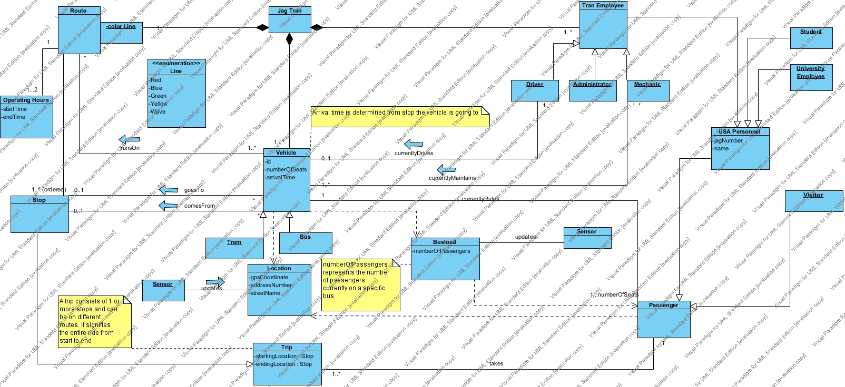
Domain Model

Slide 2
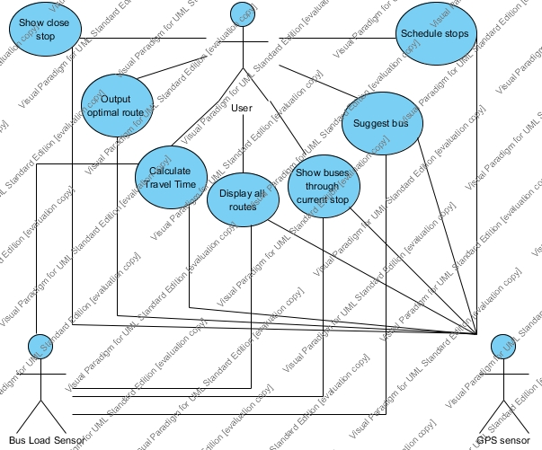
Use Case Model

Slide 3
Main Brief Use Cases
User accesses application and chooses desired Jag Tran stop. System outputs the amount of time since last departure of a bus and amount of time before another bus arrives.
Application is accessed and the system tells how many people are on each jag Tran bus.

