Slide 1
Usetrace
Automated test tool

Slide 2

Created in 2012
By four main Developers

Slide 3
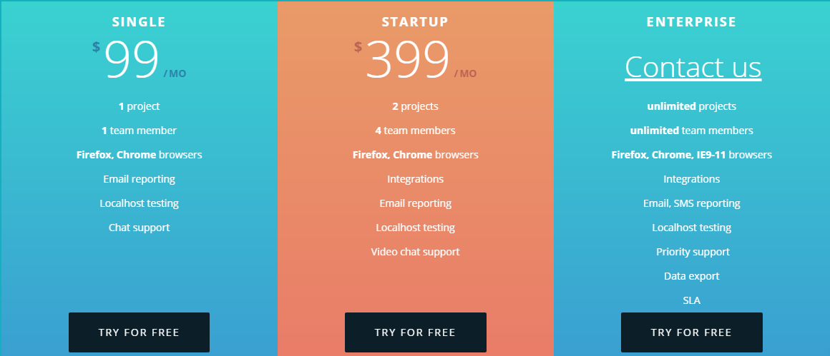

Slide 4
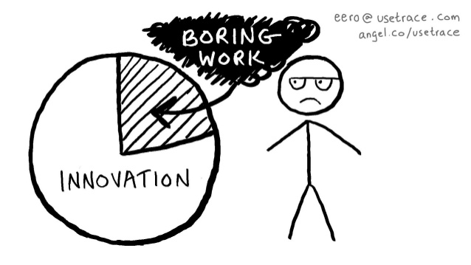
Why to use AUTOMATED testing tools

Slide 5
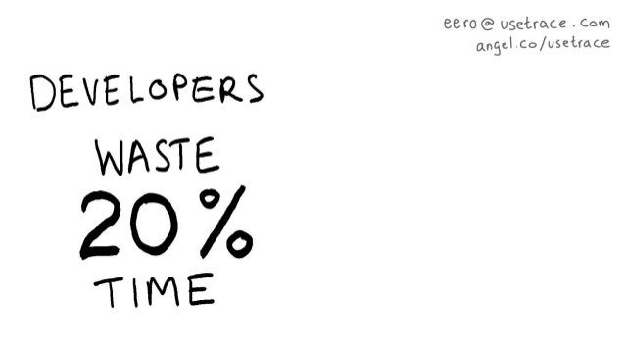

Slide 6
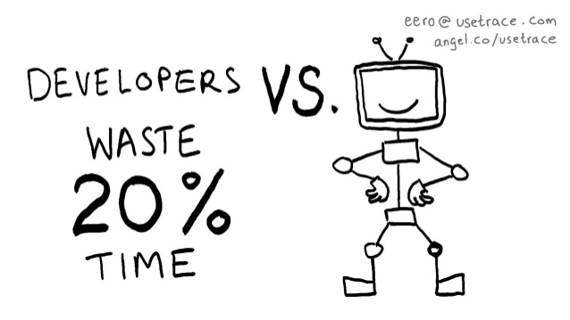

Slide 7
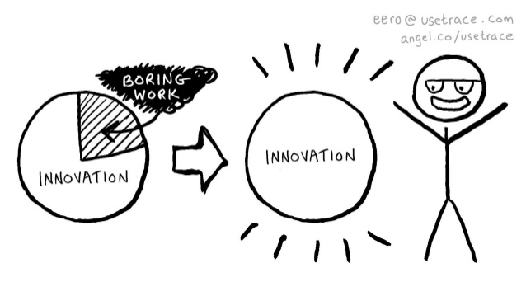

Slide 8


