Slide 1
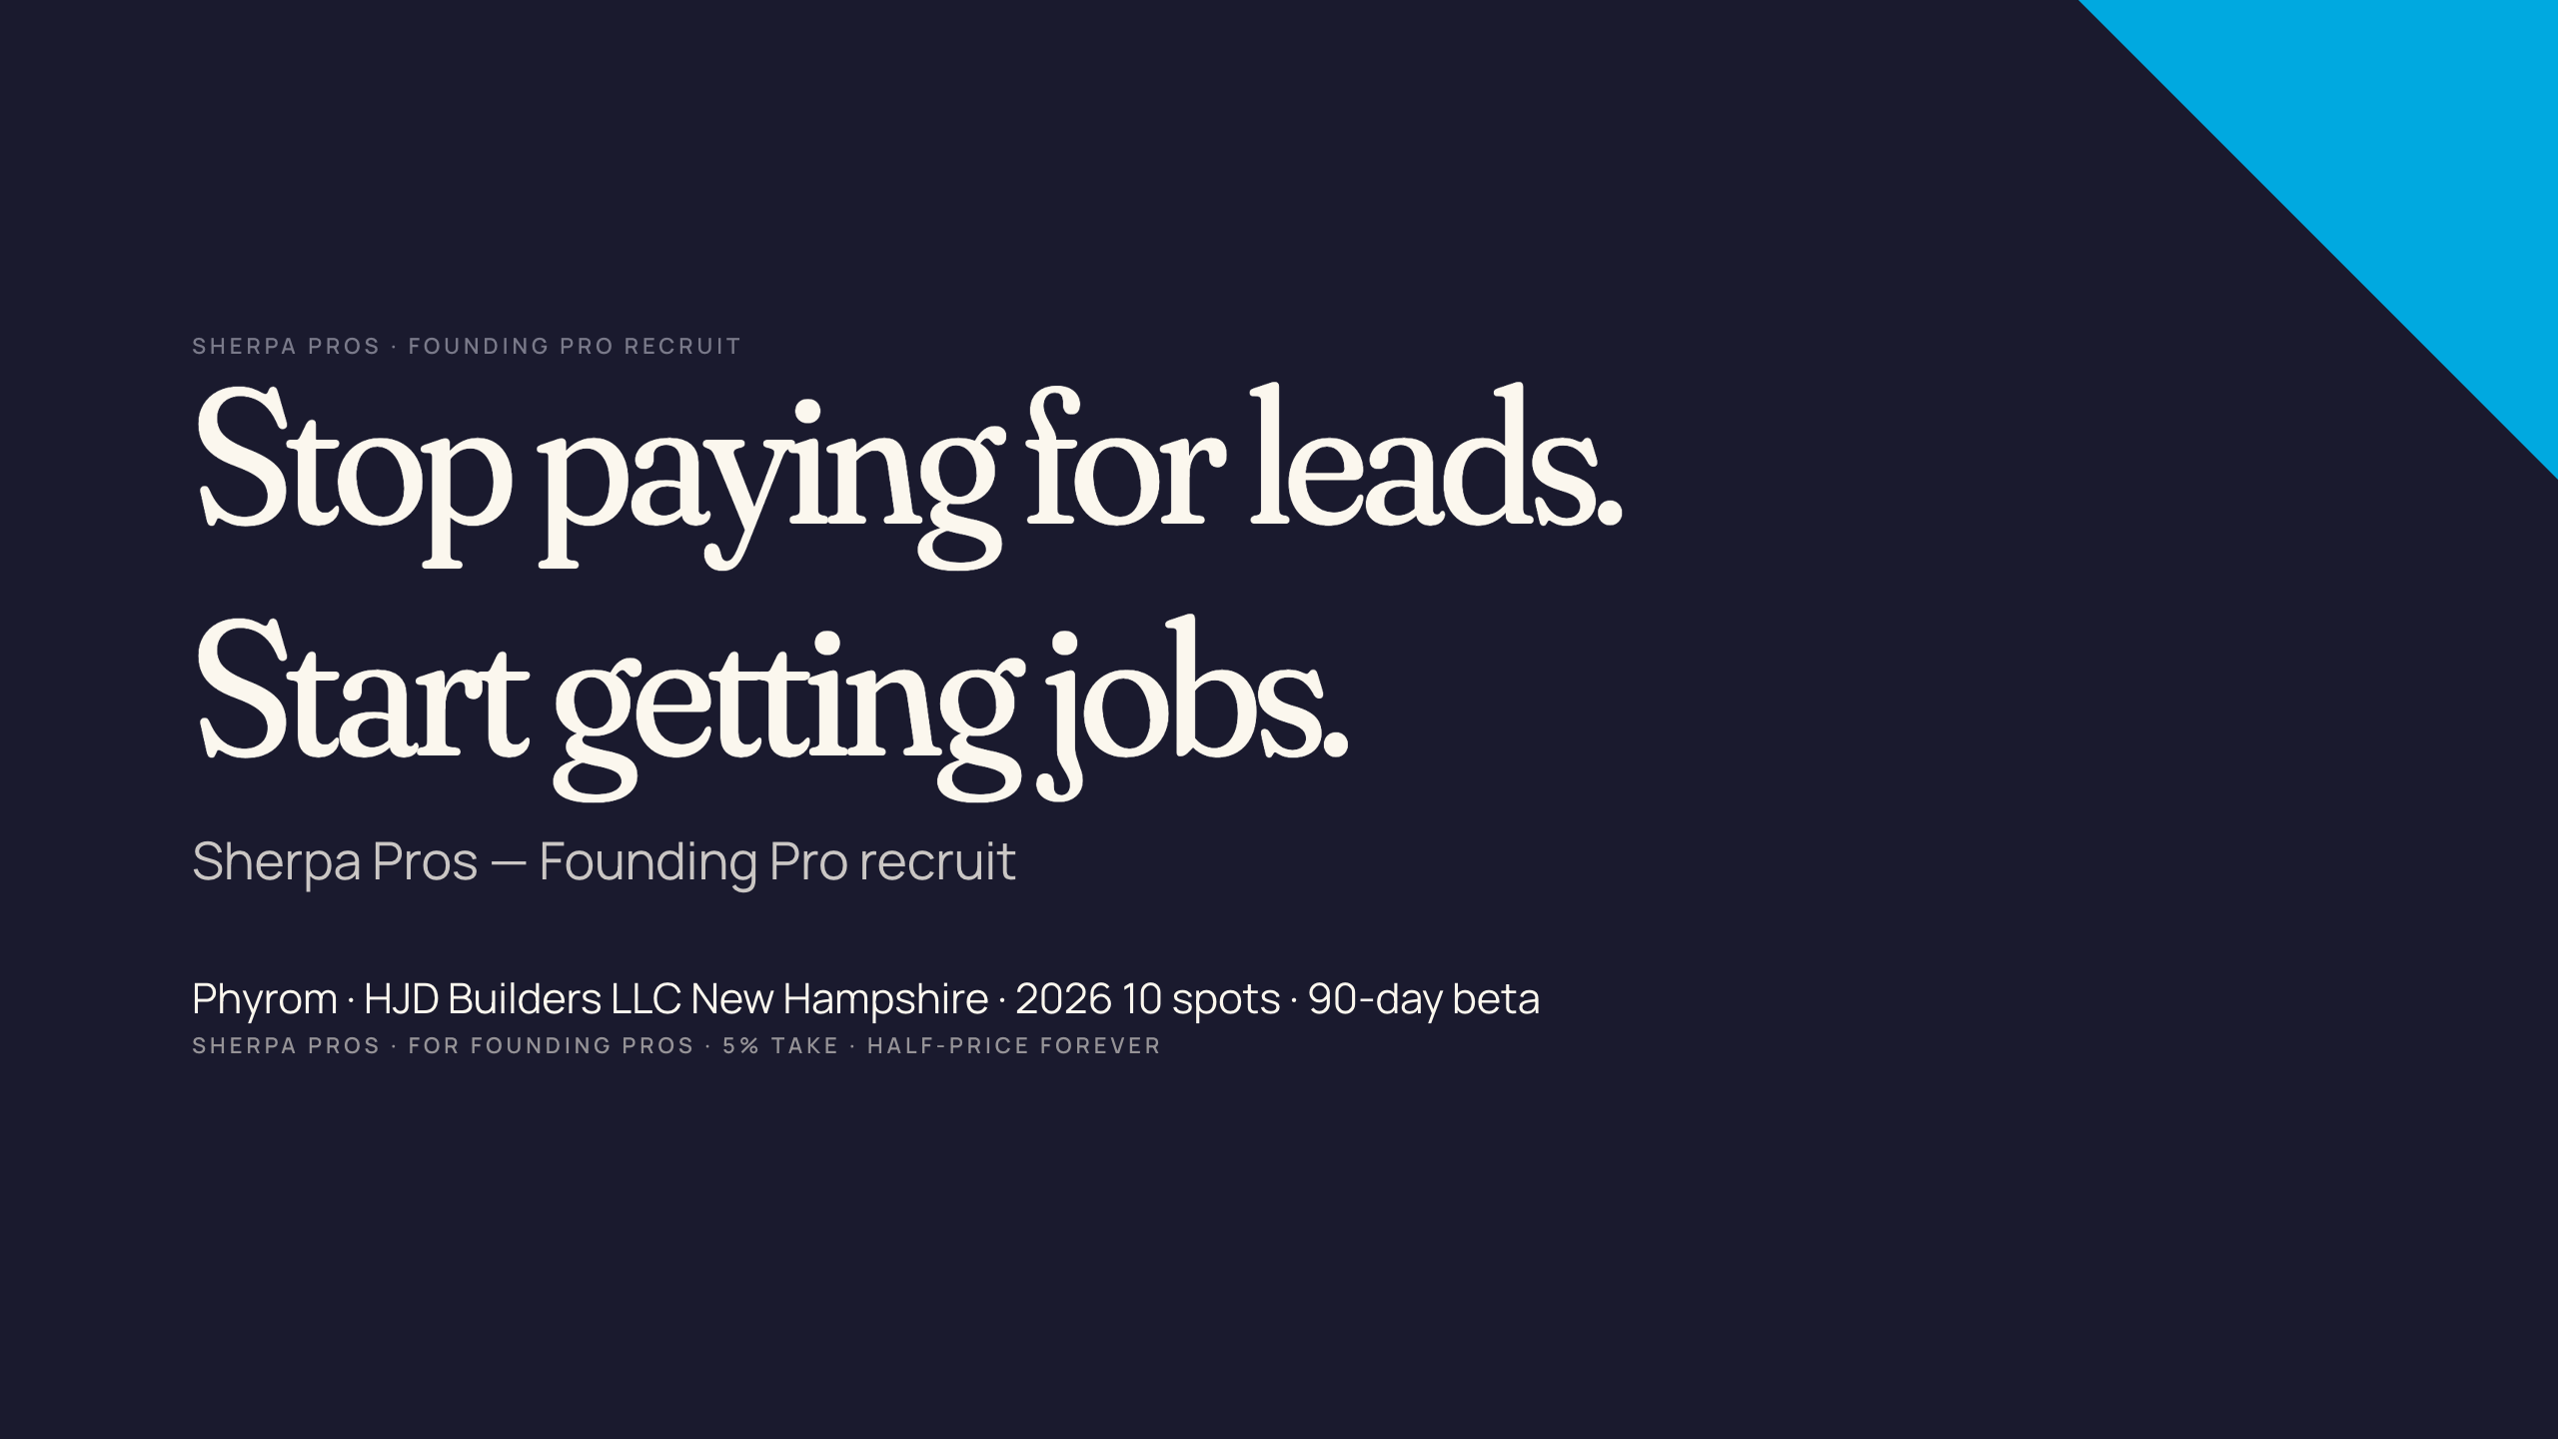
Notes:
ASSET REQUIRED: cover treatment — bold cream-on-navy or navy-on-cream typographic poster. Optional: behind the type, a desaturated full-bleed jobsite photo (work boots on subfloor, framing in background) at 15% opacity. Source: Phyrom's iPhone or Ideogram brief: "documentary contractor work boots, framed wall, subfloor, mid-day, 35mm, no faces." Dimensions: 1920x1080.

Slide 2
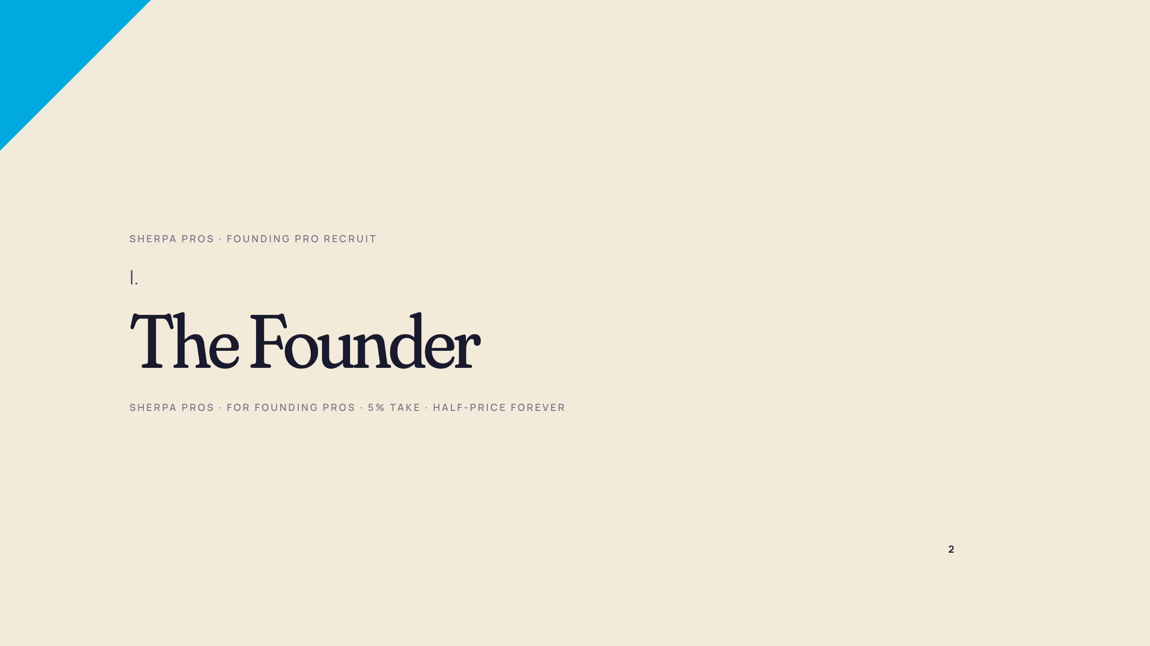

Slide 3
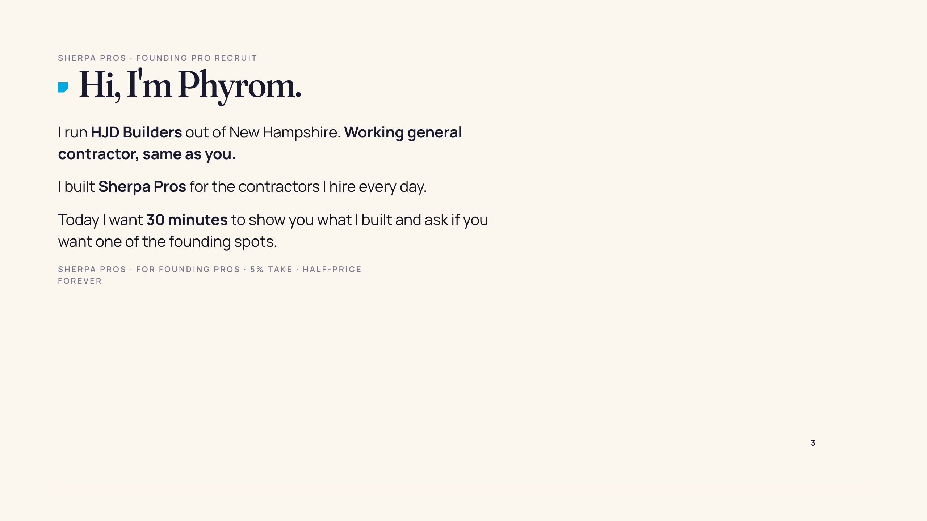
Notes:
ASSET REQUIRED: NH jobsite portrait of Phyrom — same photo used in investor + BV decks for visual continuity. Source: Phyrom captures on jobsite. Dimensions: 1080x1920 vertical.

Slide 4
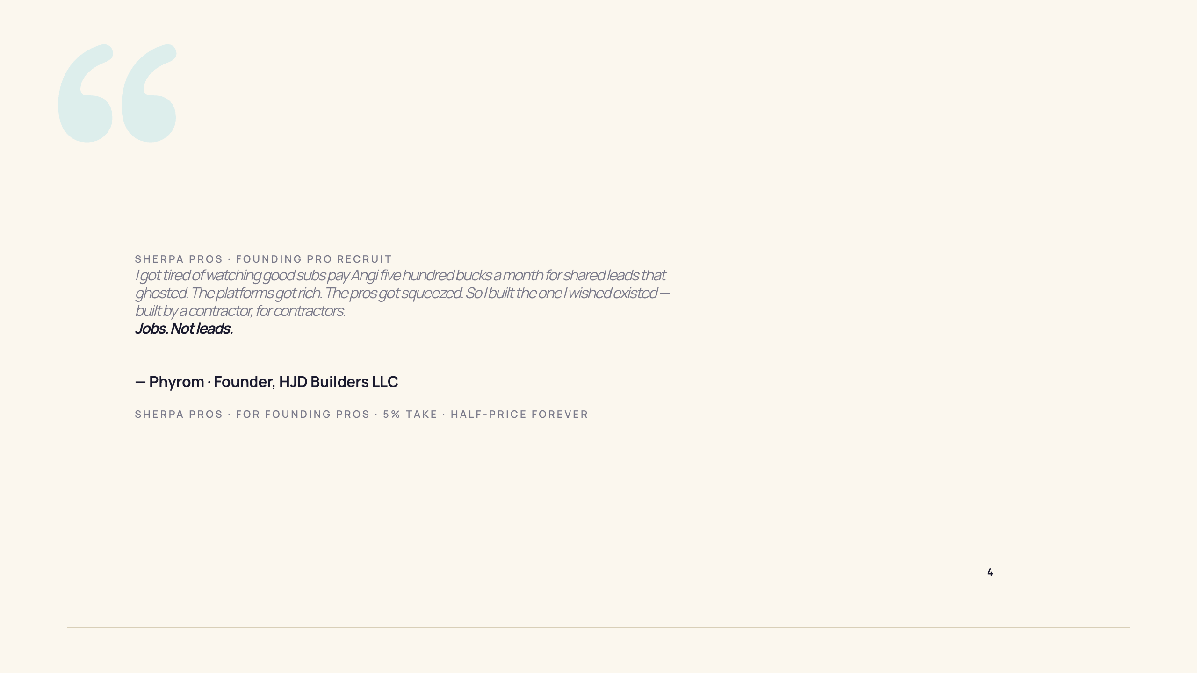

Slide 5


Slide 6
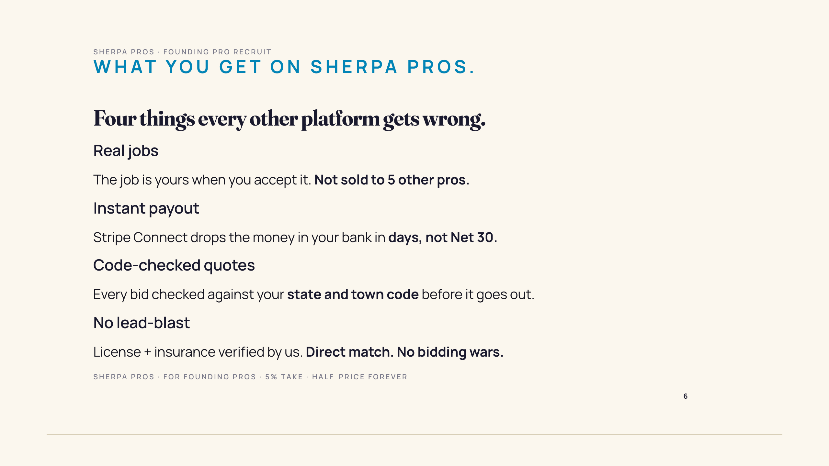

Slide 7
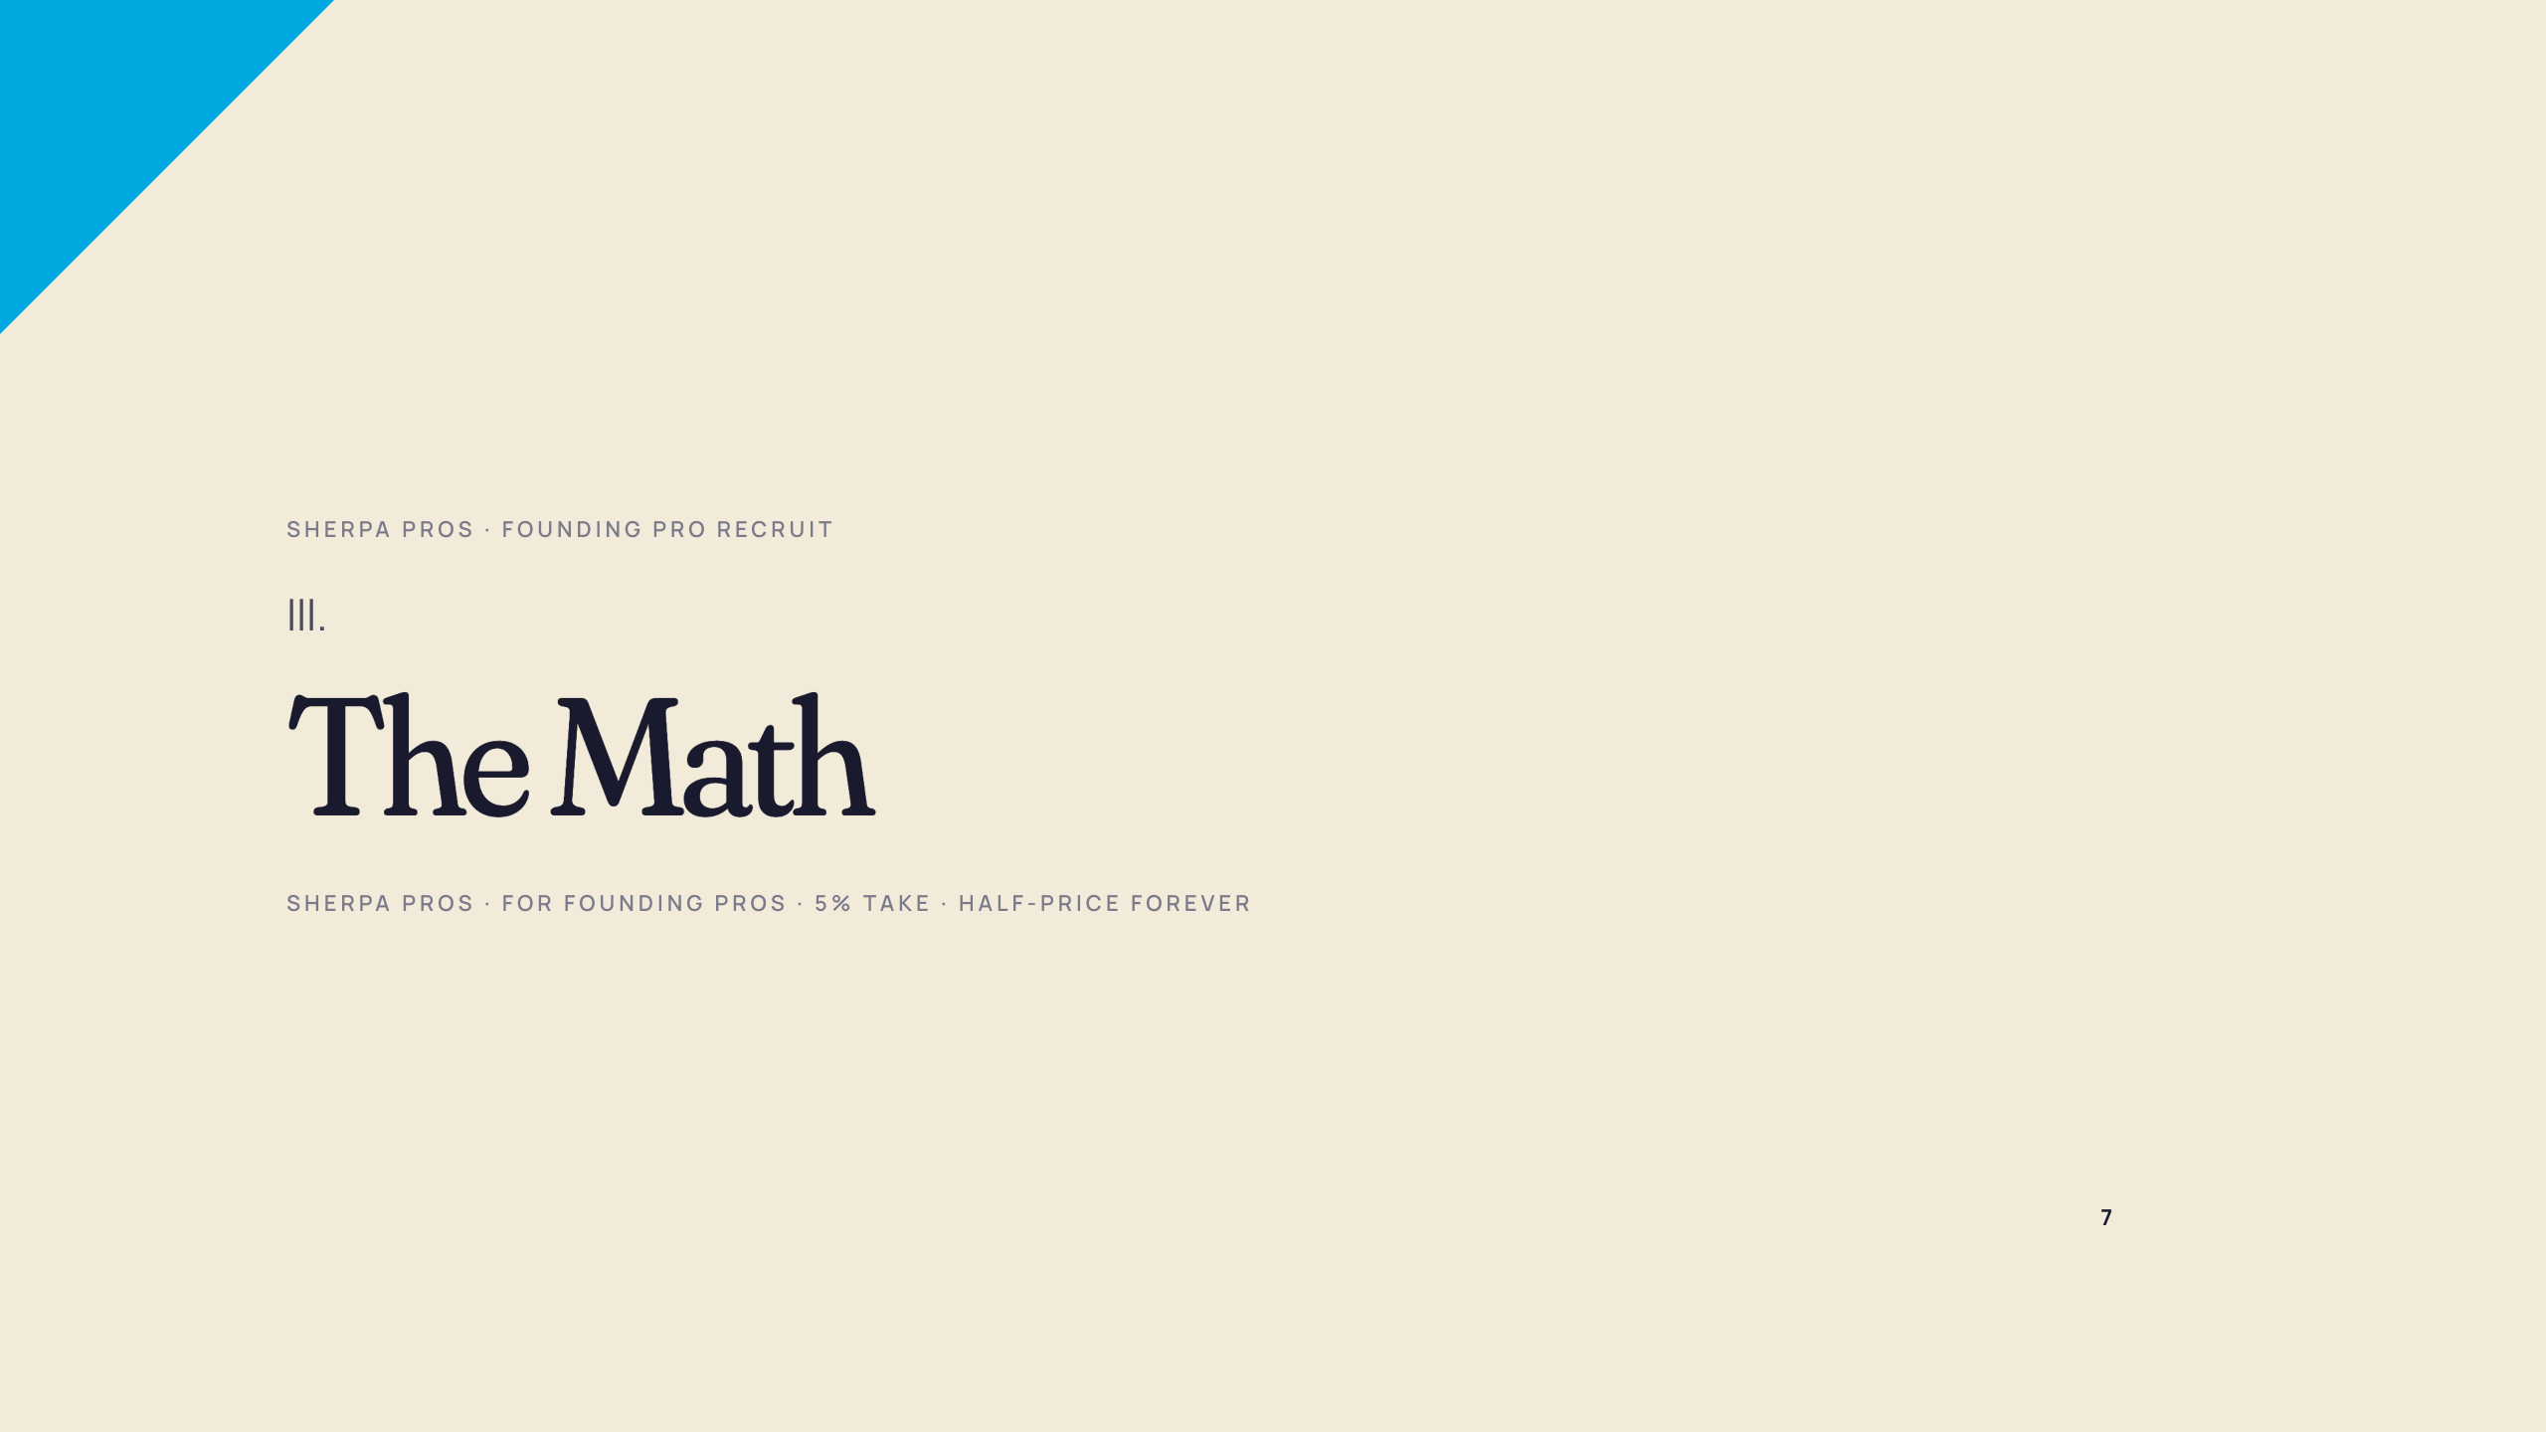

Slide 8
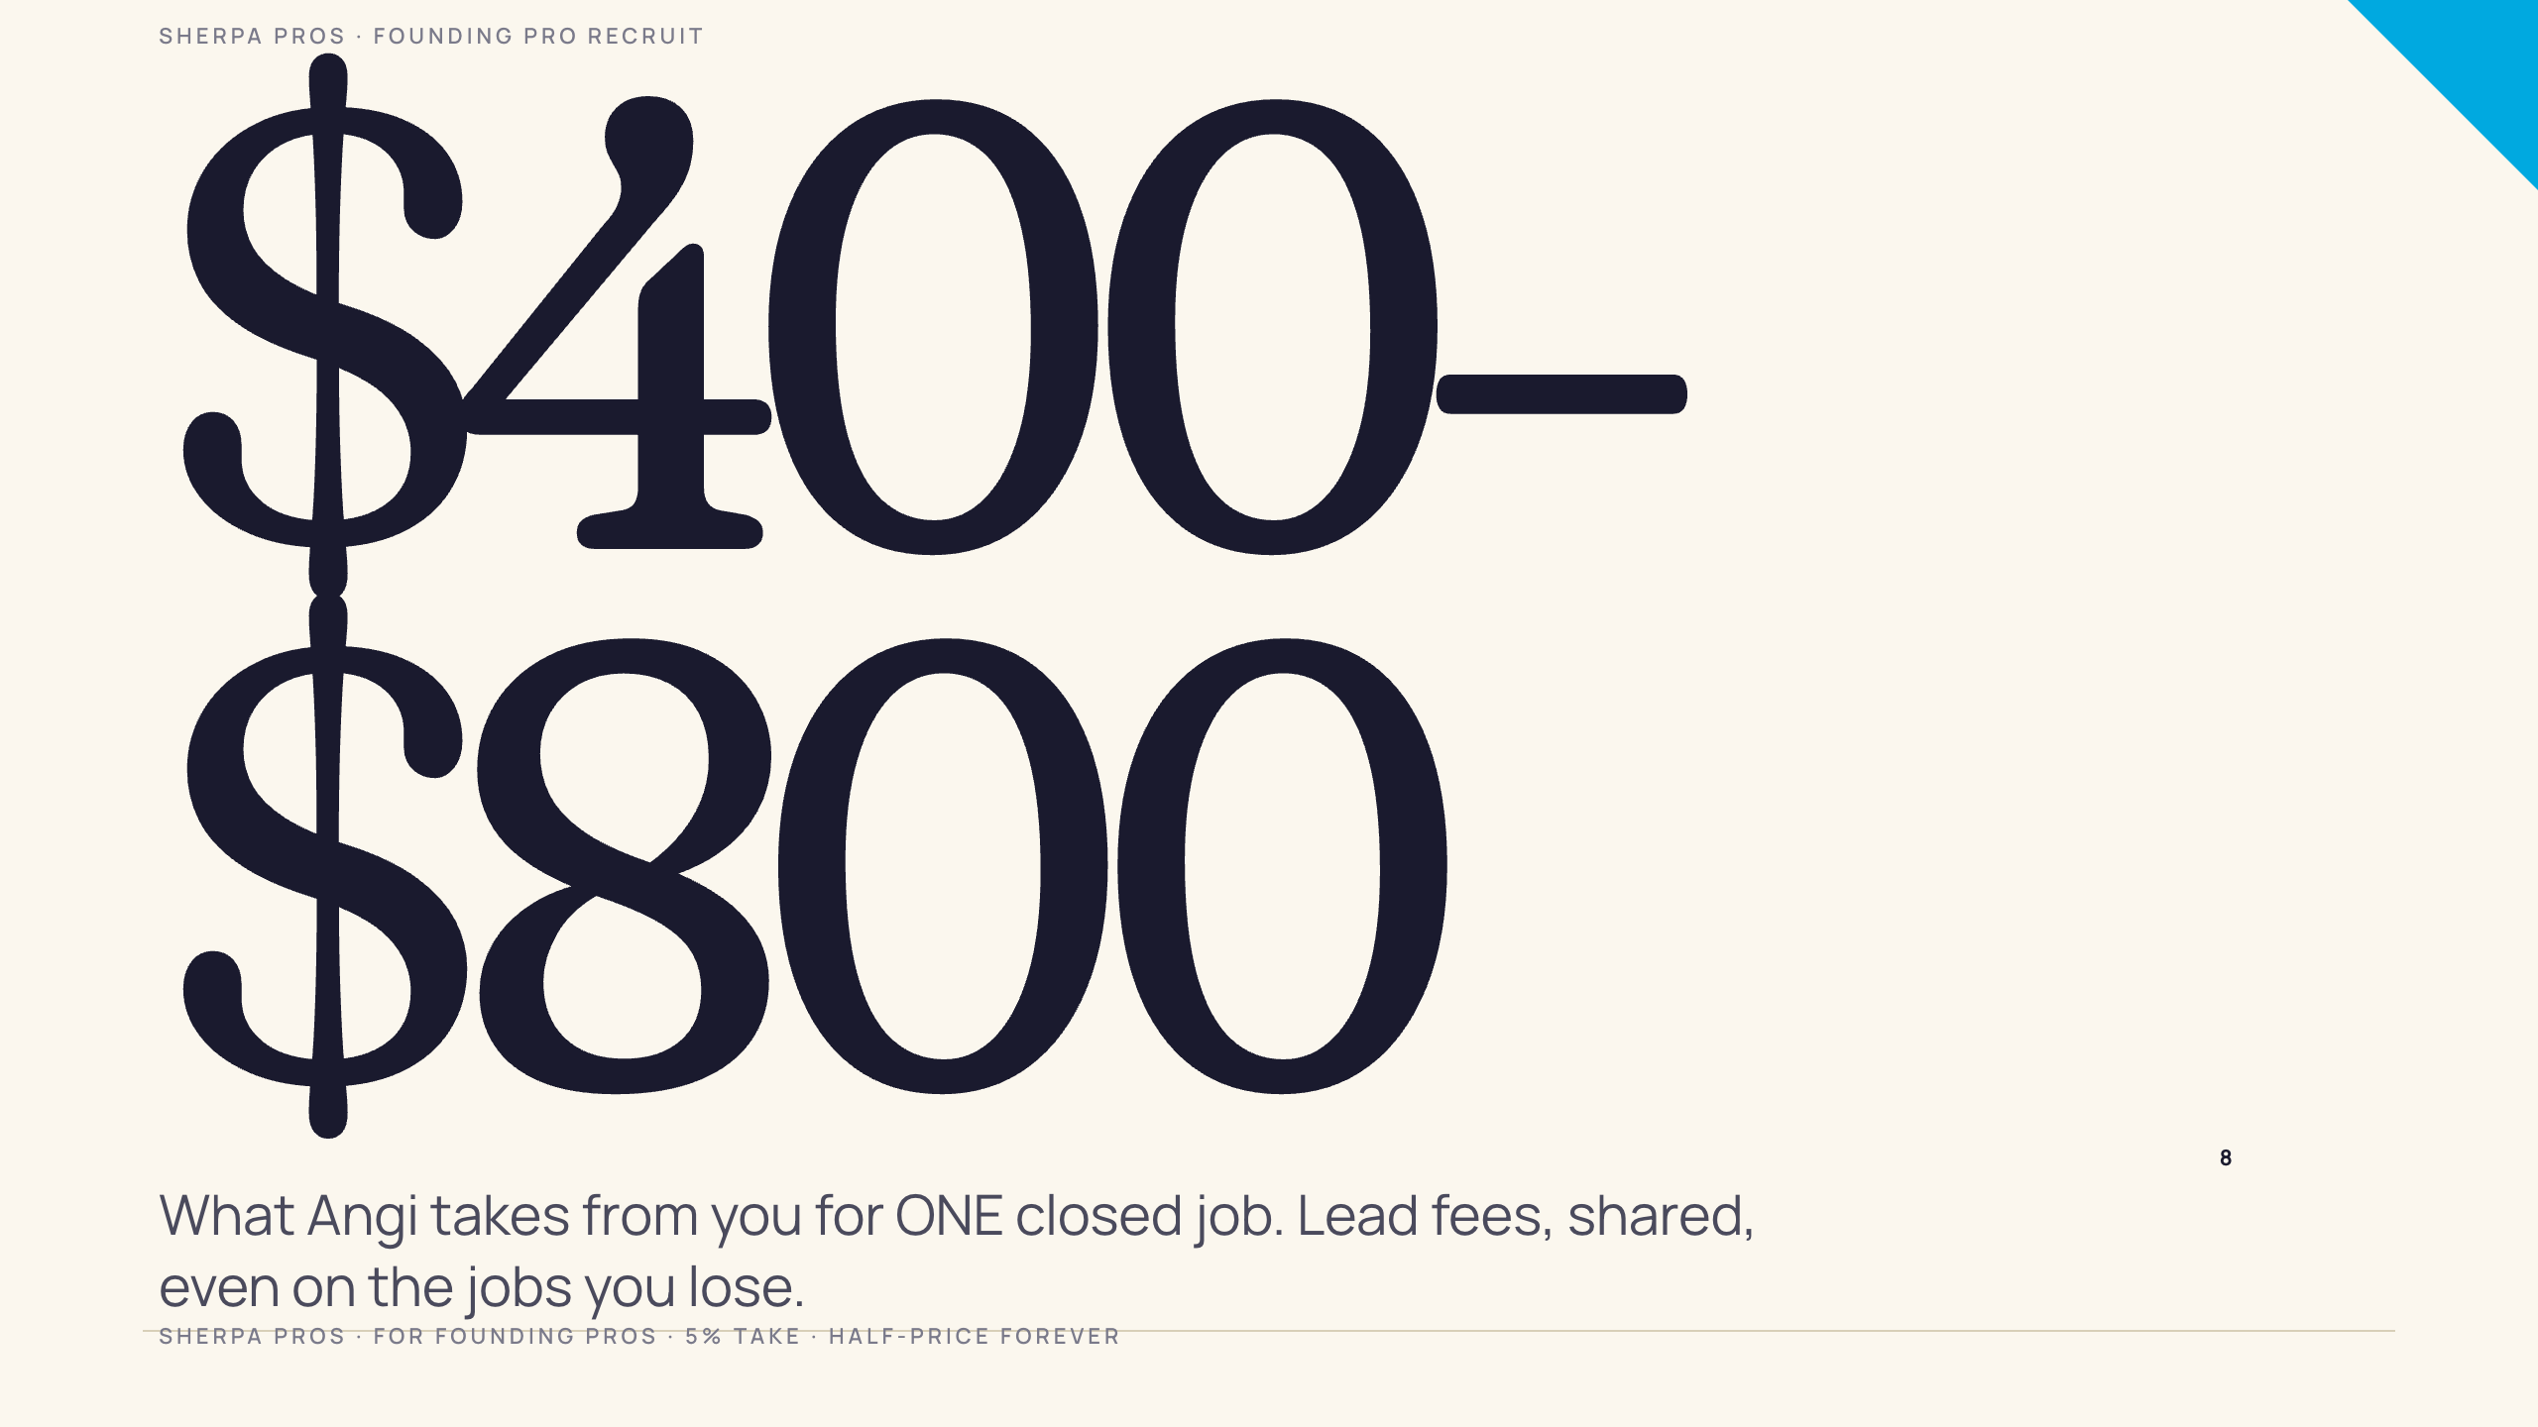

Slide 9
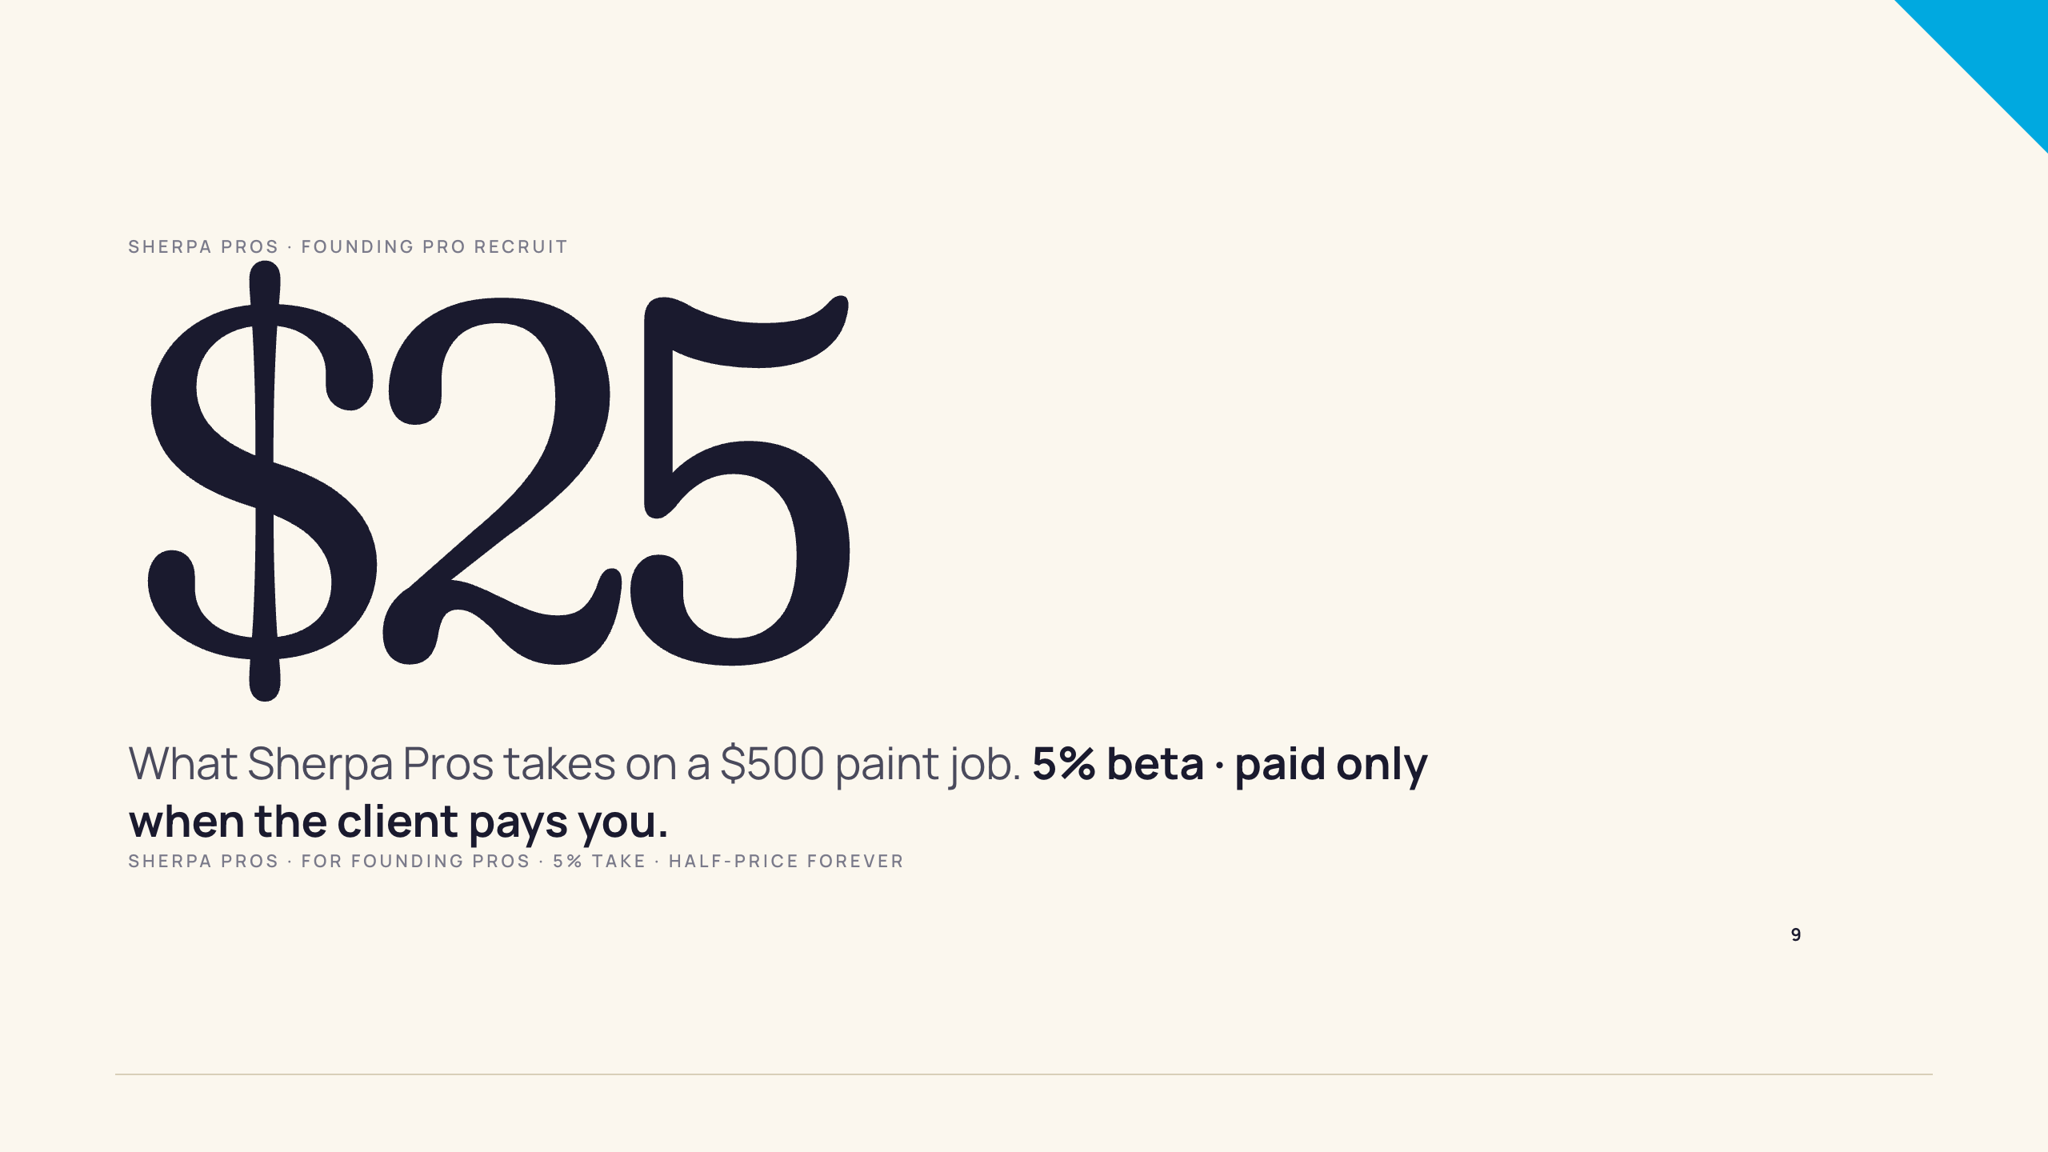

Slide 10
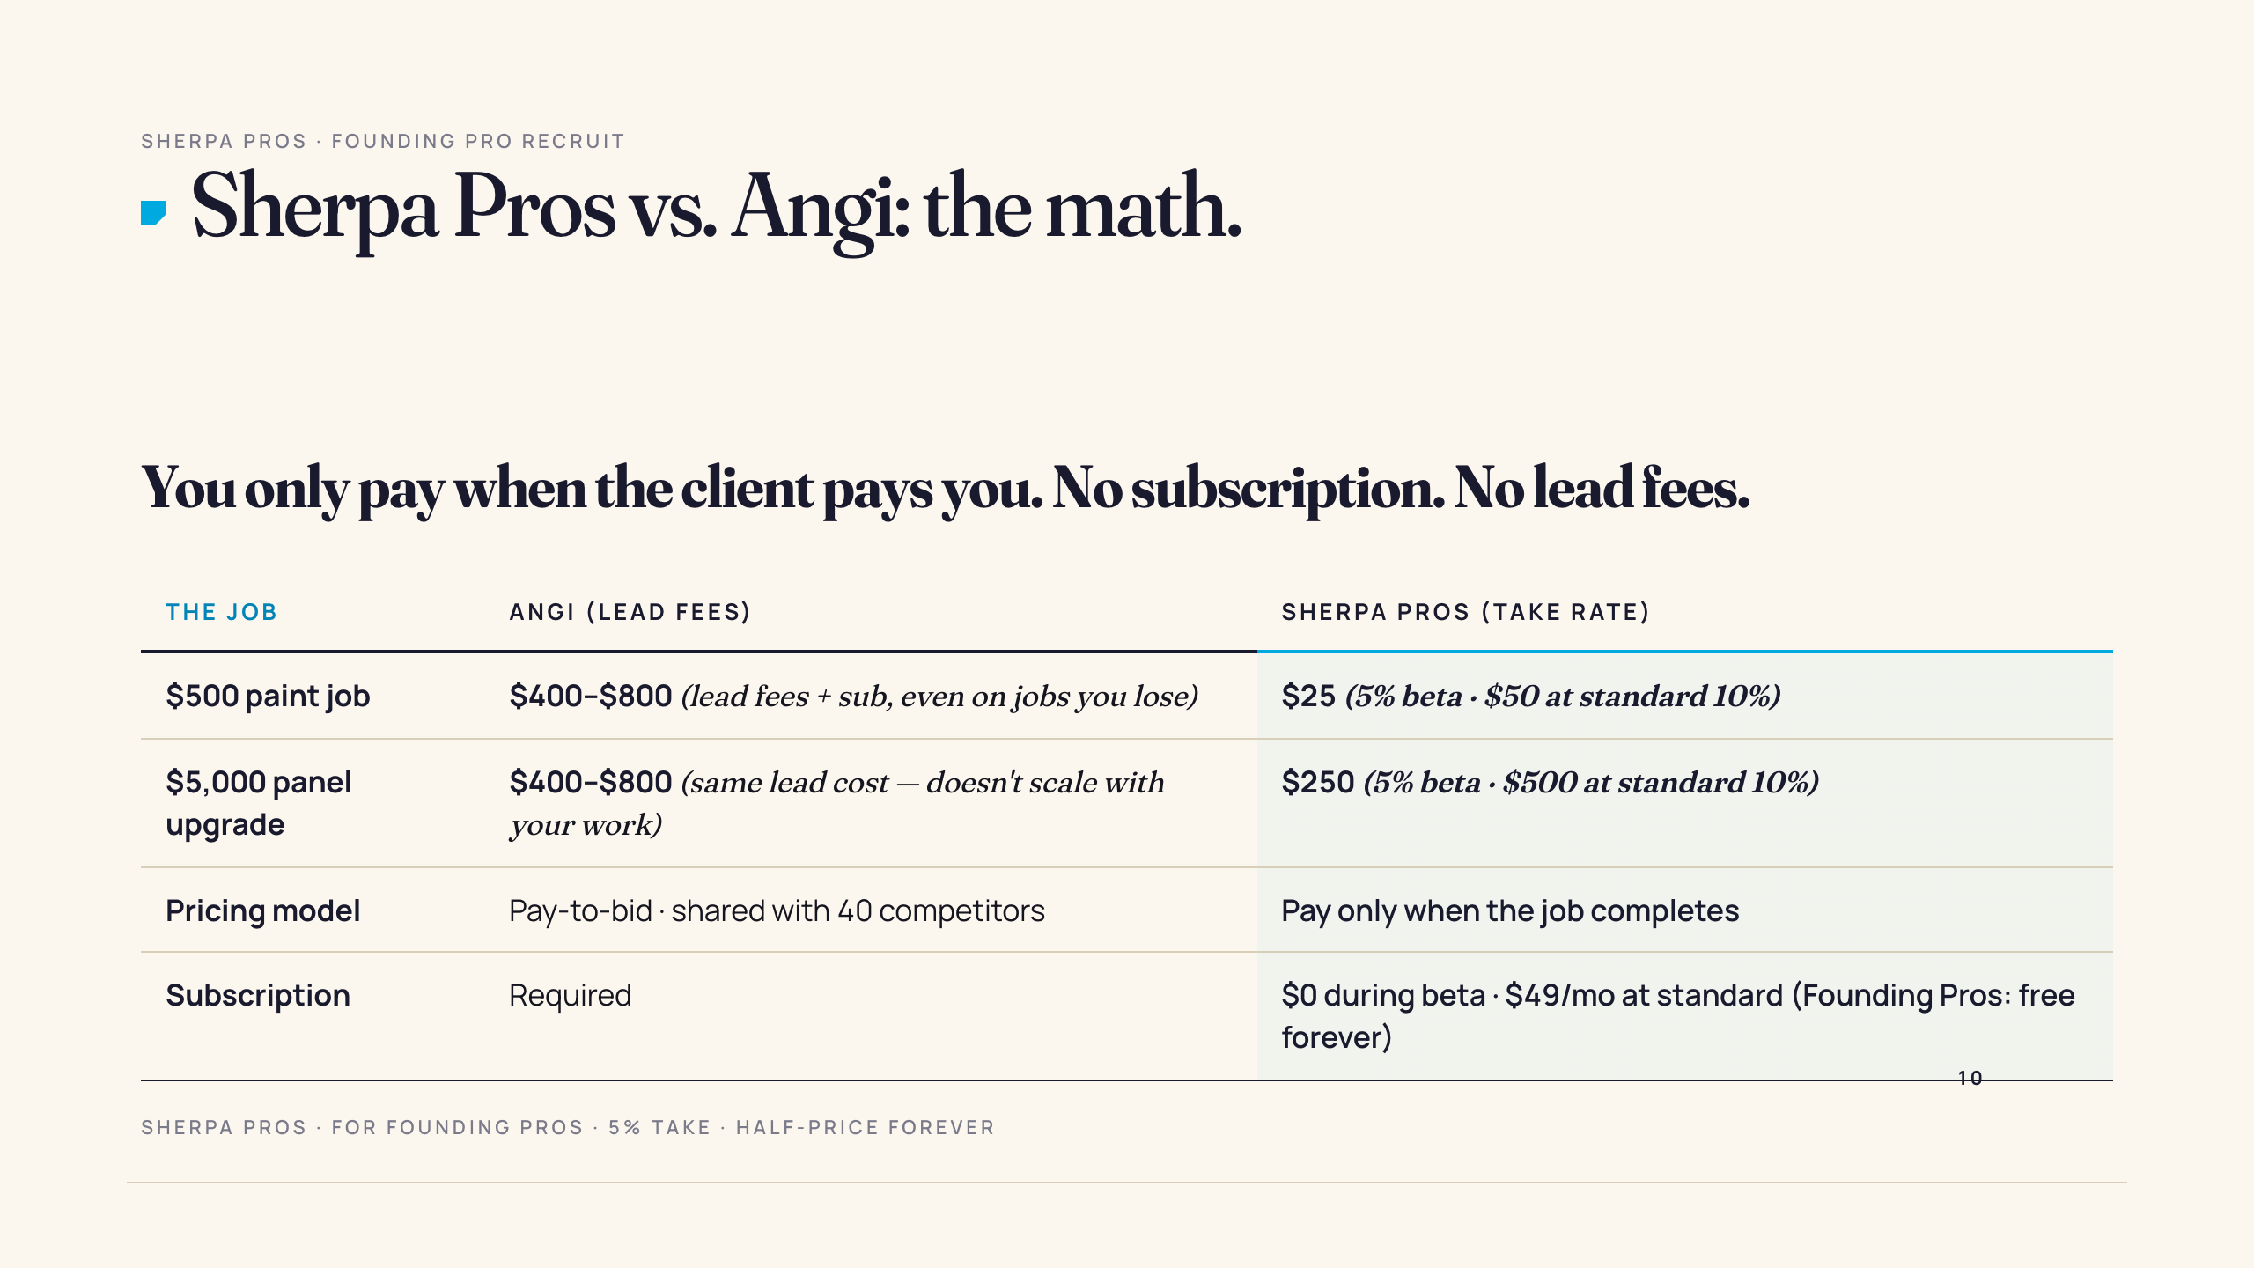

Slide 11
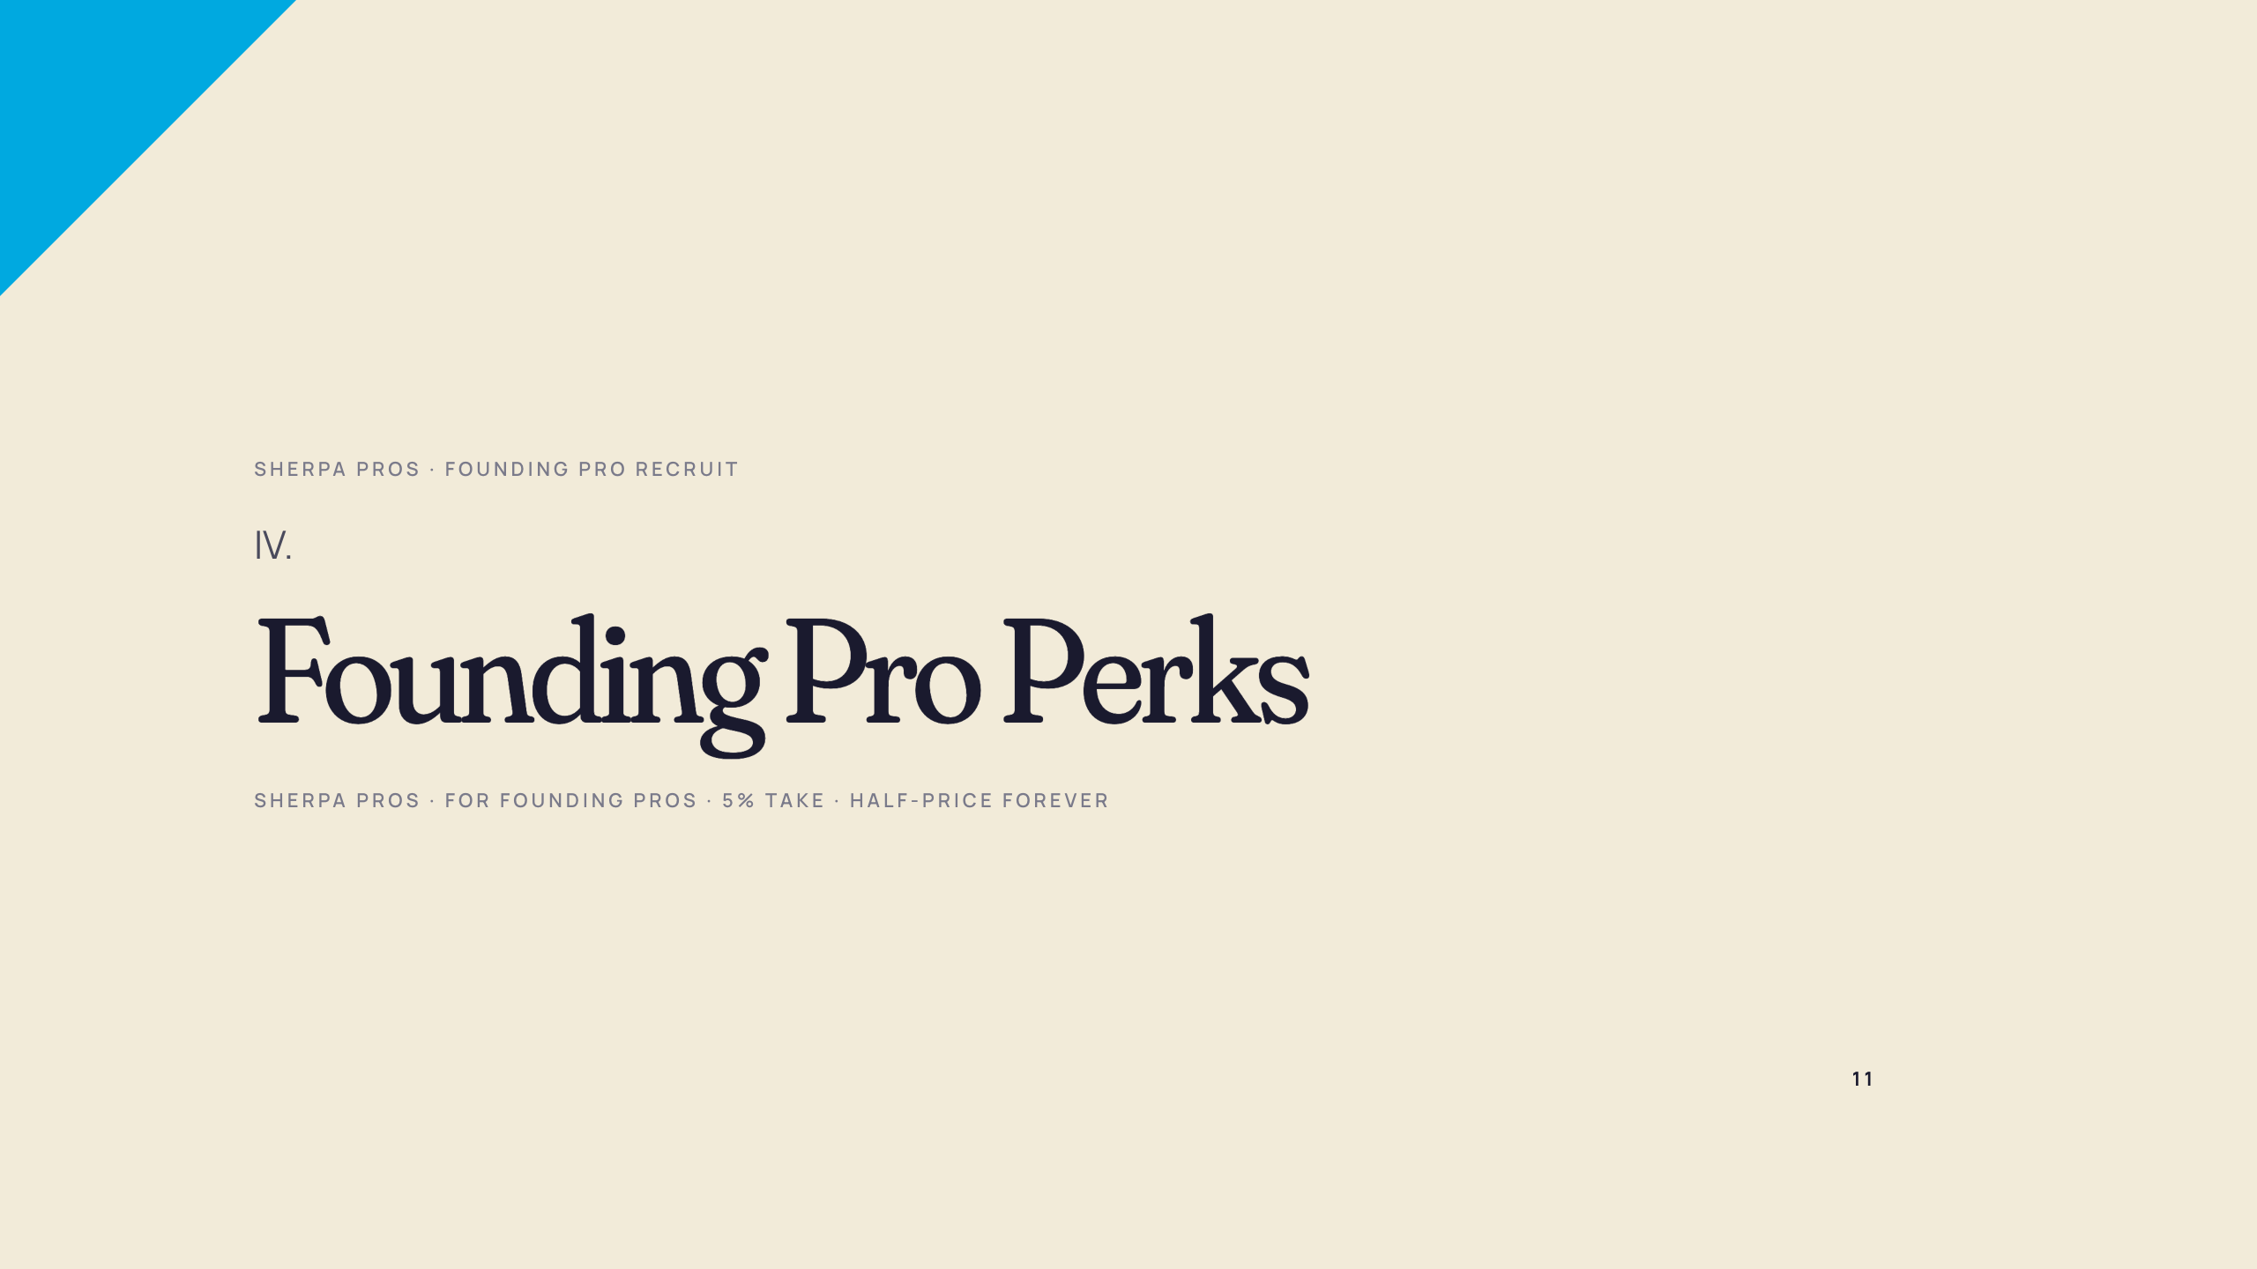

Slide 12
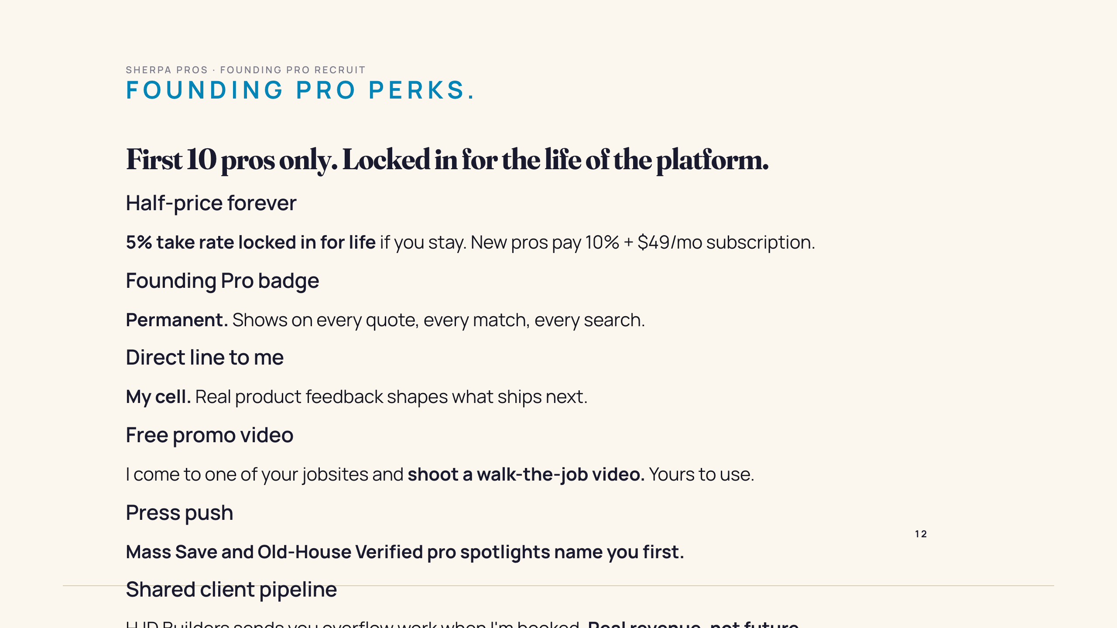

Slide 13
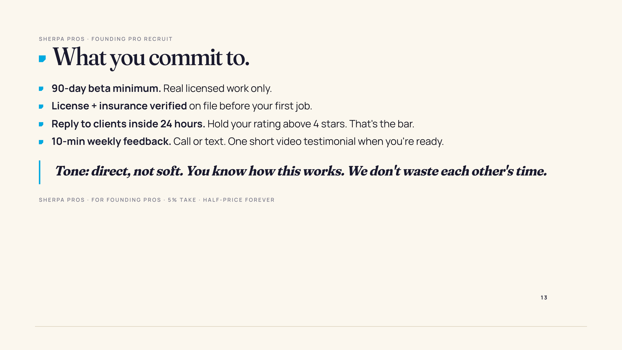

Slide 14
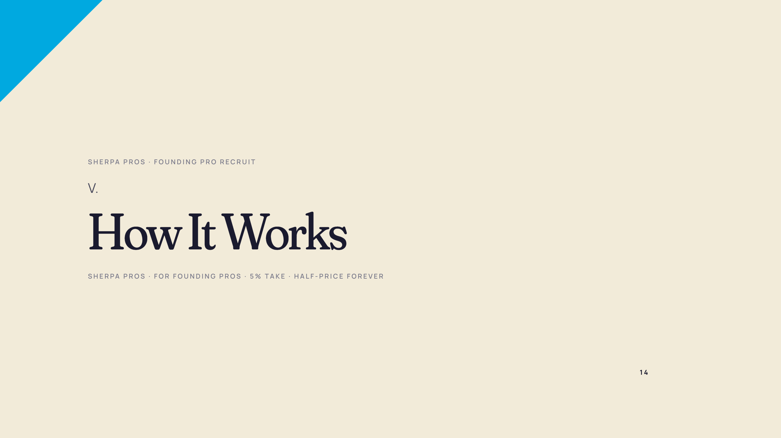

Slide 15
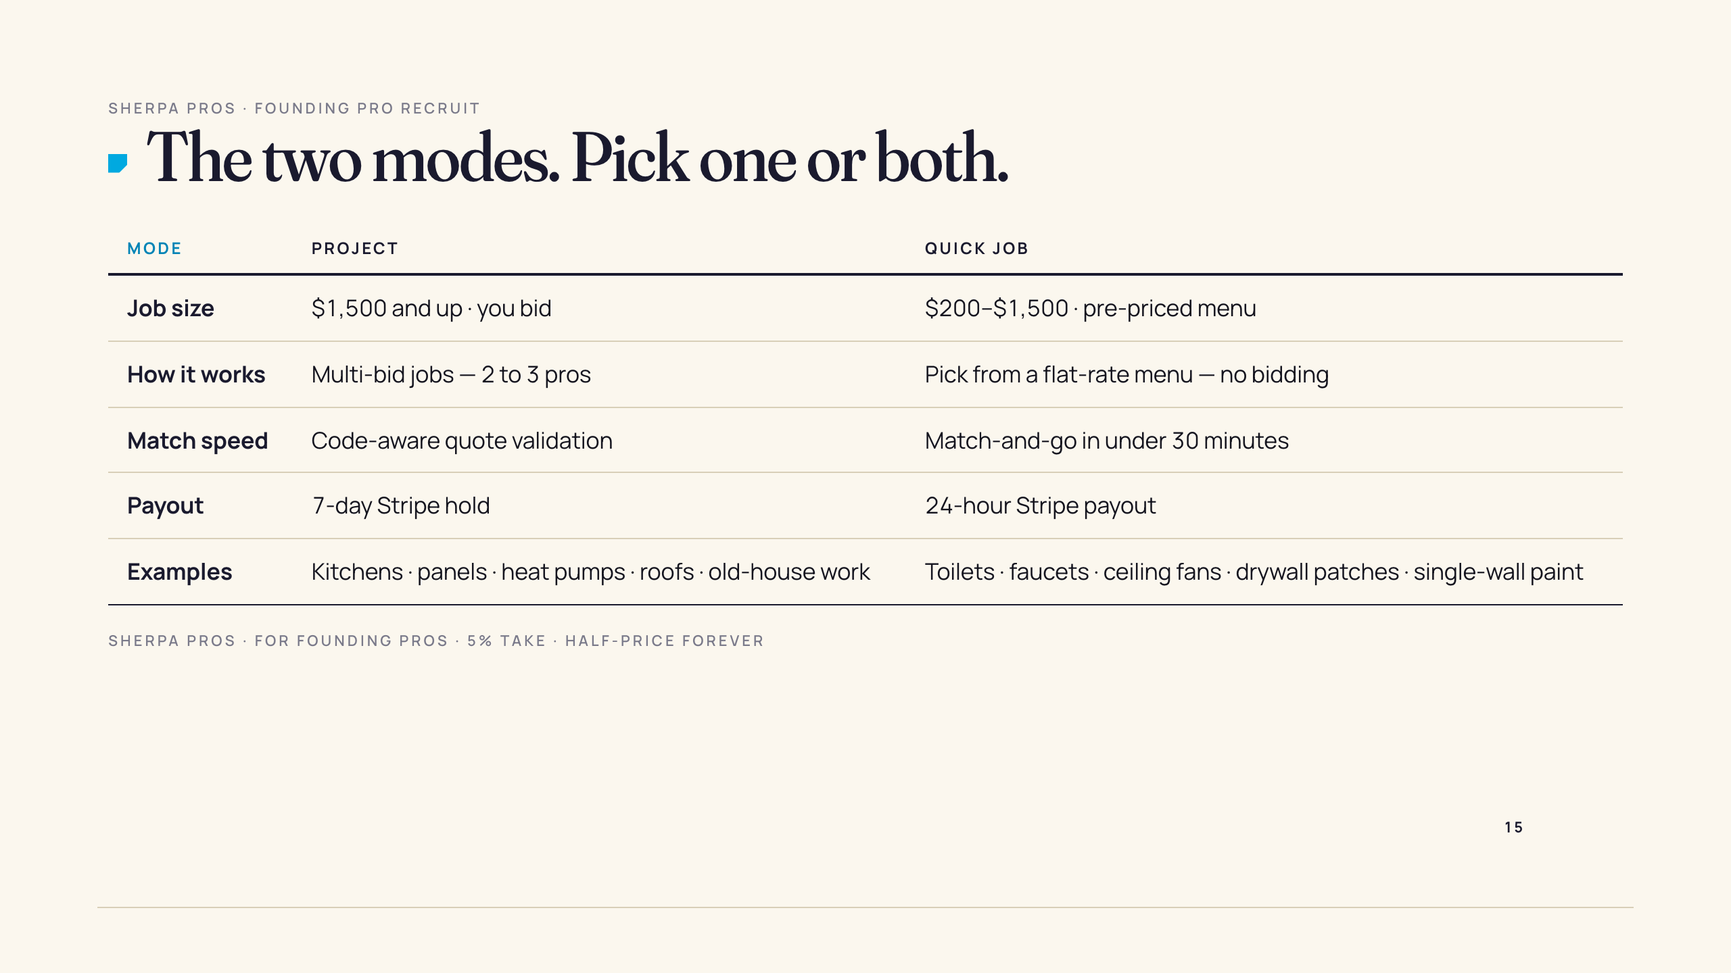

Slide 16
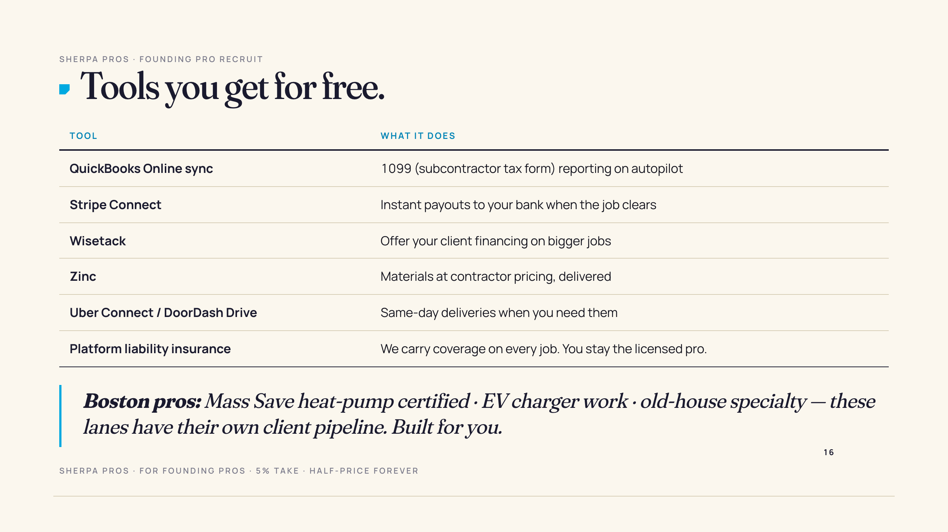

Slide 17
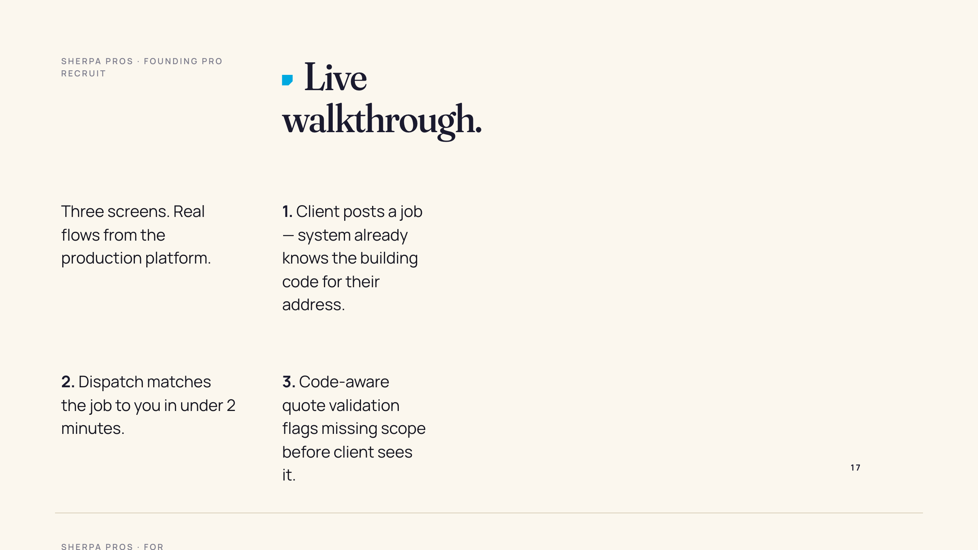
Notes:
ASSET REQUIRED: composite product still — three iPhone frames overlapping on cream field. (1) Client post-job wizard. (2) Pro inbox with one matched job + green "Code-checked" badge. (3) Code-aware quote with one flagged line item. Source: Phyrom captures fresh from production within 24h of any send. Dimensions: 1920x1080 composite, transparent background.

Slide 18
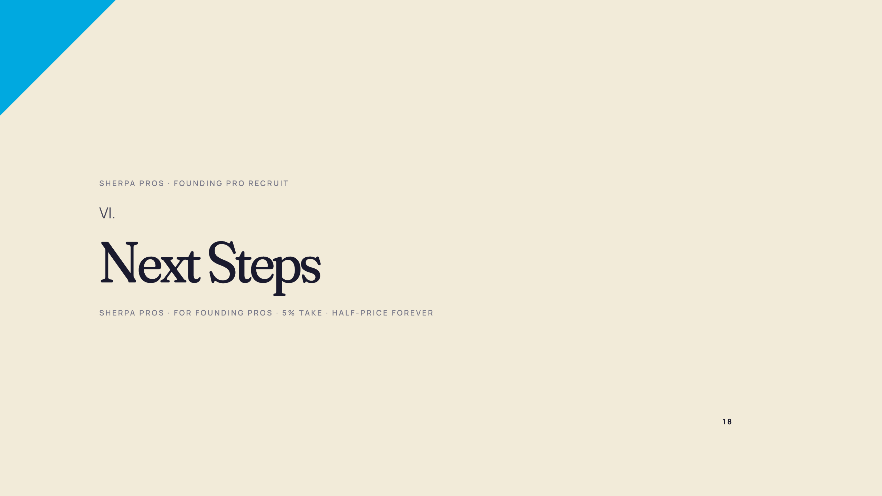

Slide 19
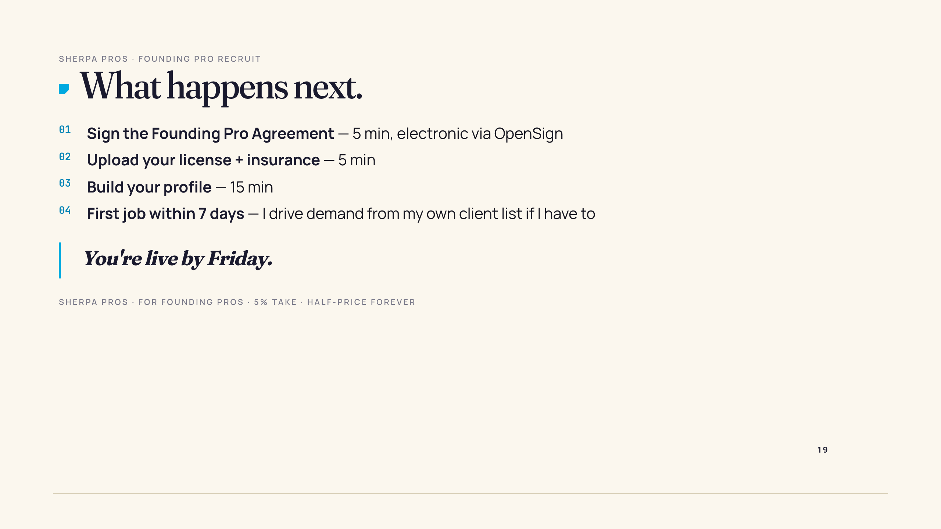

Slide 20
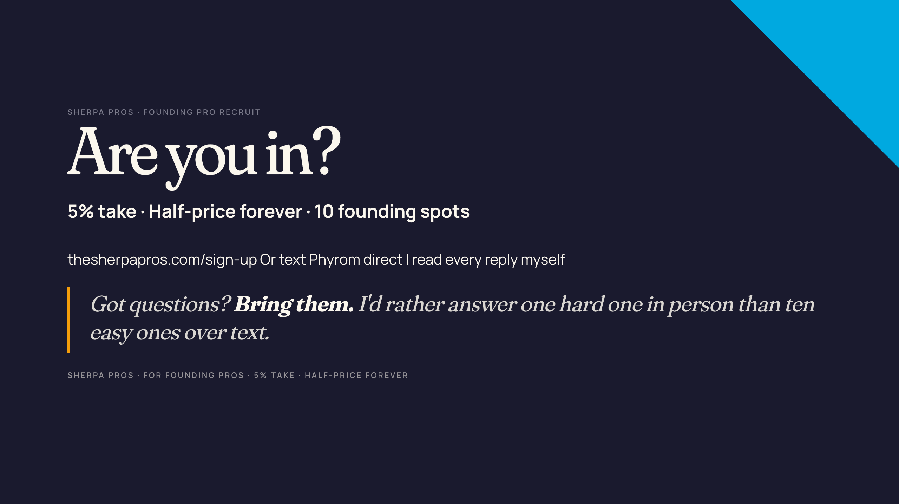
Notes:
ASSET REQUIRED: QR code linking to www.thesherpapros.com/founding-pros (or wherever the Founding Pro Agreement signup lives). Generate at qr-code-generator.com. Place lower-right corner. Dimensions: 400x400px, sky-blue on navy for the lead-class dark background.

