Slide 1
Network Implementation CEN500
WAN Implementation
(ACME Network - Software Model)
Dr. Shakeel Ahmad

Slide 2
Review of Past
What we have done so far
ACME Company (use case)
Network Servers (DHCP, Web Server, DNS)
Network Servers implemented on real computers
Packet Tracer → IP addressing scheme VLSM, IPv4, IPv6.

Slide 3
Future Activities
WAN Implementation of ACME Scenario
ACME’s Addressing Scheme, NAT/PAT and IPv6 (today)
Software Model (Packet Tracer) (next week)

Slide 4
Network Implementation
Objectives/LOs :
Work out solutions for ACMEs networking requirements – to link their offices together to form a wide area network
Learn how to implement WAN link in Packet Tracer
Learn IOS command – how to configure CISCO routers using CLI commands.

Slide 5
IPv6 Basics
An IPv6 address is 128 bits as opposed to a 32 bit IPv4.
IPv6 address is represented in 8 groups of 16 bits each.
Each group is written as four hexadecimal digits and the groups are separated by colons (:).
An example of this representation is 2001:0db8:0000:0000:0000:ff00:0042:8329.

Slide 6
Compressing an IPv6 Address
leading zeroes are removed; e.g.,the group 0042 is converted to 42
Consecutive zeroes are replaced with a double colon (::)
Example
Initial address: 2001:0db8:0000:0000:0000:ff00:0042:8329
After removing all leading zeroes in each group: 2001:db8:0:0:0:ff00:42:8329
After omitting consecutive sections of zeroes: 2001:db8::ff00:42:8329

Slide 7
Topics Important for the session
Routing Protocols and how they work
    Dynamic vs static routing
    How do Distance Vector routing protocols work?
    How do Link State routing protocols work?

Slide 8
Distance Vector Routing
Each router maintains a routing table consisting of entries
An entry is a triplet (destination, distance, output line)
Routing table is updated dynamically by exchanging information with neighbours.
The metrics used to measure distance
  hop count, delay etc.

Slide 9
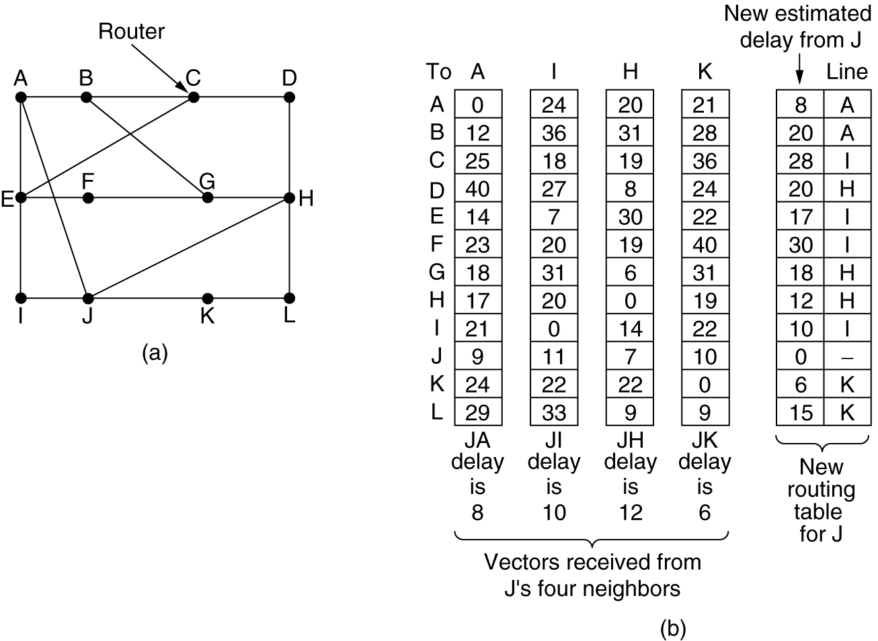
A subnet.
Input from A, I, H, K, and the new routing table for J.

Slide 10
Link State Routing
Each router must do the following:
Discover its neighbors, learn their network address.
Measure the delay or cost to each of its neighbors.
Construct a packet telling all it has just learned.
Send this packet to all other routers.
Compute the shortest path to every other router using Dijkstra Algorithm

Slide 11
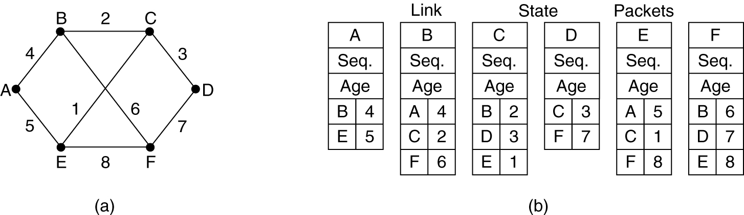
Building Link State Packets (LSP)
(a) A subnet. (b) The link state packets for this subnet.
LSP are generated at regular intervals or when there is a major change
Distribution of LSP
  Refined flooding. Using sequence number, age
Notes:
Once information about the neighbours is collected the next important task is to build a packet containing this information. The packet starts with the router identity, sequence number and age, neighbours and the distance to their neighbours.
An important question is when to build the packet, can be done at regular interval or can be done when there is a major change.
The sequence number is 32 bit long, it means that one LSP per second, it will take 137 years to wrap around. But the sequence number may be corrupted. So if a single bit error occurs, and 65540 is received instead of 4, the all the following will be rejected. To take care of it, we use age after the sequence number and decrement it by one each second.

Slide 12
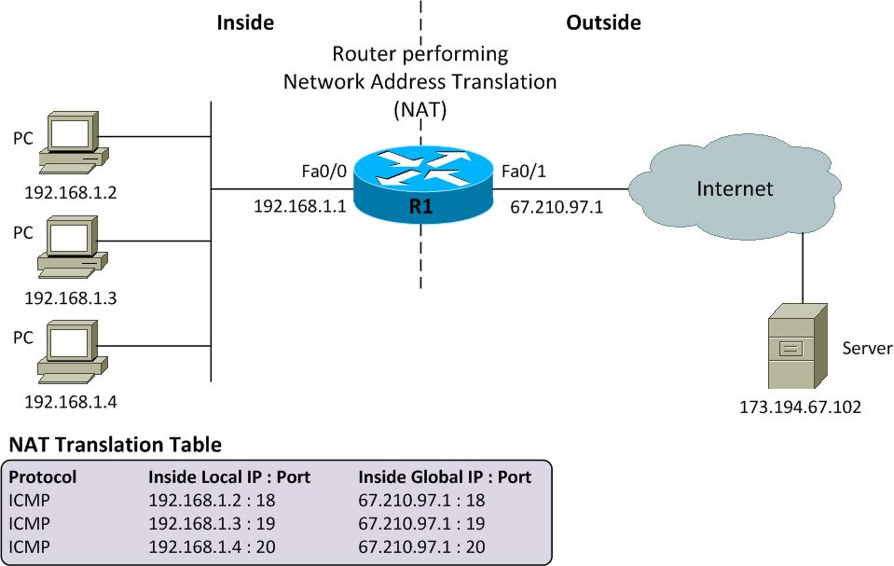
Network Address Translation
Network Address Translation
Two interfaces
–one public connected to Internet (or other external network)‏
one private connected to the internal LAN
-Public static IP address (issued by InterNic, etc.)‏
-Private IP address can be static or dynamically issued by DHCP (or by NAT from pool)‏

Slide 13
Network Address Translation
Two interfaces
–one public connected to Internet (or other external network)‏
one private connected to the internal LAN
-Public static IP address (issued by InterNic, etc.)‏
-Private IP address can be static or dynamically issued by DHCP (or by NAT from pool)‏

Slide 14
External hosts cannot see hosts on private network, but hosts on private network can see the Internet.
However:
- a port mapping can be created so that public IP address+port is mapped to private IP address+port – so that certain hosts are visible from the public interface - eg. a web server on the private network.

Slide 15
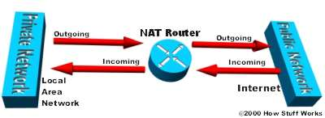
NAT Router
The NAT router translates traffic coming into and leaving the private network.

Slide 16
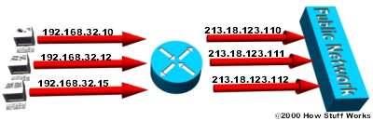
Static NAT
In static NAT, the computer with the IP address of 192.168.32.10 will always translate to 213.18.123.110

Slide 17
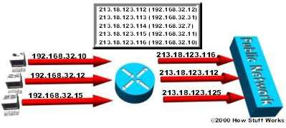
Dynamic NAT
In dynamic NAT, the computer with the IP address 192.168.32.10 will translate to the first available address in the range from 213.18.123.100 to 213.18.123.150

Slide 18
How NAT works:
When host on private network sends IP packet to external network:
NAT router maintains a table of private to public address mappings
at the NAT router the source address (on the private network) in the IP packet is changed to that of the public IP address
external host returns IP packets to the public address and NAT router changes destination address in the IP packet to the private address of host

Slide 19
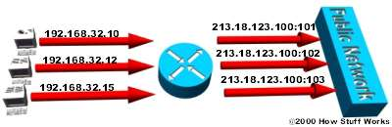
Overloading
In overloading, each computer on the private network is translated to the same IP address (213.18.123.100), but with a different port number assignment

Slide 20
In overloading:
the same public IP address is used for all hosts on the private network
NAT router maintains a table of private IP address and port mappings
when private host sends packet to external host the NAT router changes source address to that of the public address and also the TCP port number allocated to that host
when external host returns IP packet the NAT router changes destination address to that of host on private network (according to port number)‏

Slide 21
Topics Important for the session
Cisco routers and interfaces
  Cisco 2911 series routers
  Interfaces: Fast-ethernet, serial
  What types of cables are used for each interface?
  What is a DCE and DTE and why does DCE need to supply a clock signal to the DTE?

Slide 22
ACME Scenario - Requirements
The 5 ACME sites must be interconnected over the Internet so that the LANs can communicate with each other and share server resources
How can these requirements be met?
Using Cisco systems?

Slide 23
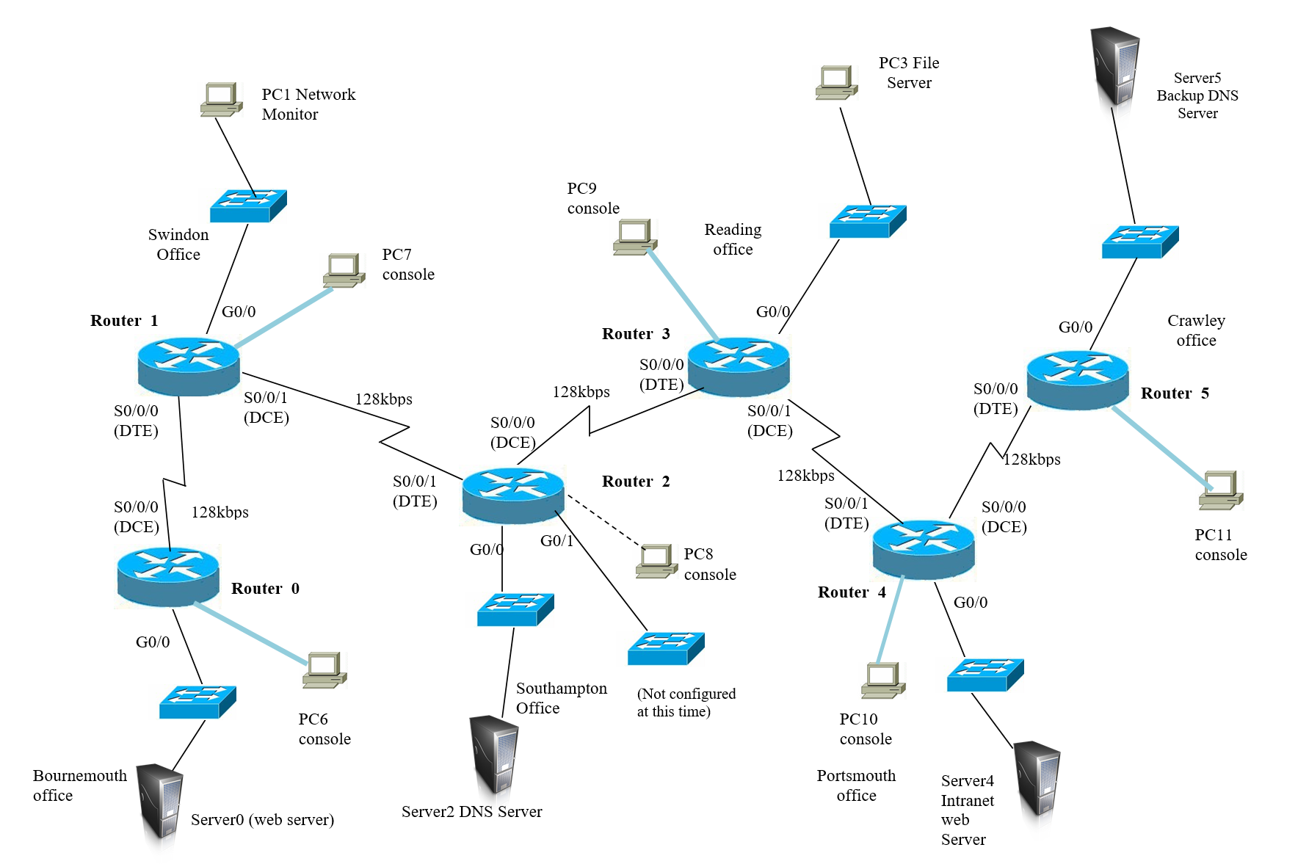
ACME Scenario - Requirements

Slide 24
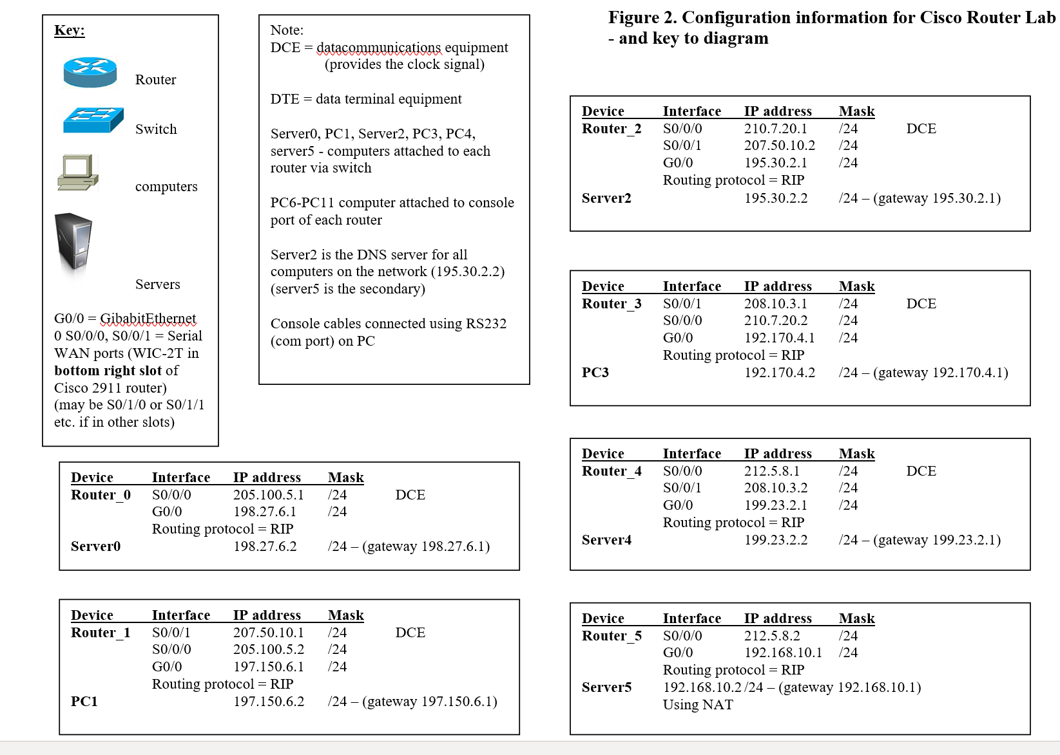
ACME Scenario – IP addressing

Slide 25
ACME Scenario - tasks
Your must decide:
1. How the sites will be interconnected using Cisco routers?
How each router will be cabled up and which router interfaces will be used at each site:
  to connect to the switches on each LAN
  to interconnect each router to the other sites
2. How each router will be configured using Cisco IOS commands:
  to configure the IP addresses of interfaces
  To bring up the interfaces
  To configure a clock rate at the DCE end of the WAN links
  To configure a dynamic routing protocol (eg. RIP or EIGRP)
Continued.....

Slide 26
ACME Scenario - tasks
Continued:
3. What will a diagram of the network look like and what servers will need to be connected to it?
  Sketch it with the servers:
  DNS, Web server, etc.
  At which site will they be hosted?
  How will you make the PCs at each site aware of them?
4. What type of routing will ACME use?
  Recommend static or dynamic
  If dynamic – which one?
  And why?
5. How will you troubleshoot the network?
  Which troubleshooting tools will you use & how will you use them?
  How do you look at a routing table?
  What information will you see in the routing tables?
  Present your results and recommendations for ACME

Slide 27
Any Questions?

Slide 28
Let’s start the work

