Slide 1
Network Implementation CEN500
WAN Implementation
(ACME Network - Software Model)
Dr. Shakeel Ahmad

Slide 2
Topics Important for the session
Cisco routers and interfaces
  Cisco 2911 series routers
  Interfaces: Fast-ethernet, serial
  What types of cables are used for each interface?
  What is a DCE and DTE and why does DCE need to supply a clock signal to the DTE?

Slide 3
ACME Scenario - Requirements
The 5 ACME sites must be interconnected over the Internet so that the LANs can communicate with each other and share server resources
How can these requirements be met?
Using Cisco systems?

Slide 4
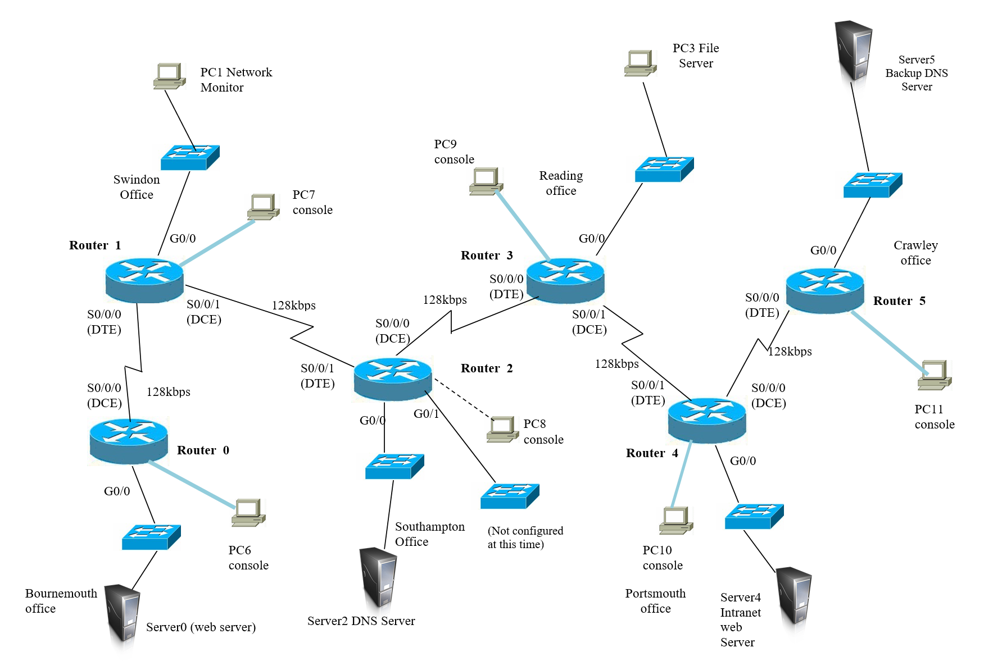
ACME Scenario - Requirements

Slide 5
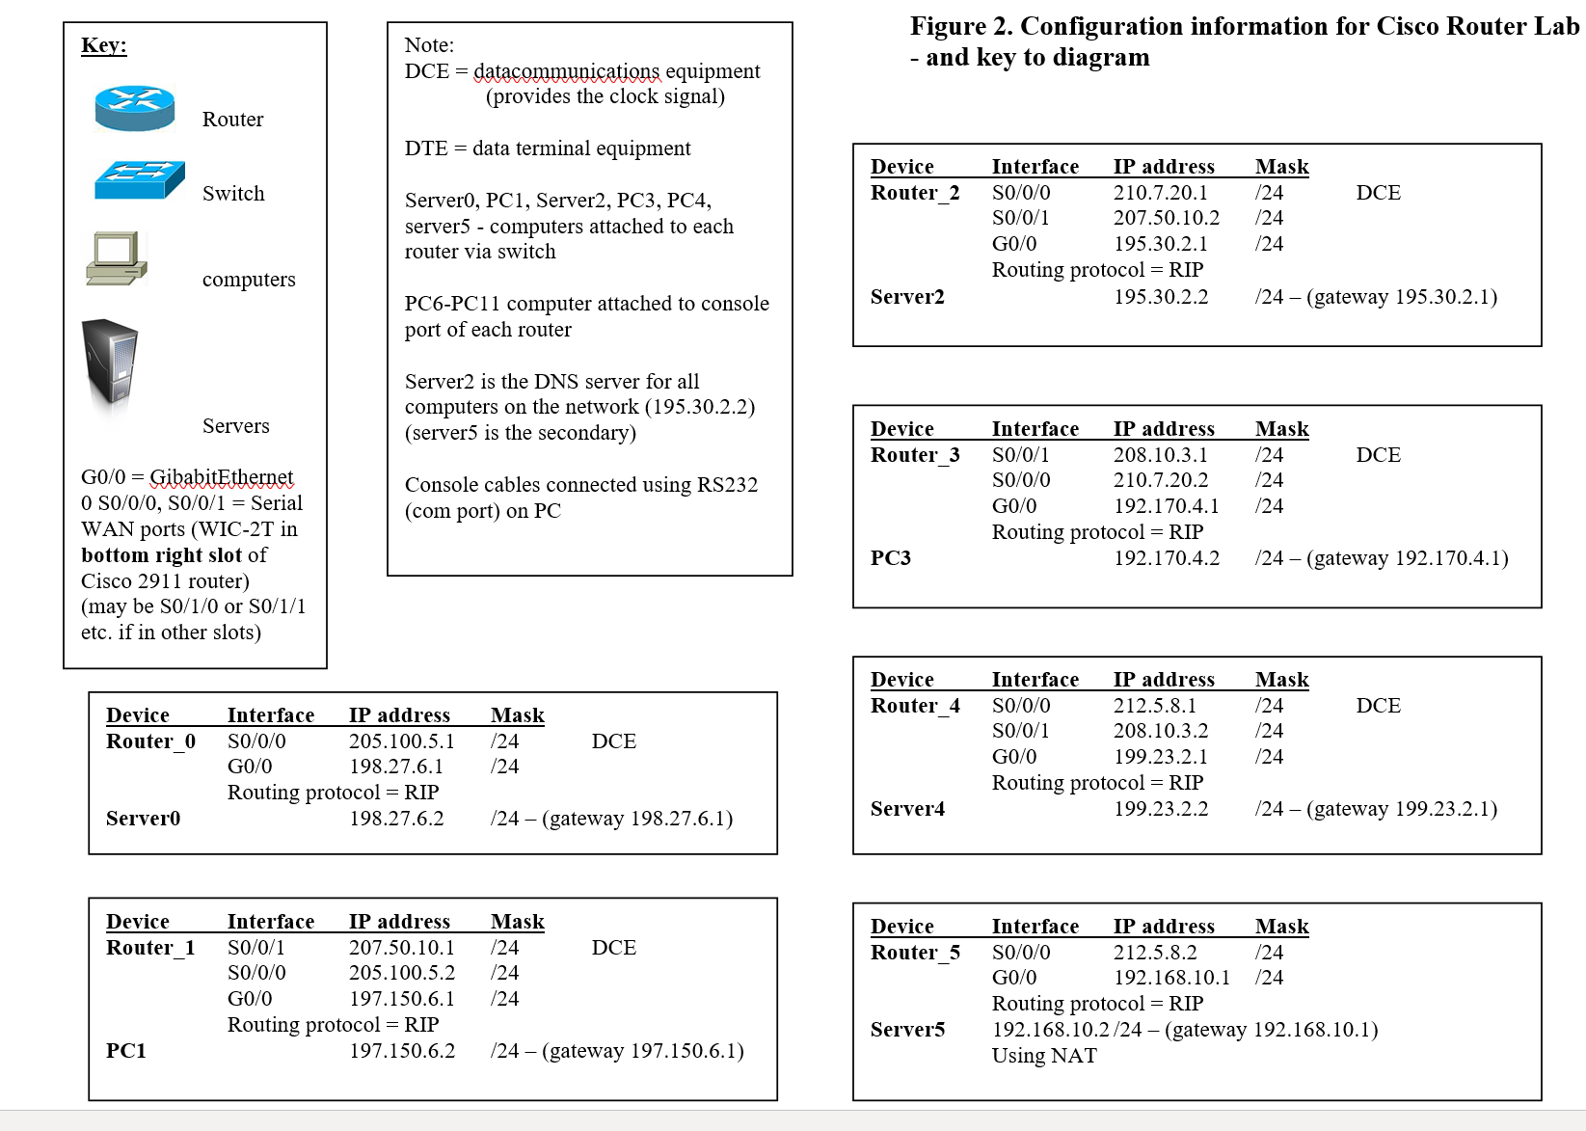
ACME Scenario – IP addressing

Slide 6
ACME Scenario - tasks
Your must decide:
1. How the sites will be interconnected using Cisco routers?
How each router will be cabled up and which router interfaces will be used at each site:
  to connect to the switches on each LAN
  to interconnect each router to the other sites
2. How each router will be configured using Cisco IOS commands:
  to configure the IP addresses of interfaces
  To bring up the interfaces
  To configure a clock rate at the DCE end of the WAN links
  To configure a dynamic routing protocol (eg. RIP or EIGRP)
Continued.....

Slide 7
ACME Scenario - tasks
Continued:
3. What will a diagram of the network look like and what servers will need to be connected to it?
  Sketch it with the servers:
  DNS, Web server, etc.
  At which site will they be hosted?
  How will you make the PCs at each site aware of them?
4. What type of routing will ACME use?
  Recommend static or dynamic
  If dynamic – which one?
  And why?
5. How will you troubleshoot the network?
  Which troubleshooting tools will you use & how will you use them?
  How do you look at a routing table?
  What information will you see in the routing tables?
  Present your results and recommendations for ACME

Slide 8
Any Questions?

Slide 9
Let’s start the work

