Slide 1
Networking Revision
Networks Configuration & Troubleshooting

Slide 2
Q. How do we configure an IP address?
easy!
Q. How do we configure an IP address correctly?

Slide 3
Static or Dynamic IP Addressing
Static
  Configured manually on each PC
  Administration overhead
  Easy to make mistakes
Dynamic
  A server automatically assign IP addresses to workstations
  The server is running the Dynamic Host Configuration Protocol (DHCP) – a DHCP Server
  Centrally assigned and administered
  Easy to configure
Note: with dynamic addressing IP address may change each time
Computer starts – so assign Servers with static IP address

Slide 4
How do we connect to the wider world?
need the address of a Router
    To route packets onto external networks
    So that we can communicate with them
and a DNS (Domain Name System) server
    To provide name resolution
    To enable us to enter a URL,
    eg. www.solent.ac.uk
    And returns an IP address that our web browser can use to find the web site

Slide 5
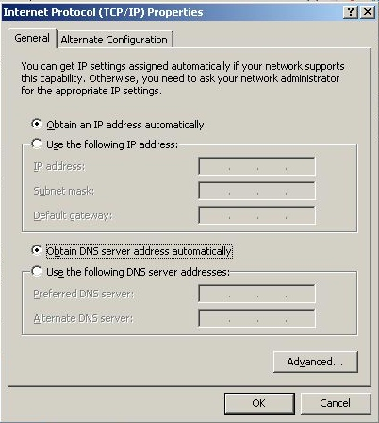
Using dynamic addressing
Can get:
IP address
Subnet mask
Router address
DNS server address
From a server running DHCP

Slide 6
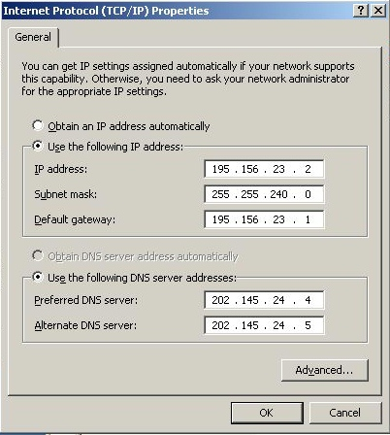
Static addressing
Information entered manually at the PC

Slide 7
Addressing information
IP address of this computer
Subnet mask – used to filter out network address
Default gateway – the address of a router to enable communication with other networks
DNS information:
Address of primary DNS server for name to IP address resolution
And a secondary DNS server in case the primary is unavailable

Slide 8
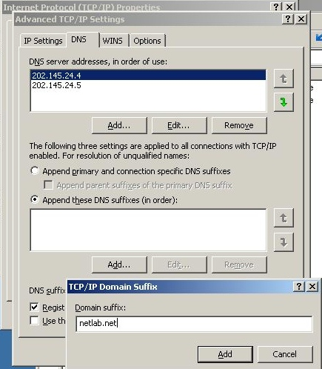
Advanced information
Such as a domain suffix for name resolution
Notes:
NetBIOS (Network Basic Input/Output System) is a program that allows applications on different computers to communicate within a local area network (LAN). It was created by IBM for its early PC Network, was adopted by Microsoft, and has since become a de facto industry standard.

Slide 9
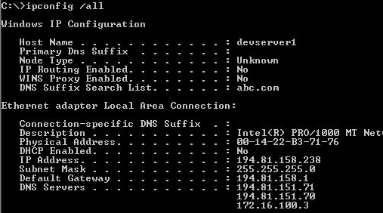
The IPCONFIG command allows information on IP address configuration to be checked
Notes:
WINS is a Microsoft NetBIOS Name Server (NBNS) that's still widely used in the industry. WINS provides a dynamic NetBIOS name to IP address database. It also interacts with the Browser Service, which assembles and provides the Browse List, or what's better known as Network Neighborhood

Slide 10
Using IPCONFIG for troubleshooting
Is the IP address correct?
  Is it static
  Or dynamic
    Was it obtained using DHCP?
    Or APIPA (169.254.x.x)
Is the subnet mask correct?
  Are we using subnetting or a default address class?
Is the router on the same network as this one – and is it correct?
Is the DNS server the correct one?
Notes:
APIPA: Automatic Private IP address.

Slide 11
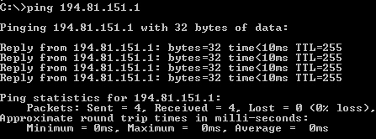
The PING command uses ICMP packets to test communication between computers (up to the network layer of the OSI model)

Slide 12

The NSLOOKUP command can test to see if the DNS server settings are configured correctly and whether a host exists on the network
- This one is a forward lookup query – name to IP resolution
Notes:
nslookup is a network administration command-line tool available for many computer operating systems for querying the Domain Name System (DNS) to obtain domain name or IP address mapping or for any other specific DNS record.

Slide 13

Reverse name resolution can also be test with NSLOOKUP – ie. the name that corresponds to a particular IP address

Slide 14
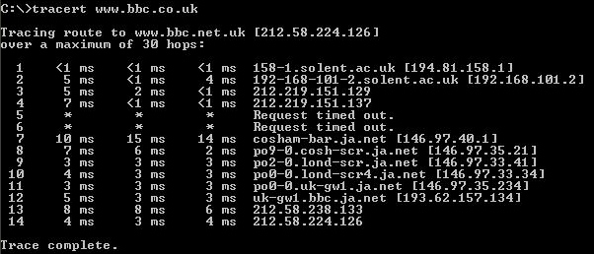
The TRACERT (or Traceroute) command enables you to trace the path taken by packets to a particular destination over a network such as the Internet – it shows the routers that the packet went through and the delayed experienced over each network segment
Read: https://www.inmotionhosting.com/support/website/ssh/read-traceroute/

Slide 15
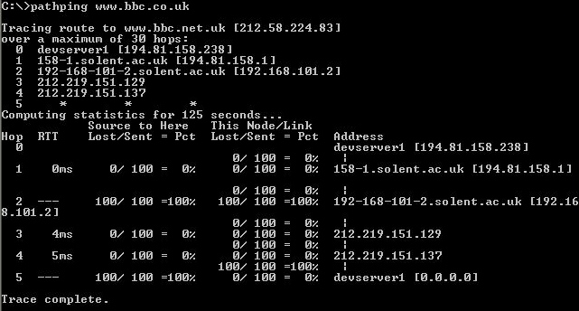
PATHPING performs a similar task to TRACERT, but shows packets lost on the path over a given time period

Slide 16

The ARP (Address Resolution Protocol)
operates at the Network layer to locate the MAC address for a given IP address
To enable communication between computer network interfaces at the Data Link layer
Uses a broadcast to locate the MAC address – stores result in memory
ARP –a command displays contents of ARP cache

Slide 17
Troubleshooting
PING
Use PING to see computers on our own network – ok?
On other networks – ok?
If we can see our network, but not others – what about the router?

Slide 18
Troubleshooting
TRACERT
If we cannot PING a computer on the Internet – where are we losing the connection?
Use TRACERT to find where the broken WAN link is!

Slide 19
Troubleshooting
PATHPING
We seem to be dropping packets on the WAN link!
Use PATHPING to see where they are being dropped

Slide 20
Troubleshooting
NSLOOKUP
Can we locate the FQDN of another computer?
No? – then can we PING it?
If we can PING it then check the DNS server and client configuration
Notes:
A fully qualified domain name (FQDN)

Slide 21
Troubleshooting
ARP
We cannot see another computer on our LAN in My Network Places
PING and then see if it appears in the ARP cache with ARP -a

Slide 22
IPCONFIG /ALL in Detail

Slide 23
Diagnostics: IPCONFIG /ALL
Hostname: Workstation1
Primary DNS suffix: NETLAB.NET
Node type: Broadcast
IP Routing Enabled: No
WINS Proxy Enabled: No
Ethernet adapter local area connection:
Connection specific DNS Suffix: NETLAB.NET
Description: Realtek RTL8139(A) PCI Fast Ethernet Adapter
Physical Address: 00-00-1C-D5-54-01
DHCP Enabled: Yes
Autoconfiguration Enabled: Yes
IP Address: 172.16.100.10
Subnet Mask: 255.240.0.0
Default Gateway: 172.16.100.1
DHCP Server: 172.16.100.2
DNS Server: 172.16.100.5

Slide 24
Hostname: the name of this computer.
Primary DNS suffix: the DNS suffix appended to the hostname.
Node type: this is the primary method by which NETBIOS name are resolved on this computer – this computer will use broadcasts to locate other computers on the network in preference to other methods (eg. LMHOSTS, WINS or DNS)
IP Routing Enabled: this interface is not used as a network router
WINS Proxy Enabled: a WINS proxy is a computer which can be elected to handle NETBIOS name resolution requests for non-Windows clients.

Slide 25
Ethernet adapter local area connection:
Connection specific DNS Suffix: this is the DNS domain suffix currently used by this connection – none has been configured
Description: this is the type of network interface card used for this connection – a PCI 100BaseTX
Adapter Physical Address: this is the physical or MAC address of the NIC (OSI data link layer address)– used by ARP to resolve the IP to MAC address
DHCP Enabled: whether the computer is configured for dynamic addressing & should receive its IP address automatically from a DHCP server (along with other options such as DNS server, etc.).

Slide 26
Autoconfiguration Enabled: whether this computer is configured to automatically receive its IP address, rather than use static addressing.
IP Address: this is the IP address allocated to this network interface card. (OSI network layer)
- either static or dynamic by DHCP or APIPA (note: if no DHCP server then address obtained by APIPA from Microsoft’s 169.254 private IP range)
Subnet Mask: this identifies which part of the IP address belongs to the network and which to the.
Default Gateway: if the network is routed to another network then this would be the address of the router or gateway.

Slide 27
Using IPCONFIG to Renew a DHCP Lease
Use IPCONFIG /RENEW to send a DHCPREQUEST message to the DHCP server to receive updated options and lease time. If the DHCP server is unavailable, the client continues using the current DHCP- supplied configuration options.
Using IPCONFIG to Release a Lease
Use IPCONFIG /RELEASE to cause a DHCP client to send a DHCPRELEASE message to the DHCP server and to release its lease. You can then renew it.
Ipconfig /all – to check configuration of address and options
Using IPCONFIG to flush the local DNS Cache:
IPCONFIG /FLUSHDNS

