Slide 1
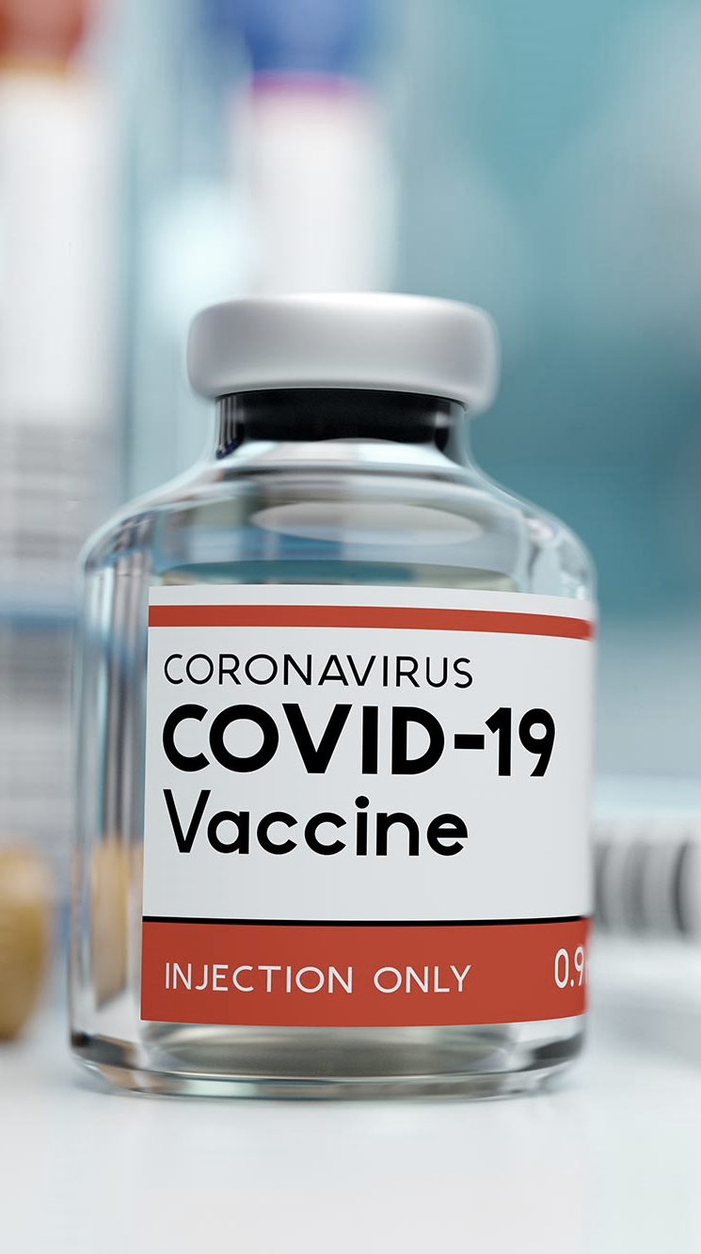
COVID-19 Who should get the vaccine first?
Team 1
Harry Feldman
Jessica Pardo
Charles Philpott
Alex Jones

Slide 2
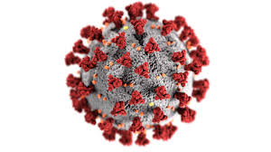
Motivation
COVID-19 (Coronavirus disease 2019) is a contagious disease that affected over 72 Million people over the world. In the United States, 16.4 Million have contracted COVID-19 disease and caused the death of 300 thousand people. Several Pharmaceutical companies are working on developing a vaccine for COVID-19 and once available, it will be limited to a target population. The big question is who should get the vaccine first?
The objective of our group project will be to determine who the initial recipients of the COVID-19 vaccine should be.

Slide 3


Data Source
The datasets utilized for this analysis are sourced from cdc.gov and healthdata.gov.
COVID-19 Case Surveillance Public Use Data Profile
Hospital Capacity Data
Conditions contributing to deaths involving coronavirus disease

Slide 4
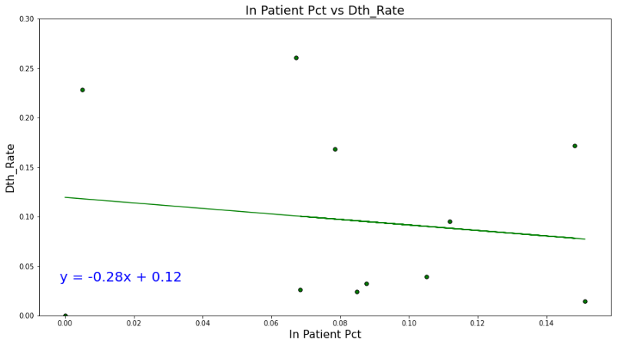
Is there a relationship between the COVID-19 admittances /hospital in-patient capacity ratio to COVID mortality rates?

Slide 5
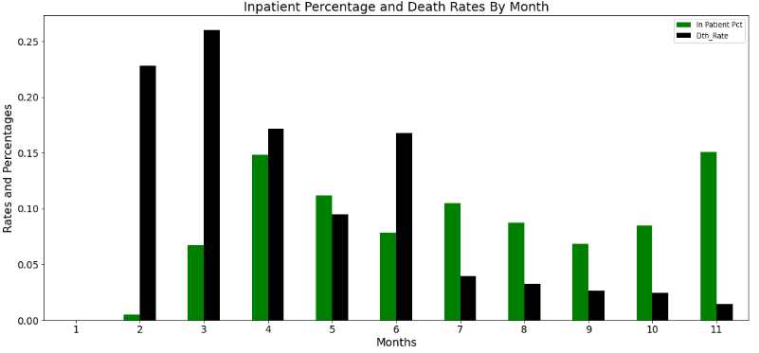
What trends in mortality rates and Covid Admittances were observed by month?

Slide 6
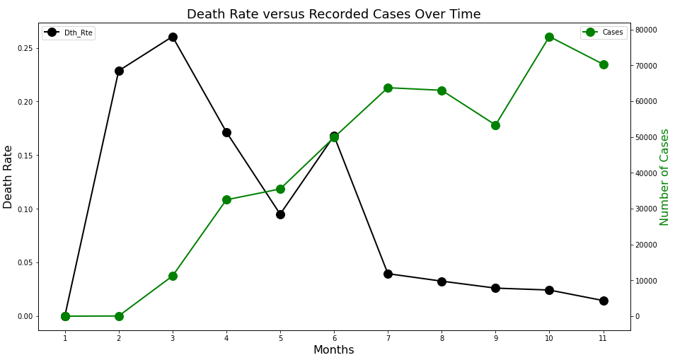
What trending in case occurrence was observed by month?

Slide 7
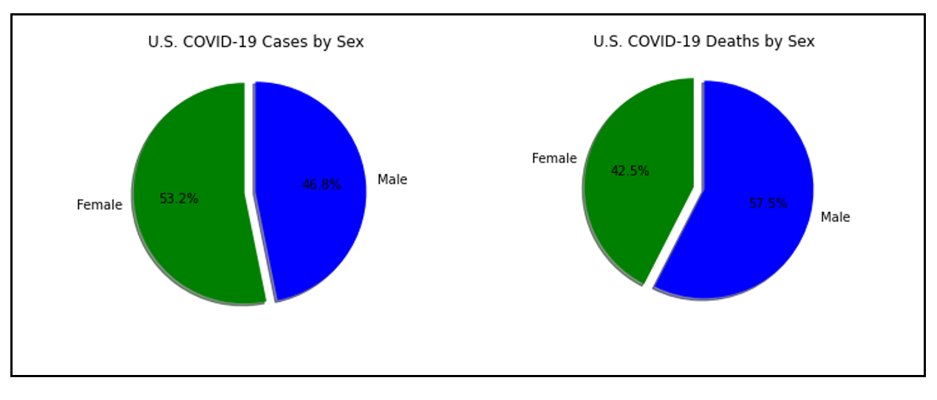
Are more men dying from COVID-19 than women?
The ratio of COVID-19 by sex mortality rate shows that men has 1.4 chances of dying compared to women.
For every 10 deaths among confirmed cases in women, there are 14 death in men.

Slide 8
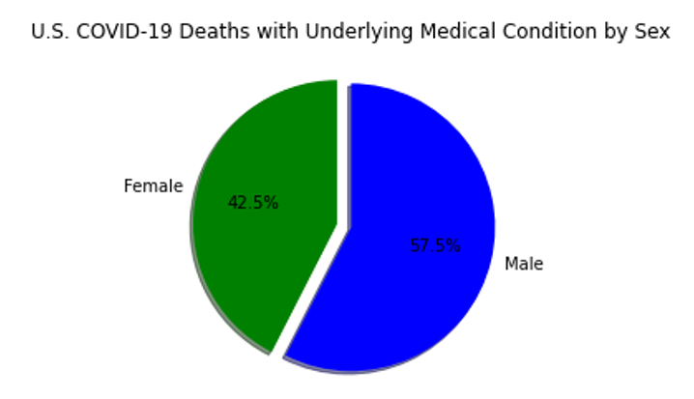
Are more men dying from COVID-19 than women?
Possible Risk Factors

Slide 9
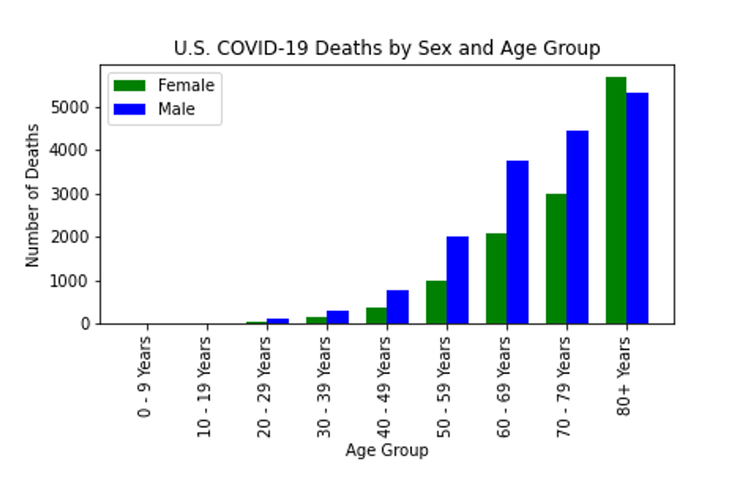
Are more men dying from COVID-19 than women?
Possible Risk Factors

Slide 10
Are more men dying from COVID-19 than women?
Possible Risk Factors
“Women also live on average six years longer than men, so there are more elderly women than men in the vulnerable population”(*)
(*)https://www.sciencealert.com/geneticist-explains-why-more-men-are-dying-from-covid-19-than-women

Slide 11
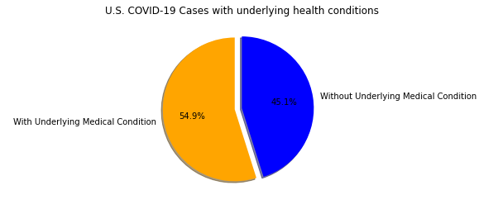
Are people with underlying health conditions at a higher risk of having serious symptoms of COVID-19?

Slide 12
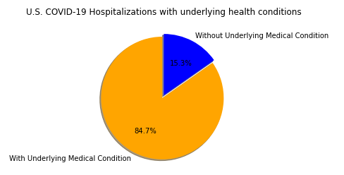
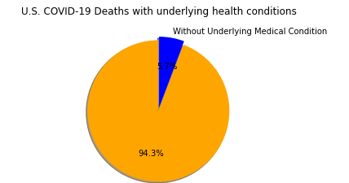
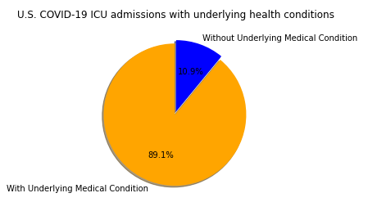
Are people with underlying health conditions at a higher risk of having serious symptoms of COVID-19?

Slide 13
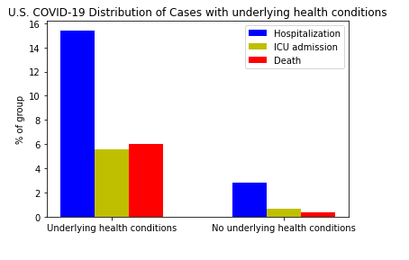
Are people with underlying health conditions at a higher risk of having serious symptoms of COVID-19?
COVID-19 patients with an underlying medical condition are 5.5 times as likely to be hospitalized.
COVID-19 patients with an underlying medical condition are 8.1 times as likely to be ICU admitted.
COVID-19 patients with an underlying medical condition are 8.1 times as likely to die.

Slide 14
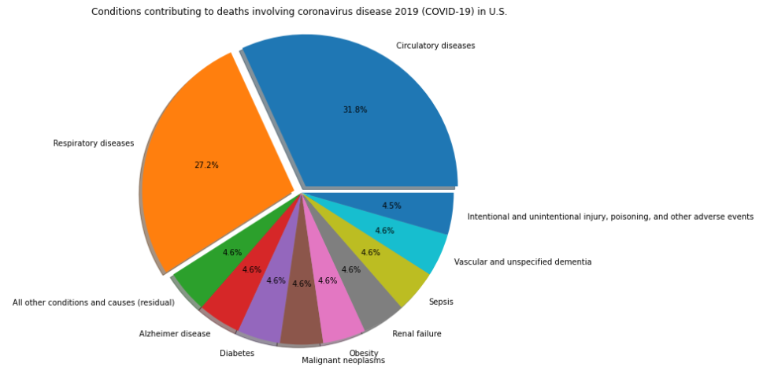
Are people with underlying health conditions at a higher risk of having serious symptoms of COVID-19?

Slide 15
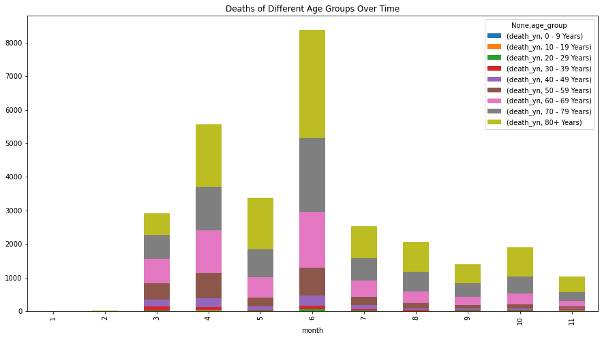
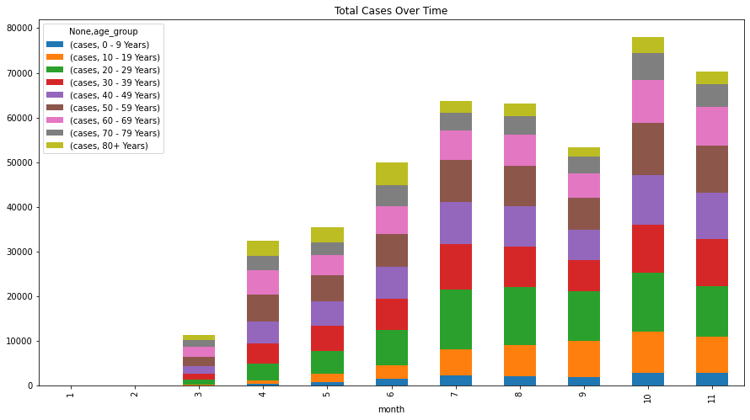
Does the date of the first positive effect need for the vaccine?

Slide 16
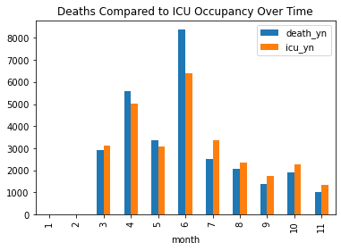
Inpatient Occupancy

Slide 17
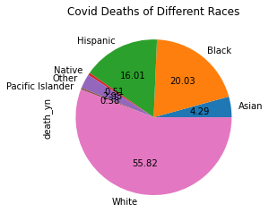
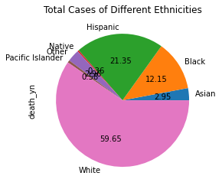
Is ethnicity a factor?

Slide 18
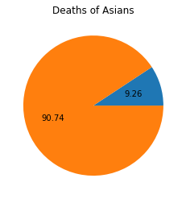
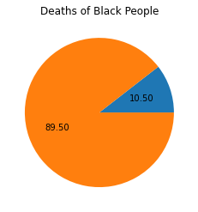
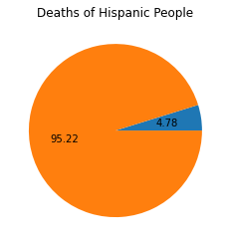
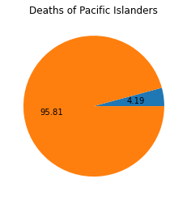
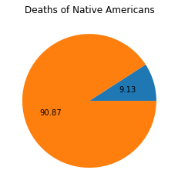
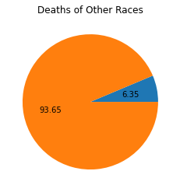
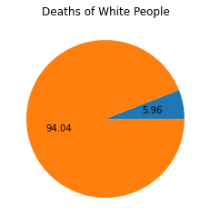
Digging deeper...

Slide 19
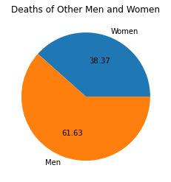
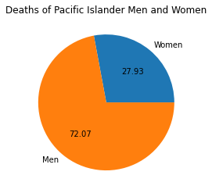
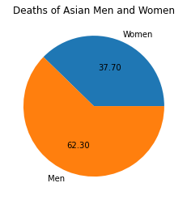
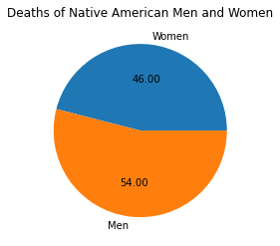
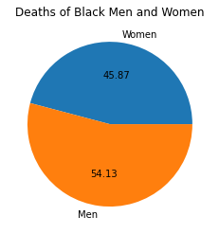
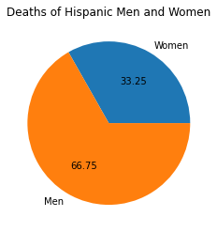
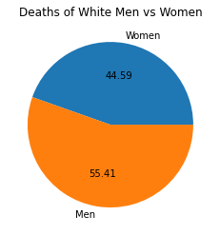
Gender and Ethnicity

Slide 20
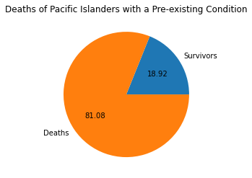
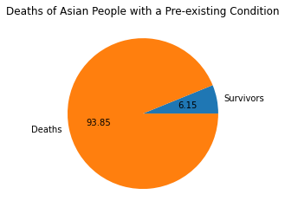
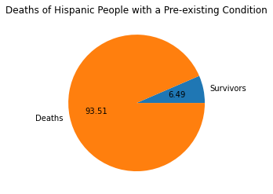

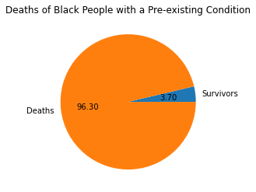
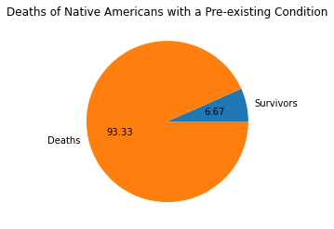

Pre-existing condition

Slide 21
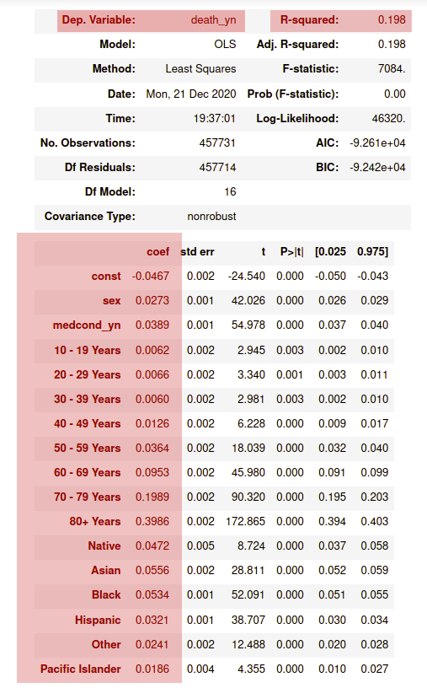
Can Mortality be Quantified?
Putting it all together with
multiple linear regression

Slide 22
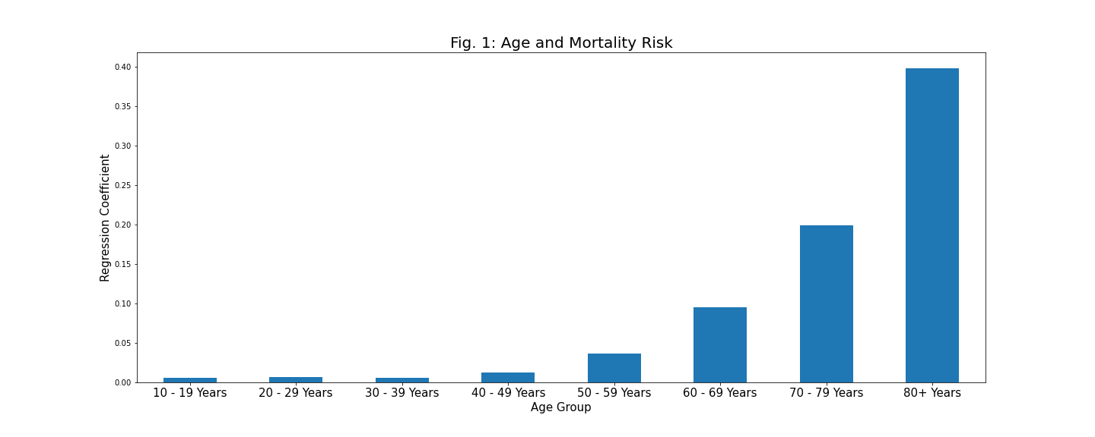
Age
The first (obvious) finding

Slide 23
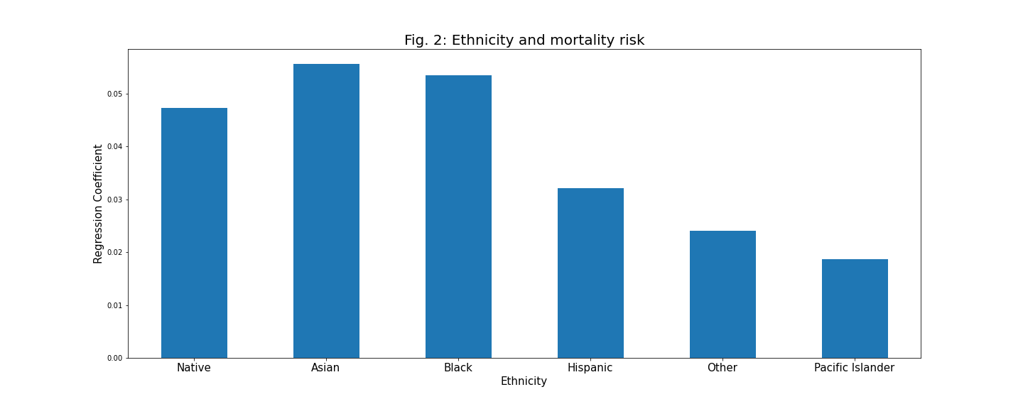
Verifying our Suspicions

Slide 24
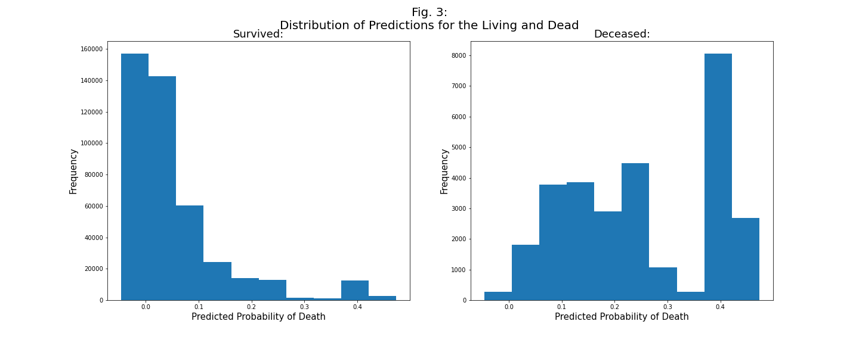
Predictive Quality

Slide 25
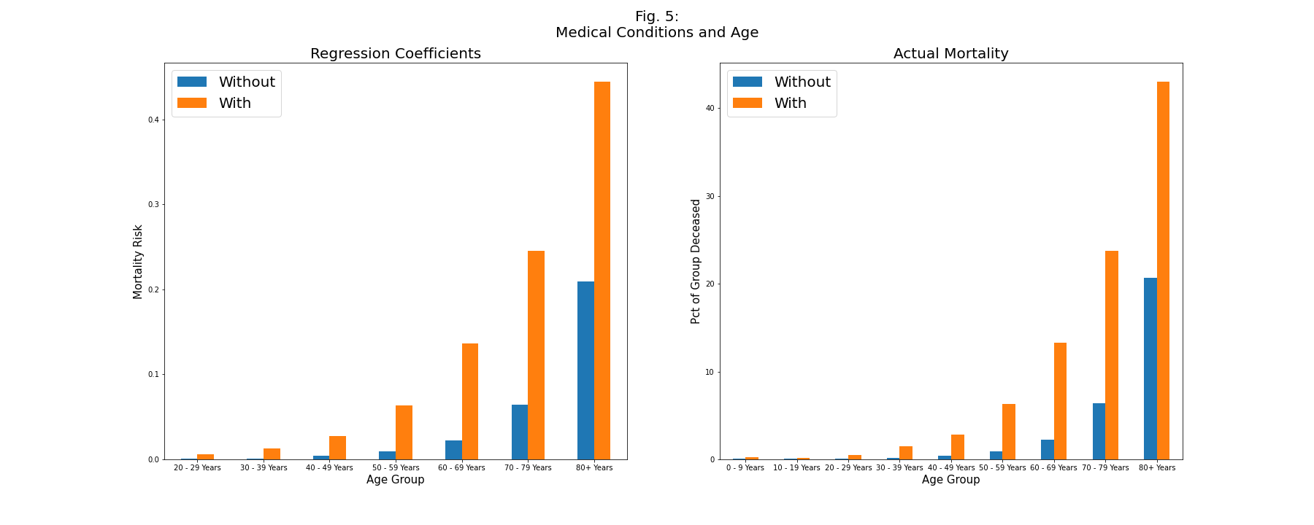
Diving Deeper
Why did we get such a small coefficient for medcond_yn?

Slide 26
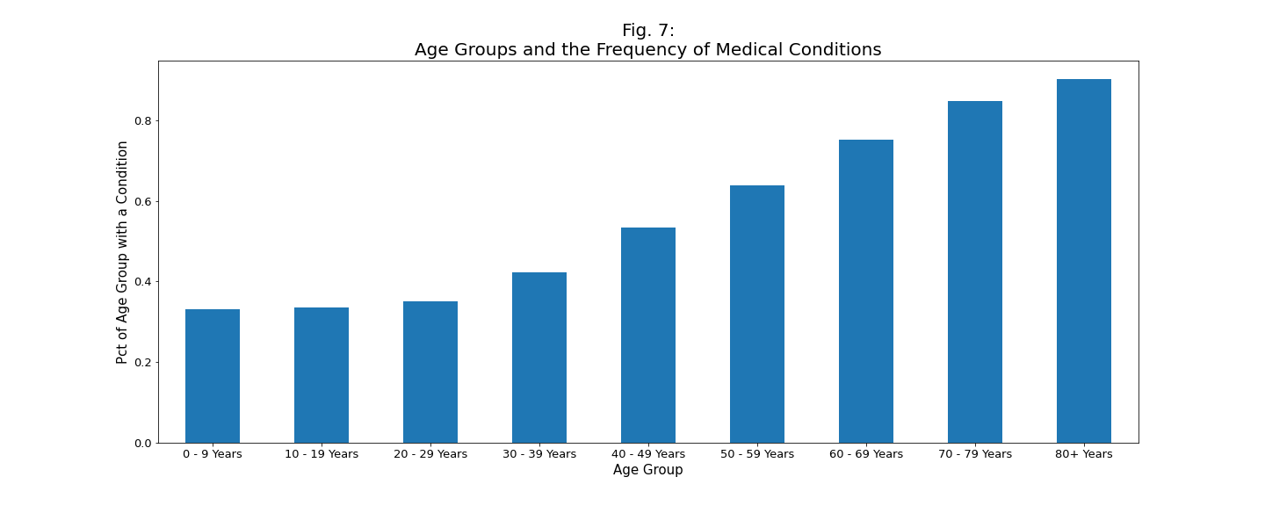
Medical Conditions, Age, and Bias

Slide 27
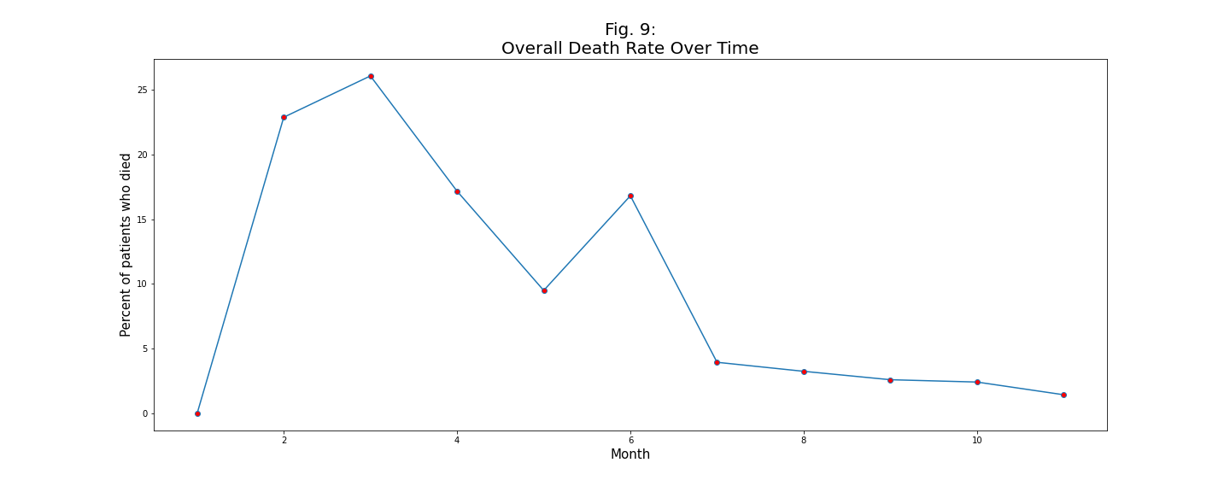
Model Respecification
Time Fixed Effects

Slide 28
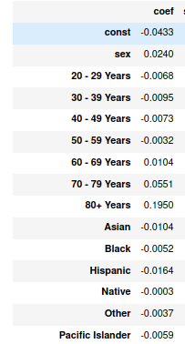
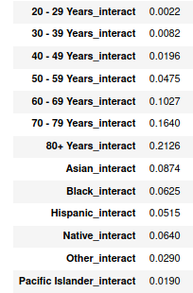
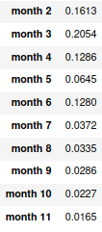
Regression results

Slide 29
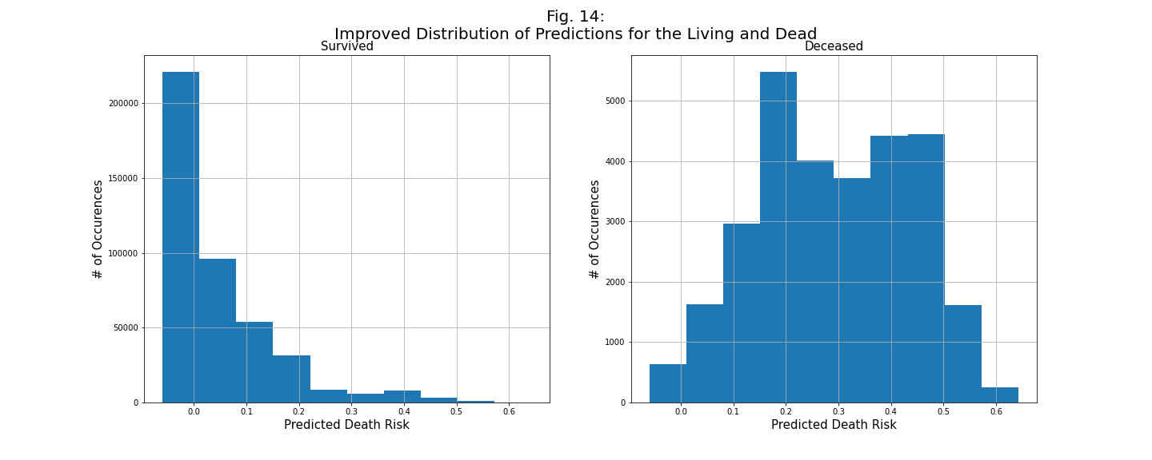
Improved Predictive Quality

