Slide 1

Weekly Fantasy Football Contest Data
Hugh Goode

Slide 2
What is Fantasy Football?
Contests on weekly basis
Pay entry fee to join a contest
Each player drafts a team of NFL players (Example: 1 QB, 2 RB, 3 WR, 1 TE, 1 Flex)
Each NFL player assigned a salary. Team salary cannot exceed budget
Players record points by the accrual of game statistics during NFL games
Team with most points wins

Slide 3
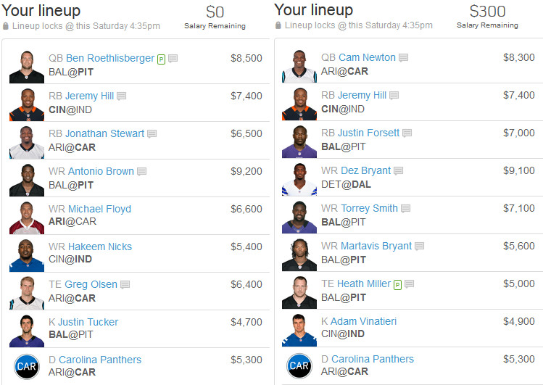

Slide 4
Market
Estimated 59 million fantasy sports players in US & Canada
40 million for fantasy football
Estimated $18.6 billion market
FanDuel – Market Share Leader
$363 million in VC raised
1,000 employees
Estimated to pay out over $2 billion in winnings this year
Sources: https://www.sportsmanagementdegreehub.com/fantasy-football-industry/, https://appinventiv.com/blog/online-fantasy-sports-platform-changing-sports-industry/

Slide 5
Dataset
Source: http://rotoguru1.com
Data from 2017 to present day
Data for individual NFL Player ‘virtual salary’ and total fantasy points organized weekly
Platforms: FanDuel, DraftKings, and Yahoo Sports

Slide 6
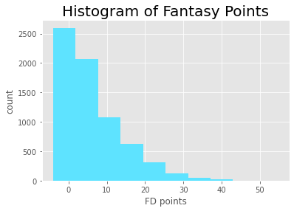
Data Exploration for Trends
 | DK points |  | FD points |  | YH points
 | mean | std | mean | std | mean | std
Pos
Def | 5.96 | 5.73 | 6.00 | 5.74 | 5.96 | 5.73
QB | 16.05 | 10.71 | 15.22 | 9.95 | 15.22 | 9.95
RB | 6.96 | 8.30 | 6.07 | 7.38 | 6.07 | 7.38
TE | 4.53 | 6.06 | 3.63 | 5.00 | 3.63 | 5.00
WR | 7.80 | 8.58 | 6.20 | 6.93 | 6.20 | 6.93

Slide 7
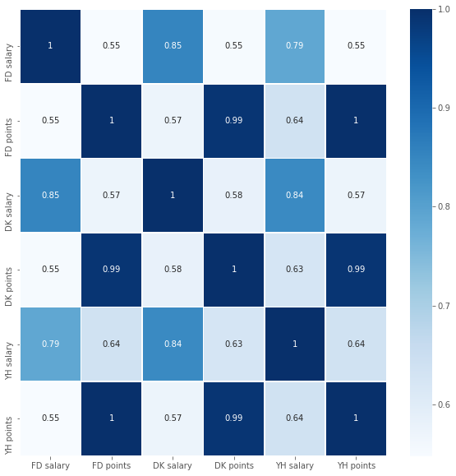

Slide 8
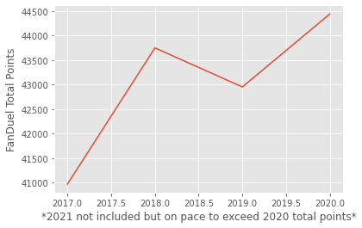
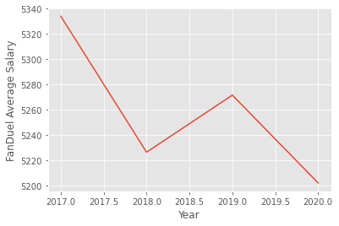
Total Fantasy Points per Year and Average Player Salary

Slide 9
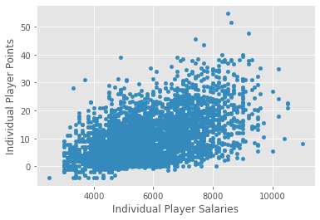
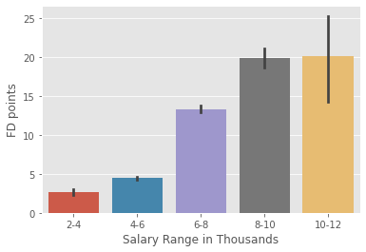
Salary Classification vs Points – 2020 Season

Slide 10
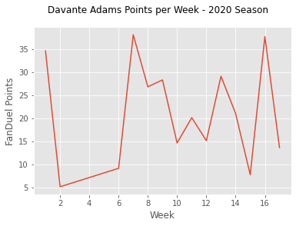
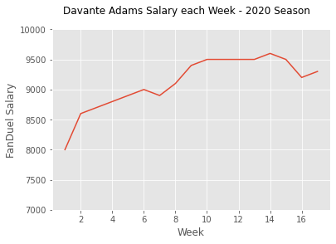
Single Player Performance Over Time

Slide 11
Highest Value = Lowest Cost per Point
Name | Pos | FanDuel Salary | Cumulative Points | Games Played | Average Points (Projection for Future Performance) | Cost per Point | Value Rank
Brown, Marquise | WR | $6,800 | 89.6 | 5 | 17.92 | $379.46 | 1
Williams, Mike | WR | $7,700 | 100.6 | 5 | 20.12 | $382.70 | 2
Samuel, Deebo | WR | $7,700 | 94.5 | 5 | 18.9 | $407.41 | 3
Kupp, Cooper | WR | $8,400 | 100.3 | 5 | 20.06 | $418.74 | 4
Chase, Ja'Marr | WR | $7,300 | 86.9 | 5 | 17.38 | $420.02 | 5
Brown, Antonio | WR | $6,500 | 61.1 | 4 | 15.275 | $425.53 | 6
Hill, Tyreek | WR | $8,500 | 96.6 | 5 | 19.32 | $439.96 | 7
Evans, Mike | WR | $7,000 | 77.8 | 5 | 15.56 | $449.87 | 8
Adams, Davante | WR | $8,200 | 90.9 | 5 | 18.18 | $451.05 | 9
Metcalf, D.K. | WR | $7,400 | 80.8 | 5 | 16.16 | $457.92 | 10

Slide 12
Future Work & Next Steps
Create an app that can randomly generate lineups
Web scrape salary data for future weeks to make value calculations more accurate
Fill lineups with only my “highest value” players at each position
Select lineup with highest projected points
Evaluate success over time

Slide 13
Questions?

