Slide 1
Weekly Fantasy Football Contest Data
Hugh Goode

Slide 2
What is Fantasy Football?
Contests on weekly basis
Each player drafts a team of NFL players (Example: 1 QB, 2 RB, 3 WR, 1 TE, 1 Flex)
Each NFL player assigned a salary. Team salary cannot exceed budget
Players record points by the accrual of game statistics during NFL games
Team with most points wins

Slide 3
Market
Estimated 59 million fantasy sports players in US & Canada
40 million for fantasy football
$18.6 billion market
FanDuel
$363 million in VC raised
1,000 employees
Estimated to pay out over $2 billion in winnings this year
Sources: https://www.sportsmanagementdegreehub.com/fantasy-football-industry/, https://appinventiv.com/blog/online-fantasy-sports-platform-changing-sports-industry/

Slide 4
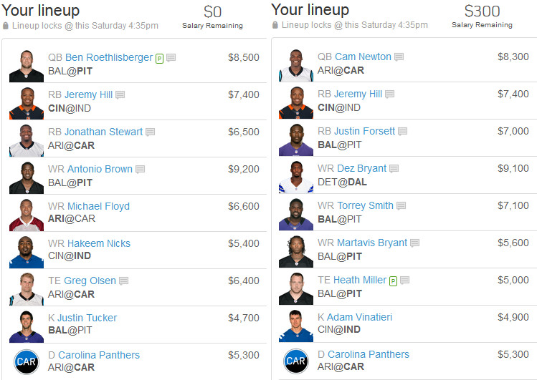

Slide 5
Dataset
Source: http://rotoguru1.com/cgi-bin/fyday.pl?game=fd
Columns: Week, Year, Player Name, Position, Weekly Fantasy Point Total (FanDuel), Weekly Salary (FanDuel), Weekly Fantasy Point Total (DraftKings), Weekly Salary (DraftKings), Weekly Fantasy Point Total (Yahoo Sports), Weekly Salary (Yahoo Sports)
Insert Sample Image

Slide 6
Data Exploration for Trends

Slide 7
Projections for Player Value and Lineup Optimization

Slide 8
Questions

