Slide 1
scenario one

Slide 2
Scenario one – PART 1
1.1 )
Total Sales = $ 2B
Promotion Impacted Sales (in percentage) = 35 %
Promotion Impacted Sales (in revenue) = 35 % of ($ 2B) = $ 700M
Calculating total promotion impacted sales through each channel :
Priority of channels will be decided by this column. More the revenue per unit cost, higher the priority. Therefore priority : 1. Website 2. TV ads Decreasing priority 3. Print Ads 4. Social Media 5. Events Answer 1.1 : (in order of decreasing priority) 1. Website Display 2. TV ads 3. Print ads 4. Social Media 5. Events
Shows cost effectiveness
Channel | %Sales due to channel | Revenue due to channel (%sales* total promotion impacted sales) | Cost per unit activity | Historical Activity | Total Cost (cost per unit activity * historical activity) | Revenue per unit cost (revenue due to channel / total cost)
TV ads | 35 | $ 245M | 300x | 1100 | 330000x | 742.42
Print ads | 25 | $ 175M | 200x | 1200 | 240000x | 729.16
Website | 17 | $ 119M | 1.5x | 100,000 | 150000x | 793.33
Social Media | 15 | $ 105M | 1x | 160,000 | 160000x | 656.25
Events | 8 | $ 56M | 1500x | 100 | 150000x | 373.33

Slide 3
Shows combined effect of cost effectiveness and market research i.e. accessibility and popularity
1.2 )
Now continuing from the table on previous slide :
Priority of channels on basis of combined effect will be decided by this column. More the combined effect, higher the priority. Therefore priority : 1. Social Media 2. TV ads Decreasing priority 3. Website 4. Print ads 5. Events
Answer 1.2 (a): (in order of decreasing priority) 1. Social Media 2. TV ads 3. Website Display
Channel | Revenue per unit cost | Access Ratio (access rating / max possible access rating) | Popularity Ratio (popularity rating/ max possible popularity rating) | Likeable metrics (access rating * popularity rating) | Combined Effect (revenue per unit cost * likeable metrics)
TV ads | 742.42 | 8/10 | 7/10 | 0.56 | 415.75
Print ads | 729.16 | 6/10 | 5/10 | 0.30 | 218.74
Website | 793.33 | 9/10 | 4/10 | 0.36 | 285.59
Social Media | 656.25 | 10/10 | 9/10 | 0.90 | 590.69
Events | 373.33 | 4/10 | 3/10 | 0.12 | 44.79
As only top three are to be selected

Slide 4
Answer 1.2 (b) : Strategies to keep in mind for : 1. Social Media: Since social media has perfect accessibility rating(10/10) as well as near perfect popularity rating (9/10), content should be relatable to a wide range of audience so that everyone interacting with it can feel a sense of connectivity with the content. Content should be moderated as high popularity and high accessibility means that features and interests of audience can vary significantly. Overall generalized content will be perfect for this channel. 2. TV ads : Since TV has high accessibility rating (8/10) and a decent popularity rating (7/10), content should be made focusing to increase both metrics to a higher level. So based on this, content should be made interesting and more engaging to the audience. 3. Website Display: Website display has a near perfect access rating(9/10) but a poor popularity rating (4/10) which shows that audience is not finding the ads attractive enough to engage with it. So ads should be made more attractive in order to increase engagement and content should be generalized for a wide range of audeince due to high accessibility rate.

Slide 5
Scenario one – PART 2
2.1 ) Total Yearly sales = $ 2B Assuming each customer in the same region spends same amount on average MAXIMUM OPPORTUNITY Answer 2.1: Maximum opportunity region for investing is REGION 3
Region | Yearly Sales (%) | Yearly Sales (revenue) (yearly sales % * total yearly sales) | Market Share (%) | Total Market (yearly sales (revenue) * 100 / market share) | Untapped or remaining market cap (total – yearly sales (revenue)) | Total Relevant population | Customers | % Customers (customers / relevant population) | % non –customers (100 - %customers)
1 | 40 | $ 800M | 63% | $1269.84 M | $ 469.84 M | 54230 | 34707 | 64% | 36%
2 | 28 | $ 560M | 84% | $ 666.66 M | $ 106.66 M | 92800 | 36192 | 39% | 61%
3 | 32 | $ 640M | 60% | $ 1066.6 M | $ 426.66 M | 86400 | 29376 | 34% | 66%
Denotes the opportunity to increase revenue in the region
Region | Average per person spend (yearly sales (revenue) / customers) ($ M/ person) | Opportunity (% non-customers * per person spend * untapped market)
1 | 0.02305 | 389.873
2 | 0.01547 | 100.651
3 | 0.02178 | 613.315

Slide 6
2.2 ) Based upon the customer engagement data for different customer segments, we applied the multiple linear regression model to find out the relationship between dependent binary variable (0 - not engaged / 1- engaged) and the independent variables (‘aired during’, ‘time of ad’, ‘length of ad’, ‘upbeat music’). Below are the calculated coefficients for each of the independent variables (after converting strings to dummy variables) : Now predicting the value of dependent variable using the trained regression model, we find out the value of the dependent variable for all customer segments, each time for remaining three cases : Since this advertisement engages every segment of customers, this will be aired broadly.
 | Aired During | Time of Ad | Length of Ad | Upbeat Music
S1 | 0.1143 | -0.2216 | -0.0057 | -0.378
S2 | -0.1415 | -0.9925 | -0.0006 | -0.054
S3 | -0.0030 | -0.2631 | -0.0032 | 0.4838
S4 | -0.5608 | -0.4549 | -0.007 | -0.230
Aired During | Time of Ad | Length | Upbeat Music | S1 | S2 | S3 | S4
Movie | 5:00-7:00 pm | 120 | No | 1 | 0 | 1 | 0
Sports event | 5:00-7:00 pm | 90 | Yes | 1 | 1 | 1 | 1
Cartoon | 10:00-11:59 pm | 90 | No | 0 | 0 | 0 | 1

Slide 7
Answer 2.3 ) Promotional Strategies: Type of Product : Promotion must be targeted glorifying the health benefits of our product due to covid. Smaller quantity of bottles must also be available for consumption due to decrease in earnings of general public.
Channels for promotion : Since ads aired during sports events generate the highest amount of engagement with all the customer segments, it should be used as the primary channel for promotion. Also assuming, TV shows and movies have become more popular due to Covid, these can also be used to engage the audience.
Segment for customers : S2 and S3 customer segments display high engagement towards sports ad, so these can be targeted using the sports ads. S1 customer segment is more engaged towards short duration ads therefore they can be targeted using shorter yet crisper version of the advertisement. Content and messaging : Since after covid, most of the people have become more health conscious, making sure our audience and customer feel safe while consuming our product is of utmost importance. Messaging and content should be targeted towards adult audience more so ever since they understand the significance of health and then only they will allow their knowns to consume our product.

Slide 8
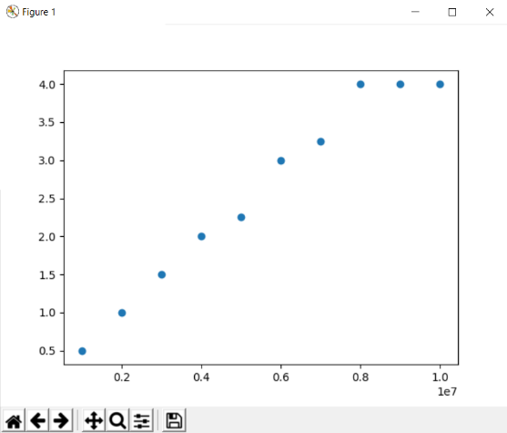
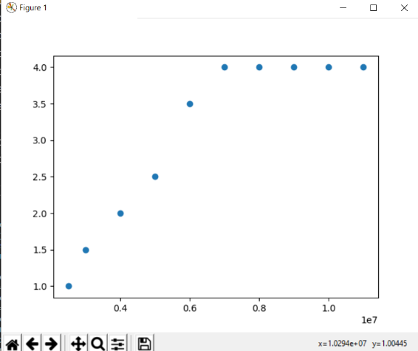
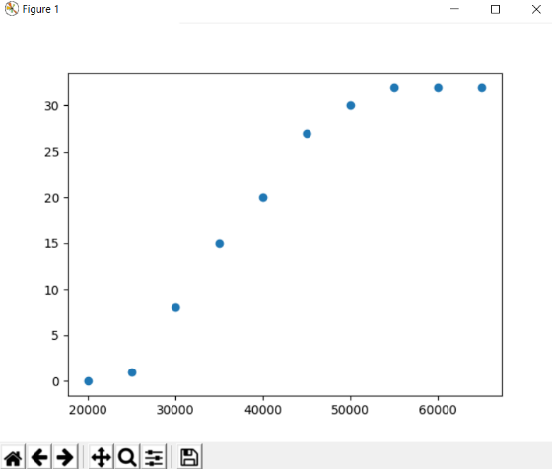
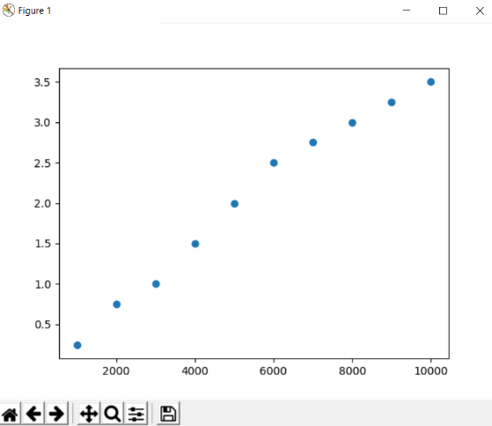
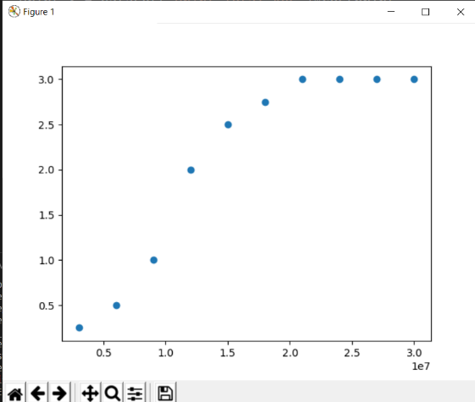
Scenario one – PART 3
Plotting the data of sales revenue v/s cost of printing ad, we get nearly linear relationship between these variables for every type of channel (ignoring those coordinates where equal sales revenue for last few coordinates since they will contribute to optimality): TV PRINT WEB SOCIAL As you can see in every type of channel, there is a linear relationship present b/w between the sales revenue per cost of ad. Higher the slope of the line, more the sales revenue generated for every dollar spent in ads for channel. Therefore, finding the slope for each channel in next slide. EVENT

Slide 9
Therefore, top three cost optimal channels are (decreasing priority): 1. Web 2. Print ads 3. TV ads In order to find out the optimal spend on these three channels, we have : 1. (No. of web display ads) * cost of one web display ad + (No. of Print ads) * cost of one print ad + (No. of TV ads) * cost of one TV ad = total promotional spend = $ 50 M 2. Maximize : (No. of web display ads) * (slope of web graph) + (No. of Print ads) * (slope of print graph) + (No. of TV ads) * (slope of TV ads) So this is a linear programming problem with these given conditions and maximizing target.
Channel | Average Slope
TV | 4.821
Print | 6.602
Web | 10.2619
Social Media | 3.696
Event | 1.696

Slide 10
Finding optimal solution for the given LPP, we get the optimal solution as: Optimal Solution : no. of website display ads = 225,000 no. of print ads = 150 no. of TV ads = 80 Finding total promotional spend for this configuration = ( 225,000 * 200 ) + (150 *20,000) + (80 *25000)
= $ 45 M + $ 3 M + $ 2M = $ 50 M Finding sales revenue for this configuration = ( 27M * 10 ) + (1M *10) + (1.5M *10) = $ 295 M Answer for 3.1 ) Optimal Promotional Spend for Website Display : $ 45 M Optimal Promotional Spend for Print ads: $ 3 M Optimal Promotional Spend for TV ads : $ 2 M
3.2) Finding global maximum for the LPP, we get the global maximum solution as: Global Maximum Solution : no. of website display ads = 250,000 no. of print ads = 0 no. of TV ads = 0

Slide 11
Therefore, Maximum revenue possible using $ 50 M promotional budget = 30 M * 10 = $ 300 M Answer 3.2 ) Maximum revenue possible = $ 300 M
Answer 3.3) Since maximum revenue possible increases by $ 5 million dollars, when only website display ads are aired, we should change the promotion strategy. Therefore most optimal strategy is when we display ONLY website ads of amount 250,000 impressions (and no other ads) which will generate max profit of $ 300 M with the promotional cost of $50 M

Slide 12
THANK YOU! ☺

