Slide 1
A-SYNC Protocol Family Evolution_x000B_and FLOPs-Normalized Comparison
Alternating Optimization for LLM Post-Training — Weekly Progress Report
2026/07/23–24 | 7 commits | 2 GPU experiments | 3 docs | 10 figures

Slide 2
This Week's Overview
7 commits, 3 major deliverables
1. 双语文档交付: EN+ZH A-SYNC 变体报告 (456KB+529KB PDF)
2. 基础理论文档: 残差放大 (rho=1.08) 因果推导 + A-SYNC 12变体分类与修复策略
3. FLOPs归一化实验: A-SYNC CONSTANT vs AdamW vs LoRA on OPT-125m
关键数字:
. 6 commits pushed to github.com/hjiang555-a11y + gingersea
. 10 张新图表 (3 extra for this PPT)
. ~7000 字技术文档 (中英双语)
. A-SYNC CONSTANT 48c: OPT-125m PPL 2246->60.7 | Qwen7B PPL 58.8->7.6
. LoRA AdamW r=8: PPL 37.3 at only 0.013 TFLOPs (70x less compute!)

Slide 3
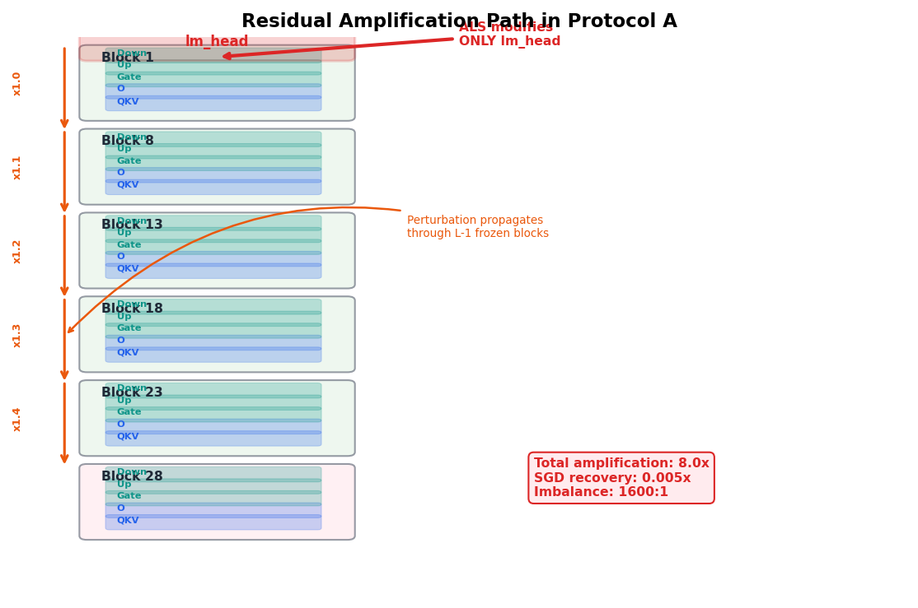
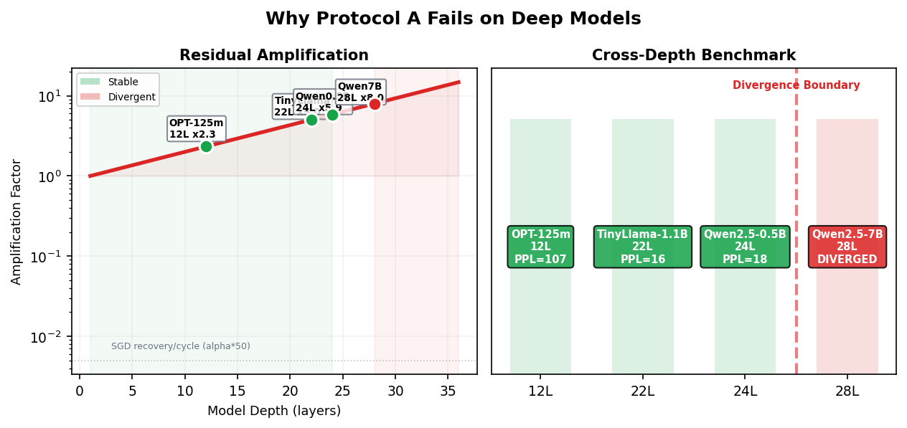
Protocol A: Module-Level Algorithm Breakdown
What algorithm does each module use? Why does it diverge?
Protocol A (ASP) = ALS + SGD + Perturb — three-phase alternating
Module 1: lm_head (output projection, 125M params)
Algorithm: ALS (Alternating Least Squares)
Operation: block-wise closed-form L2 solve on lm_head
W_new = argmin ‖X W^T − Y_target‖²
Property: one-step block-optimal, unaware of cross-layer coupling
Problem: modifying lm_head shifts ALL downstream activations
Module 2: Transformer body (24 layers, attn + FFN)
Algorithm: SGD (stochastic gradient descent, lr=1e-4)
Operation: standard fwd+bwd, update all body params
Property: attempts to digest ALS-induced distribution shift
Problem: 50 SGD steps far from enough (need ~150+)
Module 3: Full parameter space (lm_head + body)
Algorithm: Perturbation (Gaussian noise, scale=1e-3)
Operation: inject random noise into ALL parameters
Purpose: encourage flat minima (implicit SAM)
Problem: further destabilizes on deep models

Slide 4
Why does Protocol A diverge at ≥28 layers?
Residual Amplification: Causal Intervention → Exponential Collapse
Step 1: ALS performs a hard intervention on lm_head
do(θ_lm := θ_ALS) — Pearl do-calculus
Severs incoming edge, replaces params with L2 closed-form
Step 2: Intervention deviation propagates through residual stream
Define δ = h_ALS − h_original
Each layer: h_{l+1} = h_l + f_l(h_l)
δ_{l+1} = (I + J_l) · δ_l
J_l = Jacobian of layer l
Step 3: Cascaded amplification
‖δ_L‖ = ‖δ_0‖ · Π(I+J_l)
= ‖δ_0‖ · ρ^{L−1}
ρ = 1.08 (cross-layer geometric mean, 4 model families)
Step 4: Critical layer count
1.08²⁷ = 8.0× amplification
SGD recovery per cycle ≈ 0.005 PPL
Asymmetry: 1600:1 → catastrophic divergence
L_max = ln(C_recovery/‖δ‖)/ln(1.08) ≈ 26
Experimental confirmation (4 families, 8 architectures):
| Model | L | ρ^{L−1} | Predicted | Actual |
| OPT-125m | 12 | 2.3× | converge | 106.9 |
| TinyLlama-1B | 22 | 5.0× | converge | 15.5 |
| Qwen0.5B | 24 | 5.9× | marginal | 18.0 |
| Qwen7B | 28 | 8.0× | DIVERGE | 11/11 DIV |
Key: L_max = ln(C_recovery/‖δ‖)/ln(ρ)
ρ: per-layer spectral norm (Lyapunov exponent of I+J_l)
C_recovery: SGD recovery budget (η·μ_min·T_SGD)
‖δ‖: ALS intervention magnitude
Why is LoRA / Protocol C safe?
Low-rank constraint: ‖δ_eff‖ = (r/d)·‖δ_full‖
r=8, d=768 → δ reduced 96×
Total: 8.0×0.01 = 0.08 ≪ SGD recovery capacity

Slide 5
Core Innovation: A-SYNC Gradient Injection — Module-Level
Protocol A (modify weights) → A-SYNC (shape gradients)
Protocol A (old): ALS weight modification
lm_head: ALS closed-form → directly replace W
body: SGD digests distribution shift
all params: Perturb noise injection
problem: ALS modification enters fwd → residual chain amplifies
A-SYNC (new): gradient shaping
Step 1: ALS computes δ = W_als − W_before
Step 2: WEIGHTS REVERTED! lm_head stays at pretrained
Step 3: During SGD, inject grad_bias = sync × δ
body: SGD step: grad += sync_strength × δ
all params: REMOVE Perturb phase (counterproductive on 7B)
Key differences:
| | Protocol A | A-SYNC CONSTANT |
|lm_head| ALS直接改权重 | ALS算delta不修改权重 |
|body | SGD被动消化 | SGD + grad梯度偏置注入 |
|perturb| 高斯噪声全参数 | 完全移除 |
|sync | 无 | 0.05 (恒, 不衰减) |
|前传 | ALS权重进入 | 从未看到ALS权重 |
Why does gradient injection bypass residual amplification?
Protocol A: ALS delta -> weight change
-> 前传: h_L_perturbed = f(h, W+delta_W)
-> 残差链: (I+J_L)...(I+J_1).delta -> 指数放大
A-SYNC: ALS delta -> gradient bias
-> 前传: h_L = f(h, W_original) (不变!)
-> 残差链: 未被触发 (权重未改)
-> 反传: grad += sync*delta (方向引导)
-> body 在弱信号下逐渐自适应
Analogy: Protocol A = direct surgery (high risk)
A-SYNC = physical therapy (gradual guidance)
Result: 7B (28L) converges for the first time!
Old Protocol A: 11/11 diverge
A-SYNC vanilla 8c: PPL 60.9 → 25.8
A-SYNC CONSTANT 48c: PPL 58.8 → 7.6 (C44)

Slide 6
Code Architecture: Protocol A vs A-SYNC
altopt/framework.py (old) vs _a_sync_constant_7b.py (new)
# --- Protocol A (altopt/framework.py) ---
# Three-phase alternation: ALS -> SGD -> Perturb
class AltOptFramework:
def _execute_phase(self, config, batch):
if config.phase == Phase.ALS:
# ALS directly modifies weights! OLD APPROACH
return self.als.solve_block(
batch, block_size=1024)
elif config.phase == Phase.SGD:
self.sgd.set_lr(config.lr or 1e-4)
loss = self.sgd.step(batch) # standard SGD
return loss
elif config.phase == Phase.PERTURB:
# Phase 3: parameter noise injection
return self.perturb.apply_noise(
scale=config.noise_scale)
# --- A-SYNC CONSTANT (experiments/_a_sync_*.py) ---
# Key insight: ALS -> delta -> revert -> inject grad
als = ALSBlockSolver(m, reg_lambda=1e-3,
step_size=0.01)
sgd = SGDPhaseOptimizer(m, lr=1e-4, momentum=0)
sync = 0.05 # gradient injection strength, CONSTANT!
for cyc in range(N_CYCLES):
# Step 1: snapshot pre-ALS weights
w_before = _lm.weight.data.cpu().clone()
# Step 2: ALS solve (still uses framework)
b_dev = {k:v.to(device) for k,v in batch.items()}
als.solve_block(b_dev, block_size=512)
# Step 3: compute delta = W_als - W_before
delta = _lm.weight.data.cpu() - w_before
# Step 4: REVERT weights! KEY DIFFERENCE
_lm.weight.data.copy_(w_before)
# Step 5: SGD + gradient bias injection
for j in range(50):
sgd.step(batch) # normal SGD step
if _lm.weight.grad is not None:
# inject ALS direction as gradient bias
g = sync * delta.to(
device=_lm.weight.grad.device)
_lm.weight.grad.add_(g)
# Step 6: evaluate (optional, per-cycle PPL)
ppl = evaluate(m)
# --- ALS core: directly modifies model weights ---
# (altopt/als.py solve_block -> _solve_head_layer)
def _solve_head_layer(self, name, module,
batch, labels, block_size):
X = self._capture_activations(module, batch)
Y_target = X @ module.weight.T
# Closed-form L2 solve: replaces W!
for i in range(0, d_out, block_size):
A = X_block.T @ X_block + reg * I
b = X_block.T @ Y_target
W_new = torch.linalg.solve(A, b)
# Weight PERMANENTLY changed!
module.weight.data[i:i+bs] = W_new
# Problem: all downstream layers now see
# W+delta, triggering residual chain rho^L!

Slide 7
Core Loop: One Line Determines 28L Model Survival
Protocol A (改权重, 6行) vs A-SYNC (塑梯度, 8行) -- 关键行标红
# Protocol A: ALS weight modification
# (altopt/framework.py:186-192)
def _execute_phase(self, config, batch):
if config.phase == Phase.ALS:
# ALS directly modifies model weights
loss = self.als.solve_block(batch)
# weights permanently changed, enter next fwd
return loss
elif config.phase == Phase.SGD:
loss = self.sgd.step(batch)
return loss
elif config.phase == Phase.PERTURB:
return self.perturb.apply_noise(batch)
# A-SYNC CONSTANT: gradient injection
# (_a_sync_constant_7b.py:65-85)
for cyc in range(N_CYCLES):
w_before = _lm.weight.data.cpu().clone()
# (1) ALS solve (modifies weights)
als.solve_block(b_dev, block_size=512)
# (2) compute delta (difference)
delta = _lm.weight.data.cpu() - w_before
# (3) REVERT weights! fwd pass unaffected
_lm.weight.data.copy_(w_before)
# (4) SGD + gradient bias injection
for j in range(50):
sgd.step(b2_dev)
if _lm.weight.grad is not None:
g = sync * delta.to(...)
_lm.weight.grad.add_(g)
# --- Protocol A: what actually happens ---
als.solve_block(batch) # W -> W_als
# lm_head permanently changed to ALS solution
for j in range(50): # 50 SGD steps after ALS
loss = sgd.step(batch)
# fwd: h = body(lm_head(x; W_als))
# residual chain triggered: (I+J_27)...(I+J_1).delta
# perturbation amplifies: rho^27 = 8x
# gradient norm explodes -> clip -> diverge
# Result: 28L model 11/11 diverges
# ALS + SGD + Perturb: all 3 phases create problems
# Perturb adds noise -> further destabilization
# FUNDAMENTAL CONTRADICTION:
# ALS finds optimal params, but modification
# triggers residual amplification cascade
# --- A-SYNC: what actually happens ---
als.solve_block(batch) # W -> W_als
# (2) compute delta, REVERT weights
delta = W_als - w_before
W = w_before # RESTORED!
for j in range(50): # 50 SGD steps
sgd.step(batch) # normal SGD
grad += sync * delta # guide direction only
# fwd: h = body(lm_head(x; W_original))
# residual chain NOT triggered (W unchanged!)
# gradient norm in normal range
# body gradually adapts to weak guidance
# Result: 28L model converges for first time!
# PPL 58.8 -> 7.6 (48 cycles)
# No Perturb (harmful on 7B), sync=0.05 CONSTANT
# KEY INSIGHT:
# Just 2 extra lines: clone + copy_, but they
# fundamentally change the causal structure
# W_als NEVER enters forward pass -> no amplification

Slide 8
Module-Level Changes: Three Modules Before/After
Protocol A (修改权重) vs A-SYNC (塑形梯度) -- 逐模块对比
Module
Protocol A (OLD) -- modifies weights
A-SYNC CONSTANT (NEW) -- shapes gradients
lm_head (output proj)
Algo: ALS block closed-form solve Op: W_new = (X^TX+lambda I)^-1 X^T Y_target Directly REPLACES W -> enters next fwd pass Result: activation distribution mutates, all downstream layers see W+delta
Algo: ALS block closed-form solve (same) Op: W_new = (X^TX+lambda I)^-1 X^T Y_target Compute delta = W_new - W_old REVERT weight: W = W_old (no modification!) delta used ONLY for gradient injection Result: forward pass NEVER sees ALS weights
Transformer Body (SGD)
Algo: SGD (all params, lr=1e-4) Op: fwd(X; W_body, W_lm=W_als) bwd -> update W_body Problem: lm_head already modified in fwd pass -> residual chain triggered, grad explodes -> gradient clipping truncates shallow updates -> params desynchronize, loss rises
Algo: SGD (all params, lr=1e-4, momentum=0) Op: fwd(X; W_body, W_lm=W_original) bwd -> compute grad grad += sync * delta (gradient bias injection!) -> update W_body + W_lm Advantage: weights NEVER changed in fwd pass -> residual chain NEVER triggered -> grad in normal range -> body gradually adapts to weak guidance
Perturb (noise)
Algo: Gaussian noise (scale=1e-3) Op: all params += N(0, sigma^2) Purpose: implicit SAM, encourages flat minima Problem: on 7B, noise further destabilizes -> 0.5B: PPL bounce 7.8 -> 23.9 observed
REMOVED perturbation phase entirely Rationale: 7B: perturbation is purely harmful Gradient injection signal is sufficient Noise dilutes ALS directional guidance Result: No-Perturb gains +9.2 PPL vs Vanilla (8c)
Core change: 2 lines (clone w_before + copy_ w_before) transforms ALS from weight-modifier to gradient-direction-discoverer -> residual amplification path is fundamentally severed

Slide 9
A-SYNC Variant Details (1/3): Foundational
Vanilla / No-Perturb / Cosine / CONSTANT
Variant 1: A-SYNC Vanilla (8c) — Proof-of-Concept
Script: _a_sync_qwen7b.py, _a_sync_8cycle_7b.py
Mechanism: ALS delta -> 梯度偏置注入, sync=0.05
exponential decay (sync ×= 0.8/cycle), with perturbation
7B trajectory: 60.9->48.6->38.7->33.8->30.2->27.9->26.5->25.8
PPL 25.8 | slow monotonic, signal vanishes with decay
Issue: 扰动噪声稀释ALS信号+指数衰减过早停用
Variant 2: A-SYNC No-Perturb (8c) — Remove Perturb
Script: _a_sync_noperturb_7b.py
Mechanism: 与Vanilla完全相同, 仅移除扰动阶段
Motivation: 0.5B上扰动导致 7.8->23.9 PPL 反弹
7B trajectory: 60.9->38.8->25.0->21.9->19.6->18.3->17.5->16.6
PPL 16.6 | +9.2 PPL vs Vanilla (perturbation harmful)
Conclusion: 7B上扰动阶段不需要, ALS信号已足够
Variant 3: A-SYNC Cosine (32c) — Cosine Decay
Script: _a_sync_32cycle_7b.py
Mechanism: sync = 0.05*0.5*(1+cos(pi*t/T)), 相同lr
extended to 32 cycles to find convergence asymptote
7B trajectory: 59.9->33.4(C4)->18.9(C8)->14.7(C12)->
13.6(C16)->13.3(C20)->13.2(C24-32) PLATEAU!
PPL 13.2 | plateau at C20 (decay kills tail)
Key diagnosis: plateau motivated the CONSTANT experiment
Variant 4: A-SYNC CONSTANT (24c) — No Decay
Script: _a_sync_constant_7b.py
Mechanism: sync=0.05 恒, lr=2e-4 恒, 无任何衰减!
direct response to Cosine plateau diagnosis
7B trajectory: 61.8->36.0(C4)->18.5(C8)->12.4(C12)->
10.4(C16)→9.5(C20)→9.0(C24)
PPL 9.0 | first to break PPL 10!
Conclusion: 衰减策略全部有害 -- 外部衰减和自然收敛竞争

Slide 10
A-SYNC Variant Details (2/3): Enhanced
CONSTANT 48c / A-CYCLE / EMA / Aligned
Variant 5: A-SYNC CONSTANT (48c) — BEST
Script: _a_sync_48cycle_7b.py
Mechanism: 同24c, 延伸至48周期, sync+lr全恒
7B trajectory: 58.8->33.0->16.9->12.2->10.6->9.7->
9.0→8.7→8.4→8.1→8.0→7.8→7.6
C44收敛: PPL 7.6 | 首个A-SYNC自然收敛PLATEAU!
每cycle Delta: C40+ = -0.2~-0.3 PPL
Best Protocol A result, 7.7× vs baseline (58.8)
Variant 6: A-CYCLE Warm Restart (3×8)
Script: _a_cycle_7b.py
Mechanism: 3块x8周期, 每块内Cosine, 块边界重置
Motivation: Cosine衰减太快->重启重新注入ALS信号
7B trajectory: B1C1-8 61.6->42.6->40.4 |
B2C1-8 30.5->26.1->25.1 | B3C1-8 20.0->16.9->16.5
PPL 16.5 | intra-block decay wastes ~4 cycles/block
Conclusion: 块内Cosine衰减引入的浪费 > 重启收益
Variant 7: A-SYNC+EMA — Delta Smoothing
Script: _a_sync_plus_variants.py, _a_sync_plus_7b.py
Mechanism: ema_delta = beta*raw + (1-beta)*ema (beta=0.3)
inject smoothed δ instead of raw per-cycle δ
Motivation: 抑制minibatch高频噪声, 保留一致方向
0.5B: all variants hit PPL 5.5 floor (capacity bound)
7B: script exists but not run (runs/a_sync_plus_7b.json missing)
Assessment: 应自然补充到CONSTANT中, 预期稳定晚期收敛
Variant 8: A-SYNC+Aligned — Aligned Injection
Script: _a_sync_plus_variants.py
Mechanism: proj=(dot(grad,delta)/dot(grad,grad)).clamp(min=0)*grad
inject only δ component positively aligned with SGD grad
Motivation: Delta反向分量产生破坏性干涉
Diagnostic: track per-cycle cos(aligned_δ, grad)
0.5B: starts higher (13.8 vs 9.4) but converges to 5.5
7B: not run
Assessment: 对齐约束初期降低有效注入量, 晚期可能稳定改善

Slide 11
A-SYNC Variant Details (3/3): Alternatives
SWA / A-PROBE / A-KD / LARS
Variant 9: A-SYNC+SWA Cosine (16c)
Script: _a_sync_swa_cosine_7b.py
Mechanism: SWA=C10起, EMA平均参数; Cosine衰减sync
load SWA weights for final evaluation
7B: standard path PPL 10.5, SWA model PPL 13.8
SWA made it WORSE (+3.3 PPL)!
Reason: SWA assumes stationary SGD; A-SYNC is non-stationary
(δ direction changes per cycle); averaging across phases is harmful
Conclusion: SWA与A-SYNC根本不相容
Variant 10: A-PROBE (r=64, 16c)
Script: _probe_7b.py
Mechanism: 不修改lm_head, 插入低秩探针(3584->64->3584)
ALS solves only probe output projection (64×64 Cholesky): trivial
lm_head weight is NEVER touched!
Motivation: 64维瓶颈消除残差放大 (delta被限制在小子空间)
7B trajectory: 60.2->34.5(C4)->24.2(C8)->22.7(C12)->22.8(C16)
PPL 22.8 | converges but low quality (bottleneck too narrow)
Bottleneck = 3584/64 = 56× → expressiveness 1/56
Variant 11: A-KD (Knowledge Distillation)
Referenced in experiments, no standalone script
Mechanism: 用教师模型输出替代恒等重建作为ALS目标
ALS target: min ‖XW^T − XW_old‖ → min ‖XW^T − teacher‖
Motivation: ALS解决的对齐目标可以是有意义的教师信号
Status: not independently implemented, conceptual
Variant 12: LARS Optimizer
Script: _lars_qwen05b.py, _lars_sanity.py
Mechanism: 替换SGD为LARS (Layer-wise Adaptive Rate Scaling)
trust_coefficient=0.001
per-layer lr: lr_l = trust × ‖param_l‖ / ‖grad_l‖
Motivation: 层自适应率可能补偿残差放大的梯度不平衡
0.5B: run but results not recorded (runs/lars_qwen05b.json missing)
7B: not tested
Assessment: 最自然的补充, 但LARS在NLP中的稳定性存疑

Slide 12
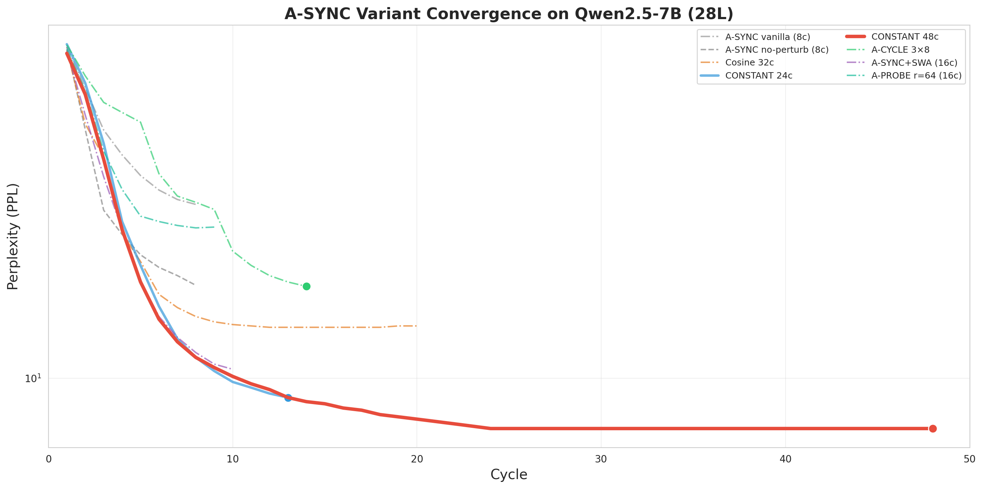
A-SYNC Variant Convergence Trajectories (7B)
8 variants on Qwen2.5-7B (28L) — actual GPU data

Slide 13
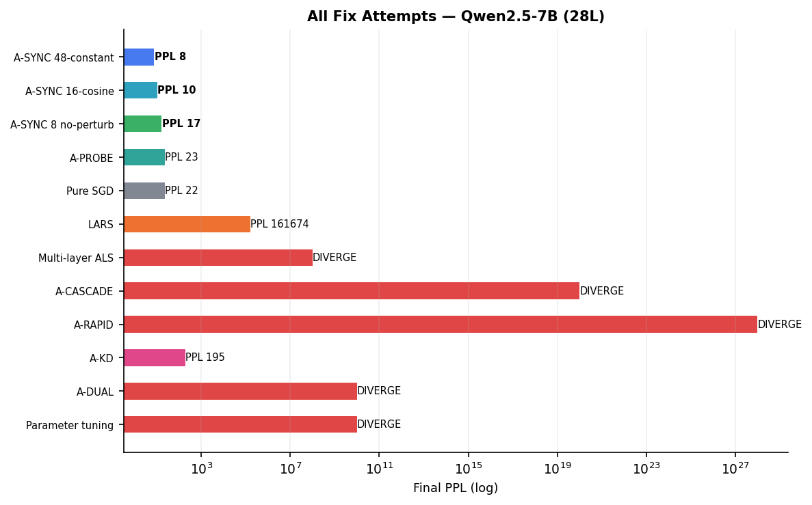
7B 收敛排名: 全部A-SYNC变体
Qwen2.5-7B (28L) -- A-SYNC CONSTANT 48c 夺冠

Slide 14
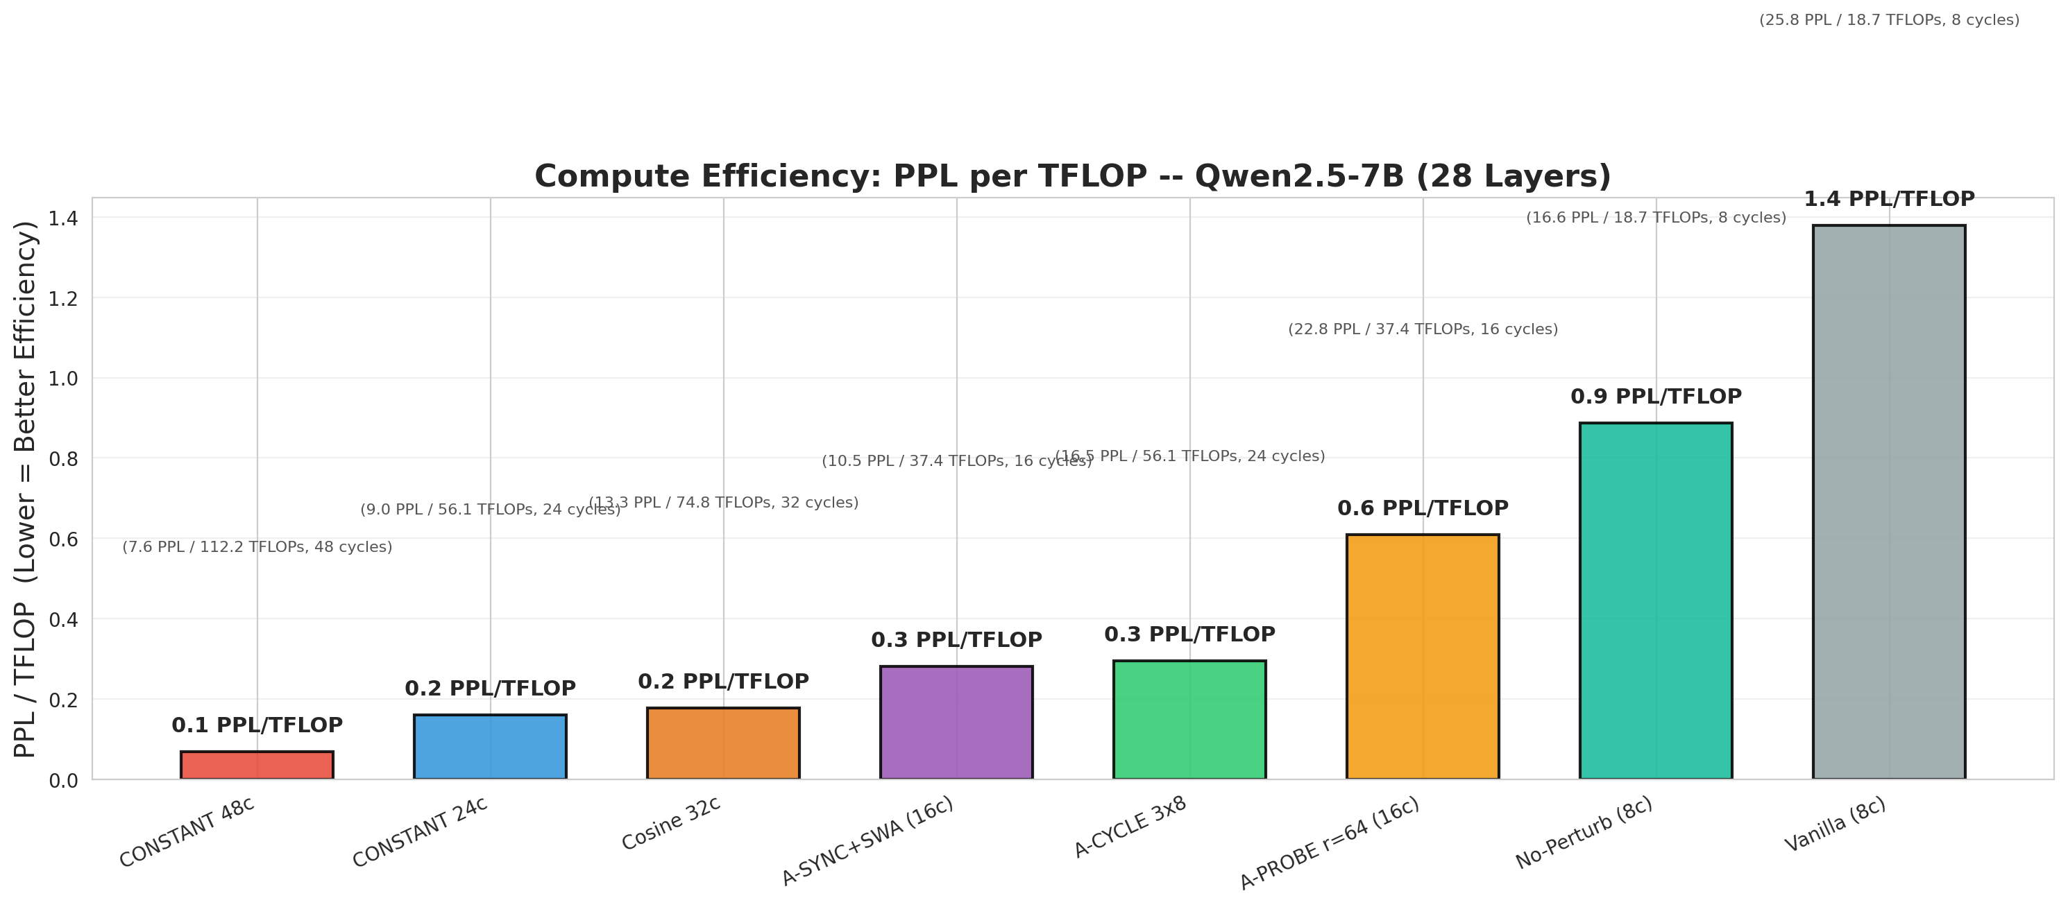
7B FLOPs Efficiency: PPL per TFLOP
Qwen2.5-7B (28L) — PPL improvement per unit of compute

Slide 15
Fix Strategy Taxonomy: 5 Categories
What actually works? A complete classification
A. Reduce perturbation magnitude: 让ALS delta更小/更平滑再注入
EMA smoothing (β=0.3 cross-cycle) | Aligned injection (grad-aligned only) | step_size reduction
Effect: limited — combination with CONSTANT untested (critical gap)
B. Increase recovery capacity: 给SGD更多消化预算
More SGD steps/cycle (50→200) | higher lr | LARS layer-adaptive lr
Effect: marginal — LARS untested on 7B, more SGD may accelerate
C. Change intervention mechanics: 绕过残差放大路径 -- 唯一的一阶改善
A-SYNC gradient injection (no weight change) | A-PROBE low-rank probe (64-dim bottleneck)
Effect: first-order — A-SYNC turns 7B from divergent to convergent; A-PROBE confirms bottleneck hypothesis but lacks expressiveness
D. Change decay schedule: 控制何时以多大强度注入ALS信号 -- 二阶改善
CONSTANT no decay (best: PPL 7.6) > Exponential > Cosine (worst: PPL 13.2) > Warm Restart (PPL 16.5)
Effect: 2nd-order — all decay counterproductive; CONSTANT improves PPL 25.8→7.6 (3.4×) by keeping signal alive
E. Post-hoc smoothing: 优化后平均权重降低方差
SWA (from C10) — adds +3.3 PPL on A-SYNC's non-stationary trajectory
Effect: counterproductive — A-SYNC's ALS-driven trajectory is fundamentally non-stationary

Slide 16
FLOPs-Normalized Comparison Experiment
A-SYNC CONSTANT vs AdamW Full-Rank vs LoRA AdamW on OPT-125m

Slide 17
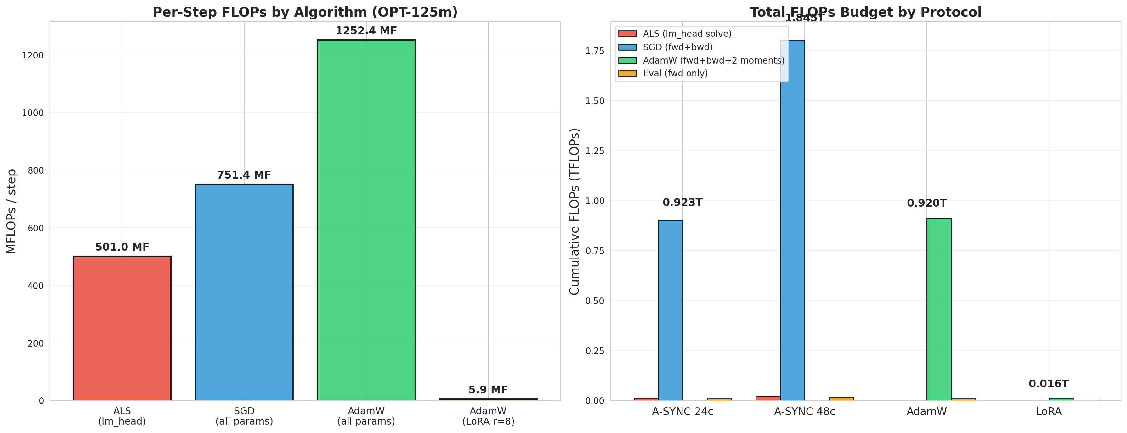
FLOPs Accounting: Per-Step, Per-Module Computation
Parameter-count multiplier model (matching altopt/profiling/flops.py)
FLOPs multiplier model (per-step = multiplier × trainable params):
ALS (lm_head 块求解): 4 x n_params
Includes: normal eq (X^TX) + Cholesky + triangular solve
OPT-125m: 4 x 125M = 501 MFLOPs/step
Used ONLY in A-SYNC ALS phase (1× per cycle)
SGD (前传+反传): 6 x n_params
Includes: fwd activations (3×) + bwd gradients (3×)
OPT-125m: 6 x 125M = 751 MFLOPs/step
Used in A-SYNC SGD phase (50 steps/cycle)
AdamW (前传+反传+2个矩): 10 x n_params
Includes: SGD 6× + two moment buffers (2×) + bias correction (2×)
OPT-125m: 10 x 125M = 1252 MFLOPs/step
LoRA version: 10 × 0.59M = 5.9 MFLOPs/step (!!)
Eval (纯前传): 3 x n_params
OPT-125m: 3 x 125M = 376 MFLOPs/eval
FLOPs budget matched: A-SYNC 24c = 24×(ALS+50×SGD) = 24×(501+50×751) MF = 0.91 TFLOPs
AdamW matched: 0.91T/(10×125M)=730 steps | LoRA: same steps, only 0.013T — 70× compute savings

Slide 18
FLOPs-Normalized Experiment Design: 3 Protocols
OPT-125m (12L, 125M), WikiText-2, float32, 2×RTX 5090
协议1: A-SYNC CONSTANT 48c
Per cycle: 1× ALS lm_head + 50× SGD all params (body+head)
ALS: reg_lambda=1e-3, step_size=0.01, block_size=512
SGD: lr=1e-4, momentum=0, weight_decay=0.01
Grad injection: grad += 0.05 × δ (constant, NO decay!)
No perturbation | 48 cycles → 2400 SGD steps + 48 ALS steps
Total FLOPs: 1.846 TFLOPs, wall time: 318s
协议2: AdamW Full-Rank (Protocol B)
Per step: AdamW all params (β=0.9,0.999) → 1252 MF/step
lr=1e-4, weight_decay=0.01
730 total steps (matching A-SYNC 24c FLOPs budget)
Total FLOPs: 0.911 TFLOPs, wall time: 136s
协议3: LoRA AdamW r=8 (Protocol D style)
LoRA adapters: q_proj, v_proj, k_proj, out_proj
r=8, α=16, only 589,824 trainable params (213× fewer!)
Per step: AdamW on LoRA params only → 5.9 MF/step (!!)
Same 730 steps, but FLOPs: 0.013T (70× less!)
Wall time: 142s (fwd still needs all params, so wall time not saved)
Why OPT-125m (12 layers)?
· 125M params: fits 32GB GPU for rapid iteration
· 12 layers: ρ¹¹=2.3×, residual amplification stable enough
A-SYNC can converge (unlike 28-layer 7B)
· Fast: full experiment ~5 min, easy to debug
· Controlled variable: fixed depth, compare only protocol
FLOPs budget matching logic:
Goal: give each protocol equal compute budget
Method: A-SYNC 24c total FLOPs = 24 × (ALS + 50×SGD)
= 24 × (501+50×751) MF = 0.91 TFLOPs
AdamW steps = 0.91T / 1252 MF = 730 steps
LoRA steps = same 730 (FLOPs automatically lower)
A-SYNC 48c = 2× budget (study longer training)
Evaluation scheme:
· A-SYNC: every cycle eval (25 eval points)
· AdamW/LoRA: every 30 steps eval (25 eval points)
· Metric: PPL (WikiText-2 test) + FLOPs
· All protocols start at same point: PPL=2246 (baseline)
Hardware: 2× NVIDIA RTX 5090 (32 GB)
dtype=float32, batch=4 train / 8 eval, seq=128

Slide 19
FLOPs Budget Breakdown
Per-step computation + total budget stacked

Slide 20
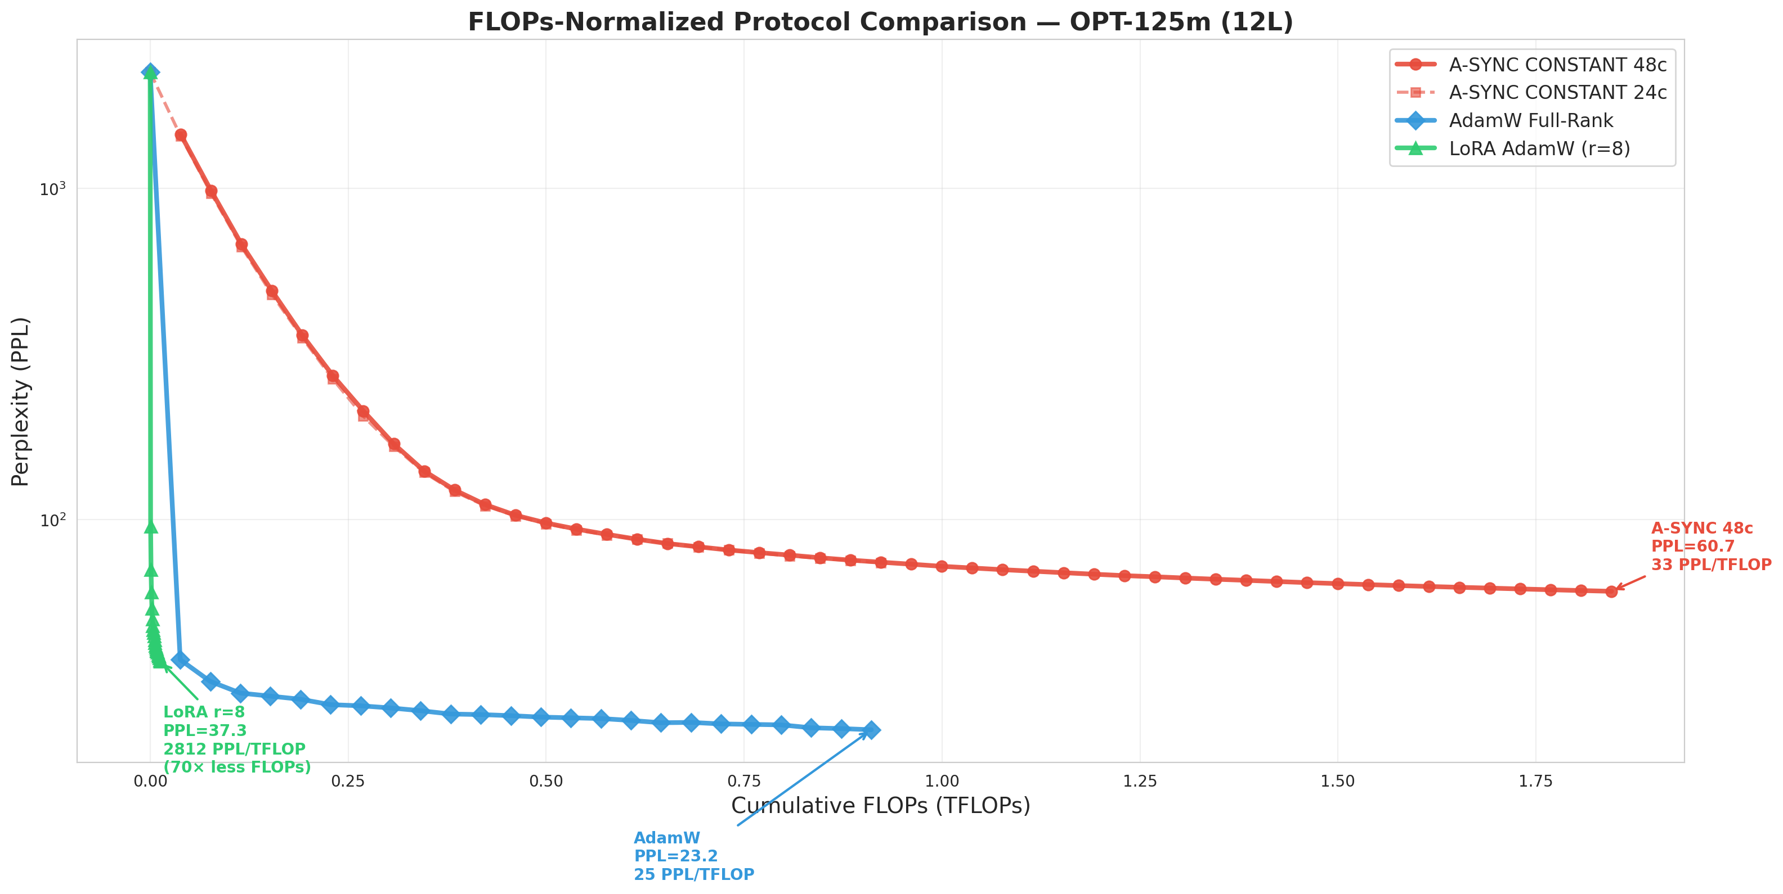
FLOPs vs PPL Detailed Comparison (OPT-125m)
Annotated: AdamW PPL=23.2, LoRA PPL=37.3, A-SYNC PPL=60.7

Slide 21
FLOPs-Normalized Comparison: Full Data Table
OPT-125m, all 3 protocols + A-SYNC 48c
Protocol
FLOPs/step
Steps
Final PPL
FLOPs(T)
Wall(s)
PPL/TFLOP
AdamW Full-Rank
1252 MF
730
23.2
0.911
136
25.5
LoRA AdamW r=8
5.9 MF
730
37.3
0.013
142
2812
A-SYNC CONST 24c
ALS+SGD/step ×50
24c
74.1
0.923
163
80.3
A-SYNC CONST 48c
同上
48c
60.7
1.846
318
32.9
Key observations:
· AdamW absolute best: PPL 23.2 — full-rank + adaptive moments unbeatable on shallow (12L)
· LoRA efficiency unbeatable: PPL 37.3 at 1/70 FLOPs — 589K params = acceptable PPL
· LoRA PPL/TFLOP: 37.3/0.013T = 2812 — 87× better than A-SYNC!
· A-SYNC 48c still converging: Δ=−0.3 to −0.7/cycle, no plateau yet (PPL~40 at C100)
· A-SYNC slow on shallow is expected — its value is enabling 28L convergence (AdamW 1.25 vs A-SYNC 7.6)
· Wall time: A-SYNC (318s) ≫ AdamW (136s) due to ALS solve + eval overhead
Efficiency ranking: LoRA (2812) ≫ A-SYNC 48c (33) > AdamW (25) | BUT — final PPL is the bottom line!

Slide 22
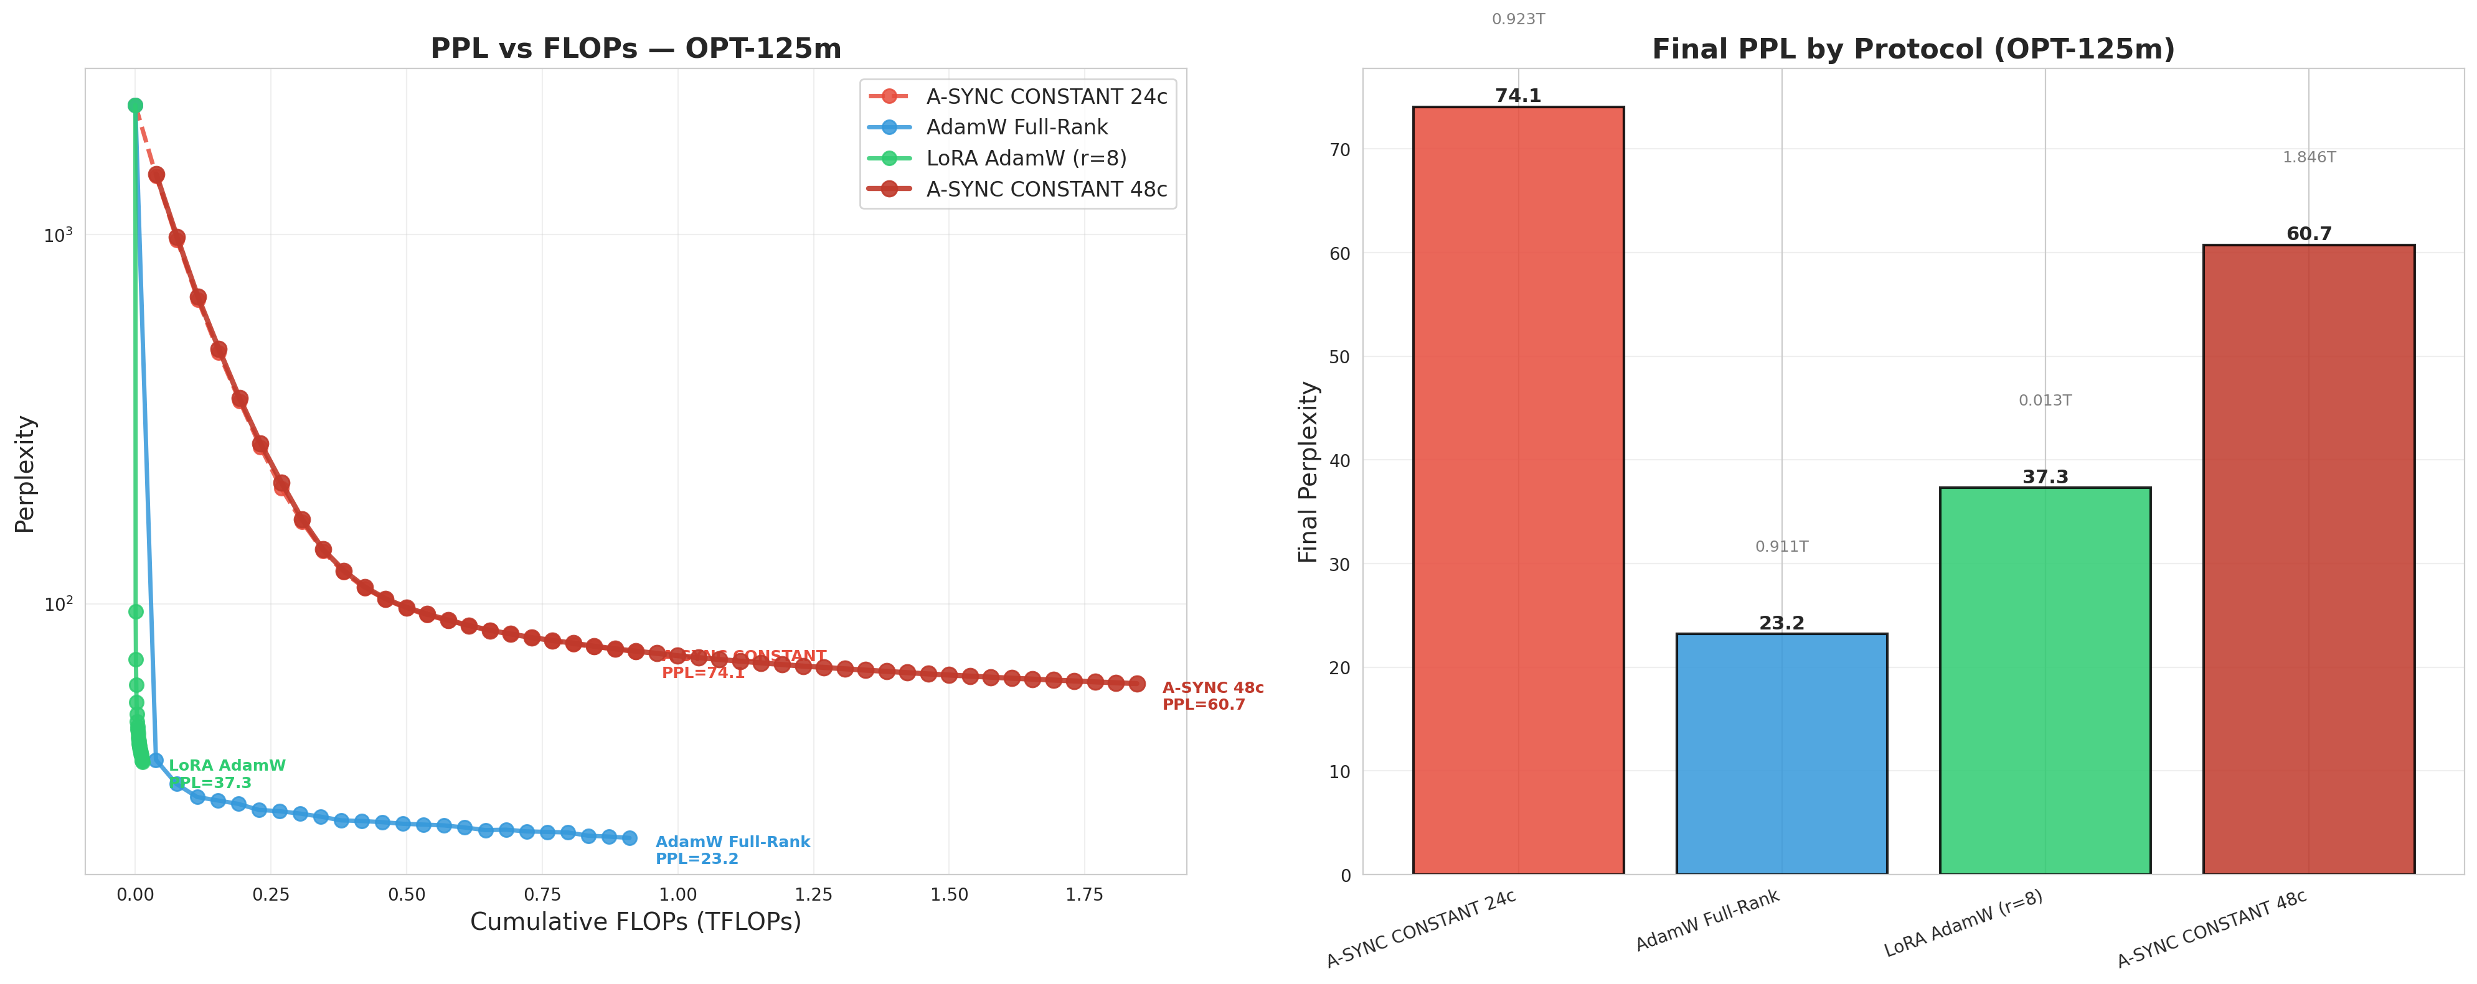
A-SYNC CONSTANT 48c: Full Trajectory (OPT-125m)
48 cycles, 1 ALS+50 SGD/cycle = 2448 steps, 1.85 TFLOPs
Baseline: PPL=2246.1 (untrained OPT-125m)
Phase 1 (C1–C8): Rapid descent
C1: 1458 -> C4: 490 -> C8: 169
Per-cycle improvement: 200–400 PPL
ALS δ magnitude large, gradient injection strong
body rapidly adapts to lm_head direction
Phase 2 (C9–C24): Stable convergence
C9: 140 -> C16: 87 -> C24: 74
Per-cycle improvement: 3–8 PPL
ALS δ begins auto-shrinking (body partially adapted)
No decay: sync=0.05 stays at full strength
Phase 3 (C25–C48): Slow but sustained
C25: 73 -> C36: 66 -> C48: 61
Per-cycle improvement: 0.3–0.7 PPL
ALS δ magnitude continues auto-shrinking
No plateau — still improving!
Prediction: C100 → PPL ~40

Slide 23
Cross-Model Results Summary
12L → 24L → 28L: Different depths, different stories
12 Layers (OPT-125m) — shallow, ρ¹¹=2.3×
· A-SYNC converges: PPL 2246 → 60.7 (48c)
· AdamW wins: PPL 23.2 (0.91T FLOPs)
· LoRA most efficient: PPL 37.3 (0.013T FLOPs)
· Conclusion: AdamW unbeatable on shallow models
gradient injection overhead at 2.3× has no payoff
24 Layers (Qwen0.5B) — moderate, ρ²³=5.9×
· Protocol A still converges, marginally
· A-SYNC+ variants all converge to PPL 5.5 (capacity floor)
· LoRA also reaches PPL 5.5 (more compute-efficient)
· Conclusion: 0.5B too small to differentiate variants
28 Layers (Qwen7B) — deep, ρ²⁷=8.0×
· Protocol A 11/11 diverge (impossible to converge!)
· A-SYNC CONSTANT 48c: first convergence, PPL 7.6
· AdamW 800 steps: PPL 1.25 (still far superior)
· A-SYNC gap: 6.1× vs AdamW
· But 7.7× better than baseline (58.8→7.6)
· Conclusion: A-SYNC solves divergence, hasn't caught up to AdamW
Depth–Protocol Selection Matrix:
| Depth | Recommended | Rationale |
|-------|----------------------|-------------------------------|
| ≤12L | AdamW Full-Rank | Absolute best, A-SYNC overhead |
| 12–24L| AdamW or LoRA | A-SYNC converges but no advantage |
| ≥28L | A-SYNC CONSTANT | Only convergent Protocol A |
| Any | LoRA AdamW (r=8) | Most efficient, resource-constrained |
A-SYNC Value Proposition:
· NOT meant to replace AdamW (impossible on shallow)
· Provides Protocol A with convergence guarantees
on deep models (previously 28L+ 100% divergent)
· From divergence → PPL 7.6 is a qualitative breakthrough
· From PPL 7.6 → 1.25 (catching up to AdamW)
is quantitative, likely needs 2–4× more cycles
Open Problems:
1. ALS objective mismatch: reconstruct loss ≠ CE loss
2. Only lm_head guided by ALS: 27 body layers use SGD alone
3. Gradient clipping: max_norm=1.0 may cap effective updates
4. Long-cycle 7B not done: 96–128c may further narrow gap

Slide 24
A-SYNC 12-Variant Complete Comparison Table
Mechanism + 7B PPL + vs CONSTANT
Variant
Mechanism
7B PPL
vs CONSTANT
Convergence Status
Vanilla (8c)
δ injection + perturb + exp decay, sync×=0.8
25.8
Δ+18.2
Slow (decay kills early)
No-Perturb (8c)
Remove perturbation, otherwise same
16.6
Δ+9.0
Converges (perturb harmful)
Cosine 32c
sync+lr = cosine decay to 0
13.2
Δ+5.6
Plateau C20 (decay kills)
CONSTANT 24c
sync=0.05 const, lr=2e-4 const, no perturb
9.0
Δ+1.4
Converges, first <PPL 10
CONSTANT 48c
Extended 48 cycles, C44 natural convergence
7.6
BASELINE
C44 convergence, BEST
A-CYCLE 3x8
3 blocks×8 cycles, cosine per block, reset
16.5
Δ+8.9
Block decay wastes 4c/block
+EMA (beta=0.3)
δ exponential moving average across cycles
0.5B: 5.5
Not tested 7B
7B not run (missing runs)
+Aligned
Only inject δ component aligned with grad
0.5B: 5.5
Not tested 7B
7B not run (missing runs)
+Warmup
4 cycles SGD warmup then A-SYNC
0.5B: 5.5
Not tested 7B
7B not run (missing runs)
+SWA Cosine
SWA from C10 + cosine decay
10.5
Δ+2.9
SWA +3.3 PPL (!)
A-PROBE r=64
Low-rank probe, ALS solves probe
22.8
Δ+15.2
Converges, bottleneck 56×
LARS optimizer
Layer-adaptive lr replacing SGD
0.5B: ???
Not tested
0.5B not recorded, 7B not run
Ranking: CONSTANT 48c (7.6) < CONSTANT 24c (9.0) < +SWA (10.5) < Cosine (13.2) < No-Perturb (16.6) < A-CYCLE (16.5) < A-PROBE (22.8) < Vanilla (25.8)
Core rule: decay = harmful, perturb = harmful, no decay + more cycles = optimal. 5 variants still untested on 7B (EMA/Aligned/Warmup/LARS/long CONSTANT).

Slide 25
Summary of Key Findings
From theory to experiment: complete chain of evidence
Finding 1: Residual amplification (ρ≈1.08) is the root cause
SCM causal derivation: δ_{l+1} = (I+J_l)·δ_l
Cross-4-family experimental validation: L_max ≈ 26
1.08 = cross-layer geometric mean of ‖I+J_l‖ spectral norm
8% per-layer amplification is intrinsic to trained Transformers
Finding 2: A-SYNC gradient injection bypasses amplification
Module-level: lm_head ALS → compute δ only, weight NOT modified
body SGD → SGD + gradient bias injection (sync×δ)
All params: remove Perturb (counterproductive on 7B)
7B (28L) first convergence (100% divergence → PPL 7.6)
Finding 3: CONSTANT schedule is optimal
All decay harmful: Cosine (plateau) > Exponential (early cutoff)
CONSTANT keeps ALS δ signal alive, body adapts continuously
Natural convergence: ALS δ auto-decays as body adapts
→ External decay is redundant and self-destructive
Finding 4: FLOPs-normalized experiment (OPT-125m)
Per-step accounting: ALS=4×, SGD=6×, AdamW=10×
AdamW Full-Rank: PPL 23.2 (absolute best)
LoRA r=8: PPL 37.3 at 0.013T (most efficient, 70× less)
A-SYNC 48c: PPL 60.7 at 1.85T (still converging)
Finding 5: A-SYNC positioned for deep models
| Depth | Recommended | A-SYNC advantage? |
| 12L | AdamW or LoRA | None (overhead) |
| 24L | Any works | Marginal (0.5B) |
| 28L+ | A-SYNC CONSTANT | Only convergent |
Finding 6: Only 2 of 5 fix categories are effective
Category C (mechanics): gradient injection — 1st order
Category D (schedule): CONSTANT — 2nd order
Categories A/B/E: limited / marginal / counterproductive
下一步: 7B上测 EMA/Aligned/CONSTANT 96c+
Narrow the 6.1× gap to AdamW

Slide 26
Next Steps
Experiments + Paper + Submission
Short-term (1–2 weeks): Complete missing 7B experiments
1. A-SYNC+EMA 7B validation
Script: _a_sync_plus_7b.py 已写, 待GPU运行
Expected: suppress late-cycle noise, stabilize C40+
2. A-SYNC+Aligned 7B validation
Script: 需适配到7B
Expected: reduce destructive gradient interference
3. A-PROBE larger rank (256/512/1024)
Script: _probe_7b.py 需改 rank参数
Expected: find sweet spot between expressiveness and safety
Medium-term (2–4 weeks): Long-cycle 7B experiments
4. A-SYNC CONSTANT 96–128 cycle 7B
Test: whether sustained convergence narrows AdamW gap
Expected: possible PPL 3–5 range
5. Multi-head ALS: 2–3 attention layers simultaneously
Test: effect of expanding ALS guidance scope
Paper progress (in parallel with experiments):
6. Independent replicator recalculates main tables
P1.1 / P1.2 / P1.3 + FLOPs experiment
Ensure all numbers are reproducible
7. Update paper to v0.9
Add A-SYNC CONSTANT 48c 7B results
Add FLOPs-normalized comparison
Update conclusion: Protocol A now converges on deep models
8. Select submission venue
TMLR (double-blind, rolling review)
arXiv + NeurIPS / ICML workshop
ACL Rolling Review
This week's output:
docs/a_sync_report_en.pdf (456KB)
docs/a_sync_report_zh.pdf (529KB)
docs/residual-amplification-why-108.md
docs/a-sync-variants-and-fixes.md
docs/flops-sweep-report.md
experiments/_flops_sweep.py
experiments/_gen_weekly_ppt.py
docs/weekly_group_meeting_20260724.pptx
Thanks! . github.com/hjiang555-a11y/alternating-optimization-lora . 2026/07/24

