Slide 1
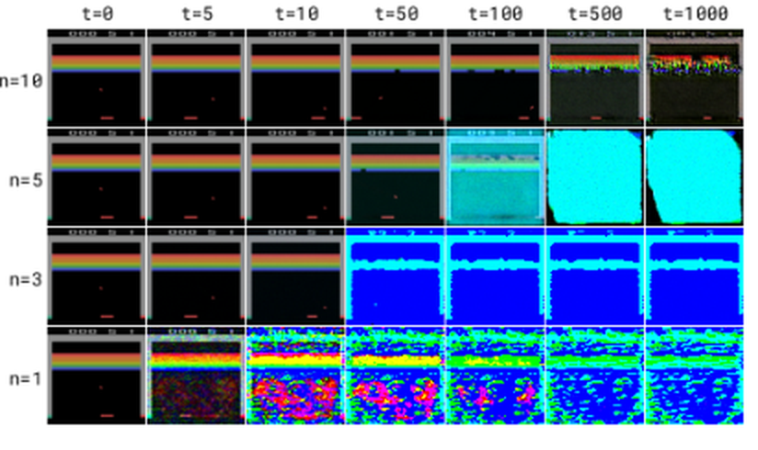
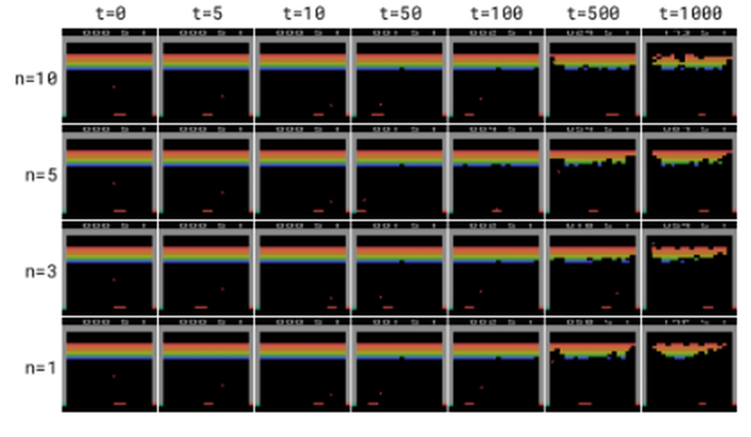
World Models and Video Consistency
Diffusion for World Modeling: Visual Details Matter in Atari
Alonso, Jelley, Micheli, Kanervisto, Storkey, Pearce, Fleuret — NeurIPS 2024 (arXiv:2405.12399)
A technical presentation on the DIAMOND world model
Diffusion world models keep
the visual details consistent —
and that consistency wins games.
DDPM — drifting, colors corrupt
EDM (DIAMOND) — stable

Slide 2
Motivation: Two Problems, One Paper
1 / 11
Problem 1 — RL is sample-hungry
Problem 2 — discrete latents lose visual details
▸ Classic Atari agents: ~50M environment steps to master a game.
▸ World models: learn dynamics from data, then train the agent "in imagination" — 100k steps (~2 h) instead.
▸ World model = simulated video of the environment; agent never touches the real env during training.
▸ SOTA world models (IRIS, DreamerV3, STORM) encode images as discrete tokens (VQ-VAE + transformer).
▸ Quantization discards fine-grained, few-pixel details — enemies flicker, rewards vanish, scores drift.
▸ Small visual errors compound over rollout → inconsistent "video" → suboptimal policy.
The bridge: diffusion models
▸ Diffusion models dominate image generation — they synthesize images in a continuous latent space, with no quantization bottleneck.
▸ Question: can a diffusion model serve as the environment simulator of a world model — and does preserving visual details actually make the agent better?
▸ Answer (this paper): yes — DIAMOND, a world-model RL agent with a diffusion dynamics model, sets a new Atari-100k record (mean HNS 1.46).
World Models and Video Consistency — DIAMOND

Slide 3
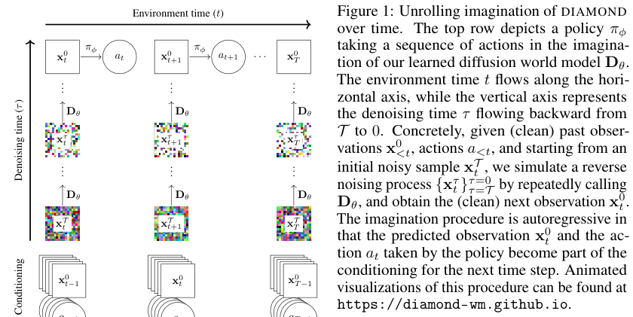
DIAMOND: A Diffusion Model as the Environment
2 / 11
The three components
1
Diffusion world model (EDM)
2D U-Net denoises next frame; past frames concatenated channel-wise; actions injected via adaptive group norm. EDM noise schedule → stable 1–3 step sampling.
2
Reward / termination model
Separate CNN + LSTM (Rψ) predicts scalar reward and episode end — handles partial observability.
3
Agent (actor-critic)
Figure 1 (paper): unrolling imagination over time. A diffusion model Dθ denoises the next frame conditioned on past observations and actions.
Shared CNN-LSTM; policy π trained with REINFORCE + value baseline; value trained with λ-returns — entirely inside imagination.
Training loop: collect data in real env → update world model on all data → train agent in imagination → repeat (standard world-model RL recipe).
World Models and Video Consistency — DIAMOND

Slide 4
Design Choice 1: EDM Beats DDPM for Stability
3 / 11
DDPM trajectories — color corrupts, error compounds
EDM trajectories — stable even with 1 denoising step
▸ Why: DDPM predicts the noise ε; when noise dominates, this collapses toward the identity map → poor score estimate at the start of sampling → error compounds over rollout.
▸ EDM instead adaptively mixes signal and noise: when noise dominates, the net is trained to predict the clean image — a much better score estimate with almost no signal.
▸ Result: EDM-based world model stays consistent over long rollouts, even at n = 1 denoising step.
World Models and Video Consistency — DIAMOND

Slide 5
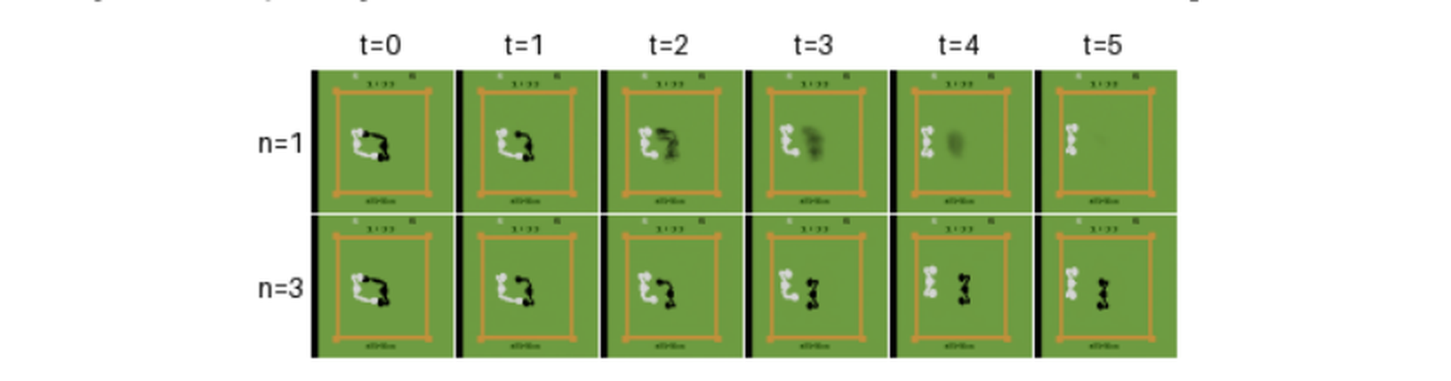
Design Choice 2: 3 Denoising Steps (Not 1)
4 / 11
1 vs 3 steps
▸ 1 step = one denoising step: cheap, but the single-step predictor is the expectation over possible next frames.
▸ Partial observability makes that distribution multimodal → the expectation is an out-of-distribution blur.
▸ 3 iterative steps drive sampling toward one specific mode → crisp, consistent frames.
Boxing: 1 step (top) vs 3 steps (bottom) — the black player's motion is unpredictable
Ablation: mean HNS on top-10 games drops from 3.05 (n = 3) to 1.96 (n = 1) — visual stability translates directly into agent performance.
The tension: each denoising step costs one full network forward pass; a world model must render thousands of frames per training episode. DIAMOND's trick is to be stable enough that 3 steps suffice — and it even samples at only ~10 FPS with 3 NFE per frame.
World Models and Video Consistency — DIAMOND

Slide 6
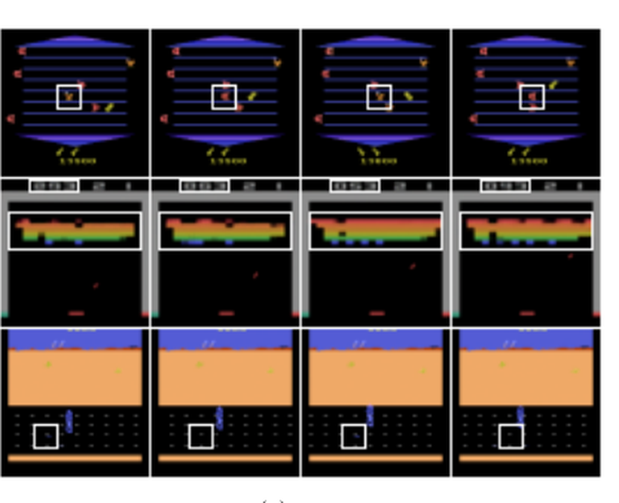
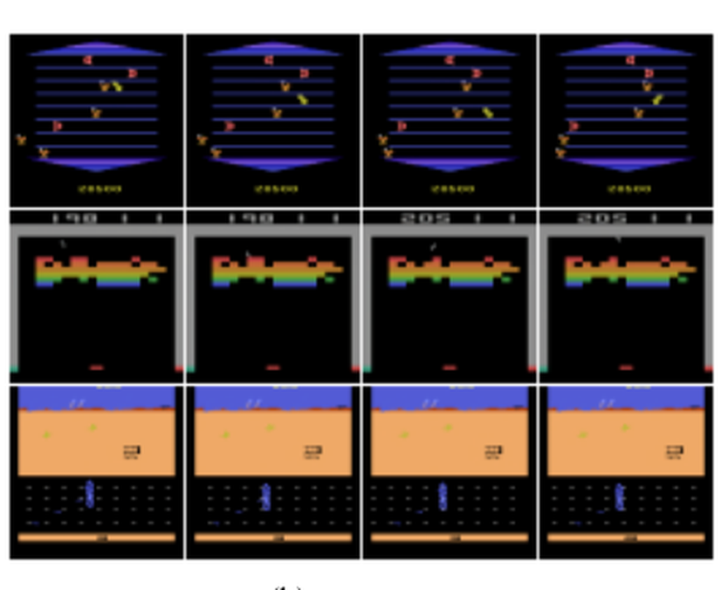
The Core Result: Consistent Videos, Game by Game
5 / 11
IRIS (discrete tokens) — inconsistencies in white boxes
DIAMOND (diffusion) — the same details stay consistent
▸ IRIS flickers: an enemy becomes a reward and back (Asterix); bricks and score drift (Breakout); road rewards vanish (Road Runner). Just a few pixels — but the agent learns from exactly those pixels.
▸ DIAMOND stays faithful: same resolution (64×64), fewer parameters, and only 3 NFE/frame vs 16 for IRIS — the consistency is not bought with more compute.
▸ Consequence: the agent targets rewards and avoids enemies more reliably → higher scores on precisely these games.
World Models and Video Consistency — DIAMOND

Slide 7
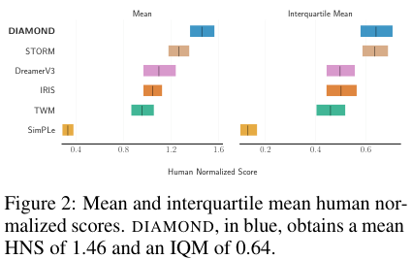
Atari 100k: A New Best Among World-Model Agents
6 / 11
Mean HNS 1.46
superhuman on average — a new best among agents trained entirely inside a world model
▸ 11 of 26 games superhuman (vs 10 for STORM/DreamerV3; 8 IRIS; 1 SimPLe).
▸ IQM 0.64 — on par with STORM, above all other baselines.
▸ Biggest wins where tiny details decide: Asterix (3698 vs 1028 STORM), Breakout (132.5 vs 83.7 IRIS), Road Runner (20673).
▸ Setup: 100k env steps (~2 h gameplay) per game, 5 seeds; ~2.9 days/run on one RTX 4090.
Human-normalized score (HNS), mean & IQM
Take-away: with agent designs held similar, the score gap traces back to the world model's visual consistency.
World Models and Video Consistency — DIAMOND

Slide 8
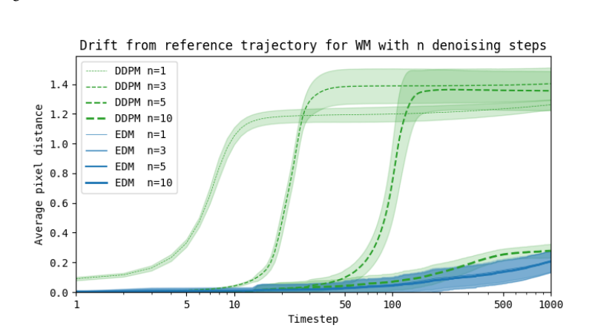
Stability, Measured: Pixel Drift over 1000 Steps
7 / 11
Quantifying compounding error
▸ Breakout: 1000-step imagined rollouts from the same frame + same action sequence (400 expert refs).
▸ DDPM drifts more and more; even 10 denoising steps stay worse than EDM with 1.
▸ EDM's residual drift is trajectory difference, not the pathological color shift seen in DDPM.
Why this matters for the talk's theme: "video consistency" is not aesthetics. In a world model, every generated frame is a training sample for the agent. Frame-to-frame inconsistency is label noise for policy learning — and it compounds with rollout length.
World Models and Video Consistency — DIAMOND

Slide 9
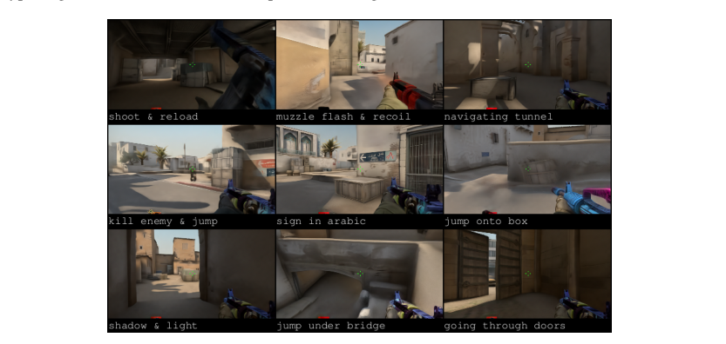
Scaling Up: An Interactive Neural Game Engine
8 / 11
▸ Trained only on static footage — no RL, no engine: 150k frames of CS:GO (Dust II, 64×64) and 3.6 h of motorway driving.
▸ People played it live with keyboard & mouse — stable over minutes of interactive rollout.
▸ FVD 34.8 on CS:GO vs 85.7 for IRIS (K = 64) and 509.1 for DreamerV3; LPIPS 0.107 vs 0.116 / 0.173.
▸ Driving: FVD 80.3 (IRIS 276.9, DreamerV3 733.7) — coherent, actionable video from real footage.
Humans playing inside DIAMOND's diffusion world model (CS:GO)
Same recipe, richer domain: the same EDM diffusion world model generalizes from 2D arcade pixels to 3D first-person environments — a step toward world models as general video-consistent environment simulators.
World Models and Video Consistency — DIAMOND

Slide 10
Limitations and Open Questions
9 / 11
Resolution & fidelity
64×64 images — far from real visual richness. Video consistency at scale is still open.
Sample efficiency of the model itself
The agent is sample-efficient; the diffusion world model is not. Training DIAMOND took ~1.03 GPU-years across the benchmark.
Speed
3 NFE/frame ≈ 10 FPS on Atari; interactive use required stochastic sampling & more steps. Real-time, high-res diffusion world models remain costly.
Single-task scope
One world model per game/environment — no cross-environment generalization or open-ended "one world" claim.
Consistency ≠ physics
Rollouts are visually consistent; they are not physically grounded. Long-horizon drift still exists (Fig. 8) — an active research frontier.
World Models and Video Consistency — DIAMOND

Slide 11
What to Remember
10 / 11
1
Consistency is the bottleneck
Discrete-token world models lose few-pixel visual details; those details are exactly what the agent's reward signal depends on.
2
Diffusion fixes it
A continuous diffusion world model (EDM) preserves visual details and stays stable over long rollouts — no quantization bottleneck.
3
Consistency → performance
Mean HNS 1.46, superhuman on 11/26 Atari-100k games; the gains concentrate where visual detail matters.
4
It scales beyond games
CS:GO FVD 34.8 and interactive human play; motorway driving FVD 80.3 — a general recipe for consistent video world models.
5
Open frontier
Resolution, speed, sample efficiency, physical grounding — world-model video consistency is still a live research area.
World Models and Video Consistency — DIAMOND

Slide 12
Thank You
World Models and Video Consistency — DIAMOND
Paper: E. Alonso, A. Jelley, V. Micheli, A. Kanervisto, A. Storkey, T. Pearce, F. Fleuret.
"Diffusion for World Modeling: Visual Details Matter in Atari." NeurIPS 2024. arXiv:2405.12399
Project page & playable world models: diamond-wm.github.io · Code: github.com/eloialonso/diamond
All figures reproduced from the paper (arXiv:2405.12399).

