Slide 1


SICode: Embedding-Based Subgraph Isomorphism Identification for Bug Detection
Yuanjun Gong, Jianglei Nie, Wei You, Wenchang Shi
Jianjun Huang∗, Bin Liang∗, Jian Zhang
ICPC 2024

Slide 2
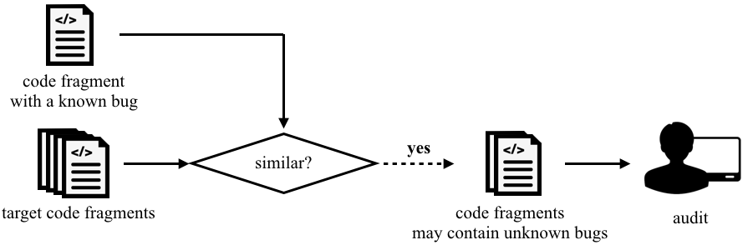
1. Introduction
Detecting bugs based on code-matching is feasible
Matched?

Slide 3
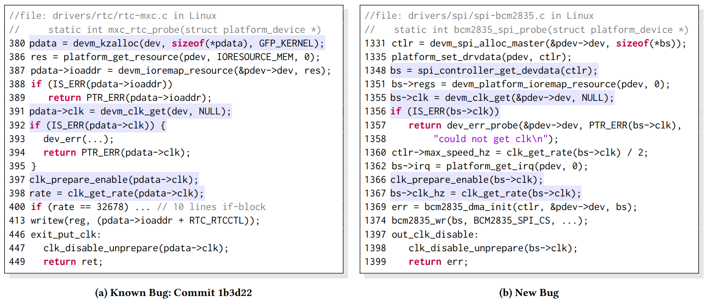
The two functions differ globally, but they have sub-structural similarities in the highlighted statements

Slide 4
Basic Idea
Subgraph isomorphism identification - find potential bugs by checking whether an approximate copy of the buggy subgraph exists within the target code graphs
Challenge: Exact subgraph-matching algorithms are time-consuming
VF2 takes more than 3 hours to compare one query across the Linux Kernel project
Solution: Embedding-based subgraph detection with graph neural networks - effective and efficient

Slide 5
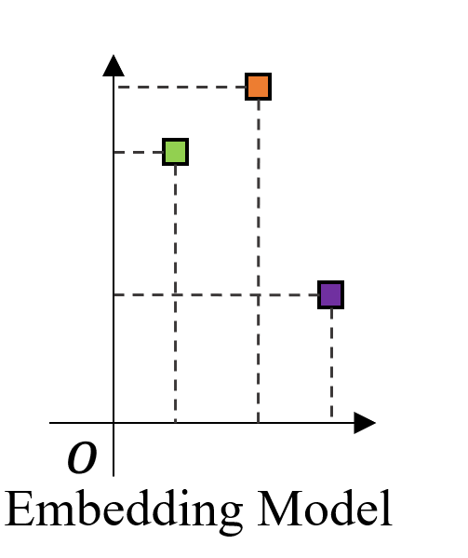
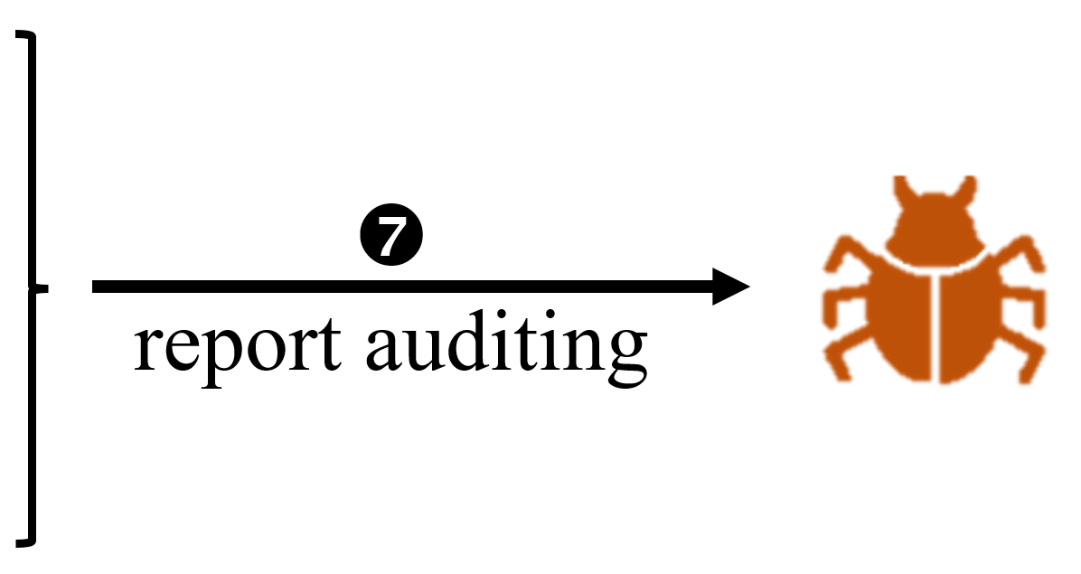
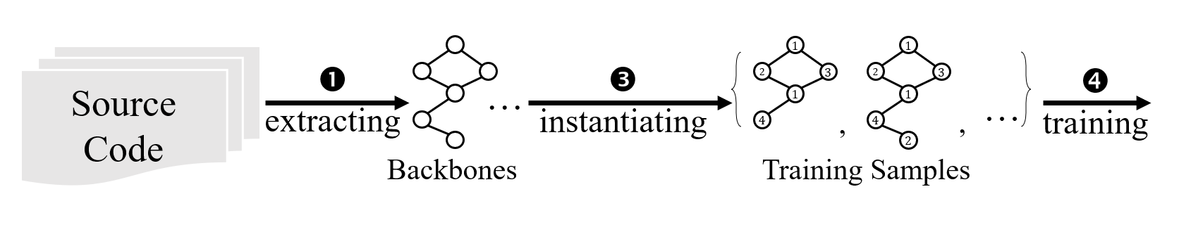
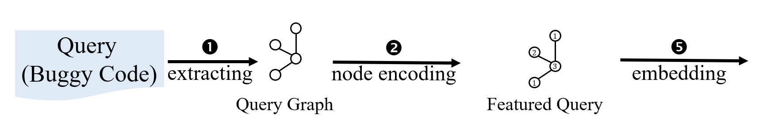
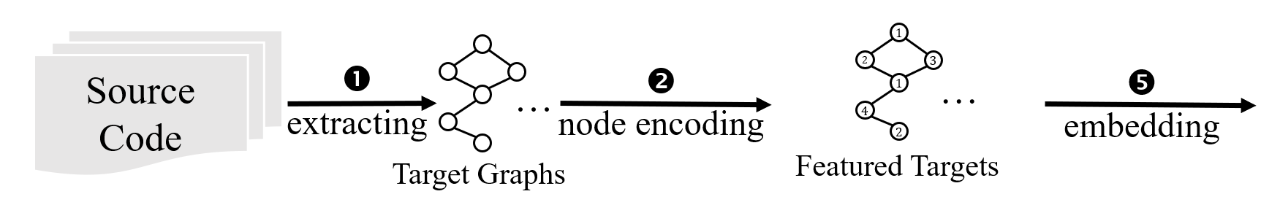
2. Our approach
SICode (Subgraph Isomorphism-based buggy Code detection)
Step1 Training the embedding model
Step2 Embedding the target functions into vector space
Step3 Embedding the query graph, get the detection result
Target
Vectors
Query
Vector

Slide 6
Graph Preparation
Method: devm_kzalloc
Method: devm_clk_get
Graph generation
Transform the function into CFG and DDG via fuzzyc2cpg
Merge the CFG and the DDG into a hybrid graph
Prune the less meaningful nodes
Encoding nodes to labels
Return - label 0
Operator - label [1, 𝐿𝑜 ]
Invoked method - label [𝐿𝑜 + 1, 𝐿𝑜 + 𝐿𝑚]
fastText embedding
K-means clustering
Method: IS_ERR
Method: clk_prepare_enable
Method: clk_get_rate
212
212
129
26
150
0
1
𝐿𝑜+1
𝐿𝑜+𝐿𝑚+1

Slide 7
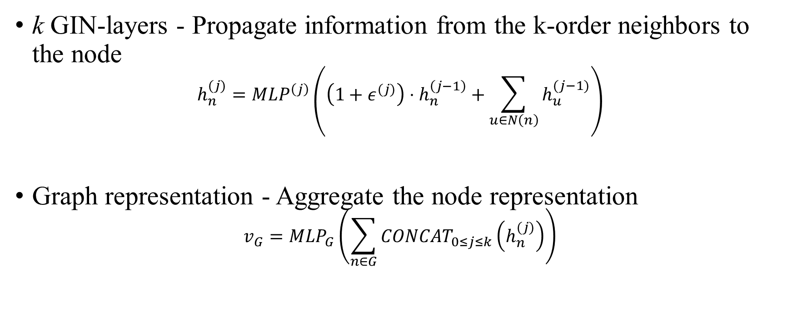
Embedding Model
k GIN-layers - Propagate information from the k-order neighbors to the node
$$h_{n}^{(j)}=MLP^{\left(j\right)}\left(\left(1+ε^{(j)}\right)⋅h_{n}^{\left(j−1\right)}+\sum_{u∈N\left(n\right)}{h_{u}^{(j−1)}}\right)$$
Graph representation - Aggregate the node representation
$$v_{G}=MLP_{G}\left(\sum_{n∈G}{CONCAT_{0≤j≤k}\left(h_{n}^{(j)}\right)}\right)$$

Slide 8

Embedding Model
We propose a cascading loss function to train the embedding model.
a
$$S$$
212
b
212
129
212
129
212
129
26
150
26
150
26
150
S
a
b
Vector Space

Slide 9
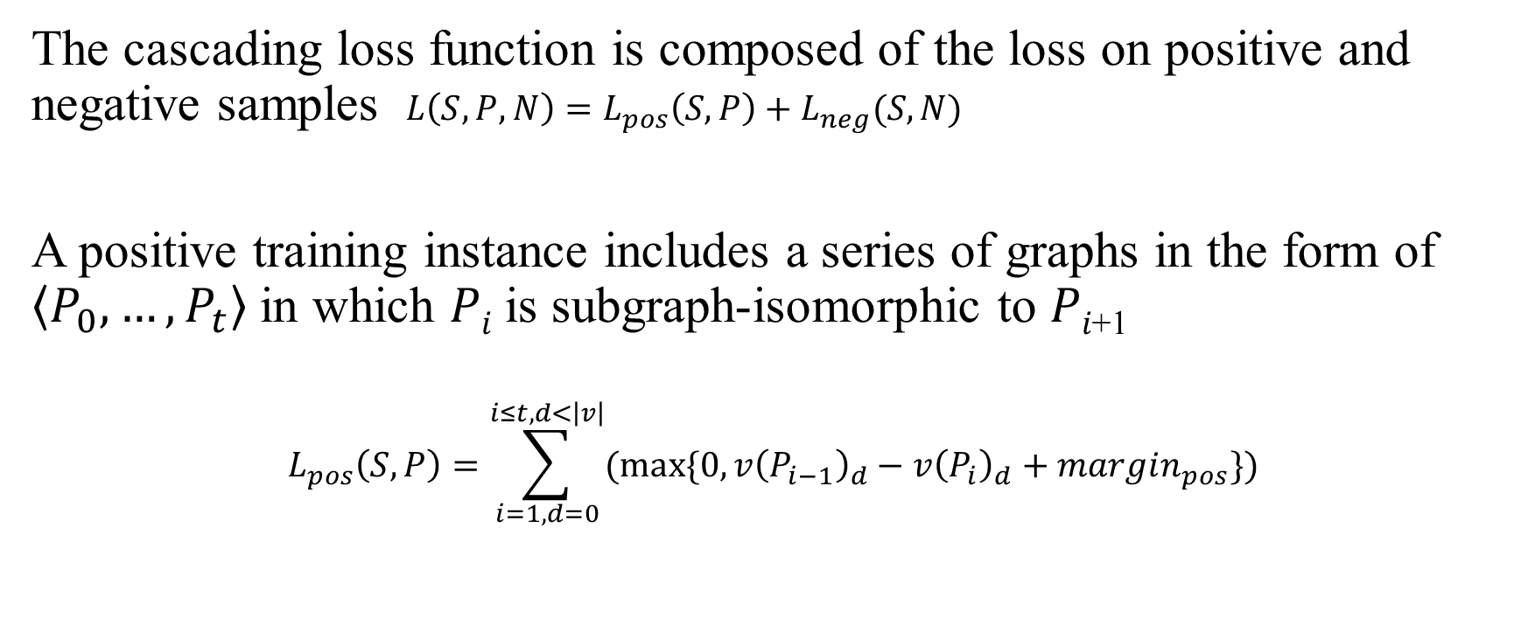
Embedding Model
The cascading loss function is composed of the loss on positive and negative samples $L\left(S,P,N\right)=L_{pos}\left(S,P\right)+L_{neg}(S,N)$
A positive training instance includes a series of graphs in the form of $\left\langle P_{0},…,P_{t}\right\rangle$in which 𝑃_{𝑖} is subgraph-isomorphic to 𝑃_{𝑖+1}
$$L_{pos}\left(S, P\right)=\sum_{i=1,d=0}^{i≤t, d<\left|v\right|}{(max⁡\{0,v{\left(P_{i−1}\right)}_{d}−v{\left(P_{i}\right)}_{d}+margin_{pos}\})}$$

Slide 10
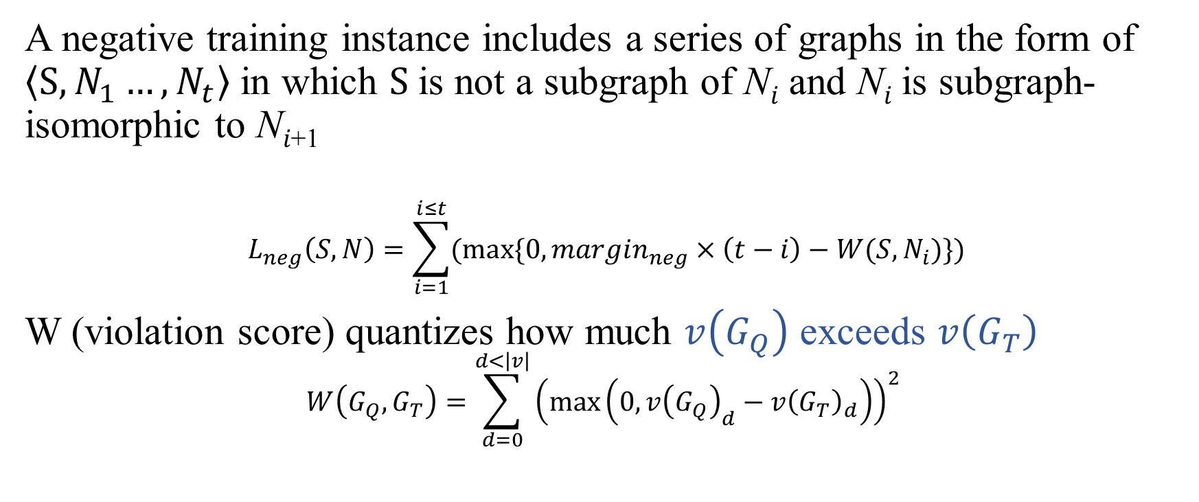
Embedding Model
A negative training instance includes a series of graphs in the form of $\left\langle S,N_{1}…,N_{t}\right\rangle$in which $S$is not a subgraph of N_{𝑖} and N_{𝑖} is subgraph-isomorphic to N_{𝑖+1}
$$L_{neg}\left(S,N\right)=\sum_{i=1}^{i≤t}{(max⁡\{0,margin_{neg}×\left(t−i\right)−W(S,N_{i})\})}$$
W (violation score) quantizes how much $v\left(G_{Q}\right)$ exceeds $v\left(G_{T}\right)$
$$W\left(G_{Q},G_{T}\right)=\sum_{d=0}^{d<\left|v\right|}{{\left(\max\left(0,v{\left(G_{Q}\right)}_{d}−v{\left(G_{T}\right)}_{d}\right)\right)}^{2}}$$

Slide 11
Embedding Model
To train a project-unspecific model, we use a backbone scheme to generate training samples
Method: devm_kzalloc
Method: devm_clk_get
M
101
extracting
instantiating
Method: IS_ERR
M
M
111
103
Method: clk_prepare_enable
M
M
120
123
Method: clk_get_rate

Slide 12
Bug Detection
The target graphs are 𝑘-hop subgraphs extracted from the target project, in case the candidate functions are too large and unable to be embedded by a fixed-depth graph neural network adequately.
A 𝑘-hop target graph starts from an invocation node, and all reachable neighbors and edges within 𝑘 hops are included.
The target graphs are encoded and embedded into the vector space.

Slide 13
Bug Detection
The query graph is a subgraph of the buggy function graph. Every node and edge should be closely related to the bug logic.
Find the center node
Program slicing
Remove unrelated nodes
The query graph is encoded and embedded into the vector space.

Slide 14
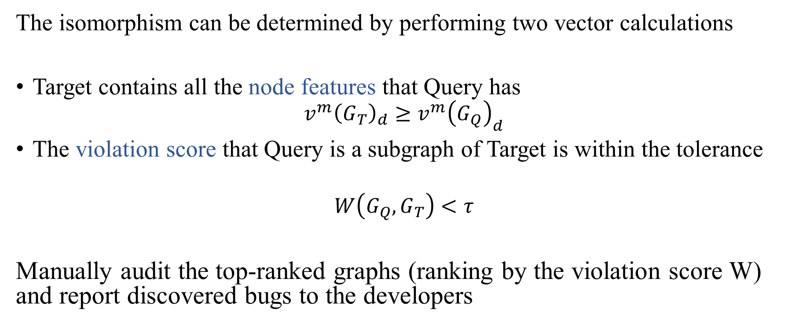
Bug Detection
The isomorphism can be determined by performing two vector calculations
Target contains all the node features that Query has
$$v^{m}{\left(G_{T}\right)}_{d}≥v^{m}{\left(G_{Q}\right)}_{d}$$
The violation score that Query is a subgraph of Target is within the tolerance
$$W\left(G_{Q},G_{T}\right)<τ$$
Manually audit the top-ranked graphs (ranking by the violation score W) and report discovered bugs to the developers

Slide 15
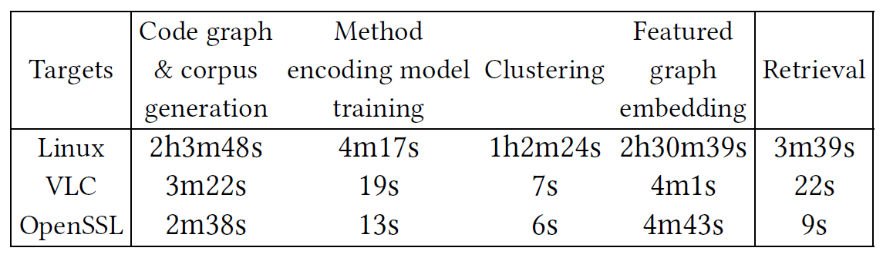
3. Evaluation
Scalability
Evaluate the runtime of SICode about subgraph isomorphism decisions on Linux v5.17, VLC, and OpenSSL
Embedding-based subgraph isomorphism method has shown great scalability compared to classic algorithms

Slide 16
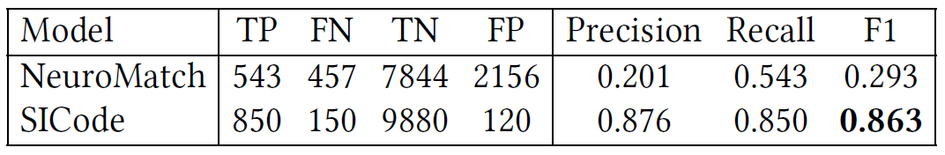
Effectiveness
Test the subgraph matching models performance w/wo cascading loss function
The cascading loss suits this problem well

Slide 17
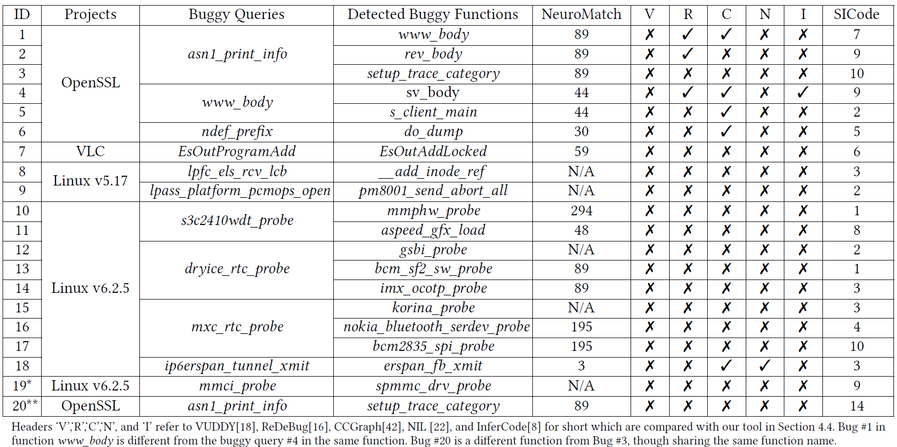
Effectiveness

Slide 18
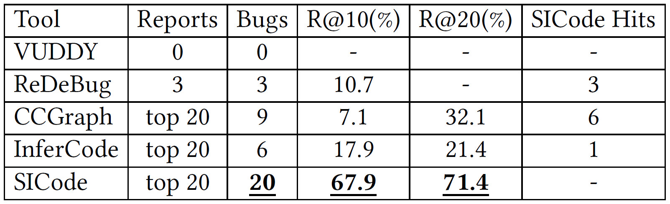
Effectiveness
Audit the reports from five tools based on the same buggy queries
SICode finds the most bugs and achieves the highest R@10 and R@20

Slide 19
4. Conclusion
We design a novel bug detection method, SICode, with embedding-based subgraph isomorphism identification. Subgraph isomorphism relations are encoded in the vectors and hence vector-based comparison can support scalable subgraph isomorphism decisions.
We propose a cascading loss function to train the embedding model, and greatly improve the model’s performance of subgraph isomorphism identification.
SICode spotted 20 real-world bugs, among which, 18 bugs were confirmed by the developers. This result is very encouraging for detecting subtle sub-structurally similar bugs.

Slide 20
Thanks

