Slide 1
SUPOR: Precise and Scalable Sensitive User Input Detection for Mobile Apps
Jianjun Huang, Zhichun Li, Xusheng Xiao, Zhenyu Wu, Kangjie Lu, Xiangyu Zhang, Guofei Jiang
Purdue University
NEC Labs America
Georgia Institute of Technology
CERIAS Security Seminar
09/02/2015
Notes:
Good afternoon, everyone. My name is Jianjun Huang, a PhD student in the department of computer science at Purdue University. My adviser is Prof Xiangyu Zhang.
Today I’m going to share with you our work on detecting sensitive user inputs in mobile apps.
This is a joint work with Zhichun, Xusheng, Zhenyu, Guofei in NEC Labs, and Kangjie from Georgia Tech. This work was started when I was an intern in NEC Labs and published in USENIX security 2015.

Slide 2
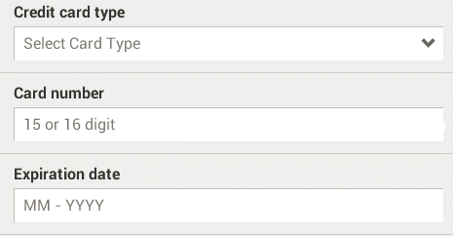
Background - UI
Text Label
Input Field
Input Hint
Widget
Notes:
I may frequently mention text label, input field, input hint, widget and layout files in this talk. So before we go into the details, I want to introduce some terminologies. Text label, input field and input hint are what the users perceive when they use the mobile apps. As in this example, we can find the text labels, the input fields and the input hints of the fields. The text labels and input fields are called UI widgets.

Slide 3
Background – Layout File
A piece in an Android layout example.
<EditText
android:id="@+id/pwd“
android:inputType=“textPassword”/>
Identifier
Interesting Attribute
Notes:
The layout files are provided by the developers to statically define the UIs. These files contain definitions of the UI widgets as well as certain attributes. In this example, the identifier is defined such that the developers can reference the widget in the code. Also some interesting attributes can indicate the expected types of inputs.

Slide 4
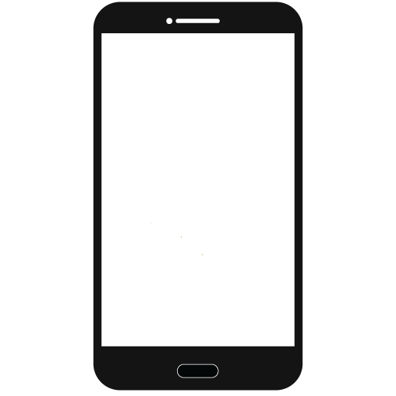
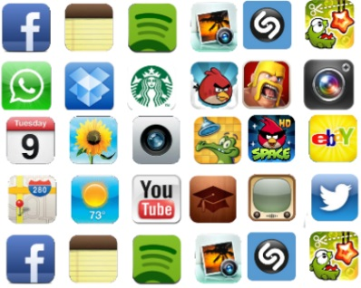



Sensitive Data Disclosures
Local Storage
Disclosed to public
Hijacked/maliciously retrieved
Notes:
OK. Recently, smartphone and mobile apps have been an essential part of our lives. At the meantime, users’ privacy has become a serious concern. It’s common for the apps to disclose the sensitive data to local storages, logs and externally public channels like Internet.
Unfortunately, such disclosures may be hijacked or maliciously retrieved by adversaries, leading to serious leakage of users’ privacy.

Slide 5


Sensitive Data
Existing work focused on sensitive data defined by certain API methods.
Most of them are permission protected
E.g., in Android, TelephonyManager.getDeviceId()
TaintDroid^{[OSDI’10]}, AndroidLeaks^{[TRUST’12]}, FlowDroid^{[PLDI’14]}
PiOS^{[NDSS’11]}
Notes:
A lot of research efforts have been spent on this area. But their focus is largely on the sensitive data defined by certain APIs, for example, the APIs that can return the device identifier or the phone’s current location. Most of these data are permission protected.

Slide 6
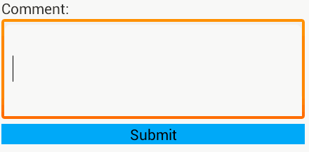
Sensitive User Inputs
We are among the first to detect user inputs as sensitive sources in mobile apps.
None of them are permission protected
E.g., user id/password, credit card number…
Insensitive
Sensitive
Notes:
Together with some approaches published in USENIX security 2015, our work, is among the first to detect user inputs as sensitive sources in mobile apps. User inputs in mobile apps are quite common and none of them are permission protected. Therefore, we need to understand the context of the inputs to determine whether they are sensitive or not.
For example, an input of credit card number is sensitive, but the comment of an app is insensitive.

Slide 7
Example User Inputs Disclosures
EditText txtCN = findViewById(R.id.cardnum);
String cnum = txtCN.getText().toString();
…
EditText txtCM = findViewById(R.id.comment);
String comment = txtCM.getText().toString();
…
HTTP
HTTP
Web Server
Notes:
For sensitive user inputs, the data is retrieved like this in the code and then disclosed to public channels, like Internet. However, for the insensitive user inputs, the data flow is the same as that of sensitive user inputs. If we wanna do some disclosure analysis, we cannot simply discover the sensitive sources by only analyzing the code because both sensitive and insensitive data are obtained through the same APIs.

Slide 8
Research Problems
How to systematically discover the input fields from an app’s UI?
How to identify which input fields are sensitive?
How to associate the sensitive input fields to the corresponding variables in the apps that store their values?
Notes:
In fact, in order to do such code analysis, we confront several challenges. (1) … (2) … (3) …
The second one is the key problem in our work.

Slide 9
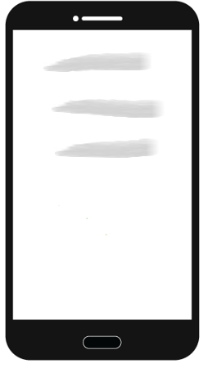


Intuition
From the user’s perspective, if we can mimic how a user looks at the UIs, we can determine which input fields can contain sensitive data within the UI context.
Notes:
We come up with an intuition that a user can simply distinguish sensitive and insensitive input fields on the UIs of mobile apps. So if we can mimic how a user looks at the UIs, we can also discover the sensitive input fields.

Slide 10
Feasibility
Render the statically defined UI layouts
 | Android | iOS | Windows Phone
Layout format | XML | NIB/XIB/Storyboard | XAML/HTML
Static UI Render | ADT | Xcode | Visual Studio
APIs map widgets to code | Yes | Yes | Yes
Associate labels to input fields based on physical locations
Notes:
Fortunately, we are able to statically build the UI via certain technologies. Mobile platforms provide some kind of static layout formats for the developers to create the Uis, and the rapid development toolkits provide WYSIWYG editing features to render the layouts. The rendered UI is close to what is shown on smartphone screens.
With the rendered UI, we can devise techniques to associate labels to input fields such that we mimic from the user’s perspective.

Slide 11
Why not use XML structure? (1)
Many developers defines relative positions of the widgets, which are not what users perceive
XML structure in this case does not guarantee that sibling widgets are physically close.
Relative positions do not intuitively show the correlation on the UI.
<Input id=“A” />
<Label id=“B” position=“above_A” />
<Label id=“C” position=“leftOf_A” />
Notes:
e.g. there are two labels B and C, and one input field A. Their positions are defined as: B is above A, and C is left of A. We cannot say whether B or C is actually the correlated label of A.

Slide 12
Why not use XML structure? (2)
Some cases in real Android apps.
<LinearLayout android:orientation=“horizontal”>
<LinearLayout android:orientation=“vertical”>
<TextView android:text=“Label 1“ />
<TextView android:text=“Label 2“ />
</LinearLayout>
<LinearLayout android:orientation=“vertical”>
<EditText android:id=“@+id/input1“ … />
<EditText android:id=“@+id/input2“ … />
</LinearLayout>
</LinearLayout>
Label 1
Input 1
Label 2
Input 2
Notes:
In addition, we also see some cases in real Android apps that define the widgets by column, instead of by row. For example, we see this table-like UI. Usually, we define it by row. That is, in the XML file, input 1 is close to Label 1 and input 2 is close to label 2. But we find that some developers define the two labels together and the two input fields together, like this. Such cases prevent us using the XML files directly to associate a label to an input field.

Slide 13
SUPOR:
Sensitive User inPut detectOR
Notes:
Based on the intuition, we propose SUPOR, a scalable and precise approach to detecting sensitive user inputs in mobile apps.

Slide 14
Overview of SUPOR
SUPOR
Keywords
Layout Analysis
Privacy Analysis
App
Layout Parsing
Disclosure
UI
Sensitiveness
Analysis
Vulnerability
Variable Binding
UI Rendering
…
Notes:
Here we come to the whole view of SUPOR. SUPOR takes as input a mobile app, and outputs the bindings of sensitive user inputs and the corresponding variables in the code to enable some further analysis.
SUPOR itself consists of three steps. The first step is to analyze the statically defined layouts, including static parsing and rendering. Then SUPOR tries to determine the sensitiveness of the input fields in the rendered layouts. At the end, it binds the discovered sensitive user inputs to the variables in the code.

Slide 15


Parsing Layout
We need to know which layout files contain input fields.
Is Sensitive User Input Detection Needed?
Layout file
layout contains input fields
layout doesn’t contain input fields
Notes:
At the very beginning, we need to know which layout files contain input fields. We do not want to spend efforts on those files without any input fields. SOPUR can discover them by parsing the layout files.

Slide 16
Rendering UI
Statically render layout files to UIs as users look at on smartphones via tools like ADT in Android.
Layout file A
Layout file B
Notes:
Based on the initial discoveries, SUPOR renders the layout files by utilizing the rapid development toolkit, for instance, ADT in Android. The results are close, if not the same, to what the users see on the smartphone screens. For example, by rendering layout A, we get this and by rendering layout B we get this.

Slide 17
Extracting Information
Collect information
Text Label
Text: Card Number
Coordinates: [16, 231, 109, 249]
Input Field
Hint: 15 or 16 digit
Coordinates: [16, 249, 464, 297]
Notes:
With the rendered UI, SUPOR can extract information for subsequent use. For the marked area, SUPOR obtains the text, the hint and the coordinates of the widgets. The text and the hint are what the users see when using the app. The coordinates are used to associate the labels to the input fields.

Slide 18
UI Sensitiveness Analysis
Sensitive Attributes in Layout Files
No
Sensitive Input Hint
Enter Password
<EditText android:id="@+id/pwd“
android:inputType=“textPassword”/>
15 or 16 digit
MM - YYYY
No
Yes
Challenge: How to precisely associate the correlated text label to a given input field?
Yes
Sensitive Text Label
Card number
Expiration date
Comment
No
Yes
The Input Field is Sensitive
The Input Field is Insensitive
Notes:
With all the information we’ve gotten, SUPOR performs a 3-step sensitiveness analysis. At first, it checks if the input field has certain attributes that indicate the sensitiveness of the data. This example shows a sensitive input field. If the sensitiveness cannot be determined, SUPOR inspects the input hints. In some apps, the users are prompted to enter password. In our previous example, the hints tell the users how to enter the data. If the hint contains sensitive keywords, the field is sensitive. Otherwise, SUPOR further checks whether the corresponding text label contains sensitive keywords. In our previous examples, the label “comment” indicates an insensitive input field but the labels “Card number” and “Expiration date” indicate sensitive input fields. The first two steps are simple but here comes a challenge that how to precisely associate the correlated text label to a given input field for the third step.

Slide 19
Associating Labels (1)
Intuition: labels at different positions relative to the input field have different probabilities to be correlated.
Label
Input Field
Input Field
Label
Label
Input Field
Input Field
Label
Notes:
An intuition is that labels at different positions relative to the input field have different probabilities to be correlated. Here are some examples.

Slide 20
Associating Labels (2)
Assign position-based weights based on empirical observations
The smaller the weight, the closer the correlation
4
2
8
0.8
Input Field
9
8
9
10
Notes:
Then we can assign position-based weights to labels at different positions, and the smaller the weight, the closer the correlation. We actually partition the UI plane into nine parts based on the borders of the input field. Based on our observations for top-down and left-right layouts, labels at left of or above the input field are most possible to be correlated while labels at right-bottom corner are most impossible.

Slide 21
Associating Labels (3)
Geometry-based correlation score computation
(x1, y1)
For each pixel (x,y) in a text label
distance(I, x, y) * posWeight(I, x, y)
Label
(x2, y2)
Average the correlation score for the text label
Input Field (I)
Notes:
To show how the text labels are correlated to one input field, we propose a geometry-based correlation score computation. For an input field and a text label with known coordinates, we compute a correlation score for each pixel in the label. The computation takes into account both the distance and the position-based weight. Then, an average score is computed for the text label.

Slide 22
Associating Labels (4)
Find out the label with the smallest correlation score among all potential labels for a given input field
Label | Number Field | Date Field
Credit card type | 265.57 | 456.42
Card number | 76.47 | 271.23
Expiration date | 205.29 | 75.40
Correlation scores
Notes:
Usually, an input field has more than one alternative labels. SUPOR selects the one with smallest correlation score. In this example, both input fields, “card number” and “expiration date” have three alternatives. The correlation scores are shown here. According to our policy, the label “Card number” is associated with the number field and the label “Expiration date” is associated with the date field.

Slide 23
Determining Sensitiveness (1)
Keyword matching approach
Sensitive
Keywords
Dataset
Card number
Matches?
Yes
Sensitive
Expiration date
No
Insensitive
Comment
Notes:
Now, we know the label text for each input field. To determine whether the input fields can contain sensitive data, we propose a keyword matching approach with a predefined sensitive keyword dataset. In our examples, “Card number” and “Expiration date” match the sensitive keywords so those two input fields are sensitive; “Comment” doesn’t match and the corresponding input field is insensitive.

Slide 24
Keyword dataset construction
App
App
All Text
Words/
Phrases
App
crawl
Select top frequent
App
App
App
App
Manually inspect
App
keywords
50,000+ apps
Dataset
Add synonyms
Notes:
Now I want to show how we build the sensitive keyword dataset. We crawled all the text in more than 50,000 apps and extract the text into words or phrases via some NLP techniques. Then we select the top frequent words and phrases, and manually inspect these words and phrases to get an initial set of sensitive keywords. Next, we add the synonyms of the selected keywords into the dataset.

Slide 25
Effectiveness
Why is keyword matching approach effective?
Small screen and short phrases or sentences
We only analyze the most relevant text label
Notes:
You may want to ask why the keyword matching approach is effective. One important reason is that the smartphone screen is relatively small and most phrases or sentences are quite short. Besides, we find out the most relevant text label and only analyze that label for each input field, instead of analyzing many labels.

Slide 26
Binding Variables (1)
Identifier: X
Widget txtCN = findViewById(X);
Data cnum = txtCN.getText();
// use of “cnum”
Notes:
After determining which input fields are sensitive, SUPOR binds them to corresponding variables in the code such that further analysis can be done. The identifier of the input field is referenced in the code, which helps SUPOR find out the variables.

Slide 27
Binding Variables (2)
Challenge: different widgets within one apps have the same identifier
<TextView android:text= =“Card Number“ />
<EditText android:id=“@+id/input1“ … />
…
<TextView android:text= =“Search“ />
<EditText android:id=“@+id/input1“ … />
…
txtInput1 = this.findViewById(input1);
txtInput2 = this.findViewById(input1);
Notes:
But one problem is that different layout files may have input fields with the same identifier. Some of them are sensitive but the others are not. input1 for card number is sensitive but insensitive for the search keywords. If we simply bind the identifier to the code, we cannot distinguish the references to the sensitive user inputs from the insensitive ones.

Slide 28
Binding Variables (3)
<TextView android:text= =“Card Number“ />
<EditText android:id=“@+id/input1“ … />
…
[layout: billing_information.xml]
<TextView android:text= =“Search“ />
<EditText android:id=“@+id/input1“ … />
…
[layout: search.xml]
Sensitive
Insensitive
id/input1
Sensitive
txtInput1 = this.findViewById(input1);
Insensitive
this.setContentView(billing_information);
txtInput2 = this.findViewById(input1);
this.setContentView(search);
Notes:
We solve this problem by leveraging backward slicing. We already know the identifier input1 can be either sensitive or insensitive and we can find out the corresponding references in the code. For the first reference, we obtain the backward slice like this. By further checking the slice, we confirm that input1 here is associated with the widget in layout billing_information instead of layout search. Then SUPOR can mark the corresponding variable txtInput1 as sensitive. For the second reference, similar slice is found and the associated widget is defined in layout search, which indicates an insensitive input field.

Slide 29
Summary of SUPOR
Statically parse layout files
Render layout files to UIs
Associate text labels to input fields
Determine the sensitiveness of input fields
Bind the sensitive input fields to variables in the code

Slide 30
Implementation & Evaluation
Implemented for Android apps and built on Dalysis^{[CHEX} ^{CCS’12]}, IBM WALA and ADT.
Only input fields of type EditText are analyzed, i.e. other user inputs like checkbox are ignored.
Implemented a sensitive user inputs disclosure detection system by combining SUPOR and static taint analysis
16,000 apps were evaluated
Notes:
Based on the design, We built SUPOR only for Android apps on top of existing tools. And we limit the input field to a small set of types in Android, instead of analyzing all possible user inputs. We also implemented a sensitive user inputs disclosure detection system to demonstrate the usefulness of SUPOR and evaluated the implementation on 16,000 apps.

Slide 31
Evaluating UI Sensitiveness Analysis (1)
9,653 apps (60.33%) contains input fields
Performance:
Average analysis time is 5.7 seconds for one app
Notes:
The UI sensitiveness analysis part, including rendering the layouts, is quite efficient. More than 96% of the apps require less than 10 seconds and the average time for one app is only 5.7 seconds.

Slide 32

Evaluating UI Sensitiveness Analysis (2)
9,653 apps (60.33%) contains input fields
Accuracy
Manually examined 40 apps . 115 layouts are rendered and 485 input fields are analyzed.
TP: sensitive user inputs are identified as sensitive
FP: insensitive user inputs are identified as sensitive
FN: sensitive user inputs are identified as insensitive
Notes:
We manually examined 40 apps, which have nearly 500 input fields. We define TP, FP and FN as follows. ..
We use recall and precision to describe the accuracy. Both of them are 97.3%, which means we have low FP rate and FN rate.

Slide 33
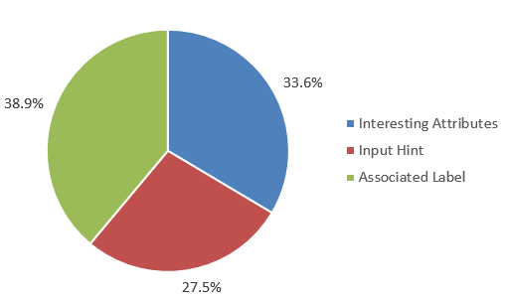
Evaluating UI Sensitiveness Analysis (3)
For the 40 apps we manually checked
149/485 (30.7%) input fields are identified sensitive.
Notes:
For the 40 examined apps, SUPOR totally identifies 149 sensitive input fields. one third can be directly identified by the interesting attributes and 27% can be discovered by matching the input hints to the keyword dataset. That means the first two steps of determining the sensitiveness can find 61% of the sensitive input fields. But we also see that 38.9% of those input fields are identified by analyzing the corresponding text label, which demonstrate the importance of associating correct labels to input fields.

Slide 34
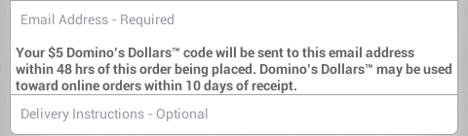
Causes for FN and FP
Insufficient context to identify sensitive keywords.
False negative: “Answer” vs “Security Answer”
False Positive: “Height” of an image file and for a human being
Inaccurate text label association
False positive: e.g. the long sentence (with keyword “email”) is associated with the “Delivery Instructions” field
Input Field
Text Label
Input Field
Notes:
We have some false positives and false negatives. One cause of false negatives and false positives in identifying sensitive input fields is that SUPOR does not have sufficient context to identify sensitive keywords. For example, “Security Answer” is a predefined sensitive keyword but one UI only has “Answer” as the text label, which actually indicates “security answer” within that context. While “answer” itself is too general, SUPOR does not consider it as a sensitive keyword. This leads to a FN. In some other cases, “Height” of a human being is sensitive but height of an image file is insensitive. We treat “Height” as a sensitive keyword then we may have FPs.
In addition to the keyword part, SUPOR sometimes incorrectly associates the labels and input fields. In this example, the long sentence is a supplemental description of “Email” field. When SUPOR cannot determine the sensitiveness of the Delivery Instruction field by analyzing the hint, it tries to find a label. That happens to be the description of the email field. The label contains sensitive keyword “email” and thus SUPOR marks the delivery instruction field as sensitive, which is a FP.

Slide 35
Evaluating Disclosure Analysis
For all 16,000 apps
Throughput: 11.1 apps/minute
A cluster of 8 servers
3 apps are analyzed on each server in parallel
Manually examined 104 apps
False positive rate is 8.7%
Limitations of underlying taint analysis framework
E.g. lack of accurate modeling of arrays
Notes:
For the sensitive user inputs disclosure evaluation, the throughput is about 11 apps per minute on a cluster of 8 servers with 3 apps analyzed on each server in parallel.
We manually check 104 apps and the false positive rate is about 8.7%. In addition to the errors of identifying sensitive user inputs, the limitation of underlying taint analysis framework is the major cause of false positives. We do not count false negatives here because we do not have oracle of the apps and it’s not easy to track the data flows manually.

Slide 36
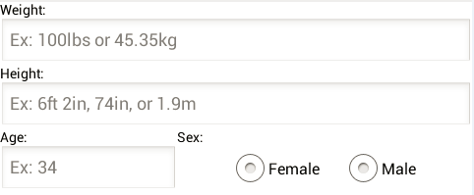
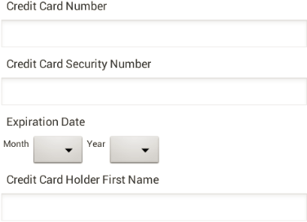
Case Studies (1)
com.canofsleep.wwdiary
3 input fields associated with labels “Weight”, “Height” and “Age” are identified sensitive.
com.nitrogen.android
The 3 marked inputs fields are identified sensitive and their data are disclosed.
Notes:
Here are some real case. In the first one, Weight, Height and Age fields are identified sensitive. In the second case, the credit card number, the security number and the holder’s name are identified sensitive and they are discovered to be disclosed to public channels.

Slide 37
Case Studies (2)
44/104 apps send sensitive user inputs via network
Only 10 adopts HTTPS
Most transmissions are in plain text via HTTP
Notes:
We also further checked 44 apps among the 104 apps, which send sensitive user inputs via network. We found that only 10 apps adopt HTTPS connections. Most of the apps directly transmit data in plain text via HTTP. So even if we cannot say these disclosures are malicious, they may cause some leakage problems of users’ privacy.

Slide 38
Related Work (1)
UIPicker in USENIX Security’15.
Build keyword dataset
Sensitive data sources
SUPOR
UIPicker
Top frequent sensitive keywords
Add synonyms
Discover keywords via machine learning based on an initial kw set
EditText only
EditText, TextView (label), Spiner, …
Notes:
Next I want to talk about a similar approach UIPicker that was also presented in USENIX security 2015. UIPicker also aims at identifying sensitive user-inputs. I will compare SUPOR and UIPicker from several aspects. For building the sensitive keyword dataset, SUPOR uses the top frequent sensitive keywords and some synonyms. UIPicker discovers keywords via machine learning based on an initial keyword set. And current version of SUPOR only focuses on a small set of input fields while UIPicker focuses on more types of user inputs.

Slide 39
Related Work (2)
UIPicker in USENIX Security’15.
Determining sensitiveness via information the widgets hold
SUPOR
UIPicker
Interesting attributes (e.g. inputType)
Input hints
Interesting attributes
Input hints
Layout descriptions (e.g. @id/edt_password)
Notes:
When we want to determine whether an input is sensitive, from what the field already has, SUPOR only focuses on interesting attributes and inputs hints while UIPicker also checks the layout descriptions. For example, the names of the references may indicate the sensitiveness. We can improve our approach in the future by taking such information into consideration.

Slide 40
Related Work (3)
UIPicker in USENIX Security’15.
Associating a corresponding label
SUPOR
UIPicker
Most correlated label in rendered UI
Sibling label in XML file
Notes:
But if we cannot determine the field’s sensitiveness, both approaches try to associate a label to the target input field. SUPOR chooses the most correlated label in rendered UI based on our correlation score computation. UIPicker, however, directly use the sibling label in the XML file, which could fail for layout files that define widgets using relative positions and some cases we mentioned earlier.

Slide 41
Conclusion
We study the possibility of detecting sensitive user inputs, an important yet mostly neglected sensitive source in mobile apps.
We propose SUPOR, among the first known approaches to detect sensitive user inputs with high recall and precision.
Mimics from the user’s perspective by statically and scalably rendering the layout files.
Leverages a geometry-based approach to precisely associated text labels to input fields.
Utilizes textual analysis to determine the sensitiveness of the texts in labels.
We perform a sensitive user inputs disclosure analysis, with FP rate of 8.7%, to demonstrate the usefulness of SUPOR.
Notes:
OK, to conclude our work,

Slide 42
Thank You!
Q & A
CERIAS Security Seminar
09/02/2015

