Slide 1


AsDroid: Detecting Stealthy Behaviors in Android Applications by User Interface and Program Behavior Contradiction
Jianjun Huang, Xiangyu Zhang, Lin Tan,
Peng Wang, Bin Liang
Purdue University
University of Waterloo
Renmin University of China

Slide 2
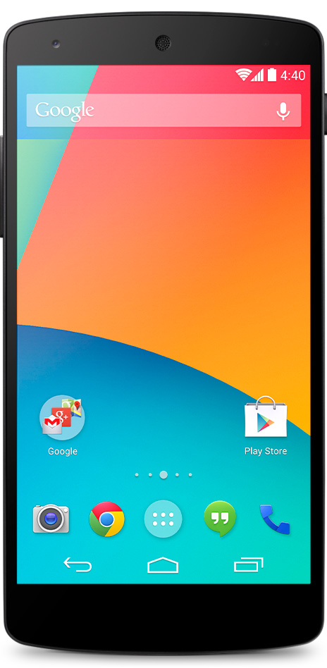
Motivation
Stealthy behaviors in Android apps
Premium rate Phone number
You didn’t see me
Send SMS to
Send request to
Respond with malicious app
Malicious Web site

Slide 3
Motivation
Stealthy behaviors in Android apps
52-64% of existing malwares send stealthy premium rate SMS messages or make phone calls (A. P. Felt. SPSM’11, Y. Zhou. S&P’12)
Stealthy HTTP requests are also very common undesirable behaviors in malware (A. P. Felt. SPSM’11)
A kind of malware making stealthy HTTP connections caused 8 million dollars loss in March 2010 in China (news in SINA.com)

Slide 4
Motivation
Challenges
Malicious behaviors appear to be indistinguishable from that of benign apps
Existing techniques are insufficient in detecting stealthy behaviors
Access control by setting application privileges
Very coarse-grained
Taint analysis
Stealthy behaviors may not leak any information
Blacklisting premium-rate phone numbers
Non-trivial to keep a blacklist up-to-date

Slide 5
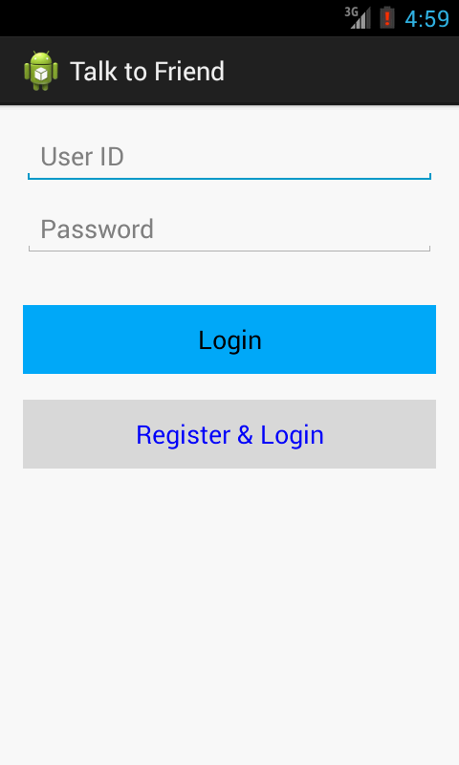
Motivating Example
public class RegLoginListener implements OnClickListener {
public void onClick(View view) {
String uid = ...;
String pass = ...;
if (pref. getBoolean("registered", false)) {
LoginTask.doLogin(uid, pass);
} else {
sendRegisterSms(getPhoneNumber());
doRegister(uid, pass);
...
}
}
}

Slide 6
Motivating Example
public class RegLoginListener implements OnClickListener {
public void onClick(View view) {
String uid = ...;
String pass = ...;
if (pref. getBoolean("registered", false)) {
LoginTask.doLogin(uid, pass);
} else {
sendRegisterSms(getPhoneNumber());
doRegister(uid, pass);
...
}
}
private void sendRegisterSms(String phoneNum) {
String msg = String.format("Register Phone: %s",
phoneNum);
SmsManager sm = SmsManager.getDefault();
sm.sendTextMessage("106053", null, msg, null, null);
}
}
public class LoginTask extends AsyncTask {
protected String doInBackground(String... params) {
http.execute(get); // http & get are fields
}
public static void doLogin(String uid, String pass) {
LoginTask login = new LoginTask();
String[] params = new String[] { uid, pass };
login.execute(params);
}
}
RegLoginListener.onClick()
LoginTask.doLogin()
sendRegisterSms()
LoginTask.execute()
indirect call
LoginTask.doInBackground()
SmsManager.sendTextMessage()
HttpClient.execute()

Slide 7
Technique Overview
Code Behavior Annotations
HttpAccess: API calls for accessing Internet
HttpClient.execute()
SendSms: API calls for sending short messages in background
SmsManager.sendTextMessage()

Slide 8
Technique Overview
RegLoginListener.onClick()
HttpAccess
SendSms
LoginTask.doLogin()
sendRegisterSms()
HttpAccess
LoginTask.execute()
HttpAccess
SendSms
indirect call
LoginTask.doInBackground()
HttpAccess
SmsManager.sendTextMessage()
HttpClient.execute()

Slide 9



Technique Overview
HttpAccess
Code behaviors
RegLoginListener.onClick()
Correlation Analysis
SendSms
UI Text
HttpAccess
SendSms

Slide 10


Technique Overview
Android App
Static Program Analysis
Code Behavior Annotation Propagation
Correlation Analysis
Text Analysis
Behavior Contradiction Analysis
Text Extraction
Keyword Dictionary Construction
Reports

Slide 11
Static Program Analysis
Code Behavior Annotation Propagation
Starting from API calls
Propagating reversely along Call Graph
1 private void sendRegisterSms(String phoneNum) {
2 ...
3 sm.sendTextMessage("106053", null, msg, null, null);
4 }
sendRegisterSms() @1
invoke (sendRegisterSms,
sendTextMessage,
3)
SendSms
hasBehavior (sendRegisterSms,
SendSms,
3)
SmsManager.sendTextMessage() @ 3
&
apiBehavior (3, SendSms)

Slide 12
Static Program Analysis
Correlation Analysis
Data Correlation Analysis
definition-use (abbr. def-use)
use-use
benign
Annotation 1
UI Artifact
correlated
Annotation 2
Manifestation annotation

Slide 13
Static Program Analysis
Correlation Analysis (def-use)
UiOperation: Display UI artifacts, e.g. set background image (used to prune FP)
defUse (2, 3)
1 protected String doInBackground(String... params) {
2 response = http.execute(get);
3 InputStream is = response.getContent();
4 Bitmap bm = BitmapFactory.decodeStream(is);
5 imageView.setImageBitmap(bm);
6 }
&
defUse (2, 3)
hasBehavior (doInBackground, HttpAccess, 2)
defUse (3, 4)
defUse (3, 4)
&
defUse (4, 5)
defUse (4, 5)
hasBehavior (doInBackground, UiOperation, 5)
&
hasBehavior (doInBackground, HttpAccess, 2)
&
hasBehavior (doInBackground, UiOperation, 5)
correlatedBehavior (doInBackground, HttpAccess, 2, UiOperation, 5)

Slide 14
Static Program Analysis
Correlation Analysis (use-use)
NotifySms: notify the user about SMS send, e.g. store the SMS into the mail-box (used to prune FP)
1 private void sendRegisterSms(String phoneNum) {
2 String msg = ...
3 sm.sendTextMessage("106053", null, msg, null, null);
4 ContentValues cv = new ContentValues();
5 cv.put("address", "106053");
6 cv.put("body",msg);
7 cv.put("type",2);
8 ContentResolver cr = getContentResolver();
9 Uri uri = Uri.parse("content://sms");
10 cr.insert(uri, cv);
11 }
defUse (2, 3)
useUse (3, 10)
&
&
hasBehavior (sendRegisterSms, SendSms, 3)
&
defUse (2, 10)
hasBehavior (sendRegisterSms, NotifySms, 10)
correlatedBehavior (sendRegisterSms, SendSms, 3, NotifySms, 10)

Slide 15
Text Analysis
Behavior Contradiction Analysis
Code Behavior Propagated to GUI Event Handling Function
Represented by
API Calls
Behavior Indicated by UI Text
Contradicted?
Represented by
UI Text

Slide 16
Text Analysis
Text Extraction
In general, Android developers tend to use XML files to define GUI layout and store constant text in XML files.
Button btn = findViewById(R.id.reg_login);
btn.setOnClickListener(
new RegLoginListener(this));
<Button android:id="@+id/reg_login"
android:text="@string/reg_login" />
<String name="reg_login">Register &amp; Login </String>

Slide 17
Text Analysis
Keyword Dictionary Construction
Text for Event Handling Function 1
Keyword 1
SendSms
Text for Event Handling Function 2
Keyword 2
Collected Text
Keyword …
Text for Event Handling Function …
Keyword m
Text for Event Handling Function n

Slide 18
Text Analysis
Keyword Dictionary Example for SendSms
Human Semantic Analysis to prune keyword set
e.g. filtering out “OK”

Slide 19
Text Analysis
The Original Example
RegLoginListener.onClick()
HttpAccess
Code
Behavior
Register
Login
UI Text
SendSms

Slide 20
Evaluation
Target Code Behavior Annotations
SendSms
HttpAccess
PhoneCall: make phone calls without user’s consent
Install: install packages in background
Auxiliary Code Behavior Annotations
Correlated target behaviors are considered benign
NotifySms
UiOperation

Slide 21
Evaluation
Apps Sources
Selection criteria: SendSms, PhoneCall, Install
Apps Source | No. of Apps
Contagio Mini Dump | 96
Google Play | 12
Wandoujia | 74
Total | 182

Slide 22
Evaluation
Analysis Results
Rep: #Apps reported with stealthy behavior
FP: #Apps false positive
FN: #Apps false negative
HTTP |  |  | SMS |  |  | CALL |  |  | INSTALL |  |  | Total
Rep | FP | FN | Rep | FP | FN | Rep | FP | FN | Rep | FP | FN | Rep | FP | FN
94 | 26 | 3 | 70 | 3 | 2 | 2 | 0 | 0 | 2 | 0 | 6 | 113 | 28 | 11

Slide 23
Evaluation
False Positive Rate:
28/113 = 24.8%
Incompleteness of keyword dictionary
HTTP
Rep | FP | FN
94 | 26 | 3
Complex Ad logic
Solution
Post-Processing phase
to suppress warning

Slide 24
Evaluation
Detection Rate
85 / (85 + 11) = 88%
Implicit call edges
INSTALL
Rep | FP | FN
2 | 0 | 6
Native libraries

Slide 25
Evaluation
Performance
Most can be done within 200 seconds.

Slide 26
Limitations
Textual keywords analysis is insufficient
More advanced text analysis or image analysis
Future adversary may obfuscate a malicious app to induce bogus correlations
Leverage testing or symbolic analysis

Slide 27
Related Work
Taint Analysis
TaintDroid (W. Enck et al. OSDI’10)
FlowDroid (C. Fritz et al. TechRep)
Malicious SMS/PhoneCall Detection
Hardcoded number (W. Enck et al. Security’11)
Stealthy Behavior Detection
Absence of data dependence path between user input/action and a sensitive function (K. Elish et al. MoST’12)
Text Analysis
Whyper (R. Pandita et al. Security’13)

Slide 28
Conclusion
We presented AsDroid to detect stealthy behaviors in Android apps.
The key idea is to identify contradiction between program behavior and user interface text.
Static program analysis is applied for correlation analysis between code behaviors.
Text analysis is utilized for contradiction analysis.

Slide 29
END
Questions?

