Slide 1

NAR-Miner: Discovering Negative Association Rules from Code for Bug Detection
Pan Bian, Bin Liang*, Wenchang Shi, Jianjun Huang
Renmin University of China
Yan Cai
Institute of Software, Chinese Academy of Sciences
November 7, 2018

Slide 2
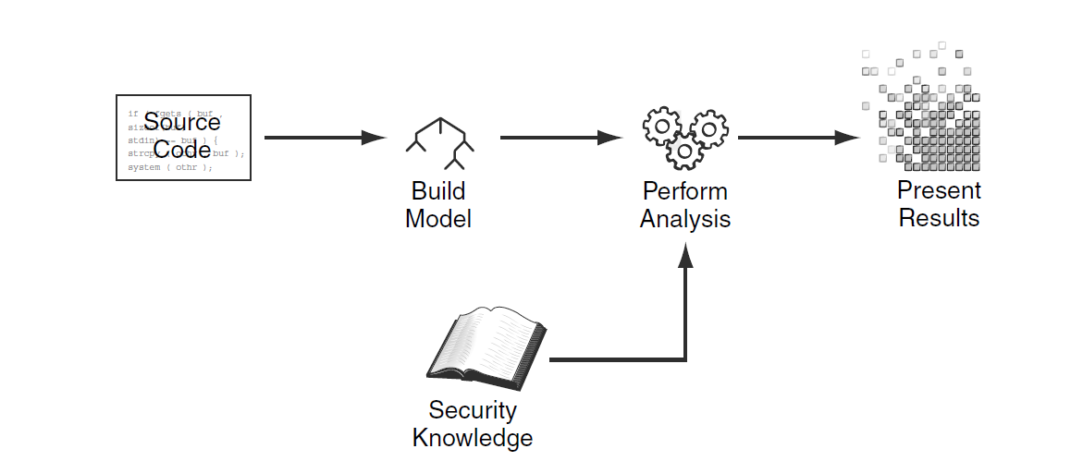
1. Background
Static program analysis is an important technique to detect software bugs
To detect bugs, static program analysis tools have to know the detection rules that specify what should do or what should not do in certain contexts
Detection Rules
The Figure is quoted from “Secure Programming with Static analysis” written by B. Chess and J. West
Notes:
The rule set is key to perform static analysis. No rules no bugs can be detected.

Slide 3
Detection Rules for Static Analysis Tools
Built-in rules: collect and integrate detection rules for well-known APIs
e.g., malloc, free, strncpy, memset, …
Application-specific rules: let users write custom rules
Difficult to enforce: time-consuming and error-prone
ERROR
scsi_host_put(v)
Start
Freed
*v
write_dev(l, v, …)
…
Use After Free
Notes:
Static analysis tools often integrate a set of rules for well-known APIs
As with application-specific elements they often provide interfaces to let users write custom rules.

Slide 4
Inferring Rules from Source Code
Automatically infer rules from source code with data mining techniques
Deep insight: Defective implementations are far fewer than bug-free ones in real-word large-scale systems
Method: If a program pattern frequently appears through the target system, we can take it as a candidate rule
Representative works: PR-Miner, Alattin, AntMiner, APISan …
Notes:
The achievements gained in previous methods have shown that mining rules is effective in detecting bugs involving application-specific rules.
Previous works mainly focus on mining positive association rules that specify which element should be called when some elements are called

Slide 5
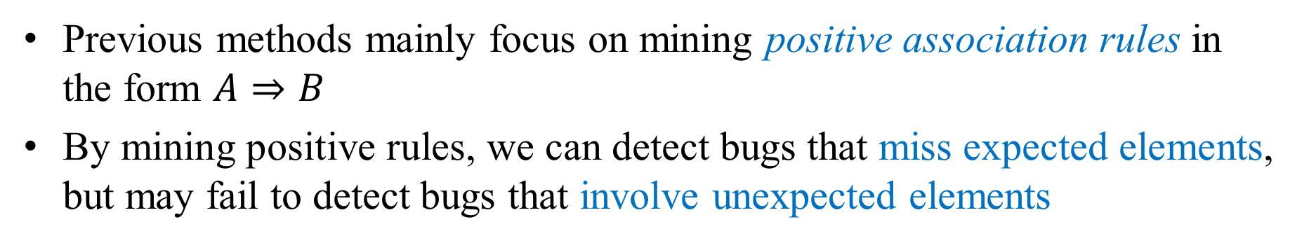


Bugs Can and Cannot be Detected by Mining Positive Rules
Previous methods mainly focus on mining positive association rules in the form $A⇒B$
By mining positive rules, we can detect bugs that miss expected elements, but may fail to detect bugs that involve unexpected elements
1: err = snd_pcm_new(…, &pcm);
2: ++ if(err < 0)
3: ++ return;
4: snd_pcm_set_ops(pcm, …);
ndev = alloc_netdev(…);
netdev_free(ndev);
-- kfree(ndev + offset)
False Negative
Violate positive rule
Not violate positive rule
{err = snd_pcm_new()} $⇒${if(err < 0)}
{alloc_netdev}$⇒$ {netdev_free}
A bug missing an expected condition
A bug containing an unexpected function call
Notes:
In such cases, program elements are negatively correlated rather than positively associated.

Slide 6
2. Motivation
// file: linux-v4.12-rc6/drivers/net/wan/lapbether.c
1 : static int lapbeth_new_device(struct netdevice *dev) {
2 : struct netdevice *ndev; struct lapbethdev *lapbeth;
3 : ndev = alloc_netdev(sizeof(*lapbeth), …);
4 : …
5 : lapbeth = ndev + ALIGN(sizeof(struct net_device));
6 : …
7 : if (register_netdevice(ndev))
8 : goto fail;
9 : …
10: fail:
11: free_netdev(ndev);
12: kfree(lapbeth);
13: }
sizeof(netdevice)
ALIGN
sizeof(lapbethdev)
allocate memory
ndev
lapbeth
point to the private data
release the whole memory chunk
ndev
lapbeth
Double Free
release the private data again
ndev
lapbeth
Notes:
We use an example to show why positive methods fail to detect some real bugs.
The example code comes from Linux, it contains a double free bug.

Slide 7

Difficult to Detect the Bug from Positive Perspective
// file: linux-v4.12-rc6/drivers/net/wan/lapbether.c
1 : static int lapbeth_new_device(struct netdevice *dev) {
2 : struct netdevice *ndev; struct lapbethdev *lapbeth;
3 : ndev = alloc_netdev(sizeof(*lapbeth), …);
4 : …
5 : lapbeth = ndev + ALIGN(sizeof(struct net_device));
6 : …
7 : if (register_netdevice(ndev))
8 : goto fail;
9 : …
10: fail:
11: free_netdev(ndev);
12: kfree(lapbeth);
13: }
Mining valid positive rules related to
alloc_netdev, free_netdev, and kfree
{alloc_netdev} $⇒$ {free_netdev}
miss neither alloc_netdev nor free_netdev
not violate
Fail to detect the bug!
Notes:
To detect the bug, a positive method first tries to infer positive association rules related to alloc_netdev, free_netdev, and kfree. Other related positive rules are not valid as their confidences are too low.
Through mining, we can get the only valid positive rule IF call alloc_netdev THEN call free_netdev.

Slide 8

Detecting the Bug from Negative Perspective
// file: linux-v4.12-rc6/drivers/net/wan/lapbether.c
1 : static int lapbeth_new_device(struct netdevice *dev) {
2 : struct netdevice *ndev; struct lapbethdev *lapbeth;
3 : ndev = alloc_netdev(sizeof(*lapbeth), …);
4 : …
5 : lapbeth = ndev + ALIGN(sizeof(struct net_device));
6 : …
7 : if (register_netdevice(ndev))
8 : goto fail;
9 : …
10: fail:
11: free_netdev(ndev);
12: kfree(lapbeth);
13: }
free_netdev and kfree are negatively associated
Calling one should not call the other
Negative Association Rule
{free_netdev} $⇒$ $¬${kfree}
contain both free_netdev and kfree
violate
Succeed to detect bug!
Notes:
In fact, the root cause of the bug is calling free_netdev and kfree in the same context. The two functions are negatively associated and should not be called together.
As a support to the negative rule, we found that in all other cases they are not called together.

Slide 9
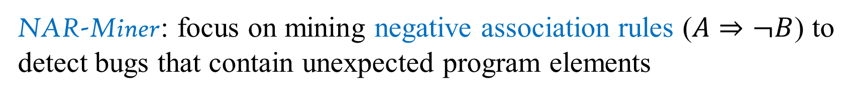
3. Approach
NAR-Miner: focus on mining negative association rules ($A⇒¬B$) to detect bugs that contain unexpected program elements
1
Transaction
Database
2
Source Code
Preparing Data
Mining
Frequent and Infrequent Itemsets
3
4
Inferring Rules
Negative Association Rules
Detecting Violations
Bugs
Function Entropy
Notes:
A negative rule is represented in the form IF A THEN NOT B, meaning that calling A should not call B.
Finally, detecting violations to find potential bugs.
Then I will introduce what is done in each phase

Slide 10
Phase 1: transforming source code into a transaction database suitable for mining
A function definition is mapped to a transaction in the database
A statement in a function is mapped to an item in the transaction
1: str = read1();
2: str = read2();
3: valid = is_valid(str);
4: if (valid) {
5: foo(str);
6: } else {
7: bar(str);
8: }
read1
read2
is_valid
foo
bar
INT==0
Source Code
Transaction
Notes:
Function definitions are mapped to transactions
Statements are mapped to items

Slide 11
Phase 2: mining the database to extract frequent and infrequent itemsets
Definition: the support for itemset I is the number of transactions that contain all items in I, denoted as support(I)
An itemset is frequent if its support is larger than a given threshold mfs
An itemset is infrequent if its support is smaller than a given threshold mis
support({free_netdev}) = 533
support({kfree}) = 18194
support({free_netdev, kfree}) = 1
mfs = 15, mis = 5
{free_netdev} is frequent
{kfree} is frequent
{free_netdev, kfree} is infrequent
Notes:
frequent and infrequent itemsets are extracted
By computing the support for each itemset and comparing with given thresholds, we can identify frequent and infrequent itemsets.

Slide 12
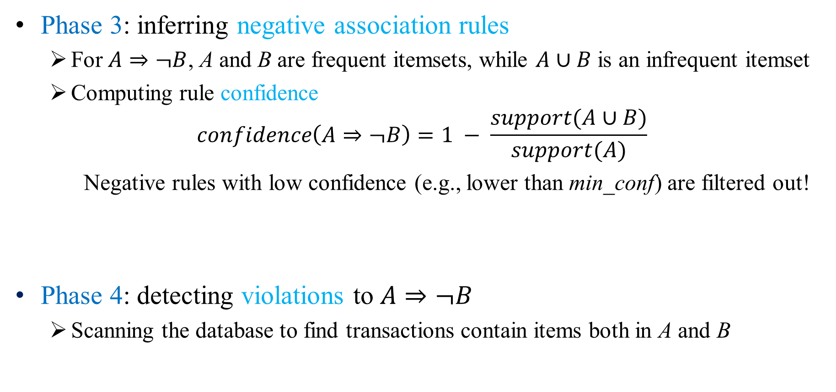
Phase 3: inferring negative association rules
For $A⇒¬B$, A and B are frequent itemsets, while $A∪B$ is an infrequent itemset
Computing rule confidence
$$confidence\left(A⇒¬B\right)=1 − \frac{support(A∪B)}{support(A)}$$
Negative rules with low confidence (e.g., lower than min_conf) are filtered out!
Phase 4: detecting violations to $A⇒¬B$
Scanning the database to find transactions contain items both in A and B
{free_netdev} $⇒¬$ {kfree}: confidence = 1 - 1/533
Notes:
We only care about negative rules that both of the left side and the right side are frequent itemsets but their union is an infrequent itemset.
Transactions contain both the left side and the right side of a negative rule are regarded as violations.

Slide 13
4. Challenge and Solution
Challenge: rule explosion problem
Many mined negative association rules are uninteresting, i.e., they do not embody real programming logics
Example: we got more than 180,000 negative association rules when directly applying the rule mining algorithm^{[1]} on the Linux-4.12
Rules composed of irrelevant elements
Rules contain general-purpose elements
Interesting rules
[1] Wu X, Zhang C, Zhang S. Efficient mining of both positive and negative association rules[J]. ACM Transactions on Information Systems (TOIS), 2004, 22(3): 381-405.
Notes:
However, when directly applying the above mining method, we will get a large number rules that do not embody real programming logics. We call such rules uninteresting rules.
We found two common types of uninteresting bugs: rules composed of irrelevant elements and rules contain general-purpose elements.

Slide 14
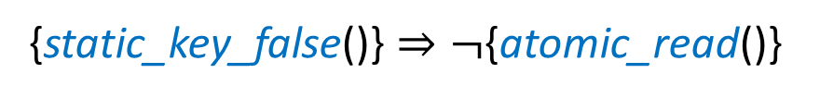

Uninteresting Negative Rule Examples
1: static void load_mm_cr4(struct mm_struct *mm) 2: { 3: if (static_key_false(&rdpmc_always_available) || 4: atomic_read(&mm->context.perf_rdpmc_allowed)) 5: cr4_set_bits(X86_CR4_PCE); 6: } | 1: static int mtk_wdt_stop(struct watchdog_device *wdt_dev) 2: { 3: reg = readl(wdt_base + WDT_MODE); 4: reg &= ~WDT_MODE_EN; 5: reg |= WDT_MODE_KEY; 6: iowrite32(reg, wdt_base + WDT_MODE); 7: return 0; 8: }
A rule composed of data irrelevant elements
A rule contains a general-purpose element
{static_key_false()} $⇒¬${atomic_read()}
{iowrite32} $⇒¬${readl}
Uninteresting Negative Rules
Notes:
These are two uninteresting negative rule examples. We can see that they do not embody real programming logics.

Slide 15
Our Solution to Rule Explosion Problem
Pruning: Introducing semantic constraints during mining to reduce negative association rules consist of irrelevant elements
Ranking: Introducing information entropy to measure the generality of program elements and further measure the interestingness of rules. Rank rules according to their interestingness
Pruning
Ranking
Notes:
pruning rules that are certainly uninteresting during mining
ranking rules to place interesting ones at top after mining

Slide 16
Technique 1: Pruning Rules
Do not generate rules whose elements have no data relationships
During preprocessing, we also store the data relationships among elements into the transaction database
During mining, we ignore itemsets whose elements have no data relationship
1: str = read1();
2: str = read2();
3: valid = is_valid(str);
4: if (valid) {
5: foo(str);
6: } else {
7: bar(str);
8: }
read1
support
{read2, foo}
read2
is_valid
not support
{read1, foo}
foo
bar
INT==0
Source Code
Transaction
Notes:
To achieve this goal, we also store data relations among …

Slide 17
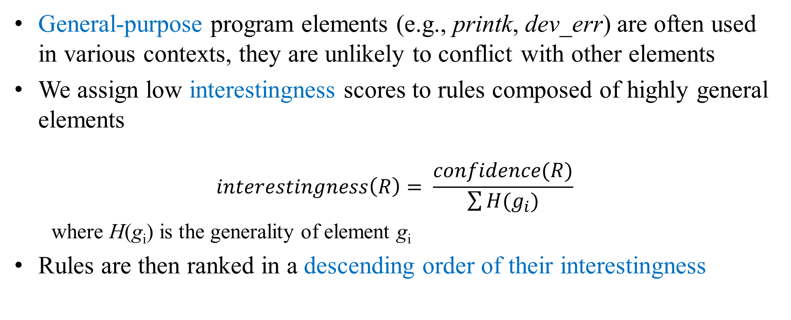
Technique 2: Rule Ranking
General-purpose program elements (e.g., printk, dev_err) are often used in various contexts, they are unlikely to conflict with other elements
We assign low interestingness scores to rules composed of highly general elements
$$interestingness\left(R\right)= \frac{confidence(R)}{\sum{H(g_{i})}}$$
where H(g_{i}) is the generality of element g_{i}
Rules are then ranked in a descending order of their interestingness
Notes:
placed at top
We note that …
The method is inspired by the heuristic that …
Now, the key is to quantitatively [ˈkwɑntəˌteɪtɪv] measure how general an element is.

Slide 18
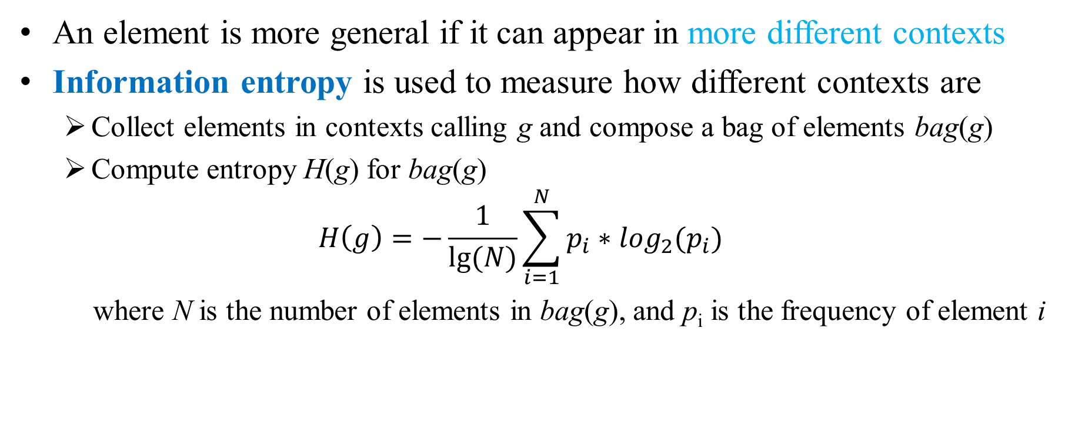
Measuring Element Generality
An element is more general if it can appear in more different contexts
Information entropy is used to measure how different contexts are
Collect elements in contexts calling g and compose a bag of elements bag(g)
Compute entropy H(g) for bag(g)
$$H\left(g\right)=−\frac{1}{lg⁡(N)}\sum_{i=1}^{N}{p_{i}∗\log_{2}(p_{i})}$$
where N is the number of elements in bag(g), and p_{i} is the frequency of element i
Notes:
Intuitively, …
The entropy is taken as the generality for the target element.

Slide 19
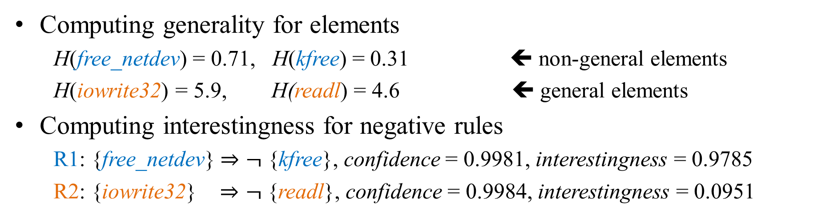
Example to Measure Rule Interestingness
Computing generality for elements
H(free_netdev) = 0.71, H(kfree) = 0.31 ⬅ non-general elements
H(iowrite32) = 5.9, H(readl) = 4.6 ⬅ general elements
Computing interestingness for negative rules
R1: {free_netdev} $⇒¬$ {kfree}, confidence = 0.9981, interestingness = 0.9785
R2: {iowrite32} $⇒¬$ {readl}, confidence = 0.9984, interestingness = 0.0951
Ranking by Rule Confidence
Ranking by Rule Interestingness
Notes:
Rules involving general elements will have relatively low interestingness, and will be put at bottom when ranked by rule interestingness.

Slide 20
5. Evaluation
RQ1: Is the rule explosion problem mitigated with our method?
RQ2: Are there real bugs violating negative association rules?
RQ3: Can these bugs detected by positive methods?
Implementation
Frontend: gcc-4.8.2
Mining Alg.: modified Apriori
TOEs
Linux v4.12-rc6
PostgreSQL v10.3
OpenSSL v1.1.1
FFmpeg v4.3.2
Parameter Thresholds
mfs: 15
mis: 5
min_conf: 85%
Notes:
We implemented NAR-Miner and applied it on four large-scale systems to show the effectiveness of our method. We conduct a series of experiments to answer three Research Questions:

Slide 21
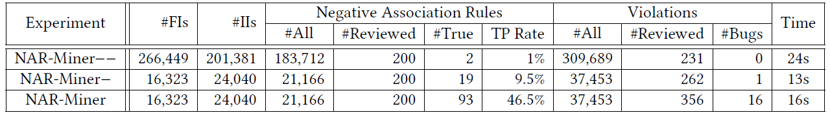
RQ1: Is the rule explosion problem mitigated with our method?
Target of Evaluation: Linux-v4.12-rc6
Experiment | Mining with | Ranking by
NAR-Miner-- | No Semantic Constraints | Rule Confidence
NAR-Miner- | Semantic Constraints | Rule Confidence
NAR-Miner | Semantic Constraints | Rule Interestingness
Notes:
double minus version
minus version
the full capability

Slide 22
Semantic Constraints
Information Entropy
NAR-Miner-- vs. NAR-Miner- | Introducing semantic constraints reduces a large number of negative rules (about 90%)
NAR-Miner- vs. NAR-Miner | Introducing information entropy does not reduce negative rules
Notes:
By comparing the number of negative rules, we see that

Slide 23
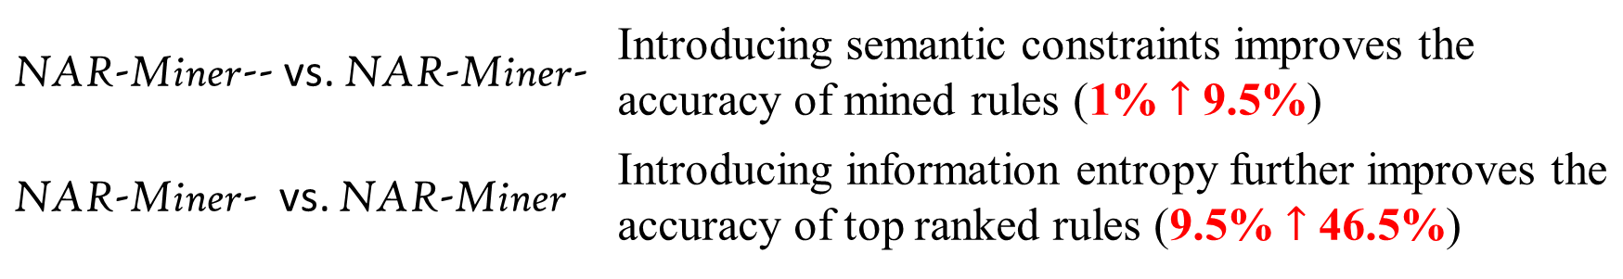
Information Entropy
Semantic Constraints
NAR-Miner-- vs. NAR-Miner- | Introducing semantic constraints improves the accuracy of mined rules (1% $↑$ 9.5%)
NAR-Miner- vs. NAR-Miner | Introducing information entropy further improves the accuracy of top ranked rules (9.5% $↑$ 46.5%)
Notes:
By comparing the number of interesting negative rules among the top ones, we see that

Slide 24
RQ2: Are there real bugs violating negative association rules?
We inspected the top ranked rules and their violations for Linux, PostgreSQL, OpenSSL, and FFmpeg
We found 29 suspicious bugs
23 of them have been confirmed by developers and fixed in latest versions
The other suspicious bugs are waiting for further confirmation
Target Project | Suspicious Bugs | Confirmed Bugs
Linux-v4.12-rc6 | 23 | 17
PostgreSQL-v10.3 | 2 | 2
OpenSSL-v1.1.1 | 2 | 2
FFmpeg-v4.3.2 | 2 | 2
Total | 29 | 23

Slide 25
RQ3: Can these bugs detected by positive methods?
Experiment: Inferring positive rules and detecting violations
18 out of the 23 bugs are not detected
The positive rules for the five detected bugs are ranked at bottom (>1000), likely to be ignored during manual inspection
Notes:
Theoretically, if a bug contains unexpected elements and meanwhile, it misses some expected elements, it can be detected both positively and negatively
This shows that mining negative rules can help find bugs that are difficult to be detected by positive mining based methods!

Slide 26
6. Conclusion
A method to mine negative association rules for bug detection
An approach to mitigating the rule explosion problem
A prototype-system that detects a considerable number of real bugs

Slide 27
Q&A
Thank you!

Slide 28


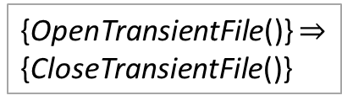
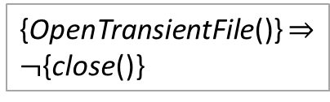
A Case Study
Positive
Negative
// PostgreSQL: function dsm_impl_mmap
{OpenTransientFile()} $⇒$
{CloseTransientFile()}
{OpenTransientFile()} $⇒$
$¬${close()}
OpenTransientFile
violate
not violate
close
CloseTransientFile
fstat
Undetected
Detected
Notes:
It incorrectly uses close to release the file handler fetched by OpenTransientFile.
Through PostgreSQL, we mine a positive rule and a negative rule related to OpenTransientFile and close. As the buggy code violates the negative rule but does not violate the positive rule. It can only be detected from a negative perspective.

Slide 29
Related Works
Reference | Short Description
Engler et al. SOSP 2001 | Inferring rules for given rule templates
Kremenek et al. OSDI 2006 | Inferring rules by computing joint probability distribution
Wasylkowski and Zeller ASE 2011 | Mining temporal rules for object usages
PR-Miner | Mining positive association rules for bug detection
Alattin | Mining alternative positive rules to eliminate false positives
AntMiner | Mining accurate positive rules by reducing noise interference
Bugram | Using language model to detect low probability sequences as bugs
Beschastnikh et al. ESEC/FSE’11 | Detecting missed or unexpected events from system execution logs

