Slide 1

UI Driven Android Application Reduction
Jianjun Huang, Yousra Aafer, David Perry, Xiangyu Zhang, Chen Tian
Notes:
Good afternoon, everyone. My name is Jianjun Huang, from Purdue University. Today I will present our paper UI Driven Android Application Reduction.

Slide 2
Background
Apps tend to contain a lot of rarely used functionalities.
Advertisements in more than 50% of Android apps^{[1]}.
Extra undesirable features.
[1] A. Brain, “Statistics of Android ad networks,” https://www.appbrain.com/stats/libraries/ad
Notes:
Nowadays, while mobile apps have been an integral part of our life, the apps tend to contain a lot of rarely used functionalities. For example, studies have found that more than 50% of Android apps contain advertisements. Besides, apps may contain extra features that are considered redundant or distracting by the users.

Slide 3
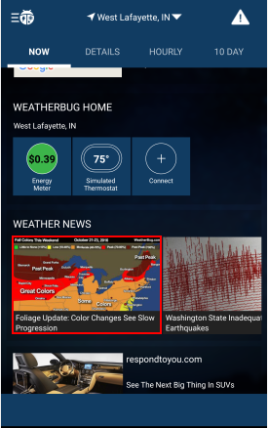
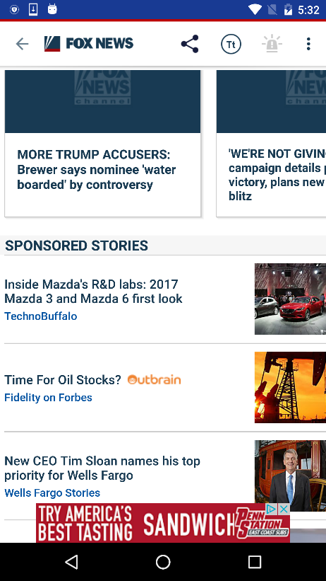

Extra Features
Advertisements
WeatherBug
Fox News
Irrelevant Functionality
China Calendar
Notes:
A weather app may contain features other than real-time weather condition; a news app usually has advertisements at the end of each news page; and even a calendar app includes news-like sections that are totally irrelevant.

Slide 4
Bad Effect
Identified sensitive information exposure in Ad networks^{[2]}.
Advertisements may reach some destinations that play an important role in propagating attacks^{[3]}.
Additional consumption of battery power, CPU, bandwidth and so on^{[4]}.
Also demonstrated in Evaluation part.
[2] M. Egele, at el. PiOS: Detecting privacy leaks in iOS applications. NDSS 2011.
[3] V. Rastogi, at el. Are these ads safe: Detecting hidden attacks through the mobile app-web interfaces. NDSS 2016.
[4] J. Gui, at el. Truth in advertising: The hidden cost of mobile ads for software developers. ICSE 2015.
Notes:
Uninteresting users might find those features quite distracting. In addition, researchers have identified sensitive information exposure in ad networks and some advertisements may reach destinations that play an important role in propagating attacks. Studies also have shown that extra features consume a lot of battery power, CPU, network data and so on.

Slide 5
Need of App Customization
To meet the various demands of different user groups.
Enterprises want the apps installed on their employee’s devices to not have potentially malicious third-party components.
Users operating devices in rough environments want to minimize battery and data consumption by turning off unnecessary app features.
Parents want to disable components that deliver inappropriate content to their children.
Notes:
Therefore, there is a need of customizing the apps to meet the various demands of different user groups. For example, enterprises may want the apps installed on their employee’s devices to not have potentially malicious third-party components. Users that often operate their devices in rough environments may want to minimize battery and data consumption by turning off unnecessary app features. Besides, parents may want to disable components that deliver inappropriate content to their children.

Slide 6

Challenge
I do NOT want feature A.
I dislike feature B.
Potentially diverse needs
I hate feature C.
App customization and personalization are prohibitively expensive in terms of human effort for the development team if no automatic tools are available.
Notes:
However, we know that, if no automatic tools are available, app customization and personalization are very expensive in terms of human effort for the development team, due to the potentially diverse needs.

Slide 7

Basic Idea
To customize an app to meet different user needs by specifying what features are not needed on the UI.
The user interface provides a way to the users for specifying unwanted features.
Notes:
To address this issue, we present an approach that customizes an app to meet different user needs by specifying what features are not needed on the UI. With the specified UI elements, we identify the correlated code elements, including the corresponding background functionalities, and then conduct proper code reduction to remove the unwanted features.

Slide 8
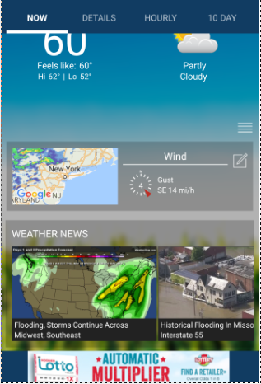
Motivating Example
App: WeatherBug
A popular Android app.
Real-time weather conditions, weather news, photos, closest spark strike, …
Users may not want the features other than real-time weather conditions.
Real-time Weather Condition
I want to remove WEATHER NEWS.
WEATHER NEWS
Banner Ad;
And More Features after Scrolling down.
Notes:
We use WeatherBug as an example. The app includes real-time weather conditions, weather news, photos and many other features. The users may not want the features other than real-time weather conditions. We take removing the WEATHER NEWS component as an example.

Slide 9

Results After Code Reduction
Replace the inflated view with a simple TextView with text “WEATHER NEWS Removed”
Data Usage | Computed Power Use
9.0% | 20.0%
Resource Savings
Notes:
Based on the specified UI element, we remove the associated functionalities and replace the inflated view for the component with a simple TextView, we get a result like this. According to our experiment, he code reduction leads to 9% of data usage saving and 20% of power use reduction.

Slide 10

Technique Overview
x = findViewById(id);
x.setText(txt);
app
txt = <input>
UI Element Discovery
UI Element
Tracking
user
y.setText(<input>);
x = findBiewById(id);
x.setText(txt);
Backward Data Tracking
reduced app
Code
Removal
Forward Data Tracking
Notes:
Our technique consists of several steps. First, given an app, the user must specify the UI elements related to the unwanted features on the UI. With the information, we discover the program locations that refer to them. We think all program locations using the specified UI elements can be removed, so we track the uses of the UI elements and remove the discovered code elements. In addition, we further think the functionalities that provide data to the UI elements for display can be removed and thus we backwardly track where the data is generated. However, we must ensure the data is exclusively provided to the specified UI elements, instead of to some other UI elements. Therefore we perform forward data tracking to see how the data is used. We collect useful information during the process and perform code removal to produce a reduced app.

Slide 11
Design
We formalize our approach in a type system.
Code element (variable, statement, method, class) is associated with type T.
Type domain: UIRelated, UIData, InputUIData, Removable, Unremovable.
Different type contexts for different steps.
Context sensitive analysis.
Notes:
We formalize our approach in a type system. In our approach, each code element is associated with tags. A tag is treated as the type of the code element. We define five types in our approach: UIRelated, UIData, InputUIData, Removable and Unremovable. Notice that InputUIData is parameterized with a data generation point to distinguish the types among multiple data generation points. We build different type contexts at different stages. Our analysis is context-sensitive and thus each code element is tagged with a subscript to indicate the calling context during analysis. But I may omit the context in my talk.

Slide 12
Code Example
01 class B extends A {
02 a () {
03 t = new BgTask(this);
04 trigger(t);
05 }
06 b() {
07 tv0 = findViewById(id0);
08 tv0.setText(data);
09 }
10 }
11 class C extends A {
12 c () {
13 g = new BgTask(this);
14 trigger(g);
15 }
16 d() {
17 ss = data.split(“:”);
18 tv1 = findViewById(id1);
19 tv1.setText(ss[0]);
20 tv2 = findViewById(id2);
21 tv2.setText(ss[1]);
22 }
23 }
24 class BgTask {
25 A ck;
26 BgTask(A a) { ck = a; }
27 void run() {
28 ck.data = getInputData();
29 }
30 }
Notes:
To exemplify the approach details, we use this code example throughout the talk. Assume that id0 and id1 refer to unwanted UI elements. Class B initiates a background task that obtains data from some outside source and then displays the data on UI. Class C also launches the background task and displays the data on UI.

Slide 13
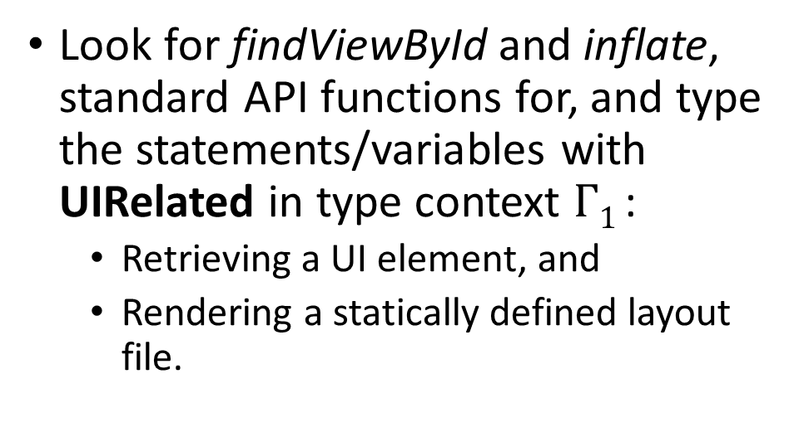
UI Element Discovery
x = findViewById(id);
UI Element Discovery
UI Element
Tracking
Backward
Data Tracking
Look for findViewById and inflate, standard API functions for, and type the statements/variables with UIRelated in type context $Γ1$:
Retrieving a UI element, and
Rendering a statically defined layout file.
Code
Removal
Forward Data
Tracking
$$UI˗FindView\frac{belongToSpecificUI\left(i\right)}{Γ1,\left\{x≔l findViewById(i)\right\}ε ⊨Γ1 ⇒[xε, lε :UIRelated]Γ1}$$
Notes:
We first try to discover the code elements that refer to the unwanted UI elements. We focus on two API functions, findViewById and inflate, one for retrieving UI elements and the other for rendering a statically defined layout file. When encountering a call to findViewById, if the given id is related to the specified UI elements, we type the statement and the resultant variable with UIRelated.

Slide 14


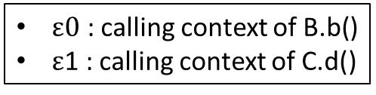
$ε0$ : calling context of B.b()
$ε$1 : calling context of C.d()
id0 and id1 are the IDs of the user specified UI elements.
01 class B extends A {
06 b() {
07 tv0 = findViewById(id0);
08 tv0.setText(data);
09 }
10 }
{tv0, L07}$ε0$
UIRelated
11 class C extends A {
16 d() {
18 tv1 = findViewById(id1);
19 tv1.setText(ss[0]);
20 tv2 = findViewById(id2);
22 }
23 }
{tv1, L18}$ε1$
id2 is not related to any user specified UI elements, so line 20 and tv2 are not typed.
Notes:
In our example, we can find two locations relevant to the specified UI elements. Therefore, we type variables tv0 and tv1, and lines 7 and 18 with UIRelated.

Slide 15
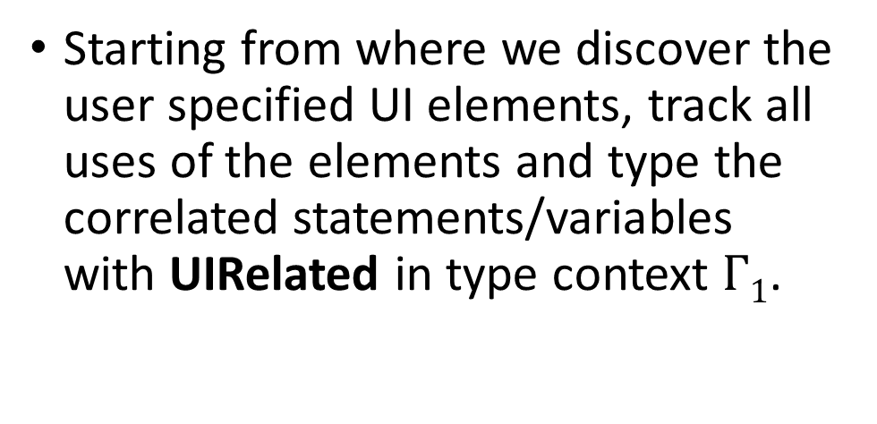

UI Element Tracking
x.setText(txt);
UI Element Discovery
UI Element
Tracking
Starting from where we discover the user specified UI elements, track all uses of the elements and type the correlated statements/variables with UIRelated in type context $Γ1$.
Backward
Data Tracking
Code
Removal
Forward Data
Tracking
$$UI˗CallAPI˗This\frac{api\left(m\right) Γ1⊢yε :UIRelated}{Γ1,\left\{x≔l y.m(z)\right\}ε ⊨Γ1 ⇒[xε, lε :UIRelated]Γ1}$$
Notes:
With all the discovered variables holding the specified UI elements, we track the uses of the variables. All correlated code elements are typed with UIRelated. For an API call with the receiver object typed with UIRelated, we propagate the type to the statement and the resultant variable.

Slide 16
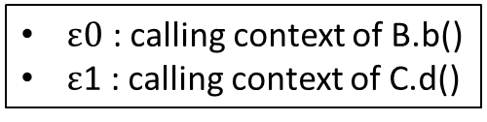




$ε0$ : calling context of B.b()
$ε$1 : calling context of C.d()
01 class B extends A {
06 b() {
07 tv0 = findViewById(id0);
08 tv0.setText(data);
09 }
10 }
tv0$ε0$
UIRelated
L08$ε0$
UIRelated
11 class C extends A {
16 d() {
18 tv1 = findViewById(id1);
19 tv1.setText(ss[0]);
20 tv2 = findViewById(id2);
22 }
23 }
tv1$ε1$
UIRelated
L19$ε1$
UIRelated
Notes:
For our example, in Class B, we can then type line 8 with UIRelated because of variable tv0. Similarly, we type line 19 in class C with UIRelated.

Slide 17
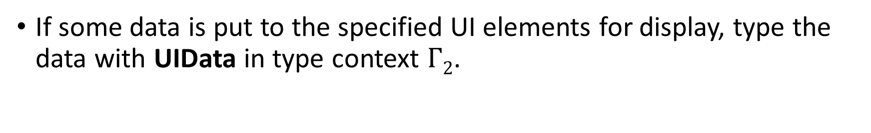
Putting Data To UI
x.setText(txt);
If some data is put to the specified UI elements for display, type the data with UIData in type context $Γ2$.
$$UI˗Put˗Data\frac{apiPutDataToUI\left(m\right) Γ1⊢yε :UIRelated Γ1⊢lε :UIRelated}{Γ1,\left\{x≔l y.m(z)\right\}ε ⊨Γ2 ⇒ [zε : UIData]Γ2}$$
Notes:
When we track the UI elements, we may encounter program locations that put data to the UI elements for display. If we see such an API method call and both the statement and the receiver object have been typed with UIRelated, we say the argument should be typed with UIData such that we can then track the functionalities providing the data.

Slide 18
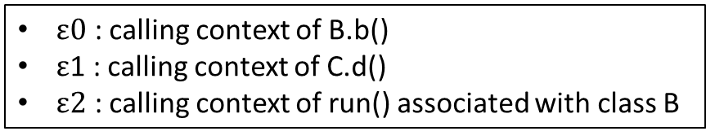




$ε0$ : calling context of B.b()
$ε$1 : calling context of C.d()
$ε2$ : calling context of run() associated with class B
01 class B extends A {
06 b() {
07 tv0 = findViewById(id0);
08 tv0.setText(data);
09 }
10 }
{tv0, L08}$ε0$
UIRelated
27 void run() {
28 ck.data = getInputData();
29 }
data$ε2$
UIData
11 class C extends A {
d() {
17 ss = data.split(“:”);
18 tv1 = findViewById(id1);
19 tv1.setText(ss[0]);
20 tv2 = findViewById(id2);
22 }
23 }
{tv1, L19}$ε1$
UIRelated
ss$ε1$
UIData
Notes:
We have two locations putting data to the specified UI elements. One is at line 8 and the argument variable data is defined at line 28. We type the corresponding variable data in proper context with UIData. The other location is at line 19 and we type the variable ss with UIData.

Slide 19
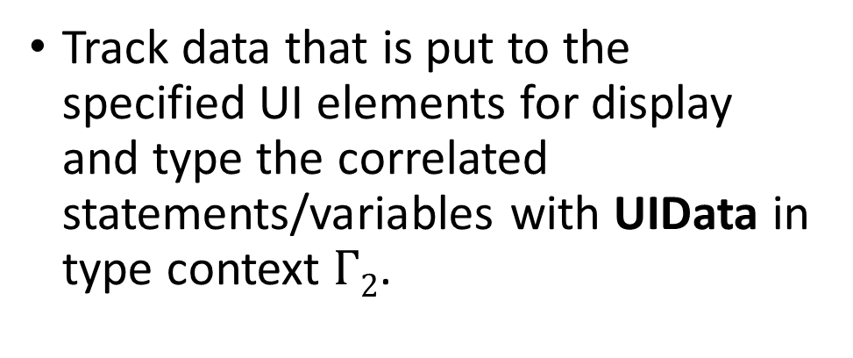
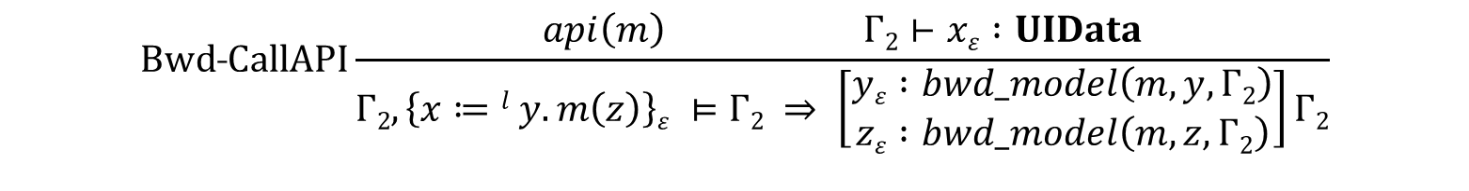
Backward Data Tracking
txt = <input data>
UI Element Discovery
UI Element
Tracking
Backward
Data Tracking
Track data that is put to the specified UI elements for display and type the correlated statements/variables with UIData in type context $Γ2$.
Code
Removal
Forward Data
Tracking
$$Bwd˗CallAPI\frac{api\left(m\right) Γ2⊢xε :UIData}{\begin{aligned}Γ2,\left\{x≔l y.m\left(z\right)\right\}ε ⊨Γ2 ⇒ \left[\begin{matrix}yε :bwd_model\left(m,y,Γ2\right) \\ zε :bwd_model\left(m,z,Γ2\right)\end{matrix}\right]Γ2\end{aligned}}$$
Notes:
So far, we have identified data use on the specified UI elements. We want to discover the associated functionalities providing the data and remove those functionalities. We backwardly track where the data is generated and type all correlated code elements with UIData. For an API call, if the resultant variable has been typed with UIData, we rely on models of the API function to type the receiver object and the argument variable.

Slide 20

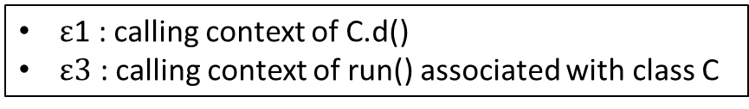


$ε$1 : calling context of C.d()
$ε3$ : calling context of run() associated with class C
11 class C extends A {
16 d() {
17 ss = data.split(“:”);
18 tv1 = findViewById(id1);
19 tv1.setText(ss[0]);
20 tv2 = findViewById(id2);
22 }
23 }
ss$ε1$
UIData
$bwd_model\left(String.split(),data,Γ2\right)$ = UIData
27 void run() {
28 ck.data = getInputData();
29 }
data $ε3$
UIData
Notes:
We know that variable ss is typed with UIData. For the API call String.split at line 17, we further type the receiver object, variable data defined at line 28 in certain context, with UIData.

Slide 21
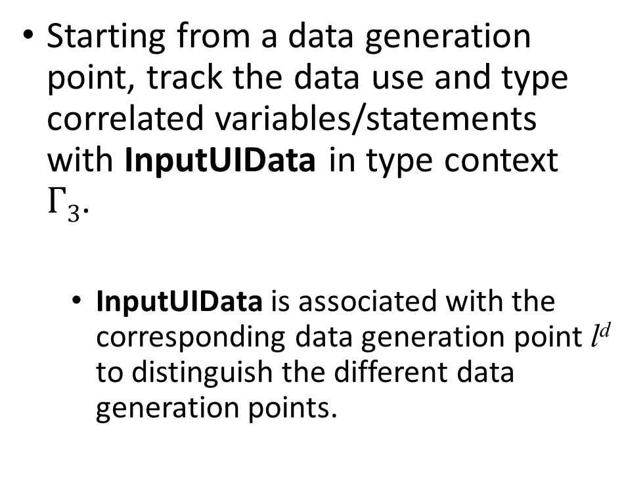
Forward Data Tracking
UI Element Discovery
UI Element
Tracking
Starting from a data generation point, track the data use and type correlated variables/statements with InputUIData in type context $Γ3$.
InputUIData is associated with the corresponding data generation point l^{d} to distinguish the different data generation points.
Backward
Data Tracking
Code
Removal
Forward Data
Tracking
y.setText(<input>);
Notes:
If we reach a data generation point through backward data tracking, we want to make sure the functionality exclusively provides data to the specified UI elements. Those functionalities providing data to the other UI elements should not be removed. So we forwardly track the data uses and type the correlated code elements with a proper InputUIData parameterized with that data generation point.

Slide 22
Rule for recognizing data generation point.
$$Data˗Gen\frac{apiGetInputData\left(m\right) Γ2⊢xε :UIData}{Γ2,\left\{x≔l y.m(z)\right\}ε ⊨Γ3 ⇒ [lε,xε :Γ3(lε)∪InputUIData(l)]Γ3}$$
Notes:
We say we encounter a UI related data generation point if the method call is an API function getting input data and the resultant variable has been typed with UIData. We then type both the statement and the resultant variable with a proper InputUIData.

Slide 23
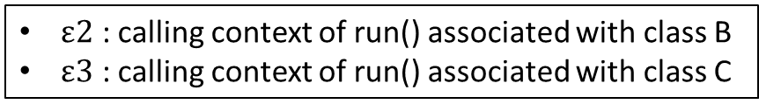




$ε2$ : calling context of run() associated with class B
$ε3$ : calling context of run() associated with class C
24 class BgTask {
27 void run() {
28 ck.data = getInputData();
29 }
30 }
data$ε2$
UIData
data$ε3$
UIData
{data, L28}$ε2$
InputUIData(L28)
{data, L28}$ε3$
InputUIData(L28)
Notes:
We have only one data generation point but it is invoked in two calling contexts. We type the variable and the statement in each context with InputUIData.

Slide 24


Rules for forward data tracking are omitted.
27 void run() {
28 ck.data = getInputData();
29 }
data$ε2$
InputUIData(L28)
01 class B extends A {
06 b() {
07 tv0 = findViewById(id0);
08 tv0.setText(data);
09 }
10 }
L08$ε0$
InputUIData(L28)
Notes:
Then we can forwardly propagate the type, and for the data generation related to class B, we further type line 8 with InputUIData.

Slide 25


Rules for forward data tracking are omitted.
27 void run() {
28 ck.data = getInputData();
29 }
data$ε2$
InputUIData(L28)
11 class C extends A {
16 d() {
17 ss = data.split(“:”);
18 tv1 = findViewById(id1);
19 tv1.setText(ss[0]);
20 tv2 = findViewById(id2);
21 tv2.setText(ss[1]);
22 }
23 }
{ss, L17}$ε1$
InputUIData(L28)
{L19, L21}$ε1$
InputUIData(L28)
Notes:
While for the data generation related to class C, we type line 17 with InputUIData and then lines 19 and 21 with InputUIData.

Slide 26
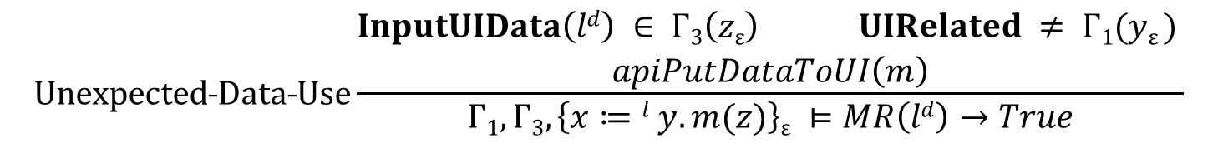
y.setText(<input>);
Rule for unexpected data use discovered.
The corresponding data generation point is marked as must-retained.
$$Unexpected˗Data˗Use\frac{\begin{aligned}InputUIData\left(ld\right) ∈ Γ3\left(zε\right) UIRelated ≠ Γ1(yε ) \\ apiPutDataToUI\left(m\right)\end{aligned}}{Γ1,Γ3,\left\{x≔l y.m(z)\right\}ε ⊨MR\left(ld\right)→True}$$
Notes:
During this process, we may see unexpected data use. Specifically, the data generated from the UI related data generation point is used in some UI elements other than the user specified UI elements. In this case, we say the corresponding data generation point must be retained. In other words, it cannot be removed even if its data is also used in user specified UI elements.

Slide 27



11 class C extends A {
16 d() {
17 ss = data.split(“:”);
18 tv1 = findViewById(id1);
19 tv1.setText(ss[0]);
20 tv2 = findViewById(id2);
21 tv2.setText(ss[1]);
22 }
23 }
ss$ε1$
InputUIData(L28)
tv2$ε1$
UIRelated
The InputUIData is used on a UI element that is not specified as unwanted element. Thus the corresponding data generation at line 28 point must be retained, i.e., the data generation point should not be removed.
MR(L28)
True
Notes:
In the example, we see such a data use at line 21 where variable tv2 is not related to user specified UI elements but the argument ss comes from a data generation point at line 28. Therefore, line 28 should not be removed.

Slide 28
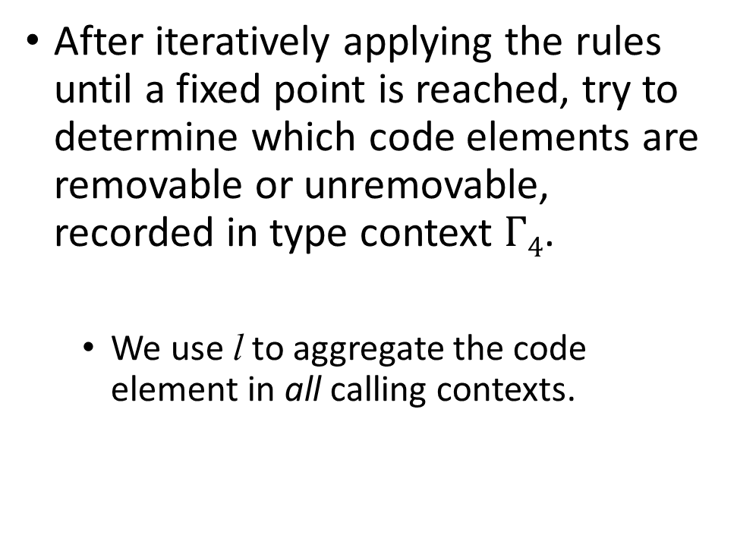
Code Removal
UI Element Discovery
UI Element
Tracking
After iteratively applying the rules until a fixed point is reached, try to determine which code elements are removable or unremovable, recorded in type context $Γ4$.
We use l to aggregate the code element in all calling contexts.
Backward
Data Tracking
Code
Removal
Forward Data
Tracking
x = findBiewById(id);
x.setText(txt);
Notes:
We iteratively apply the rules until a fixed point is reached. We already have all the related code elements well typed. Then we can determine which code elements are removable or not, based on the collected type information.

Slide 29
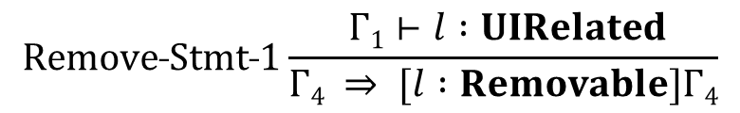
All UIRelated statements are removable.
$$Remove˗Stmt˗1\frac{ Γ1⊢l :UIRelated}{Γ4 ⇒ [l :Removable]Γ4}$$
All statements related to a must-retained data generation point will not be removed.
$$Unremove˗Stmt\frac{InputUIData\left(ld\right) ∈ Γ3\left(lε\right) MR\left(ld\right) Γ1(l) ≠UIRelated}{Γ4 ⇒ [l :Unremovable]Γ4}$$
All statements related to a removable data generation point will be removed.
$$Remove˗Stmt˗2\frac{InputUIData\left(ld\right) ∈ Γ3\left(lε\right) ¬MR\left(ld\right) Γ4(l) ≠Unremovable}{Γ4 ⇒ [l :Removable]Γ4}$$
Notes:
If a statement in all contexts is directly related to the specified UI elements, it is absolutely removable. If it is not directly related to the specified UI elements, but one instance of the statement in certain context is typed with InputUIData and the corresponding data generation point must be retained, we say the statement is Unremovable. For a statement not typed with Unremovable but its instances have been typed with InputUIData and the corresponding data generation point is not necessarily to be retained, the statement is removable.

Slide 30
Apply rule Remove-Stmt-1.
01 class B extends A {
06 b() {
07 tv0 = findViewById(id0);
08 tv0.setText(data);
09 }
10 }
L07, L08
UIRelated
L07, L08
Removable
11 class C extends A {
16 d() {
18 tv1 = findViewById(id1);
19 tv1.setText(ss[0]);
20 tv2 = findViewById(id2);
22 }
23 }
L18, L19
UIRelated
L18, L19
Removable
Notes:
Applying the rules to our example, we say lines 7, 8, 18 and 19 are removable because they are directly related to the user specified UI elements.

Slide 31
Apply rule Unremove-Stmt.
11 class C extends A {
16 d() {
17 ss = data.split(“:”);
18 tv1 = findViewById(id1);
19 tv1.setText(ss[0]);
20 tv2 = findViewById(id2);
21 tv2.setText(ss[1]);
22 }
23 }
L17
Unremovable
L21
Unremovable
27 void run() {
28 ck.data = getInputData();
29 }
L28
Unremovable
Notes:
Similarly, lines 17, 21 and 28 are unremovable.

Slide 32
Trigger Removal
Discover the corresponding trigger of the background functionality in which the data generation is useless because all uses of the data are removed.
In the example, though the data generation point cannot be removed, for class B, the data is useless and thus the corresponding trigger site can be removed to disable the data generation.
Notes:
Since we do not remove the data generation point. For class B, the data access still occurs, causing additional consumption of bandwidth and CPU cycles. We use some heuristics to find out the corresponding trigger site of the background task and then remove the trigger site to disable the corresponding data generation.

Slide 33
01 class B extends A {
02 a () {
03 t = new BgTask(this);
04 trigger(t);
05 }
06 b() {
07 tv0 = findViewById(id0);
08 tv0.setText(data);
09 }
10 }
L04
Removable
The trigger site for the background functionality related to class B is removed.
24 class BgTask {
25 A ck;
26 BgTask(A a) { ck = a; }
27 void run() {
28 ck.data = getInputData();
29 }
30 }
Notes:
Therefore, line 4 which launches the background task for class B is marked removable.

Slide 34
Example Results
01 class B extends A {
02 a () {
03 t = new BgTask(this);
04 trigger(t);
05 }
06 b() {
07 tv0 = findViewById(id0);
08 tv0.setText(data);
09 }
10 }
11 class C extends A {
12 c () {
13 g = new BgTask(this);
14 trigger(g);
15 }
16 d() {
17 ss = data.split(“:”);
18 tv1 = findViewById(id1);
19 tv1.setText(ss[0]);
20 tv2 = findViewById(id2);
21 tv2.setText(ss[1]);
22 }
23 }
24 class BgTask {
25 A ck;
26 BgTask(A a) { ck = a; }
27 void run() {
28 ck.data = getInputData();
29 }
30 }
Notes:
Eventually, we have 5 lines to remove, line 4, lines 7 and 8, and lines 18 and 19.

Slide 35
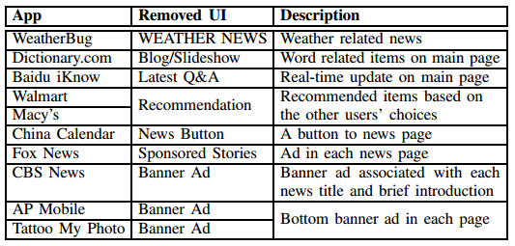
Evaluation
Prototype built on top of Soot.
Benchmark Apps.
Run apps (original/modified) on Nexus 6P with Android 6.0.1 and collect battery/data uses.
Notes:
We build a prototype on top of Soot and select 10 popular Android apps to evaluate our technique. We specify the unwanted features based on our understanding of the expected app behavior. The unwanted features include relevant but undesirable functionalities of the apps, irrelevant functionalities and also advertisements. We run the original apps and the modified versions on a Nexus 6P for 10 to 30 minutes and collect data usage and battery usage information. The battery usage includes the total CPU time, Wi-Fi running time and computed power use.

Slide 36
Results of Reduction Savings
App | Data Usage | CPU Total | Wi-Fi Running | Computed Power Use
WeatherBug | 9.0% | 4.8% | 27.8% | 20.0%
Dictionary.com | 48.5% | 9.9% | 34.4% | 12.5%
Baidu iKnow | 37.3% | 39.1% | 1.5% | 40.4%
Walmart | 22.4% | 2.0% | 42.7% | 17.6%
Macy’s | 19.2% | 24.9% | 4.5% | 27.3%
China Calendar | 14.5% | 33.2% | 25.0% | 31.3%
Fox News | 36.6% | 3.1% | 29.6% | 14.3%
CBS News | 45.4% | 66.7% | 28.9% | 70.6%
AP Mobile | 26.4% | 67.4% | 42.9% | 50.0%
Tattoo My Photo | 21.5% | 90.2% | 24.2% | 92.0%
Average | 28.1% | 34.1% | 26.2% | 37.6%
Notes:
The results are presented in this table. From the table, we observe that, on average, removing the specified features results in reductions of 28%, 34%, 26% and 37% for data usage, CPU total time, Wi-Fi running time and computed power use.

Slide 37
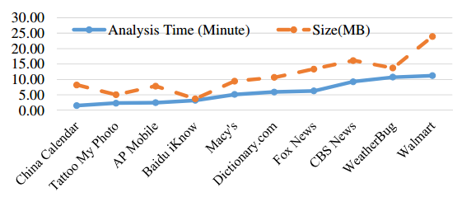
Performance
The analysis time increases as the code size increases.
Apps with more complex removable functionalities take longer time to be analyzed.
Notes:
The analysis is also efficient. Most of the apps can be finished within 10 minutes. Generally, the analysis time increases as the code size increases and the apps with more complex removable functionalities take longer time to be analyzed. For example, app China Calendar is only specified to disable a button, and the analysis finishes very soon.

Slide 38
Discussion
Limitations
Our analysis inherits the limitations of Android app analysis.
Rewriting supported by Soot may produce unrunable apps.
Usability
While the prototype runs on PCs, efforts are required to make it more usable for end users.
Notes:
Our approach has some limitations. First, our analysis inherits the limitations of Android app analysis. And the rewriting functionality supported by Soot may produce some unrunable apps. Our current prototype runs on PC, but we plan to make efforts to make the tool more usable for end users, for example, building the tool inside a smartphone.

Slide 39
Discussion
Our technique can be used to help the development team automatically generate various customizations and personalizations of an app.
A more aggressive business model
The developers sell the right of customization to the end users such that the customized versions will be signed correctly to avoid possible legal issues.
Notes:
As we have mentioned earlier, our technique can be used to help the development team automatically generate various customizations of an app. Besides, the developers can sell the right of customization to the end users such that the customized versions will be signed correctly to avoid possible legal issues.

Slide 40
Related Work
Detecting third-party libraries, including ad libraries.[Grace/WISEC’12, Book/CoRR’13, Narayanan/ISSNIP’14]
Rely on specific code patterns.
Our technique removes features indicated by users.
Improving energy efficiency.[Jelschen/CSMR’12, Gui/GREENS’16, Wu/CC’16]
Rely on code patterns or domain knowledge.
Using our technique, energy saving occurs because of the removal of selected unwanted features.
Notes:
Some existing studies are related to our work. Some researchers detect third-party libraries, including ad libraries. Some others improve energy efficiency by refactoring the correlated code. These techniques reply on specific code patterns or certain domain knowledge. Our technique, in contrast, removes the features indicated by the users and the energy saving occurs because of the removal of selected unwanted features.

Slide 41
Conclusion
We propose a static technique to remove code elements in Android apps.
The code elements are relevant to user specified unwanted UI elements.
The analysis is featured as a type system and each reachable code element is tagged with a type that is propagated.
We implement a prototype and evaluate it on 10 real-world Android apps. The experimental results show that our approach can accurately identify removable code elements and removing those functionalities leads to substantial resource savings.
Notes:
To conclude my talk, we propose a static technique to remove code elements in Android apps. The users specify the unwanted UI elements and our technique automatically discovers the correlated code elements for removal. The analysis is featured in a type system. We implement a prototype and evaluate it on 10 real-world Android apps. The experiments show that our approach can accurately identify removable code elements and the removal leads to substantial resource savings.

Slide 42
END & Thanks
Notes:
OK. That’s all my talk. Thanks.

