Slide 1

FuzzInMem: Fuzzing Programs via In-memory Structures
Xuwei Liu, Wei You, Yapeng Ye, Zhuo Zhang, Jianjun Huang, Xiangyu Zhang

Slide 2
Search in Fuzzing
Search Space
Valid Space 1
Mutants
Valid Space 2
Initial Seeds
Mutants
?
Mutants
Valid Space 3
Valid Space n

Slide 3





Search in Fuzzing (Example)
Fuzz
Initial seed
Mutant
Interesting?

Slide 4
PDF Structure
Header
%PDF-1.7
1 0 obj
<</Type /Catalog /Names <</Dests 2 0 R>> /Pages 3 0 R>>
endobj
2 0 obj
<</Kids [2 0 R] /Limits [(wl0) (wl0)]>>
endobj
…
xref
0 17
0000000000 65536 f
0000000009 00000 n
0000000060 00000 n
…
trailer
<</Size 17 /Root 1 0 R>>
startxref
21829
%%EOF
9
Objects
60
21829
Xref Table
Trailer
End of File

Slide 5
Mutate a PDF
16 offset changes required!
1 0 obj
<<
/Type /Catalog
/Names <</Dests 2 0 R>>
/Pages 3 0 R
/Annotation <<>>
>>
endobj
1 0 obj
<<
/Type /Catalog
/Names <</Dests 2 0 R>>
/Pages 3 0 R
>>
endobj
xref
0 17
0000000000 65536 f
0000000009 00000 n
0000000060 00000 n
…
startxref
21829
xref
0 17
0000000000 65536 f
0000000009 00000 n
0000000060 00000 n
…
startxref
21829
x
x
x

Slide 6


Mutate a PDF
Open
Edit
Save
Parse
Mutate
Print
The printer rebuilds constraints!

Slide 7
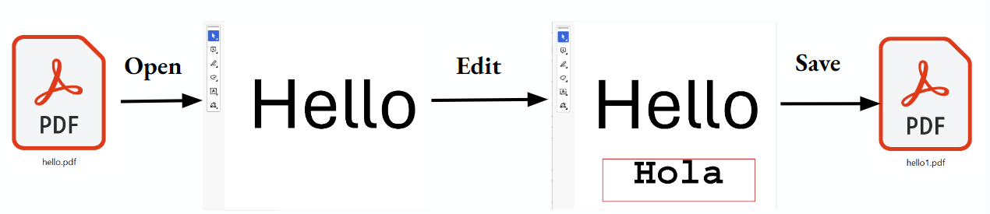
Workflow
1 0 obj
<<
/Type /Catalog
/Names <</Dests 2 0 R>>
/Pages 3 0 R
>>
endobj
1 0 obj
<<
/Type /Catalog
/Names <</Dests 2 0 R>>
/Pages 3 0 R
/Annotation <<>>
>>
endobj
Parse
Mutate
Print
xref
0 17
0000000000 65536 f
0000000009 00000 n
0000000060 00000 n
…
startxref
21829
(Open)
(Edit)
(Save)
xref
0 17
0000000000 65536 f
0000000009 00000 n
0000000082 00000 n
…
startxref
21849
Input
In-memory structure
Mutated structure
Mutated file

Slide 8
Locate key structures
main
parseArgs
GlobalParams
getTextEncoding
createPDFDoc
getNumPages
printInfo
strcmp
…
NameToCharCode
…
buildPDFDoc
…
…
opendir
read
Read functions
GlobalParams
GlobalParams
getTextEncoding
getTextEncoding
PDFDoc
createPDFDoc
createPDFDoc
getNumPages
printInfo

Slide 9
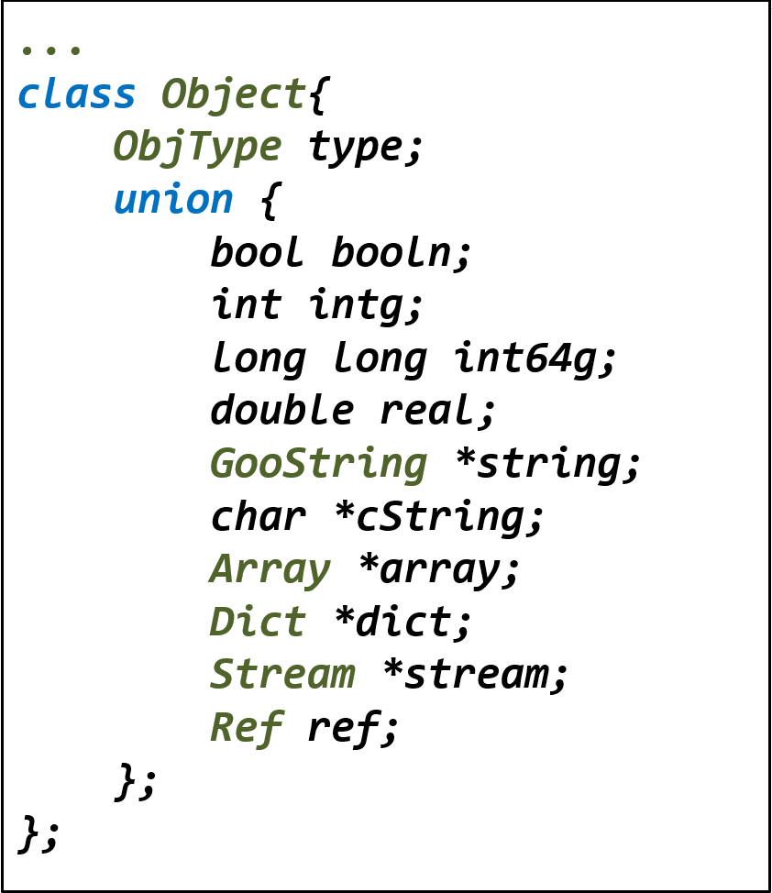
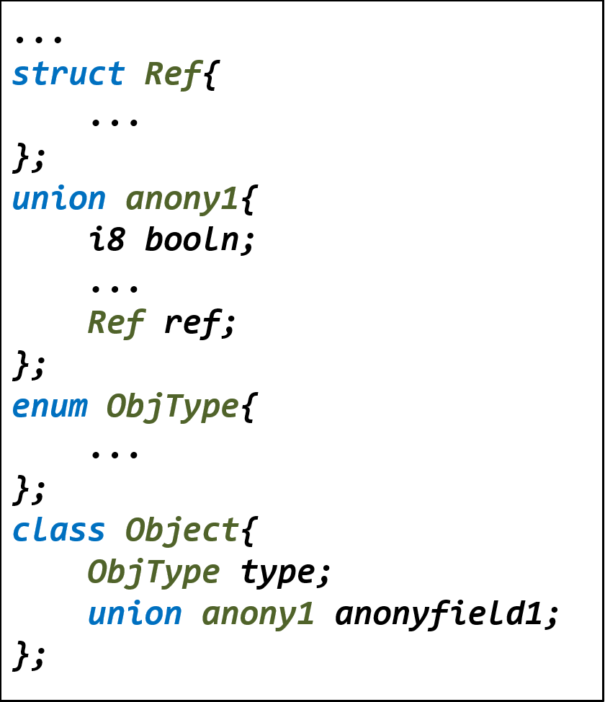
Synthesize

Slide 10
Mutation
Compound
primitive
reference
Structure
Primitive
Compound
exchange
Reference

Slide 11
Reuse printers
1 0 obj
<<
/Type /Catalog
/Names <</Dests 2 0 R>>
/Pages 3 0 R
/Annotation <<>>
>>
endobj
Dict*
vector<pair>
Printer
vector[0]
xref
0 17
0000000000 65536 f
0000000009 00000 n
0000000082 00000 n
…
startxref
21849
vector[3]
…
Mutated
/Annotation
Dict*
16 offsets fixed by printer!

Slide 12
Evaluation
How popular are printer functions in various applications?
Can FuzzInMem automatically locate key structures and synthesize codes to generate mutators?
How does FuzzInMem compare to SOTA fuzzers in terms of seed generation and code coverage?
Can FuzzInMem help find vulnerabilities?

Slide 13
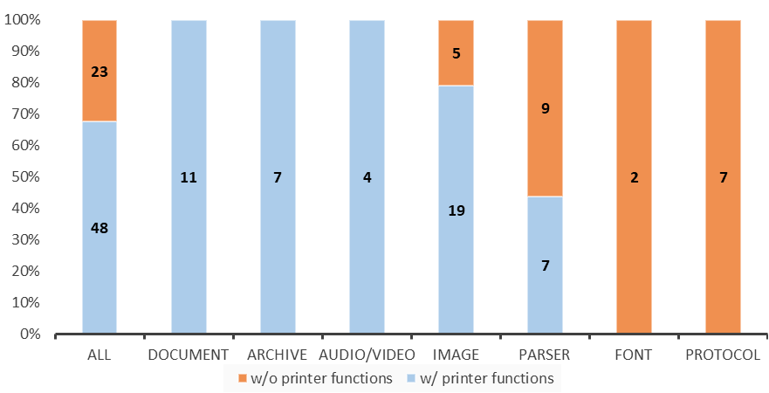
Existence of printer functions
67.61% libraries have printer functions

Slide 14
Benchmark and Competitors
15 programs which have most stars in Github
FuzzInMem can automatically find parsers and key structures in 13 programs
Compare with AFL, AFL++, Mopt, FormatFuzz and Weizz

Slide 15
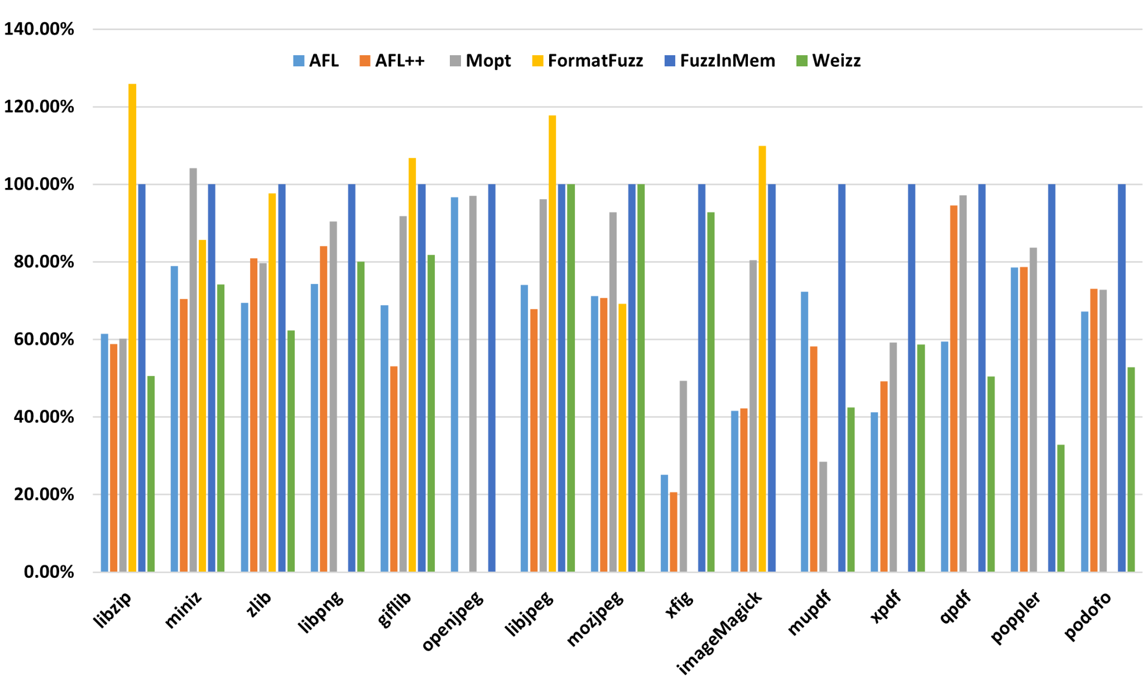
Path Coverage
Best coverage in 10 out of 15 programs
Path coverage compared to FuzzInMem

Slide 16
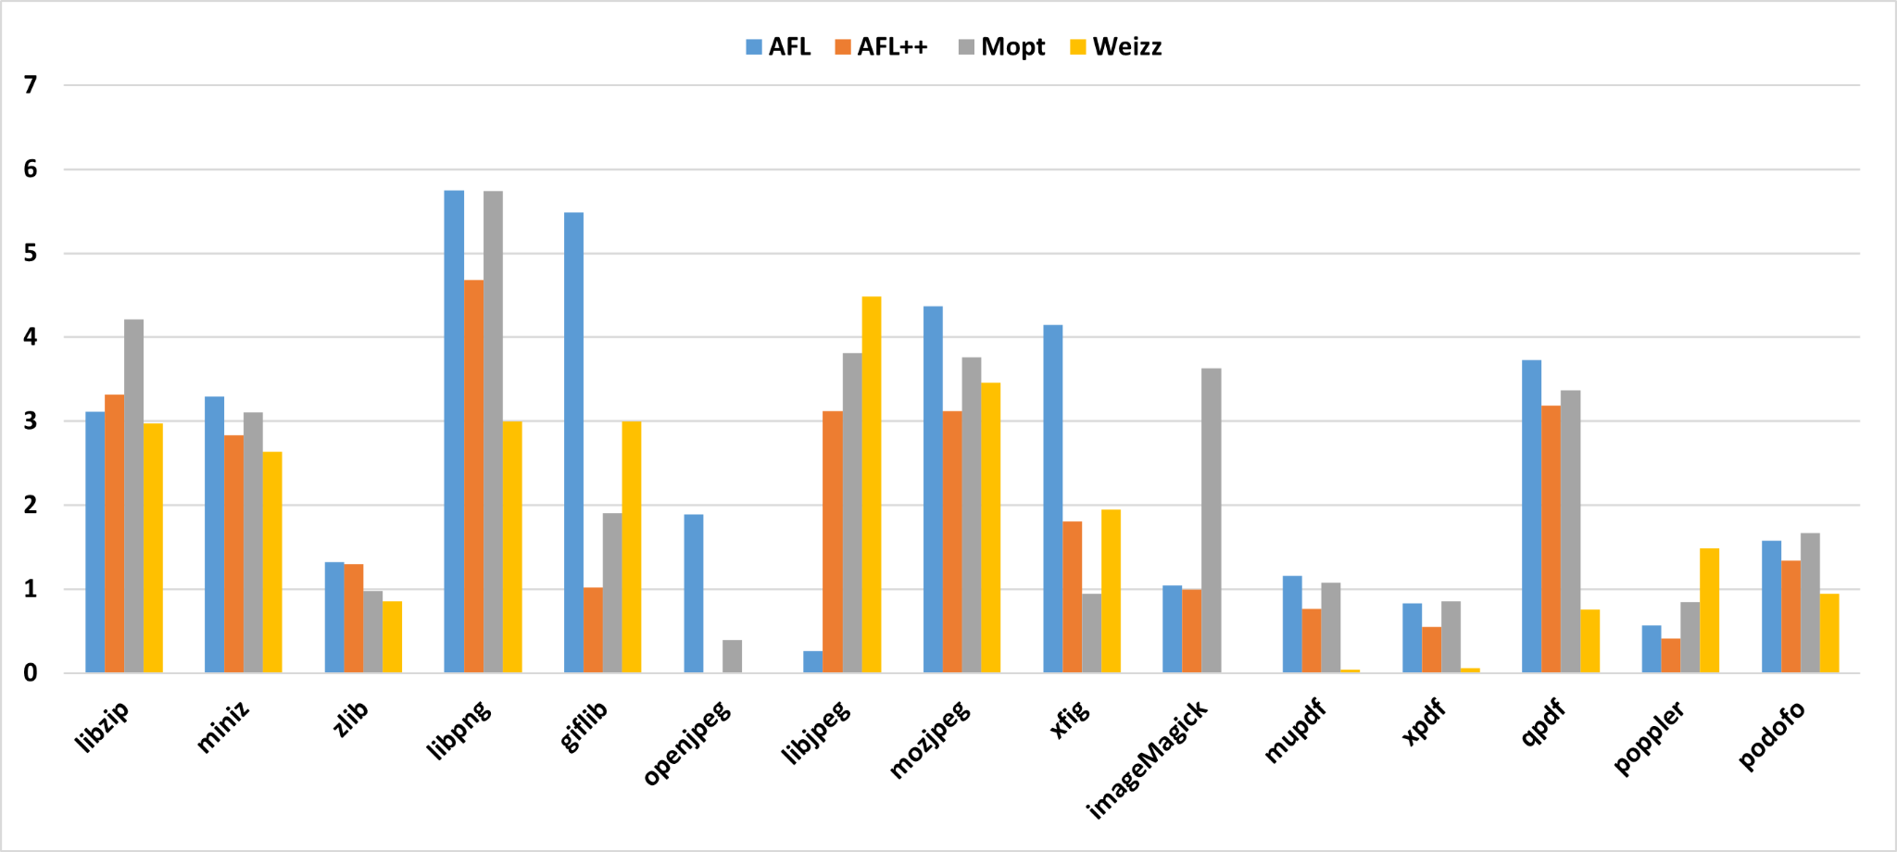
Seed Generation
Generate up to 500,000 times more seeds!
Magnitude difference compared to FuzzInMem

Slide 17
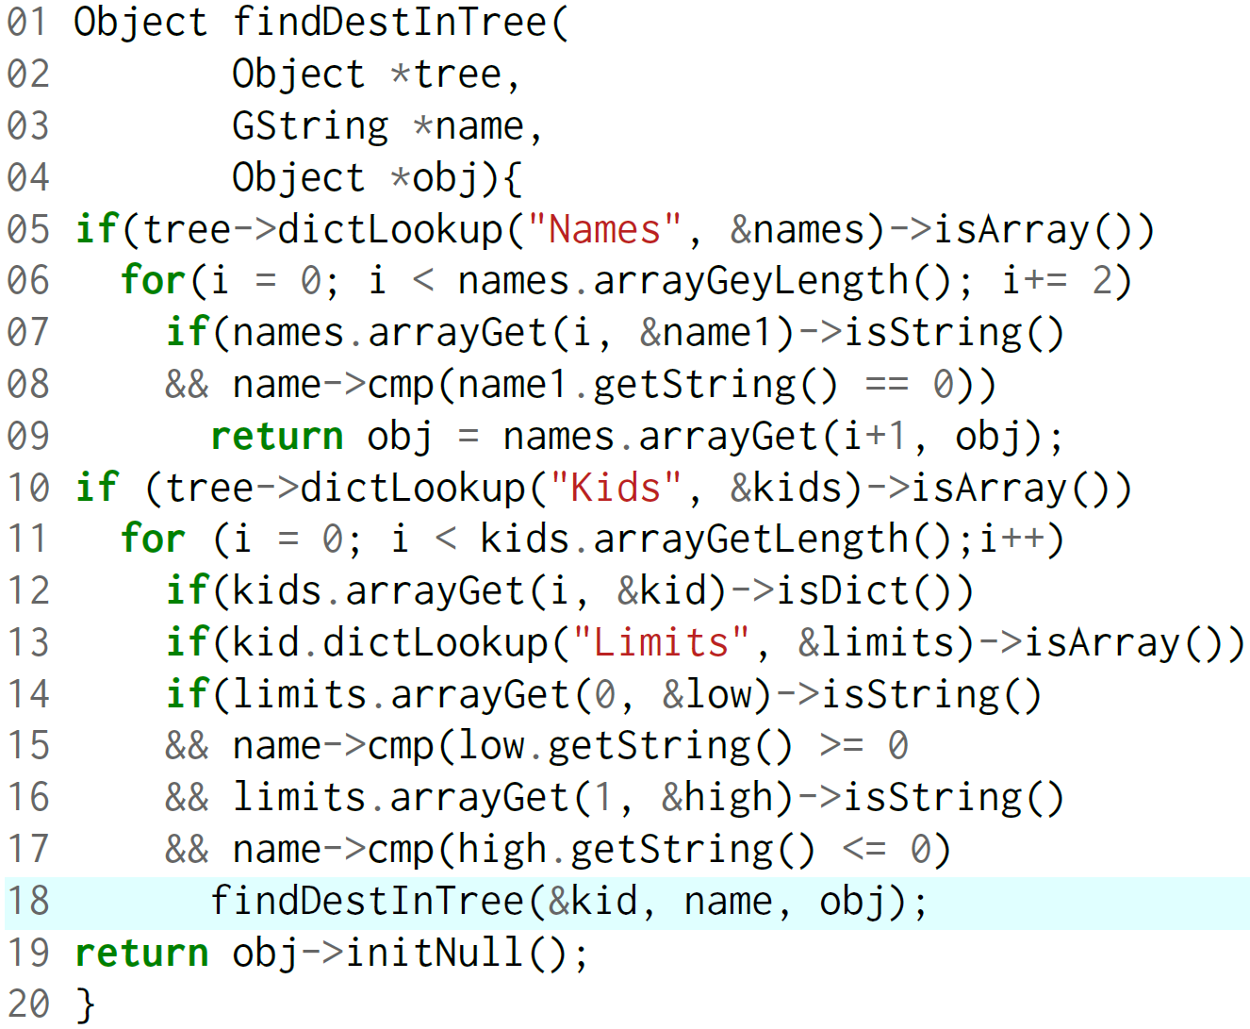

Bug finding
A bug exists in Apple Preview, Adobe Acrobat and Foxit Reader for more than 10 years!
2 0 obj <</Kids [4 0 R] /Limits []>>
2 0 obj <</Kids [4 0 R] /Limits [(w) (w)]>>
2 0 obj <</Kids [2 0 R] /Limits [(w) (w)]>>

Slide 18
Conclusion
A technique that automatically locates parser, synthesizes codes and reuses printer function to perform in-memory fuzzing
42%-70% more path coverage and 10x-10000x valid seed generation
29 new vulnerabilities and 5 exploitable CVEs

Slide 19
Thank you!
Q & A

