Slide 1
Working Process
YouTube Shorts data collection

Slide 2
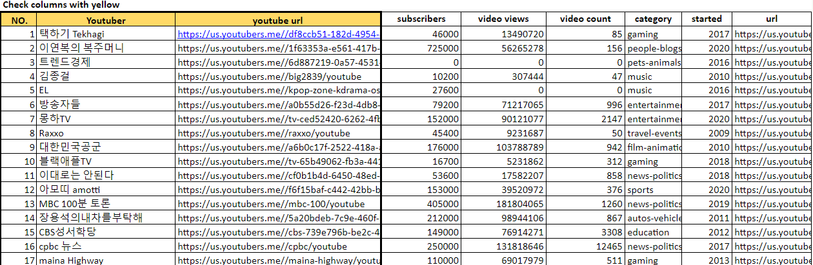
1. Check Shared Google Sheet
Go to YouTube URL
Click the url and check the YouTube channel
Click

Slide 3
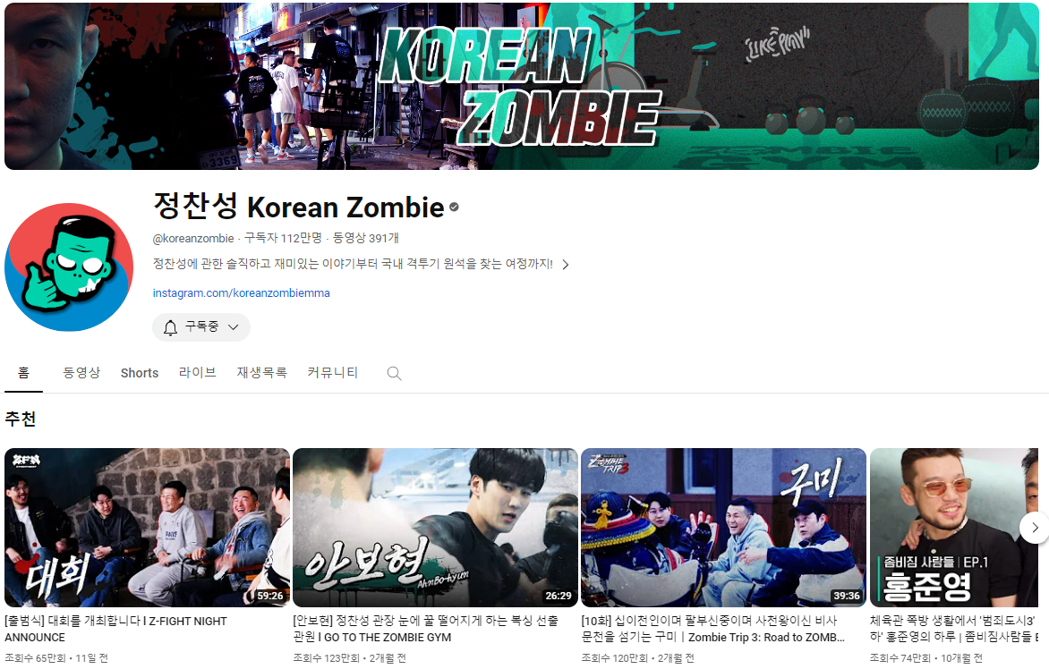
2-1. Data Collecting Process
When you click the youtube url then you will be led to the channel homepage
Go to the Shorts tab
Click

Slide 4
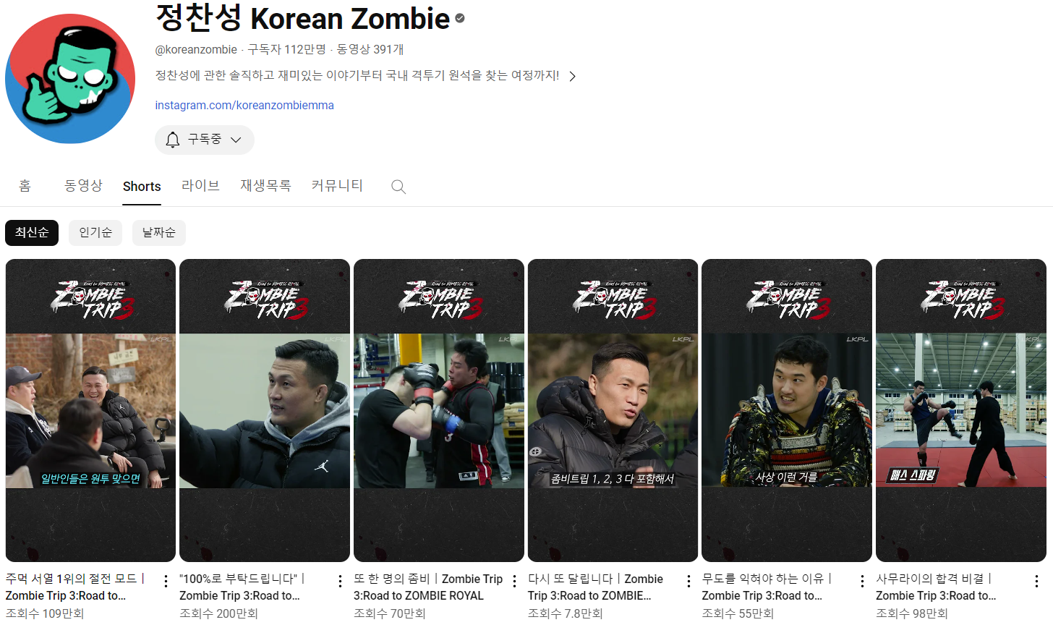
2-2. Data Collecting Process
Go to the Shorts page
Click the latest short (Make sure that shorts option is latest)
Click

Slide 5
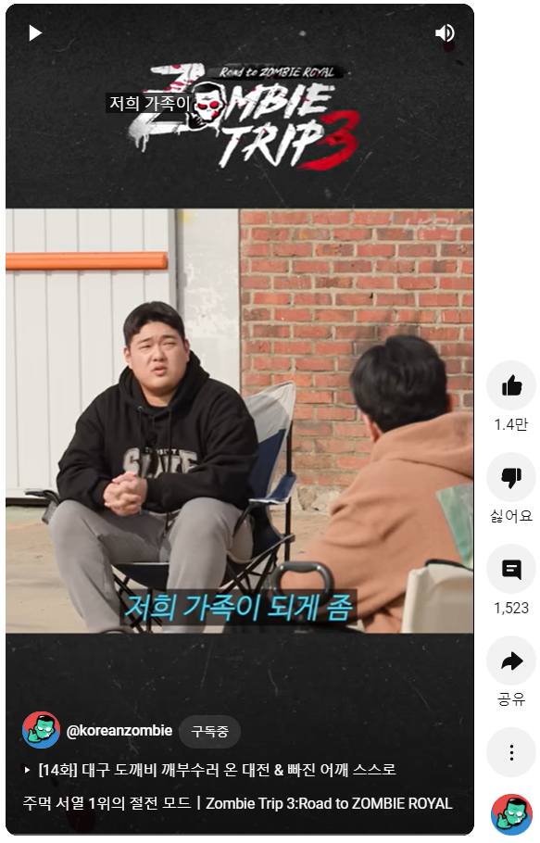
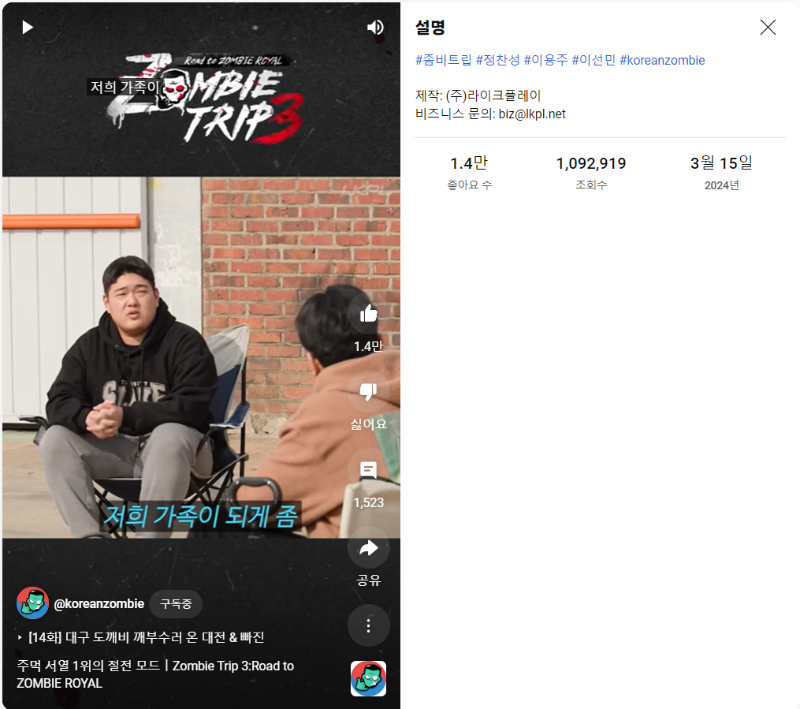
2-3. Data Collecting Process
Click the description and collect data below
Shorts Name, Description
Description
Likes
Views
Dates
Click
Title

Slide 6
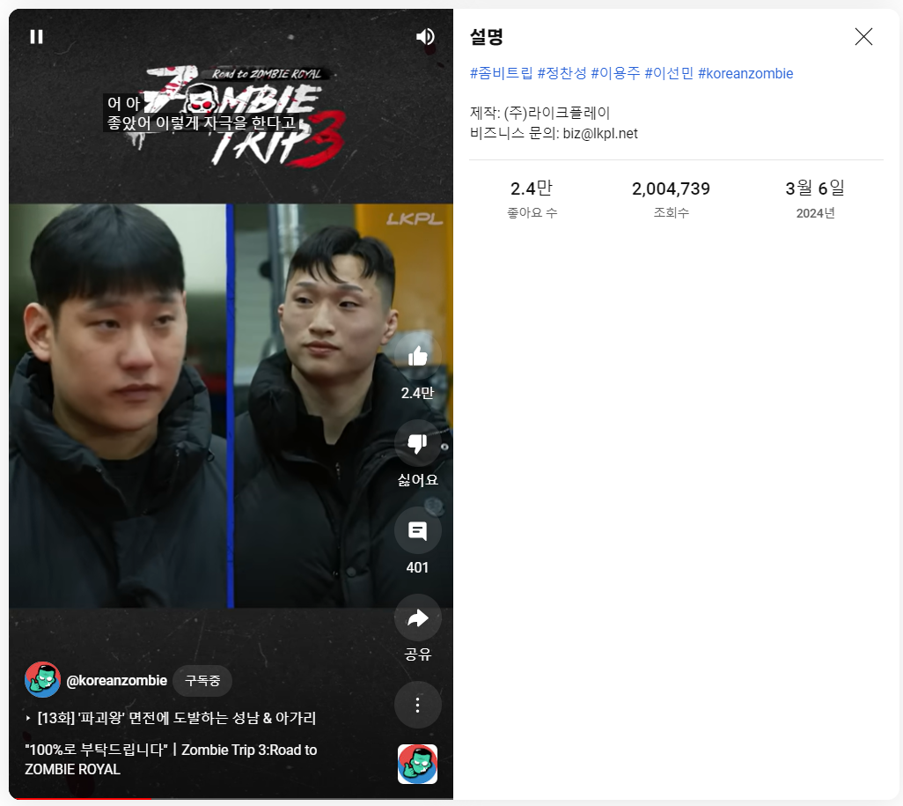
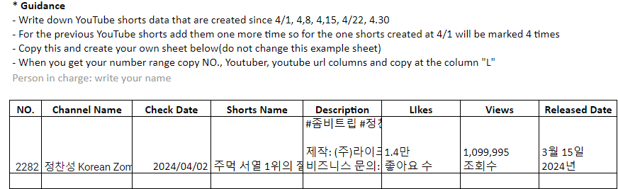
2-3. Data Collecting Process
Scroll down and repeat collecting data until target date
Write copy and paste the data at the Google Sheet Form
Scroll down
Data collecting Reminder
This data collecting need to be done in 00:00 KST to 23:59 KST (Korean Time)
Make sure that data are collected in Korean set language as Korean
Do not collect them in translated language Check link

