Slide 1


FRE-GY 6883 Financial Computing
The impact of the earnings on stock prices
Hatim J Kagalwala
Danish Khidir
Harshavardhan Chavan
Xin Luo
Yue Zhang
12/16/2017

Slide 2
Executive Summary
The aim of the project is to evaluate the impact of earnings release on the stock price of S&P 500 stocks using C++. We have categorized S&P 500 stocks into 3 groups based on their Bloomberg EPS estimate and Actual EPS. Then, we have used stock prices of 30 days before and after the earnings release to calculate and display charts of the Abnormal Average Returns (AAR) and Cumulative Abnormal Average Returns (CAAR) for each group by using gnuplot.

Slide 3
Task Allocation
Team members | Task
Hatim J Kagalwala (Team leader) | Design the project structure Create functions for the menu options Multithreading to improve performance Code integration
Danish Khidir | GNUplot function to plot the Time Series, AAR and CAAR Bloomberg data research
Harshavardhan Chavan | Create classes to download stock and reference data from Yahoo Calculate returns and abnormal returns for stocks Code integration
Xin Luo | Create module to reading the stocks data from csv file and categorizing the stocks into Beat, Meet and Miss groups Random sampling of stocks
Yue Zhang | Create classes to store stock and time series data Operator overloading to calculate AAR

Slide 4
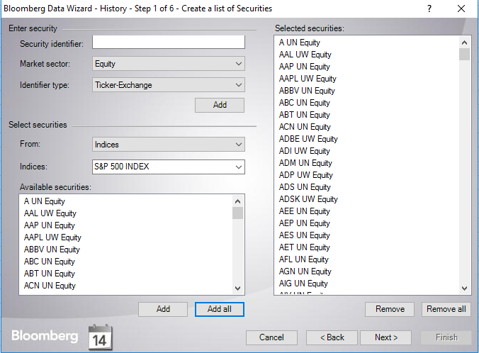
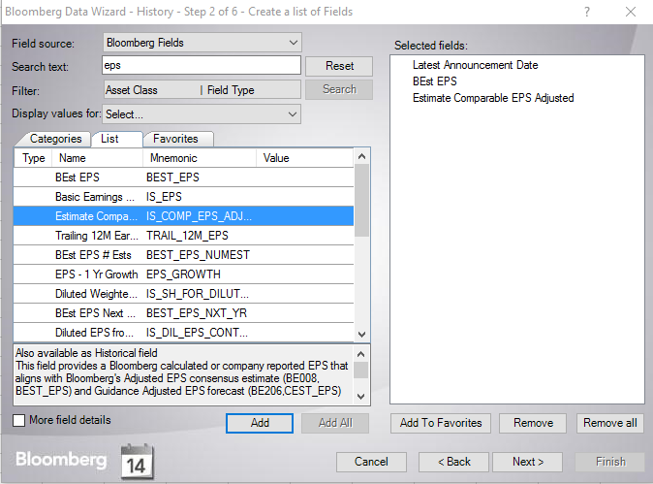
Get Bloomberg Data
Notes:
Many stocks had N/A values for dates, Bloomberg estimate and Actual Earnings. So those stocks were removed from the list.

Slide 5

Project Design
Create classes and data structure
Use EPS Estimate and Actual Estimate to select stocks into 3 groups
Data Matching and Returns Calculation
AAR and CAAR Calculation
gnuplot: Time Series Chart, AAR Chart and CAAR Chart

Slide 6
Menu Design
Menu Design
SwitchStart
Option 1: Display & Plot time series
Option 2: Plot AAR
Option 3: Plot CAAR
Option 4: Exit

Slide 7
Implementation
1. Class Structure
Create an abstract base class Data
Create two derived classes Stock and Reference
Data
Stock
Reference
Notes:
Class Stock is created to download stock price data from Yahoo
Class Reference is created to download the price data for benchmark from Yahoo
We have used inheritance as most of the data members such as ticker, start date, end date, close price are common to both stocks as well as benchmark stock and these are hence declared in the base class

Slide 8
Class Structure
Stock
Data
Reference
Protected Data Member:
  +AnnDate
  +Dates
  +Returns
  +AbReturns
Member Function:
  -SetTicker( )
  -SetAnnDate( )
  -CalculateReturns( )
  -GetTimeSeries( )
  -GetReturns( )
  -GetAbReturns( )
  -GetData( )
Protected Data Member:
  +static DatesR
  +static ReturnsReference
  +Ticker
  +Start
  +End
  +Close
Member Function:
  -virtual GetData( )
Member Function:
  -SetTicker( )
  -DatesRef( )
  -GetReturns( )
  -CalculateReturns( )
  -GetData( )
Notes:
Class Data:
It is an abstract class with GetData() as pure virtual function
The data member DatesR is a static data member used to store dates of the benchmark stock
ReturnsReference is also a static data member which stores the returns of the benchmark stock
The data members Ticker, Start, End and Close stores the ticker, start date, end date and close prices of a stock respectively
Class Stock:
It is a derived class of class Data
The data members AnnDate, Dates, Returns, AbReturns are used to store the announcement date, dates of 61 days, stock returns and Abnormal returns of stock as compared to the benchmark respectively
The member function SetTicker() is used to set the ticker of the stock
The member function SetAnnDate() is used to set the earnings announcement date of the stock
The member function CalculateReturns() is used to calculate daily returns of the stock
The member functions GetTimeSeries(), GetReturns(), GetAbReturns(), are used to access the data members Close, Returns, AbReturns respectively
The member function GetData() is used to download stock data from the Yahoo and calculate returns and abnormal returns of the stock
Class Reference:
It is a derived class of class Data
The member function SetTicker() is used to set the ticker of the benchmark stock
The member functions DatesRef() and GetReturns() are used to access the data members DatesR and ReturnsReference respectively
The member function CalculateReturns() is used to calculate daily returns of the benchmark stock
The member function GetData() is used to download benchmark stock data from the Yahoo and calculate returns of the benchmark stock

Slide 9
Implementation
1. Class Structure (contd…)
Create a class BloombergData to store date, category, estimated EPS and actual EPS data for each stock in a class object
Create a class TimeSeries to store time series data for each stock in a class object
We store these class object in maps with stock ticker as their key
BloombergData
TimeSeries
Protected Data Member:
  +AnnDate
  +Category
  +BbgEst
  +ActEPS
Member Function:
  -GetAnnDate( )
  -GetCategory( )
  -GetBbgEst( )
  -GetAPS( )
Protected Data Member:
  +Dates
  +Close
  +AbReturns
Member Function:
  -GetDates( )
  -GetClose( )
  -GetAbReturns( )
Notes:
BloombergData: create a obj in read_csv.h; both: used in main function as the value of maps AllStocks and MapTS to get stock data when plotting timeseries.

Slide 10
Data Structures
Map
  map<string, TimeSeries> MapTS is a map where the key is the ticker and value is an object of class TimeSeries which is used to store the Dates, Close and returns in a vector.
  map<string, BloombergData> is a map where the key is the ticker and value is an object of class BloombergData which is used to store the category (Meet, Beat and Miss), Announcement date, Actual earnings and Bloomberg estimate.
  map<string, string> BeatAll/MeetAll/MissAll used to store the ticker and announcement date for all stocks in each category which is then used for random sampling.
Vector
  Vectors have been used to store the Dates, Close, Returns and Abnormal Returns of the stocks at various places.
  Vector of vector which is nothing but a Matrix has been used to store the AAR and CAAR for the three categories.

Slide 11
2. Stocks Selection
Download S&P500 data from Bloomberg to Excel: Ticker, EPS Estimate, Actual EPS and Announcement Date of each stock
Divide all stocks into 3 groups based on EPS Estimate and Actual Estimate
BeatAll: Actual EPS is greater than the EPS Estimate by more the tolerance %
MeetAll: Actual EPS are EPS Estimate is within the +/- tolerance % limits
MissAll: Actual EPS is lower EPS Estimate by more than tolerance %
Use Map to store stocks for each group
Key: Ticker, Value: Announcement Date
At each sampling, randomly select 40 stocks from each group
Notes:
In order to perfectly match the data format of Bloomberg data and Yahoo data,
we convert data format from yyyymmdd to yyyy-mm-dd.
Then create three maps to store three groups(passed by reference): key: Ticker, value: Announcement Date;
Randomly select 40 stocks from each group and store them in three vectors, separately.

Slide 12
SPY
2017-02-01
3. Data Matching and Returns Calculation
Use simplecurl to get reference(SPY) data, which includes dates from
2017/02/01 to 2017/11/25 and close prices
Calculate reference returns and store them in a vector
Use iterator to find the position of the stock by announcement date
in Stock class and match it with the position in SPY
Use simplecurl to get stock close price and store stock close prices in map
Key: Ticker
Value: vector of close price for 61 days
Stock
start
pos-30
announcement date
position
end
pos+30
2017-11-25
Notes:
We use to get the SPY data to be used as reference. Also calculate the daily returns of SPY.
Using Iterators we locate the position of announcement date within the SPY Time series and use it to obtain the start and end date (-/+ 30 from announcement date)
Using simplecurl, we download the Close Prices for Stocks between start and end dates and store them in map with Key: Ticker and Value: vector of close price for 61 days

Slide 13
SPY
2017-02-01
3. Data Matching and Returns Calculation (contd…)
Calculate stock returns and abnormal returns
Store abnormal returns in matrix
Each row of matrix is returns of a stock for 61 days Calculate abnormal returns
Stock
start
pos-30
announcement date
position
end
pos+30
2017-11-25

Slide 14
Implementation
4. AAR and CAAR Calculation
Operator overloading: ~
Calculate AAR of each group for one sampling, and use vector to store AAR of each group
Use a loop to calculate AllAAR for all samples and store it in a Matrix
Use operator ~ to get the average AllAAR (FinalAAR in code)
Calculate CAAR for each group by summing up the elements of FinalAAR for each group
Store CAAR of three groups in a matrix
Notes:
operator overloading; input a matrix, sum up the elements of each column, and then return a vector; used in main function to calculate AAR and average AAR.

Slide 15
5. gnuplot
plotresults function: plotresults(vector<vector<double>> *matrix)
Plot average AAR and average CAAR for each group
plotResults function: plotResults(vector <double>* TS)
Plot the close price of a single stock for 61 days
1 | FinalAARBeat | CAARBeat
2 | FinalAARMeet | CAARMeet
3 | FinalAARMiss | CAARMiss
Notes:
Call plotresults function using call by pointer method to display Average AAR and CAAR Values for the all the samples.
Call plotResults to plot the Time Series for a selected stock by call by pointer method.

Slide 16
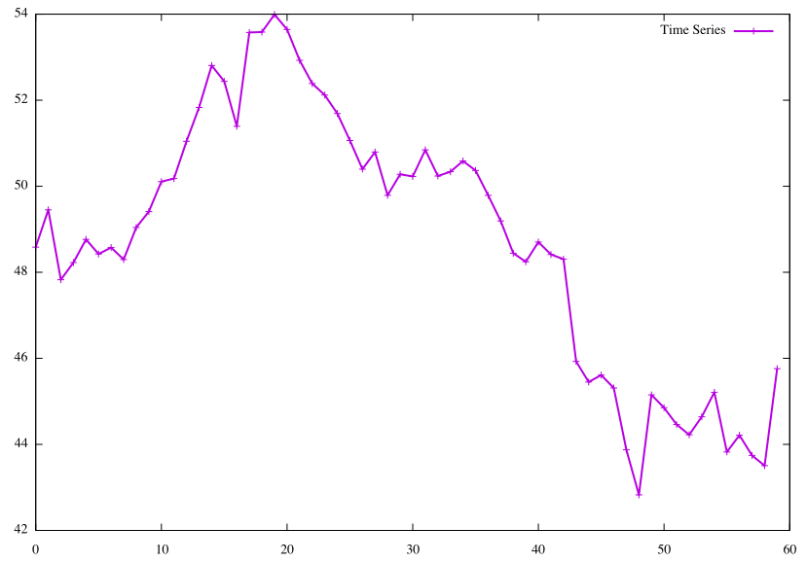
Time Series Chart
(Using AAL as an example)
Plot close prices in 61 days of AAL
Notes:
Time Series Chart of Stock “AAL”

Slide 17
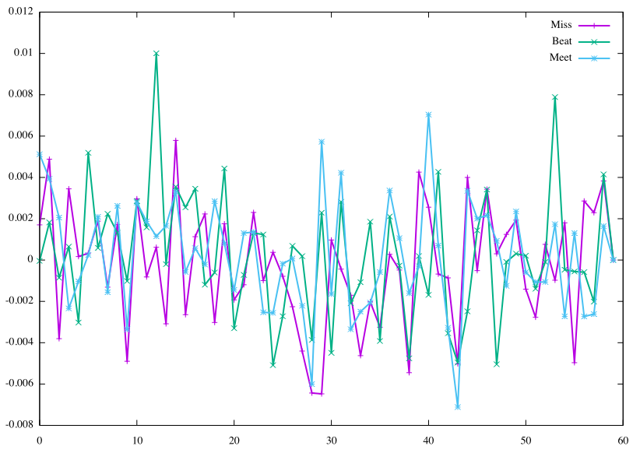
AAR Chart
Plot Average Average Abnormal Returns of three groups
Notes:
Plot shows Average AAR for all samples for three Groups (Beat, Miss and Meet)

Slide 18
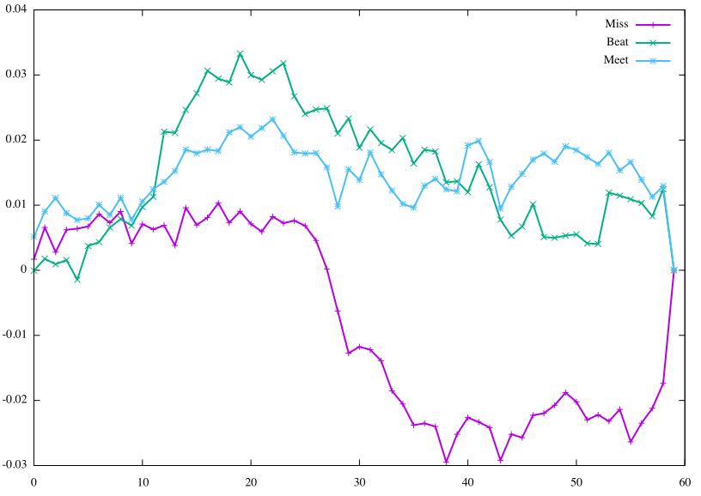
CAAR Chart
Plot Average CAAR of three groups
Notes:
Plot shows Average CAAR for all samples for three groups (Beat, Miss and Meet)

Slide 19
Enhancements
Implement Multi-Threading within the main function to download stock data within each of the groups in order to reduce elapsed time
Increase flexibility of sampling size to calculate Average AAR and CAAR Values
Implemented additional functionality to plot time series data of a selected stock

Slide 20
Multithreading
The data for each category (Beat, Meet and Miss) were downloaded using three threads simultaneously in order to reduce the time. Able to download the data for 414 stocks in 15 seconds.
std::thread beat(StockDataYahoo,(BeatStock),std::ref(BeatAll),std::ref(MapTS));
std::thread meet(StockDataYahoo,(MeetStock),std::ref(MeetAll),std::ref(MapTS));
std::thread miss(StockDataYahoo,(MissStock),std::ref(MissAll),std::ref(MapTS));
beat.join();
meet.join();
miss.join();
Notes:
The function StockDataYahoo is called on each thread and the arguments for the function are passed. std::ref means pass by reference. .join() is used to ensure that the main thread waits for the three threads to finish execution.

Slide 21
Conclusion
Stocks beating estimated EPS (over 5%) have a CAAR drop after EPS was released
Stocks meeting estimated EPS (between -5%-5%) have a relatively stable CAAR after EPS was released and then keep it in a relatively high level
Stocks missing estimated EPS (below -5%) have a dramatic CAAR drop after EPS was released and then keep it in a relatively low level
Earning releases have a significant impact on stock prices

Slide 22
Reference
“Working with Historical and Market Data.” Song Tang, NYU FRE 6883 Financial Computing Class slides, 2017 Fall.
Financial Instrument Pricing Using C++, Daniel J. Duffy, ISBN 0470855096, Wiley, 2004.
“Jump between cases in C switch statement”, Stackoverflow https://stackoverflow.com/questions/19473679/jump-between-cases-in-c-switch-statements/19473710#19473710

