Slide 1
Visualizing pore size distribution files in VisIt
Marielle Pinheiro
May 28, 2013

Slide 2
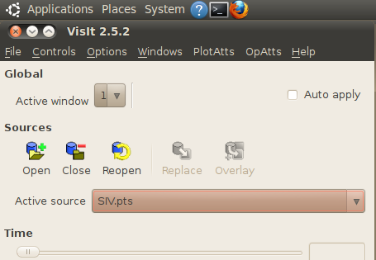
Files needed:
.xyz structure file
.psd_histo file (generated by Zeo++)
STEP 1: Loading files
You will load files by clicking “Open” button below Sources heading in the main window.

Slide 3
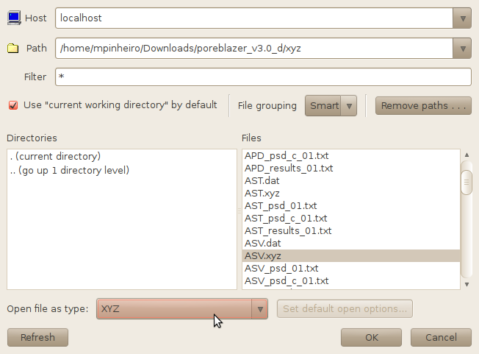
This window will pop up.
1.1.1: To open .xyz file:
Navigate to the directory that contains your .xyz file by typing the directory path into “Path” and hitting Enter. You can also double click “..(go up 1 directory level)” to navigate folders. Your default directory will be the directory that you are running VisIt out of.
Select the .xyz file of interest.
Open file as type: You can keep the default “Guess from file name/extension” or choose “XYZ” from the drop down menu.
Once you are finished, click “OK”. You will be back in the main window.

Slide 4
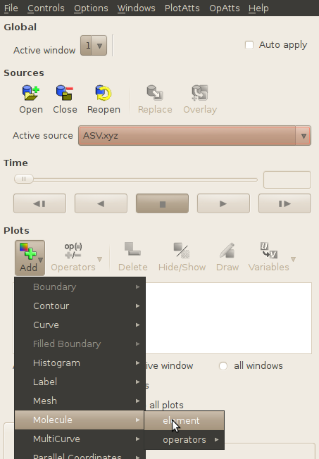
1.1.2: Adding .xyz file as molecular structure
Your .xyz file should be in “Active source”.
To add your file to the drawing window, click the “Add” button and go to “Molecule”, then “element.”

Slide 5
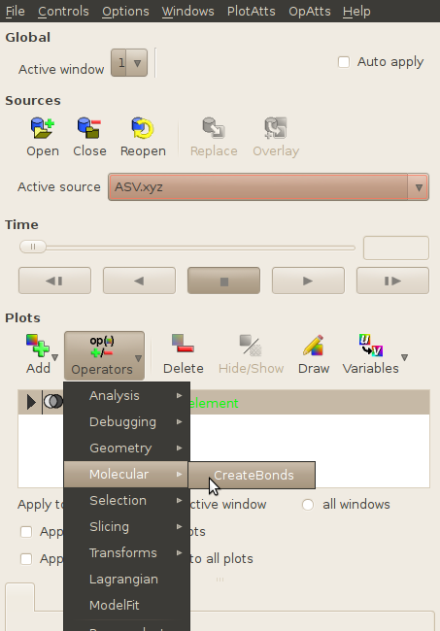
Next, click on “Operators” and go to “Molecular”, then “CreateBonds”.
NOTE: Be sure to uncheck the two boxes that say “Apply operators to all plots” and “Apply subset selections to all plots”.

Slide 6
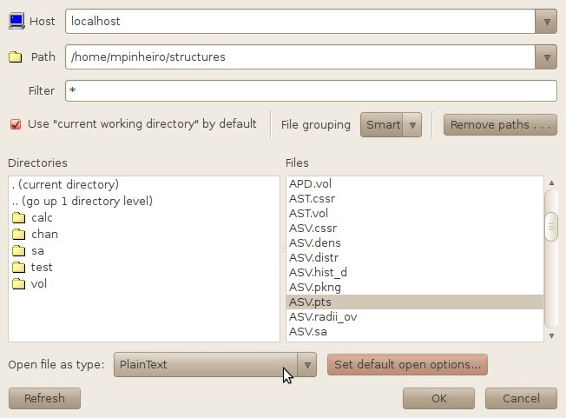
1.2.1: To open .psd_histo file:
Click the “Open” button again under the Sources heading in the main window, and follow the steps in 1.1 to navigate to the directory with your .psd_histo file.
Select the .psd_histo file of interest.
Open file as type: Choose “PlainText” from the drop down menu.
You will need to change the default options.

Slide 7
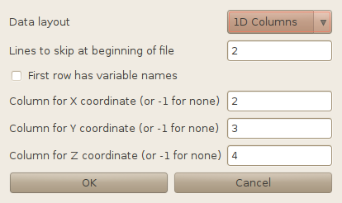
1.2.2: Changing Plaintext defaults
Change the values in the boxes to match the ones shown in this screenshot. Click “OK”. Then click “OK” in the preceding window to exit back to the main window.
Note: This only has to be done once per session. As long as you don’t close VisIt, the settings will be preserved.

Slide 8
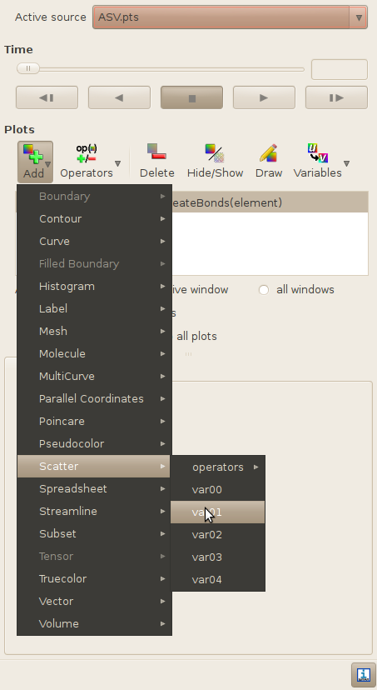
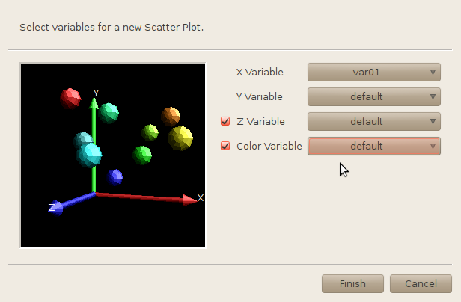
1.2.3: Adding .psd_histo file as Scatterplot
The .psd_histo file should now be your active source in the main window.
To add your file to the drawing window, click the “Add” button and go to “Scatter”, then “var01”.
A new window will pop up. For some strange reason, VisIt doesn’t allow you to select var02, var03, and var04 in this window, so you will have to do it manually in the next step. For now, check the Z and Color Variable boxes and change the values to “default”. Click “Finish” to exit back to the main window.

Slide 9
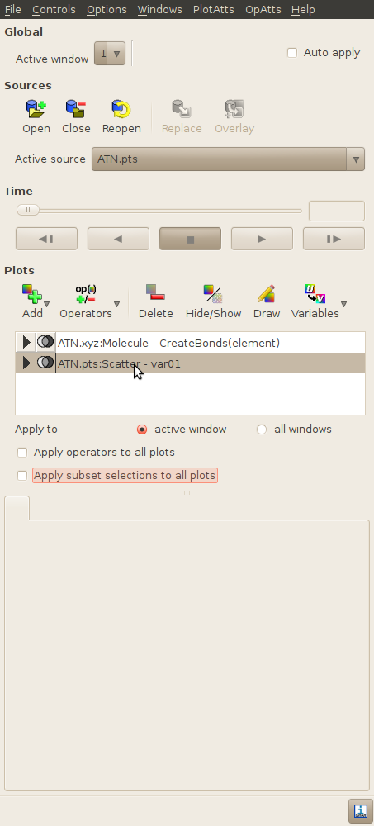
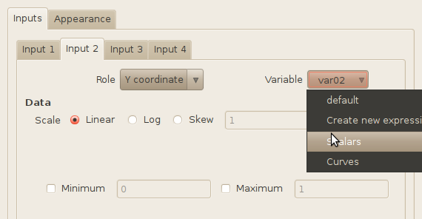
Double-click on your .psd_histo file.
A new window will appear. Input 1, the x coordinate, should already be assigned to var01.
Click on the “Input 2” tab. Go to the Variable drop-down menu, go to “Scalars”, and choose var02 for Y coordinate.
For “Input 3” (Z coordinate), follow the Input 2 steps, choosing var03. For “Input 4” (color), choose var04.

Slide 10
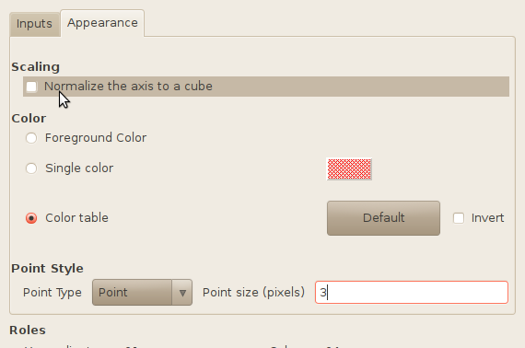
Next, switch to the “Appearance” tab.
Uncheck the “Normalize the axis to a cube” box.
Change the point size to 3 pixels. Everything else should be fine, unless you want to choose a different color table. Hit “Apply”, then “Dismiss” to close this window.

Slide 11
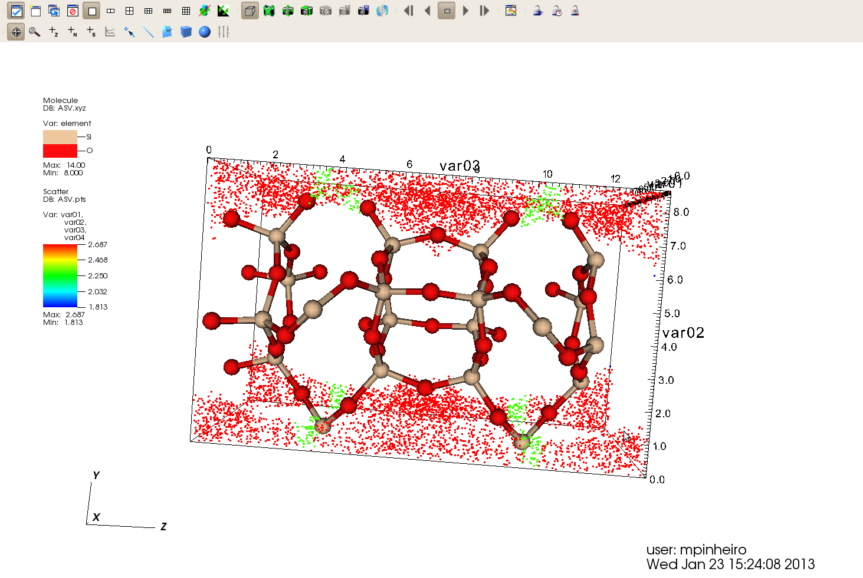
2. Generating image
Back in main window:
Click “Draw” and your image will be generated.
You can toggle files on/ off by highlighting a file name (one click) and selecting the “Show/Hide” button.

Slide 12
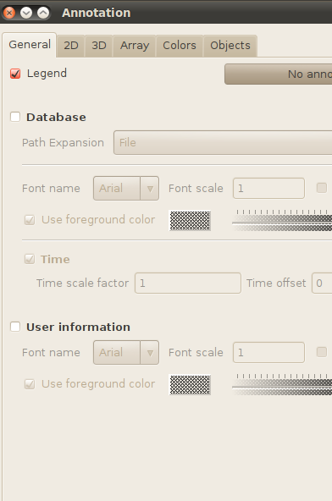
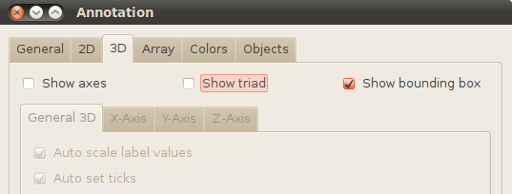
3. Modifying Annotations
There are a few unnecessary labels that we can hide in order to clean up this image.
In the top menu bar, click on “Controls” and choose “Annotation”. This window will appear.
You can select/ unselect features and click “Apply” to see what turns on and off in the image. In the “General” tab, I unchecked “Database” and “User Information”.
In the “3D” tab, I unchecked “Show axes” and “Show triad”.
Once you are satisfied, click “Apply” and then “Dismiss”.

Slide 13
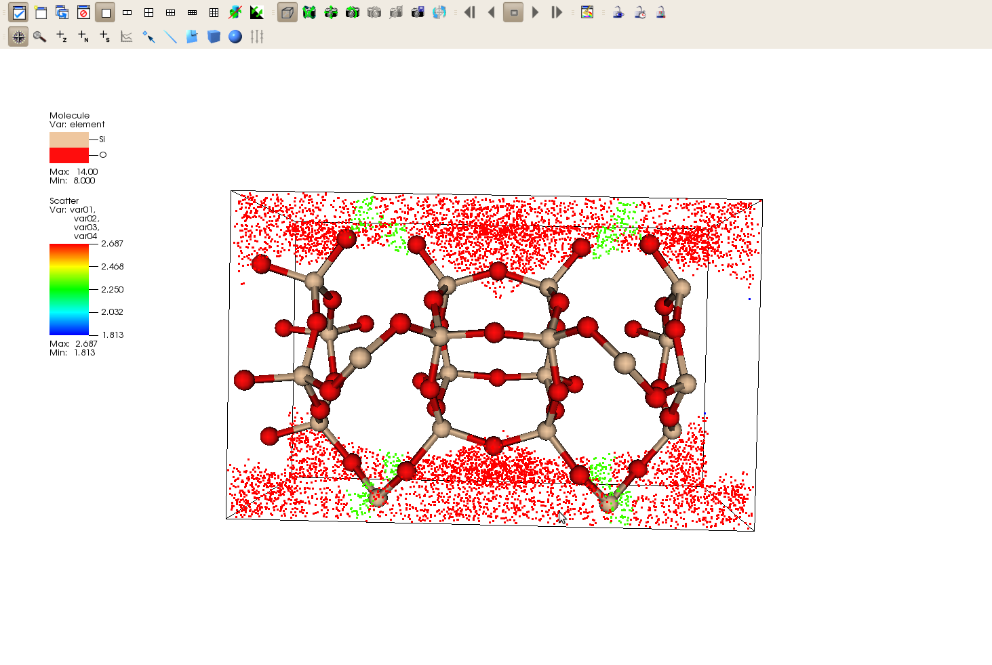
Play with the view by clicking on the structure and dragging it to look at different perspectives, or adjust the “View” settings in the “Controls” menu. (Ctrl+V)
Follow steps 1 and 2 for any other structure that you would like to add. Use the “Show/ Hide” button to toggle between structures.
You can also replace existing files with new ones, thus preserving the settings so that you don’t have to go through steps 1 and 2 repeatedly.

Slide 14
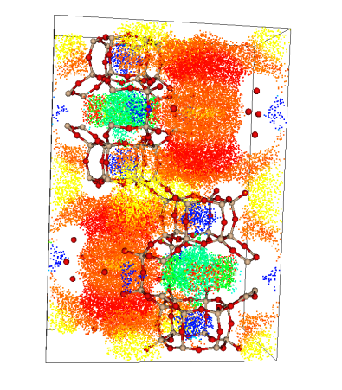
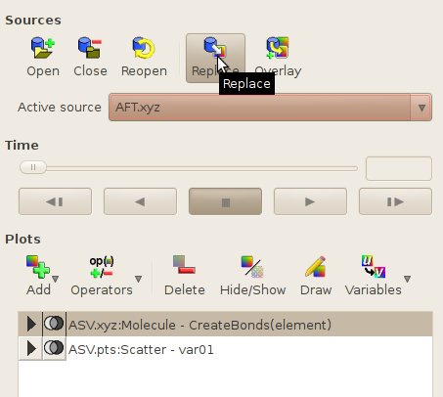
4. Replacing structures
Open the new file as shown in 1.1.1 (for .xyz file) or 1.2.1 (for .pts file). However, instead of adding the file as a new object, highlight the file that you will be replacing (make sure it’s the same file type!) and click “Replace”.
Once you have done the necessary replacements, click “Draw”.

Slide 15
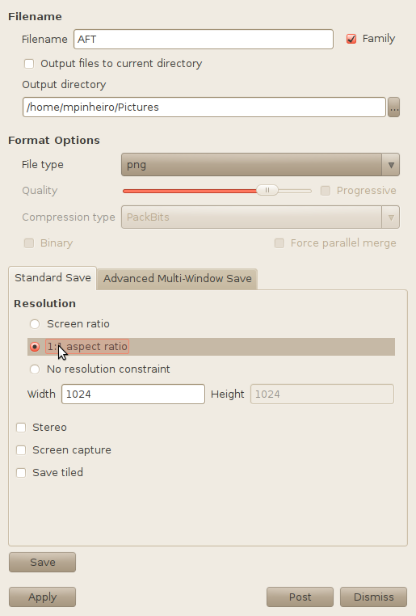
5. Saving images
Go to “File”→ “Set Save Options…”
Name your file.
Uncheck “Output files to current directory” and “Family” and enter the directory that your pictures will be saved to.
Choose your file format.
Choose your aspect ratio.
Click “Save”.

