Slide 1
Zeo++: Geometry-based analysis of porous materials
Zeo++ is a open source software for performing high-throughput geometry-based analysis of porous materials and their voids. It utilizes radical Voronoi decomposition and the resultant network to perform various analytical functions
Version 0.1.0 released December 2011
Updated version (Version #) includes:
-new descriptors (holograms, pore size distribution, ray trace)

Slide 2
Command line specifications
./network -r -flag chan_rad probe_rad
Includes radii in Voronoi decomposition. Custom atom radii values can be included by entering .rad filepath after -r flag
Tells Zeo++ which function to perform
Radius of probe used to determine proportion of accessible space
Radius of probe used in Monte Carlo sampling
num_samples output.name input.name
Number of Monte Carlo samples
(Optional)
User-specified output file name
Input file name. Can be .cssr, .cuc, or .v1 file

Slide 3
Zeo++ Flags
Filetype conversion
-xyz
-v1
-nt2
Void space and accessibility
-sa
-vol
Structural characteristics
-chan
-res
Pore landscape characterization
-holo
-psd
-ray

Slide 4
Zeo++ flags: filetype conversion
-xyz: outputs file with Cartesian coordinates of atoms
-v1: similar to .xyz file, but contains unit cell vectors
-nt2: outputs Voronoi network for given structure
./network -xyz output.xyz input.name
./network -v1 output.v1 input.name
./network -r -nt2 output.nt2 input.name

Slide 5
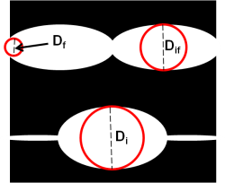
Zeo++ flags: structural characteristics
  -res: calculates included sphere (D_{i}), free sphere (D_{f}), and included sphere along the free sphere path (D_{if}) diameters, in Å
./network -r -res output.res input.name
File output:
name.res 5.65992 3.37868 5.65992
output file name
D_{i}
D_{f}
D_{if}
-D_{i} is the largest overall diameter
-D_{f} is the restricting pore diameter
-D_{if} is the largest diameter along a viable path through the structure

Slide 6
Zeo++ flags: structural characteristics
  -chan: identifies number and dimensionality of channels
./network -r -chan probe_rad output.chan input.name
File output:
2 channels identified of dimensionality 1 1
Number of channels in structure
Dimensionality of each channel
Dimensionality refers to the channel shape

Slide 7
Zeo++ flags: Void space and accessibility
  -sa: calculates amount of surface area accessible to probes specified in chan_rad and probe_rad (ASA). Obtained via Monte Carlo sampling of probe-accessible space.
./network -r -sa chan_rad probe_rad num_samples output.sa input.name
NAME
A^2: 88.5767
m^2/cm^3: 2880.69
m^2/g: 1775.58
Structure name
ASA per unit cell, in Å²
ASA in m²/g³
ASA in m²/g

Slide 8
Zeo++ flags: Void space and accessibility
  -vol: calculates amount of volume accessible to probes specified in chan_rad and probe_rad (AV). Obtained via Monte Carlo sampling of probe-accessible space.
./network -r -vol chan_rad probe_rad num_samples output.vol input.name
NAME
A^3: 42.5743
Volume fraction: 0.13846
cm^3/g: 0.0853429
Structure name
AV per unit cell, in Å³
fraction of unit cell volume accessible to probe
AV in cm³/g

Slide 9
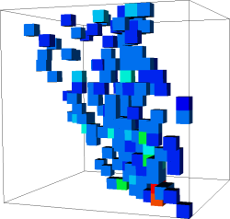
Zeo++ flags: Pore landscape characterization
  -holo: Generates 3D array that contains a histogram of enumerated probe-accessible space
./network -r -holo chan_rad probe_rad num_samples output.holo input.name
x | y | z | Freq.
5 | 15 | 15 | 24
7 | 7 | 5 | 96
9 | 13 | 11 | 48
11 | 1 | 1 | 24
11 | 11 | 7 | 96
12 | 5 | 0 | 48
14 | 7 | 1 | 96
14 | 11 | 5 | 96
14 | 13 | 5 | 24
14 | 15 | 9 | 96
15 | 9 | 5 | 96
Column 1-3: Cartesian coordinates in array
Column 4: number of sampled occurrences
Visualization of a hologram output

Slide 10
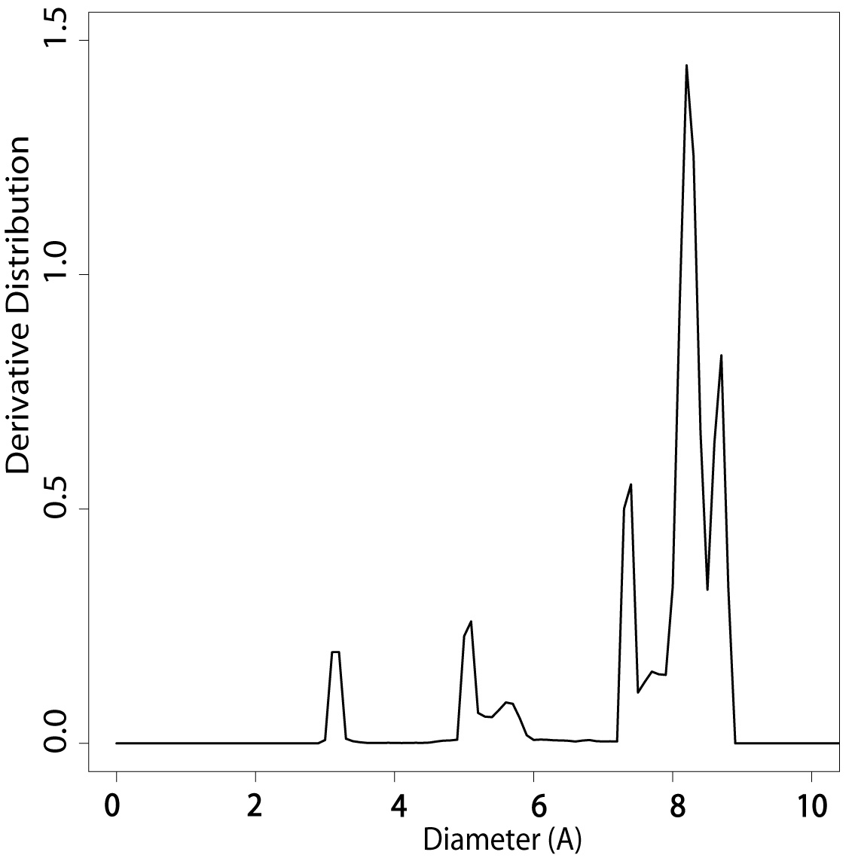
Zeo++ flags: Pore landscape characterization
  -psd: calculates relative proportions of pore diameters within probe-accessible space. Outputs histogram with 0.1Å bin resolution
./network -r -psd chan_rad probe_rad num_samples output.psd_histo input.cssr
Bin | Count | Cum. Dist | Der. Dist
0 | 0 | 1 | 0
0.1 | 0 | 1 | 0
. | . | . | .
. | . | . | .
5.9 | 5 | 0.925068 | 0.052384
6 | 2 | 0.924689 | 0.002657
6.1 | 2714 | 0.924537 | 1.03097
6.2 | 7 | 0.718494 | 1.03287
6.3 | 9 | 0.717962 | 0.006073
. | . | . | .
. | . | . | .
Column 1: Pore diameter
Column 2: number of samples in spheres with corresponding pore diameter
Column 3: cumulative distribution of samples
Column 4: change in cumulative distribution
Plot of bin vs derivative distribution

Slide 11
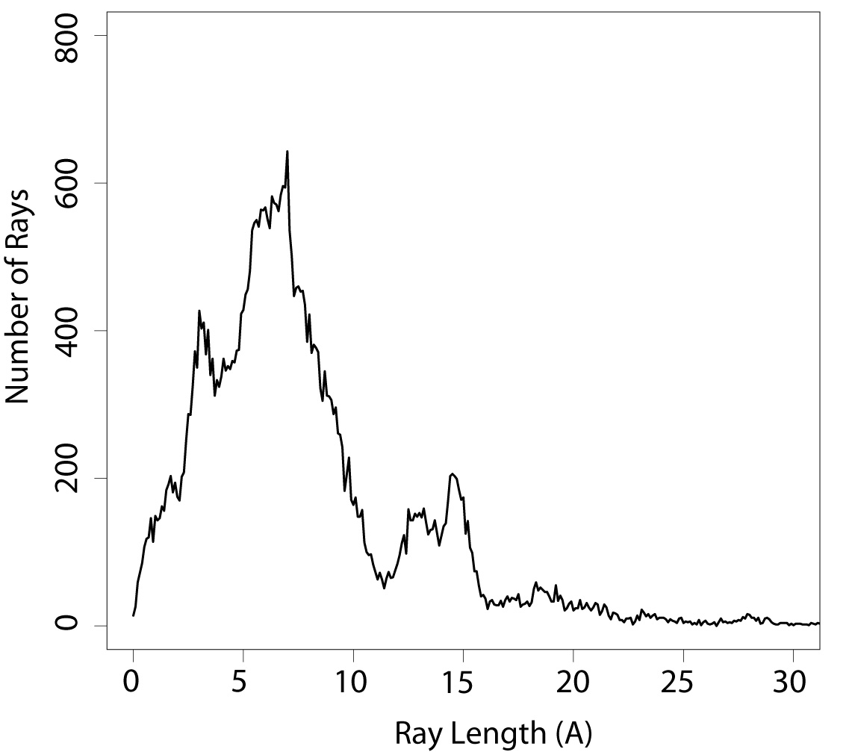
Zeo++ flags: Pore landscape characterization
  -ray_atom: generates randomly oriented rays (relative to probe-accessible space) that characterize pore landscape curvature. Outputs histogram with 0.1Å bin resolution.
./network -r -ray_atom chan_rad probe_rad num_samples output.ray_atom input.name
0
0.1
0.2
0.3
0.4
0.5
0.6
0.7
0.8
0.9
1.0
1.1
1.2
1.3
.
.
10
20
37
42
49
67
67
76
89
133
136
152
132
151
.
.
Outputs number of rays per corresponding ray length
Plot of ray length vs number of rays

Slide 12
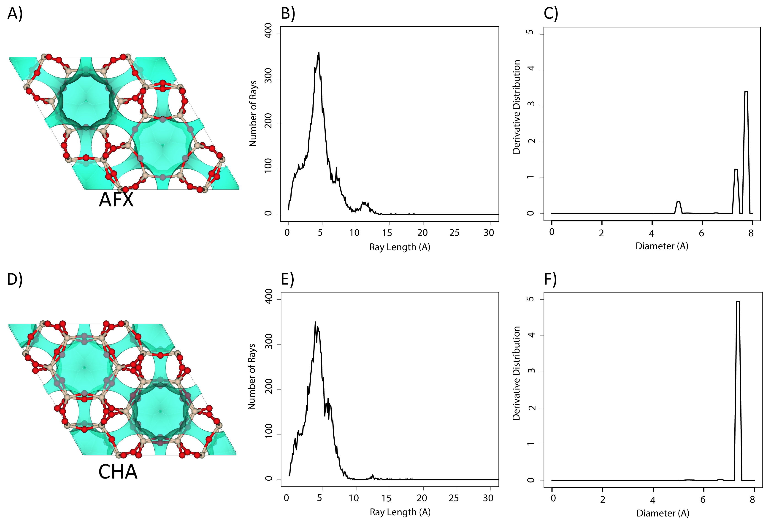
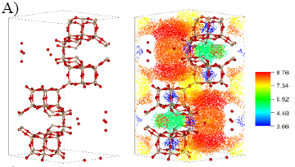
Pore landscape characterization: Applications
(Dis)similarity calculations between structures, based on histogram comparisons of hologram, PSD, and ray trace descriptors
-CITE HOLOGRAM PAPER
Visualization of accessible space:
vpsd flag generates .xyz file of accessible sample points that can be colored according to corresponding pore diameter length
gridBOV and -gridG generate contour maps of accessible space

