Slide 1

Middle column
Surface characteristics & CTD cast location
x
x
x
Right column
Vertical CTD profiles

Slide 2
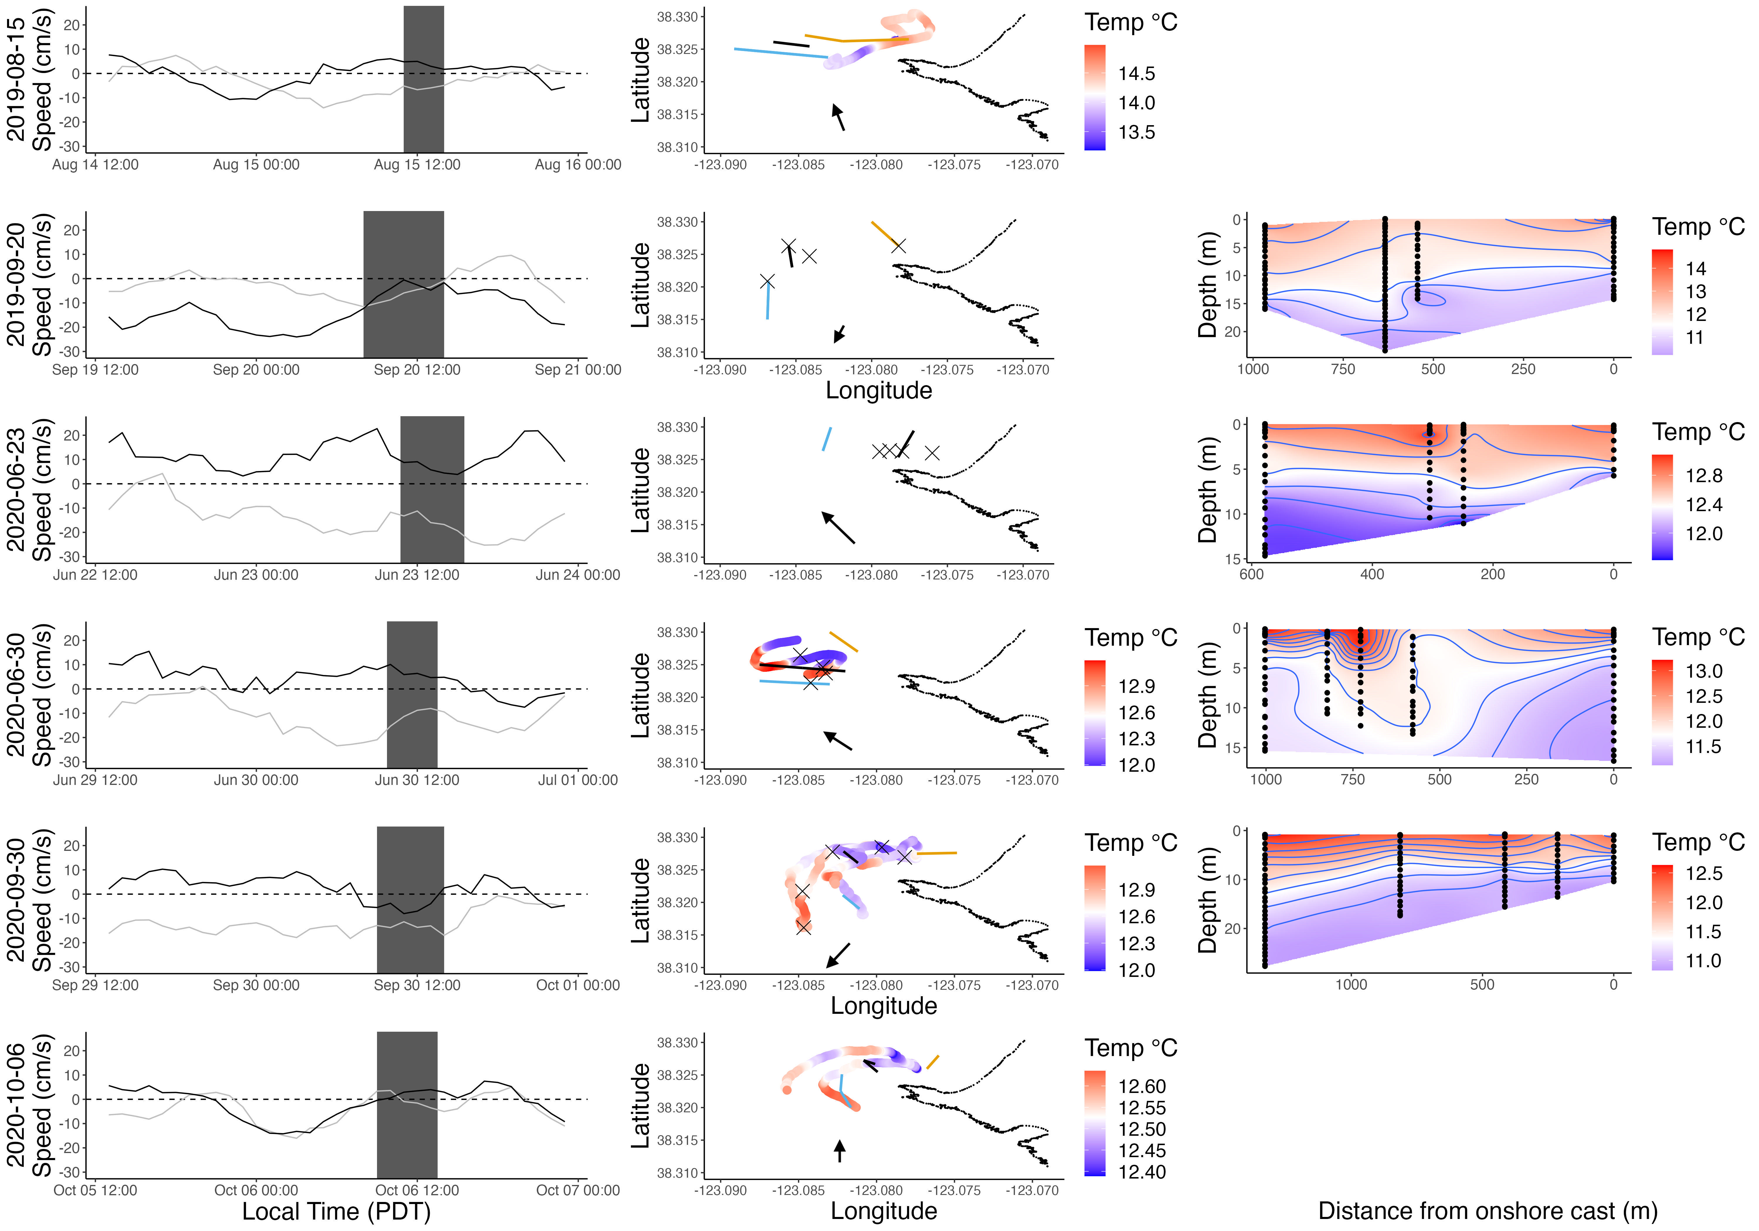
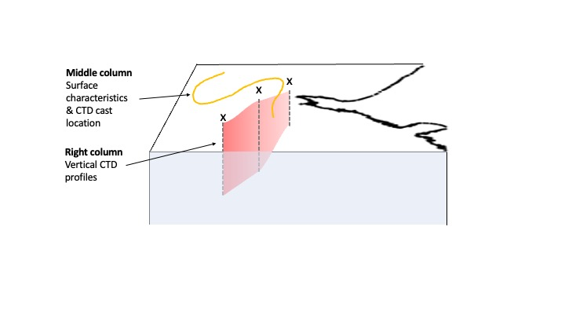
Guide
C
A
D
C
B
A
B
D
C
B
D
C
B
A
A
D
A
E
D
C
B
A
B
X
C
E
D
C
B
A
E
D
C
B
A
D
E

