Slide 1
Layla
04 · HOW WE BUILT IT
Three real-time AI loops, on
one DGX Spark / Nano AI Station.
PLAN routes for you SEE vision @ 33 ms IMPROVE civic agent
Nemotron-3-Nano-Omni-30B · NVFP4 · vLLM aarch64 · 6 fused data layers · 128 GB unified memory
Team Layla · NVIDIA Hack for Impact, London 2026
Notes:
SECTION 4 opener (~5s). 'Layla is three real-time AI loops on one Spark: it plans a route for who you are, sees the street when you can't, and improves the city for the next person. Here's how it works.'

Slide 2
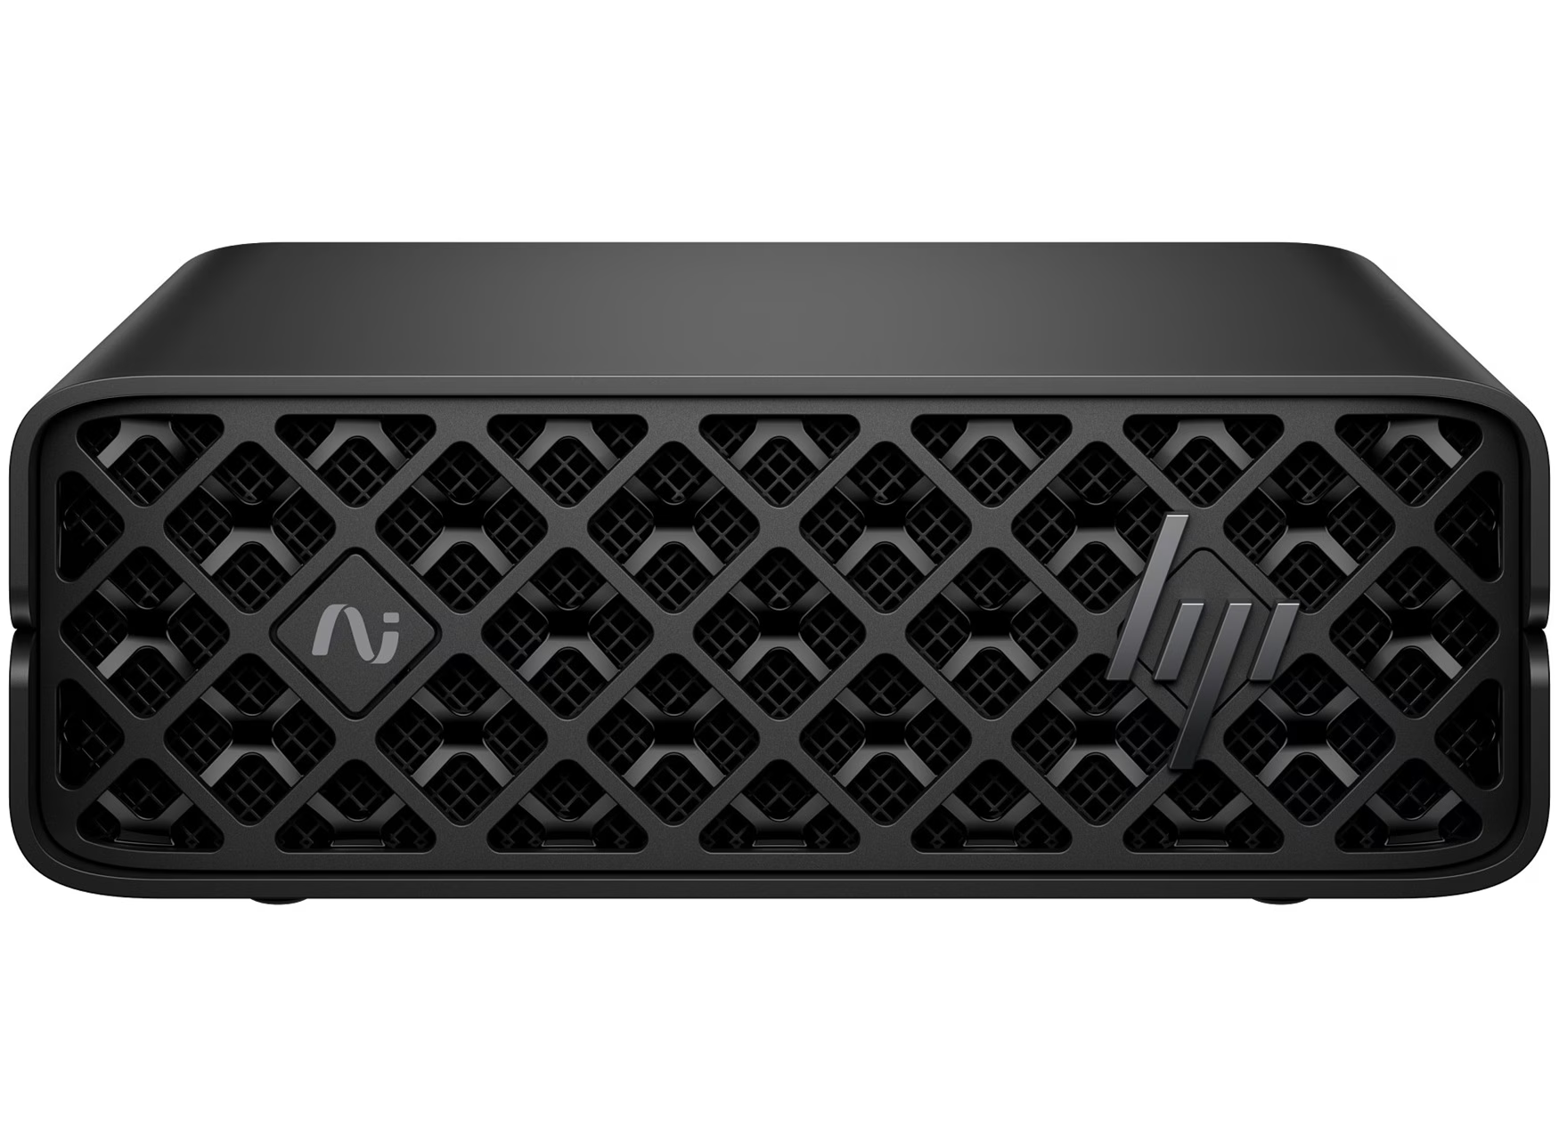
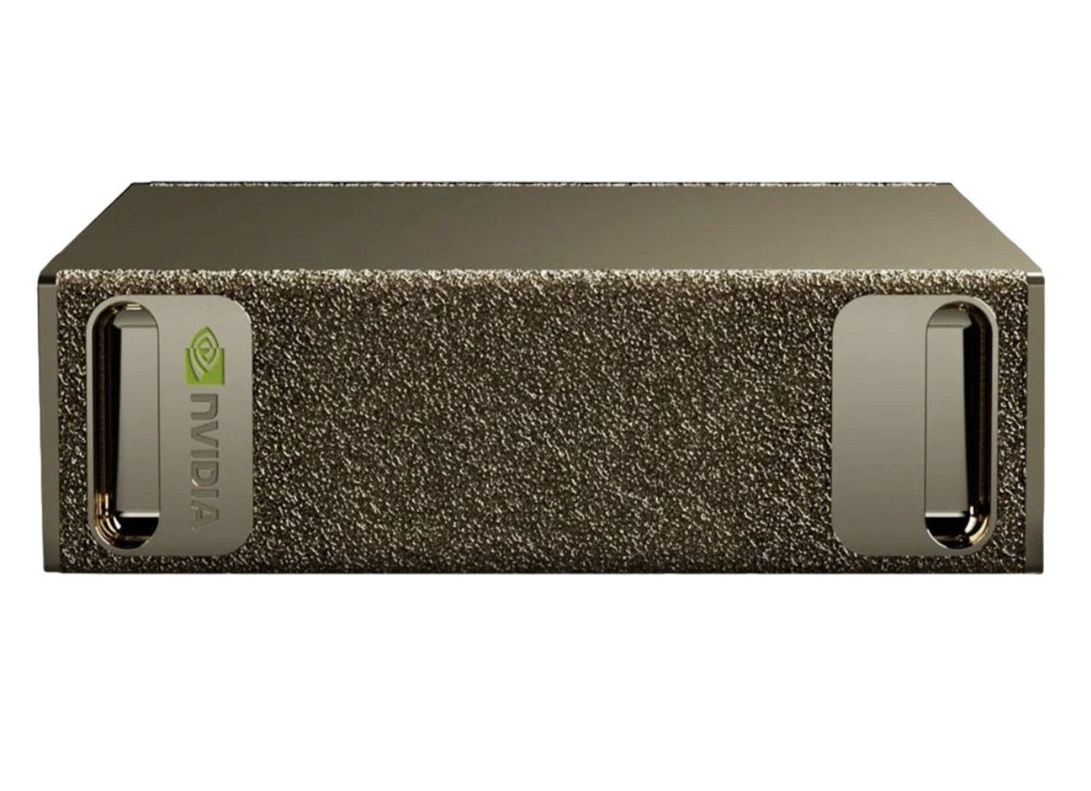
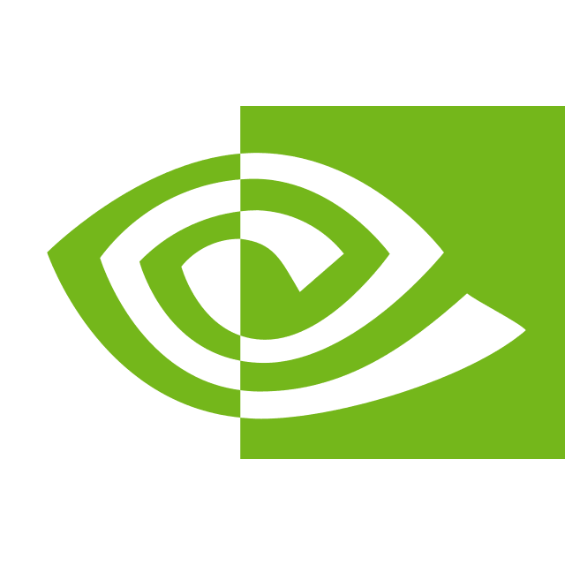
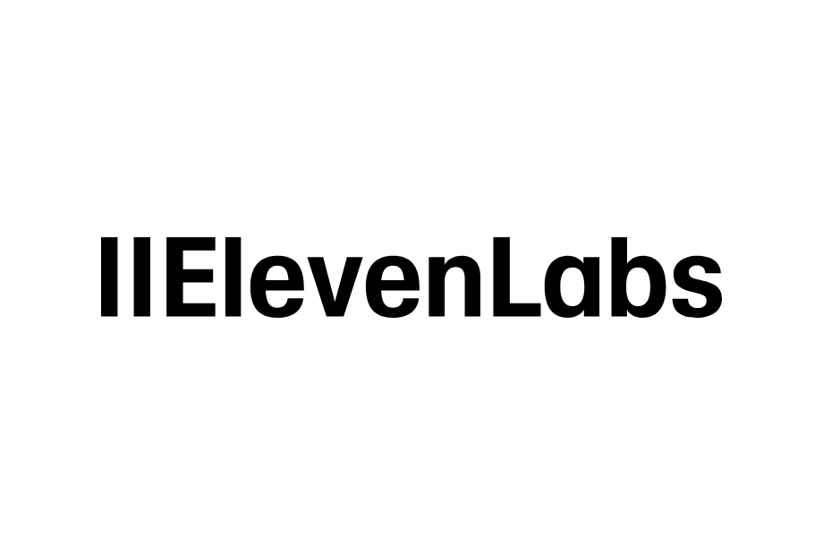



ARCHITECTURE & STACK
one request, end to end
The stack
REQUEST FLOW
FRONTEND
User · voice · camera · touch
Next.js 16 · React 19 · TypeScript · Bun
Leaflet map · Tailwind · ARIA a11y layer
↓ HTTPS · Cloudflare Tunnel → Caddy
Next.js 16 frontend
API /mobility /camera /voice
↓ fan-out
AI & DATA SERVICES
TfL Unified API
ElevenLabs Scribe + TTS / ElevenAgents VAD / ASR / TTS
ElevenLabs Scribe STT · TTS / EvevenAgents
Nemotron-3-Nano-Omni on vLLM
Nebius TokenFactory hazard vision + civic email
YOLO11n vision · 5 TfL APIs · OSM/ London Police crime/ Defra - noise/ London air
Nemotron Nano 30B Omni · vLLM
Nebius TokenFactory - Vision LM + email
YOLO11n.pt vision service · 33 ms
⚡ DGX Spark / Nano AI Station · Grace Blackwell GB10 · 128GB unified
RUNTIME & INFRA
vLLM v0.20-aarch64-cu130
Docker · Caddy · Cloudflare Tunnel
LAYLA · Accessibility Mobility Intelligence
04 · How we built it
1
Notes:
~15s. Layla is a Next.js app. Speech in/out is ElevenLabs. Route reasoning runs on Nemotron-Omni via vLLM on our DGX Spark. A separate YOLO11n service does real-time vision. The hazard path runs vision+web-search on Nebius. Everything serves behind one Cloudflare tunnel and Caddy, so the demo URL stays stable.

Slide 3


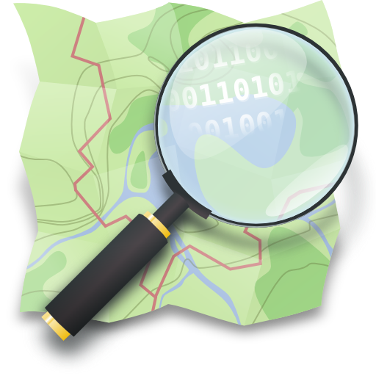



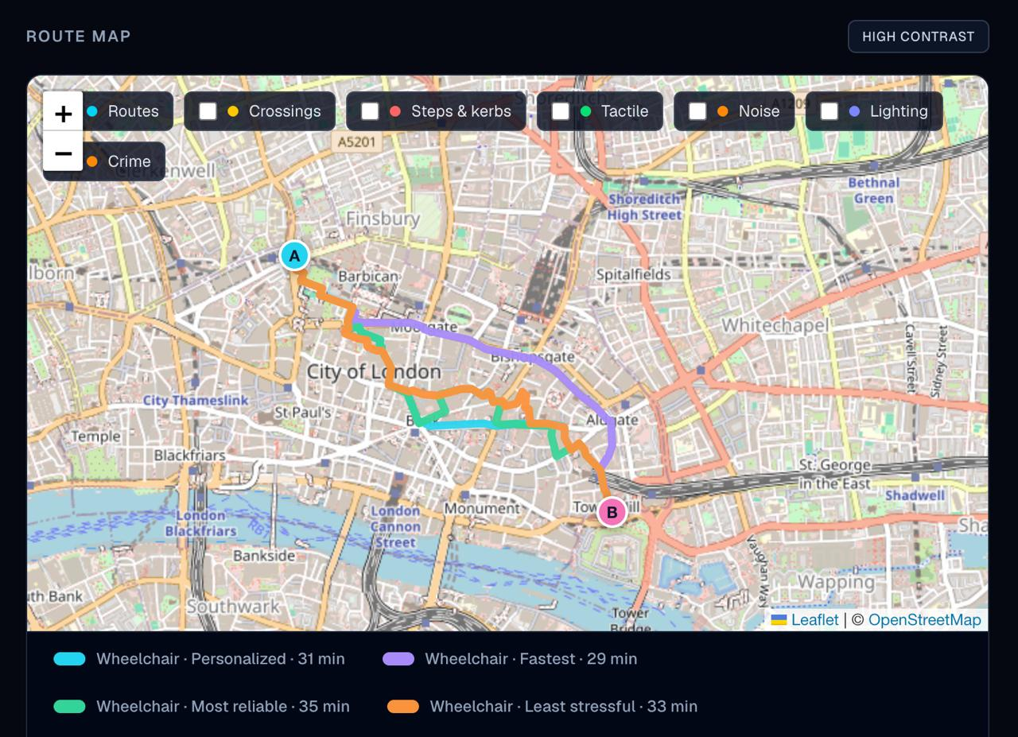
PLAN · ENGINEERING CORE
weighted Dijkstra · pure stdlib
The route engine —
6 DATA LAYERS → 1 FUSED WALKABLE GRAPH
PER-PERSONA COST FUNCTION
▣ DROP REAL SCREENSHOT
Route Map panel — 4 persona routes on one map (A→B)
cost(edge) = length × (1 + Σ w·score)
wheelchair steps×80 · incline×6
blind steps×8 · tactile×2 · noise×3
night-safety crime×8 · darkness×5
5 SIGNALS · ONE PER DATA LAYER (0–100)
3,825 edges · 264 a11y points · 17,585 crime · 945 noise polys
Same A→B · different persona → different edge cost →
different GEOMETRY (not the same line re-labeled)
Accessibility
steps · incline · tactile
OSM
Safety
crime density
police.uk
Quiet
road-noise dB
DEFRA
Re-route, not re-rank
Lighting
unlit segments
OSM lit
Air
nearest index
LAQN
LAYLA · Accessibility Mobility Intelligence
04 · How we built it
2
Notes:
~18s — the part to remember. We don't re-rank one route, we RE-ROUTE. Six open-data layers fuse on-device into one walkable graph of 3,825 edges. Each persona is a different set of edge-cost weights, so a wheelchair user and a blind user get genuinely different geometry from a weighted-Dijkstra search. Then five signals, one per data layer, score every route 0-100 and pick the recommended one. [Drop the Route Map screenshot showing the 4 colored persona routes.]

Slide 4
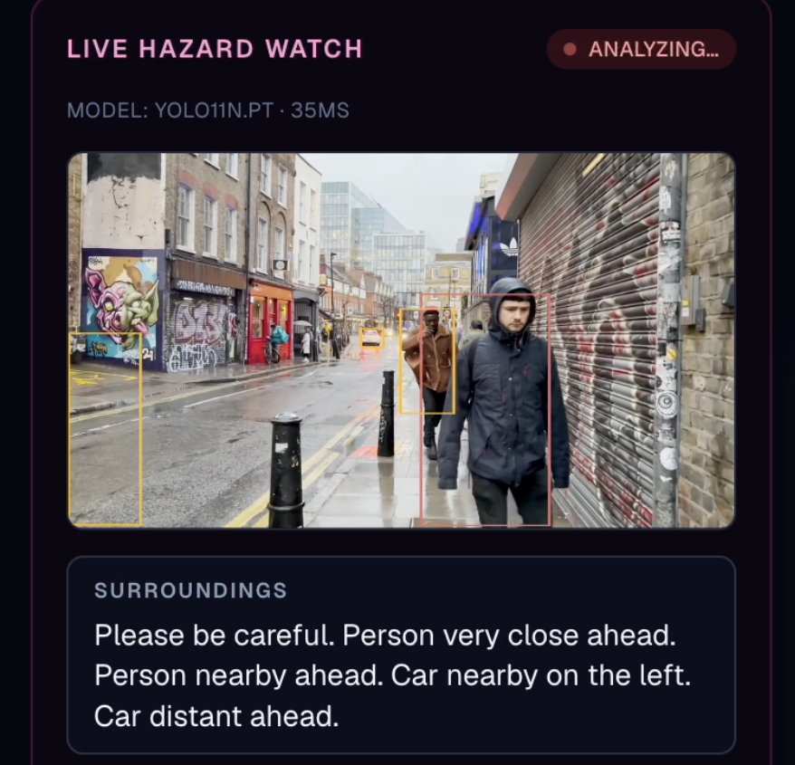
SEE · REAL-TIME INFERENCE
on-device · screen-free
Eyes for blind walkers
LIVE HAZARD WATCH
VISION PIPELINE
camera live stream → YOLO11n.pt → detections → distance + direction → spatial audio
“Please be careful. Person very close on the right. Person nearby ahead.”
33 ms
50 ms
0 screens
YOLO inference
Spatial audio
eyes-free
WHY IT MATTERS
Direction + distance → lower cognitive load than a beep
Runs on Spark beside the route engine — no cloud round-trip
LAYLA · Accessibility Mobility Intelligence
04 · How we built it
3
Notes:
~15s. For blind users, Layla streams 5-second camera chunks to a YOLO11n service running at 33 milliseconds on-device. It doesn't just say 'obstacle' — it gives direction and distance through spatial audio: 'person very close on the right'. That directional cue lowers cognitive load versus a generic beep, and it's fully screen-free. [Drop the Live Hazard Watch panel screenshot with the YOLO bounding boxes.]

Slide 5
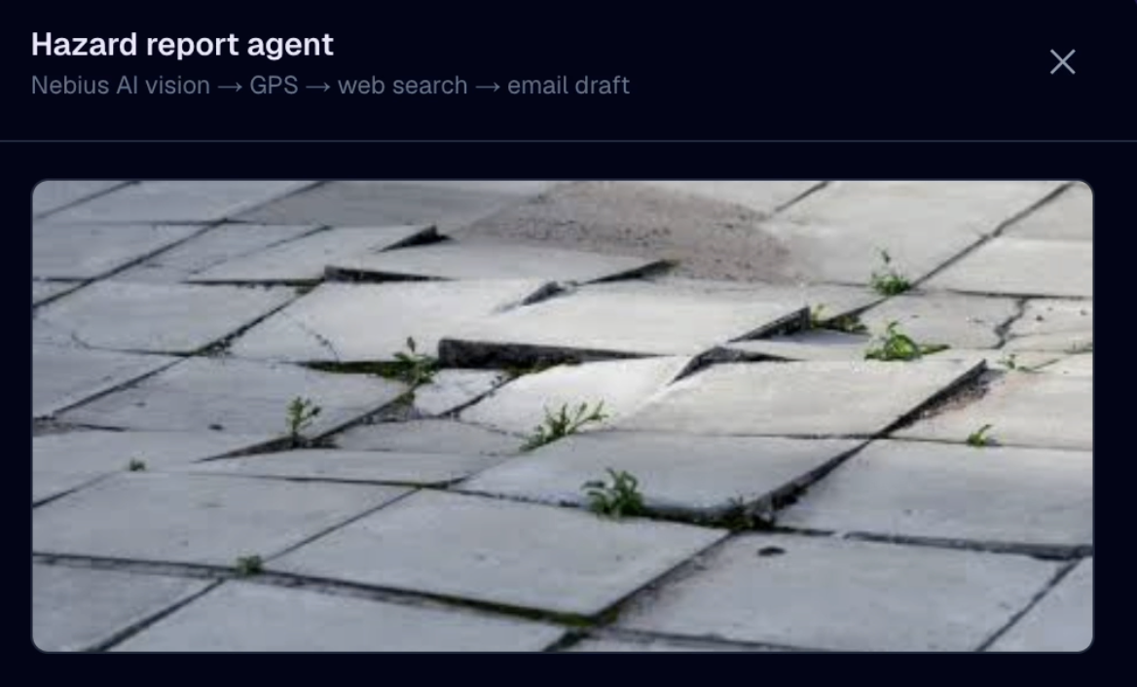
IMPROVE · AGENTIC LOOP
vision → authority → email
An agent that acts on the city
1
2
3
4
5
User taps
Report hazard
→
Vision verifies
the hazard
→
Web search finds
the right authority
→
Drafts a
professional email
→
Sends — logged
to the map
MODEL CHOICE & TRADEOFF
Vision + web search in one agent call
Runs on Nebius for live web lookup
⊘ Not on-device — fires only on Report
Everyone contributes → the map heals
LAYLA · Accessibility Mobility Intelligence
04 · How we built it
4
Notes:
~15s. The third loop is agentic. A user taps Report; the agent verifies the hazard from the photo, web-searches the correct authority, drafts a professional email, and sends it — logged to the shared map. We run this on Nebius because it needs live web reach. Tradeoff: it's not on-device, but it only fires on an explicit Report, so private data never leaves otherwise. Everyone contributes, the map heals itself. [Drop the Report-hazard email screenshot.]

Slide 6
MODELS & SYSTEM DESIGN
hardware-driven choices
Why DGX park / Nano AI Station
REASONING BRAIN
128 GB UNIFIED MEMORY
Nemotron-3-Nano-Omni
30B · NVFP4 · 15 GB · 128K ctx
was model→GPU → PCIe shuffle → CPU
now one address space · zero copy
Nemotron + route graph + YOLO + Next.js coexist
Multimodal — voice intent + image in ONE model
MoE — 3B active per token → fast inference
Reasoning toggle for hard queries
NemoClaw tool-calling → clean agent loop
Cloud ⇄ edge: LLM_PROVIDER = nemotron nano omni | nebius | backend
Same model on DGX or Nebius · one env var · zero code change
30 B
15 GB
113 GB
parameters
NVFP4
headroom
ARM64 GB10 · sm_121
vLLM v0.20-aarch64-cu130 — native, no emulation
Marlin NVFP4 GEMM backend
LAYLA · Accessibility Mobility Intelligence
04 · How we built it
5
Notes:
~15s. One brain: Nemotron-Omni — multimodal, MoE so only 3B params are active per token, NVFP4 to fit in 15GB, Hermes tool-calling for the agent. It's provider-agnostic: one env var swaps it between our DGX and Nebius. Hardware drove the design — 128GB unified memory means Nemotron, the route graph, YOLO, and Next.js all share one address space with no PCIe shuffling. We run vLLM aarch64-cu130 native to GB10's ARM64.

Slide 7
CHALLENGES & SOLUTIONS
24 hours
What we pushed, what we solved
Fused graph build
CREATIVE WORKAROUND
13 s every call → cache → 0.6 s reload
One Cloudflare Tunnel + Caddy reverse proxy
layla.ai-cloud.io survives reboots
First-token latency
HONEST TRADEOFF · COVERAGE
1.5 s · too slow for voice → prefix cache → 400 ms
Routing = City of London (~1 km²) today
Expand = re-ingest a larger OSM bbox
NIM cold-start
one Spark
2 h pull · killed iteration → pre-warmed images
30B model · vision · 6 feeds · agent
all running concurrently
LAYLA · Accessibility Mobility Intelligence
04 · How we built it
6
Notes:
~15s. Four bottlenecks in 24 hours. The fused graph took 13 seconds to build — we cache it and reload in 0.6. First-token latency was 1.5s, unusable for voice — prefix caching brought it to 400ms. NIM cold-start cost 2 hours — pre-warmed images. We kept a stable demo URL with one Cloudflare tunnel and Caddy. Honest tradeoff: routing covers the City of London today — expanding is just a bigger OSM box. The headline: one Spark runs a 30B model, real-time vision, six live feeds, and an agent — concurrently.

