Slide 1

Quantum Resource Workshop 2022
Quantum Resource Workshop 2022
Can we extract work from temporal correlations using memory?
Engines for predictive work extraction from memoryful quantum stochastic processes
arXiv: 2207.03480
Ruo Cheng Huang¹, Paul M Riechers¹, Mile Gu¹, Varun Narasimhachar¹
¹Nanyang Technological University, Quantum Hub

Slide 2
Information as fuel
Maxwell’s demon (1867), Szilard’s engine (1929)
particle can be dynamic and change with time
“0”
“1”
?
?
Notes:
General idea: information engine
Szilard’s engine and Maxwell’s demon (1867)
Given a box and a particle, if one knows which half the particle is in, then useful work can be extracted by inserting a partition and attaching a weight
label the 2 configuration as “0” and “1”, 0 for left, 1 for right
Particle can move around as time goes by, from left to right and vice versa

Slide 3

































Z
Z
Z
$$0$$
$$0$$
$$0$$
$$0$$
$$0$$
$$0$$
$$0$$
$$0$$
$$0$$
$$0$$
$$0$$
!
$$0$$
$$1$$
$$0$$
$$1$$
$$0$$
$$1$$
$$0$$
$$1$$
$$0$$
$$1$$
$$0$$
!
!
!
$$0$$
$$0$$
$$1$$
$$1$$
$$0$$
$$0$$
$$0$$
$$0$$
$$0$$
$$1$$
$$0$$
!
Notes:
We can view the box’s configuration as a series of symbols on a tape.
If the system does not change, then the demon doesn’t need to do anything
If system alternates, then demon have to use memory to track the last state to know what's the next state
If now the system behaves in some kind of random manner then, the demon may need to keep track of more pasts in order to predict what’s to come

Slide 4










Stochastic source as fuel
$$0$$
$$0$$
$$1$$
$$1$$
$$0$$
$$0$$
$$0$$
$$0$$
$$0$$
$$1$$
$$0$$
Stochastic processes
Non-trivial temporal correlations
Future behaviour cannot be perfectly predicted, given the past
Need not be Markovian
Notes:
So such series of data can be modelled using stochastic processes
Essentially they have non-trivial temporal correlations and given any past, the future statistics cannot be PERFECTLY PREDICTED
For those more interested in detail… it need not be markovian

Slide 5








More specifically..
Hidden Markov Model (HMM)
$$x^{(1)}:p$$
$$x^{(0)}:1−p$$
$$S_{0}$$
$$S_{1}$$
$$x^{(1)}:1−p$$
$$ℳ=\left(𝒮,{\left(x^{\left(i\right)}\right)}_{i∈𝒳} ,{\left(T^{\left(i\right)}\right)}_{i∈𝒳}\right)$$
$$x^{(0)}:p$$
$$⋯{x_{t+1,}x}_{t}, x_{t−1}, x_{t−2},⋯$$
Source
Notes:
More specifically Hidden Markov model
Each HMM is composed of 3 components
Hidden states
Potential emissions
Emissions over time can seen as a time series or temporal pattern
Transition matrices which defines the dynamic

Slide 6






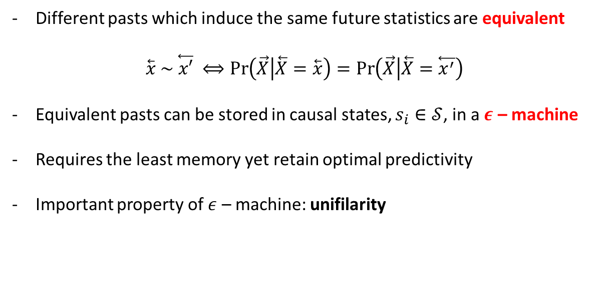
Classical predictive modelling
$$x^{(1)}:p$$
$$x^{(0)}:1−p$$
$$S_{0}$$
$$S_{1}$$
$$x^{(1)}:1−p$$
$$x^{(0)}:p$$
Different pasts which induce the same future statistics are equivalent
$$\overset{⃖}{x} \sim \overset{⃖}{x′} ⟺\operatorname{Pr}\left(\vec{X} | \overset{⃖}{X}=\overset{⃖}{x}\right)=\operatorname{Pr}\left(\vec{X} | \overset{⃖}{X}=\overset{⃖}{x^{′}}\right)$$
Equivalent pasts can be stored in causal states, $s_{i}∈𝒮$, in a $ε$ – machine
Requires the least memory yet retain optimal predictivity
Important property of $ε$ – machine: unifilarity
$H\left(S_{t} | S_{t−1},X_{t}\right)=0$ (unifilarity)
Crutchfield, J. P., & Young, K. (1989). Inferring statistical complexity. Physical review letters, 63(2), 105.
Notes:
Classically predictive modelling has been well studied in term of epsilon machines
If the different pasts induce the same future statistics in a process, then these pasts are equivalent and stored in causal states
Eps machine are provably the predictive model that requires the least memory and retain optimal predictivity
Important property is that of unifilarity, which is important for prediction as it allows for synchronisation

Slide 7






















!
!
!
$$0$$
$$0$$
$$1$$
$$1$$
$$0$$
$$0$$
$$0$$
$$0$$
$$0$$
$$1$$
$$0$$
!
?
$$σ^{(0)}$$
$$σ^{(0)}$$
$$σ^{(1)}$$
$$σ^{(1)}$$
$$σ^{(0)}$$
$$σ^{(0)}$$
$$σ^{(0)}$$
$$σ^{(0)}$$
$$σ^{(0)}$$
$$σ^{(1)}$$
$$σ^{(1)}$$
Notes:
Now what happens if the tape become quantum? Can the demon still keep track and predict the future to extract work?

Slide 8








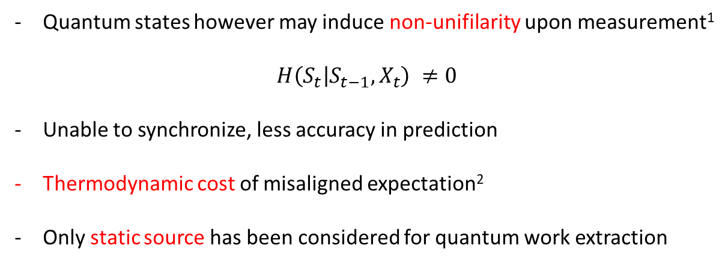




Quantum mechanically…
$$x^{(1)}:p$$
$$σ^{(1)}:p$$
$$x^{(0)}:1−p$$
$$S_{0}$$
$$S_{1}$$
$$x^{(1)}:1−p$$
$$σ^{(0)}:1−p$$
$$S_{0}$$
$$S_{1}$$
$$σ^{(1)}:1−p$$
$$x^{(0)}:p$$
$$σ^{(0)}:p$$
Quantum states however may induce non-unifilarity upon measurement¹
$$H\left(S_{t} | S_{t−1},X_{t}\right) ≠0$$
Unable to synchronize, less accuracy in prediction
Thermodynamic cost of misaligned expectation²
Only static source has been considered for quantum work extraction
Venegas-Li, A. E., Jurgens, A. M., & Crutchfield, J. P. (2020). Physical Review E, 102(4), 040102.
Riechers, P. M., & Gu, M. (2021). Physical Review E, 103(4), 042145.
Notes:
same HMM but the outputs are non-orthogonal quantum states
Unifilarity is now violated
Agent observing the sequence of measurement cannot to synchronize,
This comes at the price as a misaligned expectation will result in thermodynamic penalties when one attempt to carry out work extraction
There are many litereatures in quantum work extraction, but most of them only consider a collection of static resource state

Slide 9
Aim
Predictive quantum engine
Must be able to adapt and change extraction protocol based on the past performance
Able to extract work from quantum systems
Synchronization + prediction
Charges batteries by operating on quantum systems that are correlated via classical stochastic processes

Slide 10









Fuel Source
Hidden Markov Model (HMM)
$$σ^{(1)}:p$$
$$σ^{(0)}:1−p$$
$$S_{0}$$
$$S_{1}$$
$$σ^{(1)}:1−p$$
$$ℳ=\left(𝒮,{\left(σ^{\left(x\right)}\right)}_{x∈𝒳} ,{\left(T^{\left(x\right)}\right)}_{x∈𝒳}\right)$$
$$σ^{(0)}:p$$
$$σ_{t}$$
$$σ_{t−1}$$
$$σ_{t−2}$$
$$σ_{t−3}$$
fuel tape
Source

Slide 11
Rule of Game
Each quantum state on the “fuel tape” has an immediate “expiration” date
Lack of quantum memory to record the state at previous time
Only allows work extraction on individual states one and a time and not collective processing
Extract work locked within temporal correlations

Slide 12
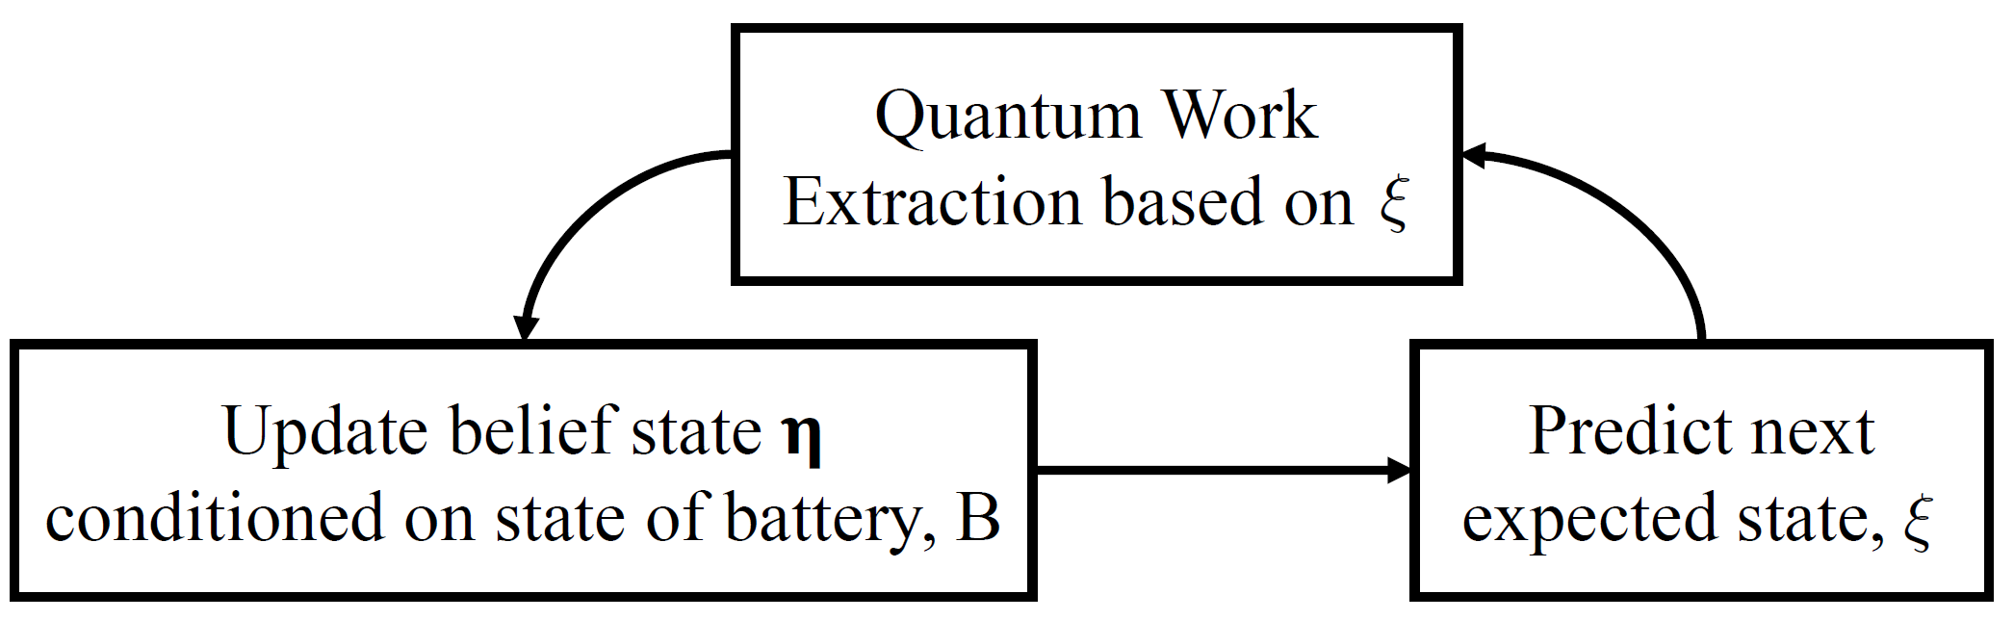
Operation

Slide 13
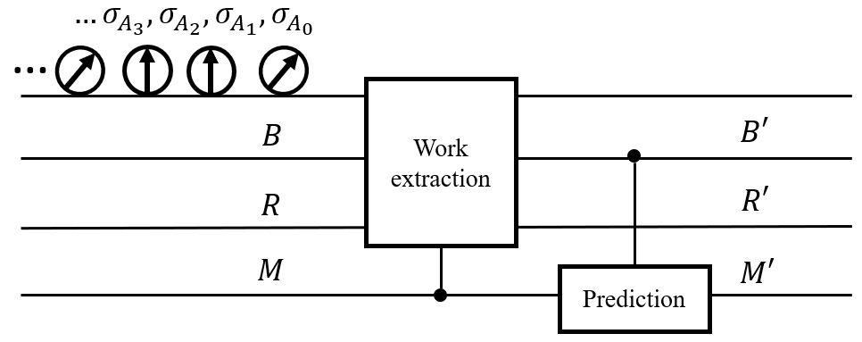
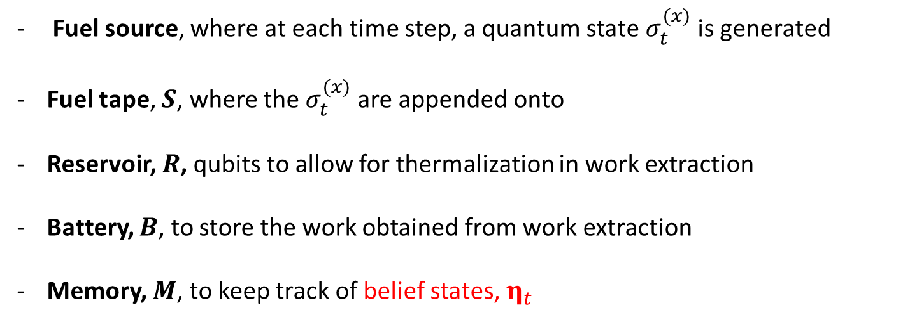
Construction
Fuel source, where at each time step, a quantum state $σ_{t}^{(x)}$ is generated
Fuel tape, $S$, where the $σ_{t}^{(x)}$ are appended onto
Reservoir, $R$, qubits to allow for thermalization in work extraction
Battery, $B$, to store the work obtained from work extraction
Memory, $M$, to keep track of belief states, $η_{t}$
Source
Notes:
Zoom into each component to discuss
Work extraction can be replaced by any form of POVM

Slide 14

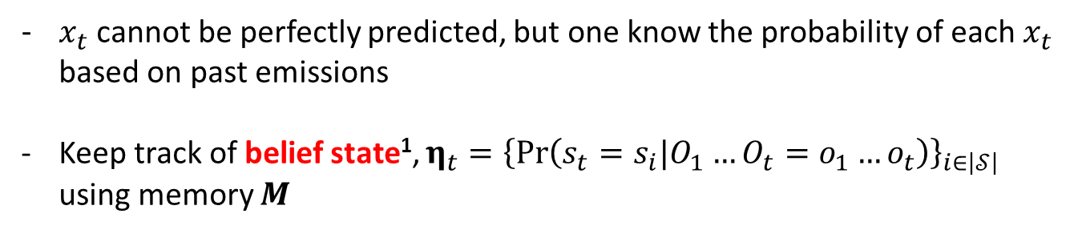

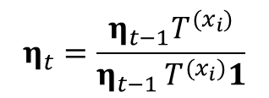






Belief states
$x_{t}$ cannot be perfectly predicted, but one know the probability of each $x_{t}$ based on past emissions
Keep track of belief state¹, ${η_{t}=\left\{\operatorname{Pr}\left(s_{t}=s_{i}|O_{1}…O_{t}=o_{1}…o_{t}\right)\right\}}_{i∈\left|𝒮\right|}$ using memory $M$
$$x^{(0)}:P_{0}$$
$$η_{1}$$
$$η_{1}\left(x^{\left(0\right)}\right)=(0.75,0.25)$$
$$η_{0}=\left(0.5,0.5\right)$$
$$η_{0}$$
$$η_{t}=\frac{η_{t−1}T^{(x_{i})}}{η_{t−1 }T^{(x_{i})}1}$$
$${η′}_{1}$$
$$x^{(1)}:P_{1}$$
$$η_{1}\left(x^{\left(1\right)}\right)=(0,1)$$
1. C. R. Shalizi and J. P. Crutchfield. J. Stat. Phys., 104:817–879, 2001.

Slide 15
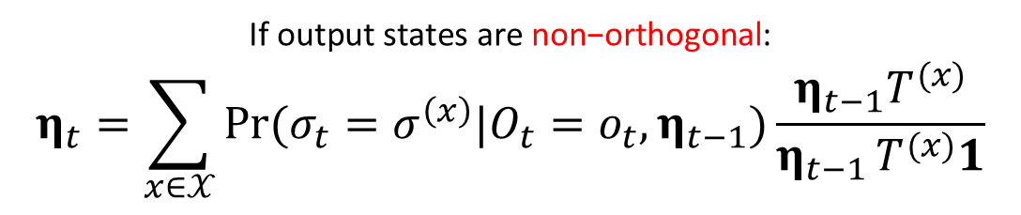

Generalized update
If output states are orthogonal:
$η_{t}=\frac{η_{t−1}T^{(x)}}{η_{t−1 }T^{(x)}1}$
$\text{If} \text{output} \text{states} \text{are} \text{non}\text{−}\text{orthogonal}$:
$$η_{t}=\sum_{x∈𝒳}{\operatorname{Pr}{(σ_{t}=σ^{\left(x\right)}|O_{t}=o_{t},η_{t−1})}}\frac{η_{t−1}T^{(x)}}{η_{t−1 }T^{(x)}1}$$
Works for ANY POVM
Posterior Probability
Notes:
The update of belief state now incorporate bayesian inference to determine to posterior probability of emission based on the observables
*** work extraction is not an ESSENTIAL part of the protocol, you can also do it with POVMs if you are uncomfortable with the formulation of work extraction we are presenting

Slide 16
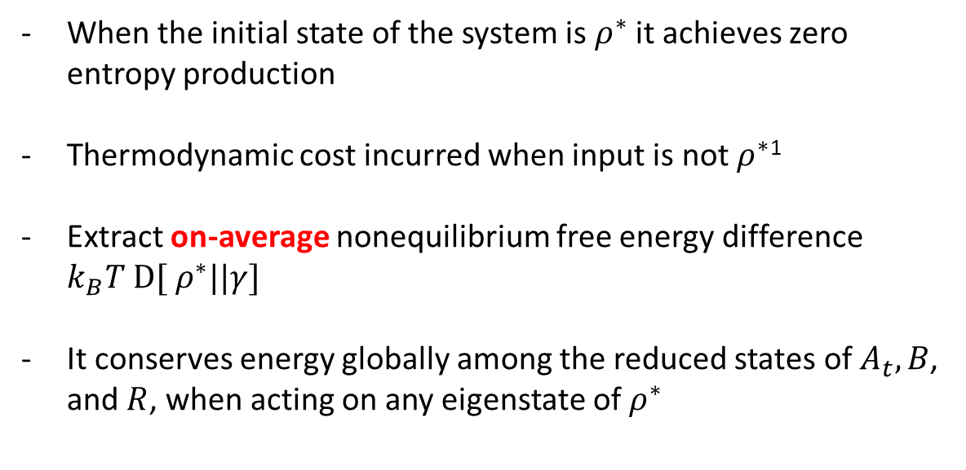

Work extraction
$ρ^{∗}−$ ideal work-extraction protocol
When the initial state of the system is $ρ^{∗}$ it achieves zero entropy production
Thermodynamic cost incurred when input is not $ρ^{∗}$¹
Extract on-average nonequilibrium free energy difference $k_{B}T D[ ρ^{∗}||γ]$
It conserves energy globally among the reduced states of $A_{t},B$, and $R$, when acting on any eigenstate of $ρ^{∗}$
Riechers, P. M., & Gu, M. (2021). Physical Review E, 103(4), 042145.
Notes:
Our work is not critically dependent on this specific protocol, this is more of a case study
Zero entropy production if input state = rho*, else there will be thermodynamic cost due to misaligned expectation
Able to extract all the non-equilibrium free energy difference between rho* and thermal state ON AVERAGE
Also conserves energy globally
****We will make use of protocol that are examples of this to illustrate later

Slide 17
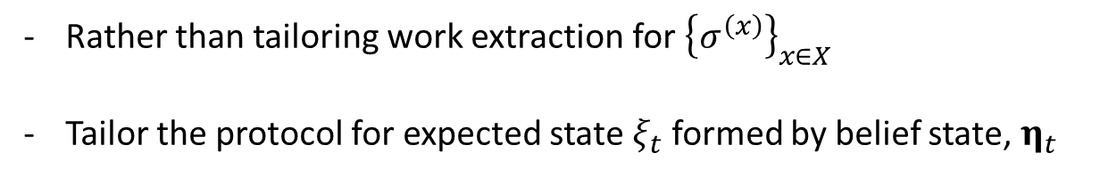



Work extraction
Rather than tailoring work extraction for ${\left\{σ^{\left(x\right)}\right\}}_{x∈X}$
Tailor the protocol for expected state $ξ_{t}$ formed by belief state, $η_{t}$
$$ξ_{t}=\operatorname{Pr}\left(x=0|η_{t}\right)σ^{(0)}+\operatorname{Pr}\left(x=1|η_{t}\right)σ^{(1)}$$
$$σ^{\left(0\right)}$$
$$ξ_{t}$$
$$σ^{\left(1\right)}$$
Notes:
Also rather than tailoring for specific output sigma 0 or sigma 1
We choose to tailor it for the expected state formed from belief state.
Convex combination of 2 outputs based on their prior emission probability

Slide 18
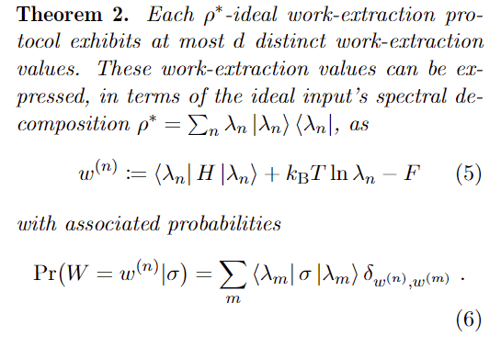




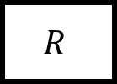


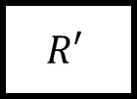
Work extraction
$$R$$
$$R′$$
$$|E_{0}⟩$$
$$ρ_{s}$$
$$γ_{β}$$
Rotation
Thermalize
$$B$$
$$B′$$
$$B′′$$
Able to extract, on average, non-equilibrium free energy amount of work from any input state
Pre-process is dependent on one’s knowledge of the state
Notes:
Our work is not critically dependent on this specific protocol, this is more of a case study

Slide 19




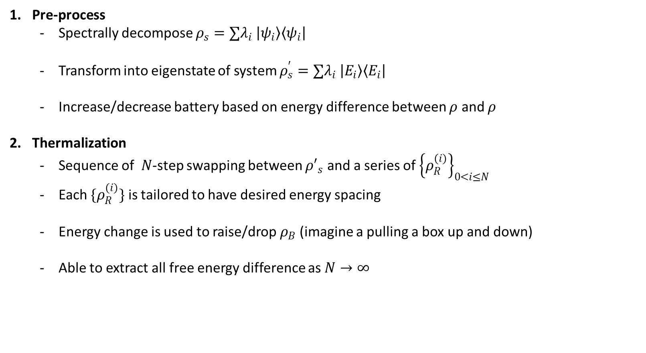







Work extraction
Suppose we have a state $ρ_{s}$, couple it with reservoir $ρ_{R}$ and a battery $ρ_{B}$
Pre-process
Spectrally decompose $ρ_{s}=∑λ_{i} \left|ψ_{i}\right\rangle \left\langle ψ_{i}\right|$
Transform into eigenstate of system $ρ_{s}^{′}=∑λ_{i} \left|E_{i}\right\rangle \left\langle E_{i}\right|$
Increase/decrease battery based on energy difference between $ρ$ and $ρ$
Thermalization
Sequence of $N$-step swapping between ${ρ′}_{s}$ and a series of ${\left\{ρ_{R}^{(i)}\right\}}_{0<i≤N}$
Each $\{ρ_{R}^{(i)}\}$ is tailored to have desired energy spacing
Energy change is used to raise/drop $ρ_{B}$ (imagine a pulling a box up and down)
Able to extract all free energy difference as $N→∞$
$$S$$
Pre-process
$$S′$$
$$B$$
$$B′$$
$$R$$
$$S′$$
$$S′′$$
$$B′$$
Thermalis-ation
$$B′′$$
$$R$$
$$R′$$

Slide 20












Results
Meta-dynamic of belief states
Dynamic of latent states
$$o_{1}$$
$$σ^{(1)}:p$$
$$σ^{(0)}:1−p$$
$$S_{0}$$
$$S_{1}$$
$$σ^{(1)}:1−p$$
$$η$$
$η$’
$$o_{4}$$
$$o_{2}$$
$$σ^{(0)}:p$$
$$o_{3}$$
Notes:
Now our first result
Map dynamic of latent states to metadynamic of belief state using the general belief state update
So the example here just shows that the belief state keep track of 2 different probability distribution, one S0 higher one S1 higher
Now it conditioned on physical observables
more operationally friendly

Slide 21






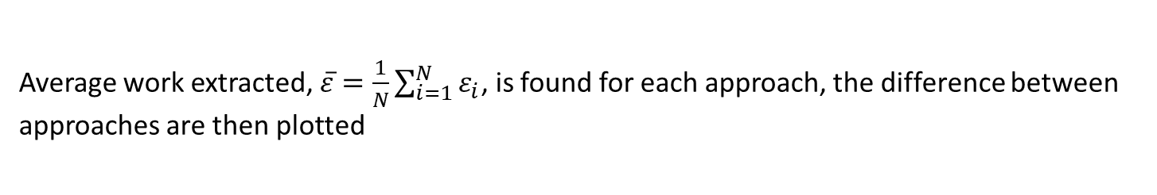
Benchmarking ¹
$$ξ_{t}$$
Memory-assisted Quantum approach
$$γ_{β}$$
Memory-assisted Classical approach
Only operates in a fixed pair of orthogonal basis
$$ξ_{t}$$
$$γ_{β}$$
Memoryless Quantum approach
Ignores all previous measurement results, operate on the state of ignorance
$$ξ_{0}$$
$$γ_{β}$$
Average work extracted, $\overline{ε}=\frac{1}{N}\sum_{i=1}^{N}{ε_{i}}$, is found for each approach, the difference between approaches are then plotted
1. Paul Skrzypczyk, Anthony J, and Sandu Popescu. Nature communications, 5, 2014
Notes:
We also tried to benchmarking our pattern engine against 2 other protocols
We call our approach the memory-assisted quantum approach, for bench marking we considered paul skrzypczyk’s paper in 2014, it is an example of the rho* ideal work extraction.
In short, we carry out a unitary rotation on the expected state such that it is diagonalize in the system Hamiltonian and then carry out a series of SWAP gate with reservoir qubit, all the while the battery’s energy will be raised or lowered to conserve energy on average
The second approach is the memory-assisted classical approach, we assume agent has no access to unitary rotations, hence he does a projection on pre-determined eigenstates and then thermalize
Lastly memoryless, the agent do not keep track of the past, so only operate base on the initial belief state/state of ignorance
***There are protocols that can extract all the work successfully
We then calculate the average work extracted at everytime step for each approach and find the difference between the approaches

Slide 22
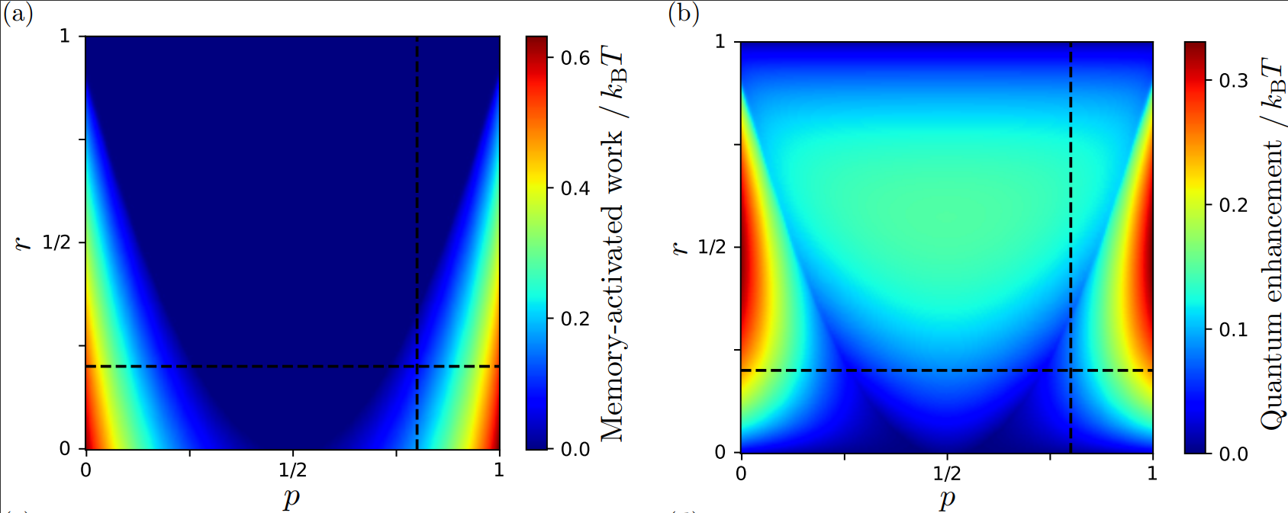





Quantum Enhancement
Memory-activated work
$$σ^{(1)}:p$$
$$σ^{(0)}:1−p$$
$$S_{0}$$
$$S_{1}$$
$$σ^{(1)}:1−p$$
$$r=Fidelity\left(σ^{\left(0\right)},σ^{\left(1\right)}\right)$$
$$σ^{(0)}:p$$
Notes:
P flipping probability
R fidelity
Quantum enhancement = diff between quantum and classical
Memory-activation = diff between memory and memoryless
Navy blue is surprising, so we took cross section

Slide 23
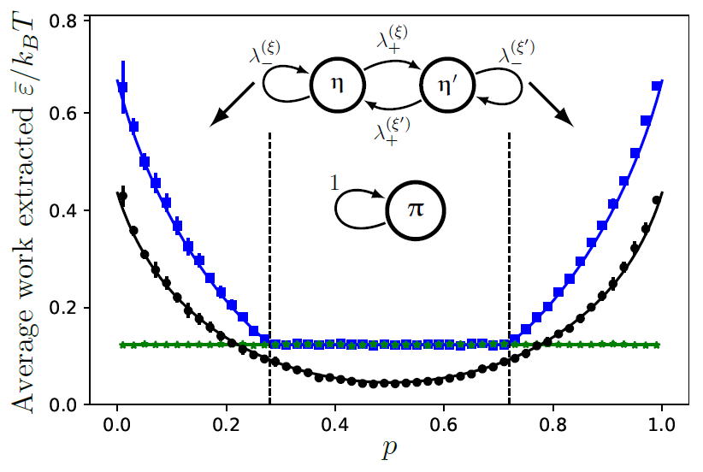
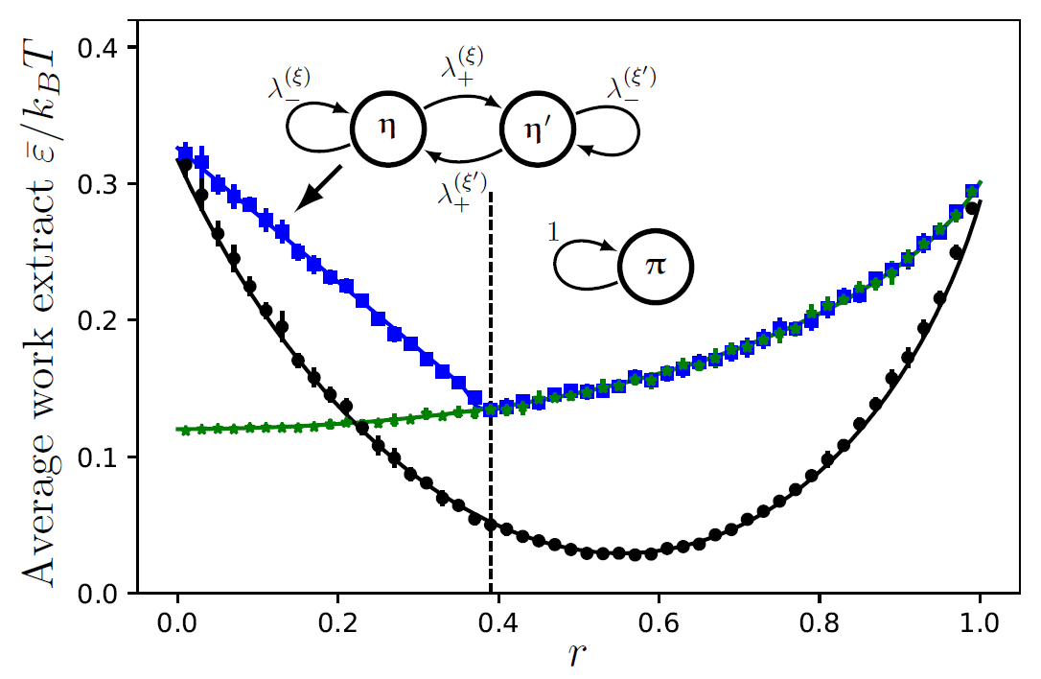
Results
Memory-assisted Quantum
Memory-assisted Classical
Memoryless Quantum
Phase transition between regions where memory can be exploited to enhance work extraction
Information obtained from past output is insufficient
Non-linear dynamic of update function
Notes:
Obtain 2 cross sections, comparing blue and green line.
In the blue part performance identical, having memory is useless
Red part memory help to boost work extraction
Surprising bcoz in blue region, process still has memory effect (out of 0.5), so tracking memory should in principle help, but it is not helping
(bound form of resource that is inaccessible)

Slide 24
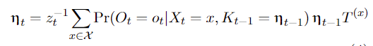
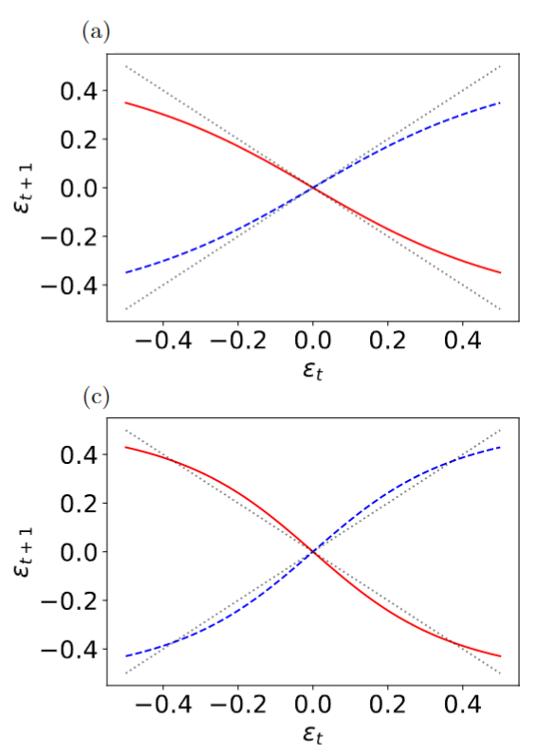
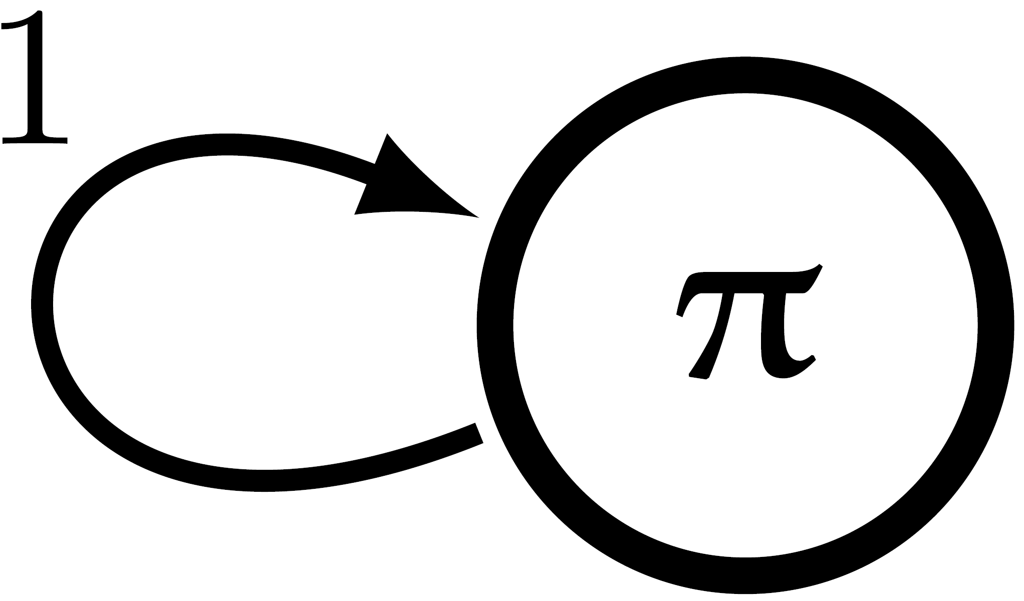
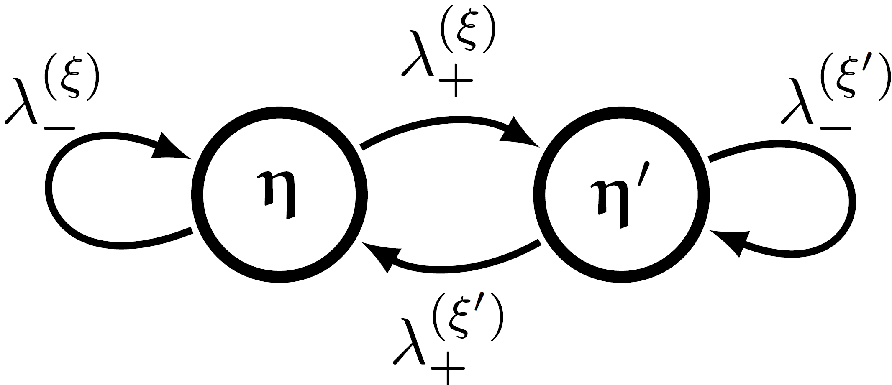



Metadynamic (Quantum)
“Memory-apathetic”
$$ε_{t+1}$$
$$ε_{t}$$
“Memory-advantageous”
$$ε_{t+1}$$
$$ε_{t}$$
$$η_{t}=\left(\frac{1}{2}+ε_{t} , \frac{1}{2}−ε_{t}\right)$$
Notes:
Mathematically, can be explained
Blue portion, identical performance as the update function only has 1 stationary point
Red portion, there exist other attractors,
can be understood as synchronization

Slide 25
Summary of results
Systematic way to construct a predictive quantum engine
Developed framework for prediction of quantum patterns
Discovery of phase transition on parameter space where memory can enhance work extraction

Slide 26
Future directions
Extension into quantum stochastic processes
Using the work extracted as reward function for quantum machine learning
Knowledge of past may not always be useful

Slide 27
Thank you!

