Slide 1
Introduction to Solid State Physics
(C. Kittel)
Chapter 9

Slide 2
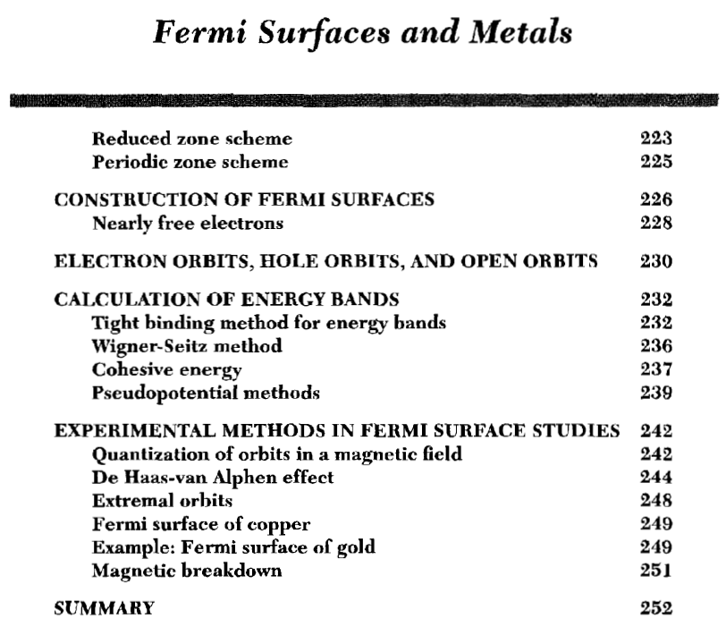
Contents
Chapter 9.

Slide 3
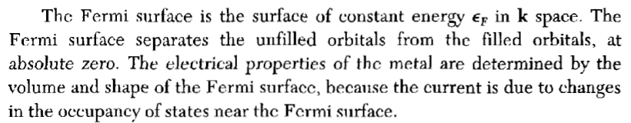

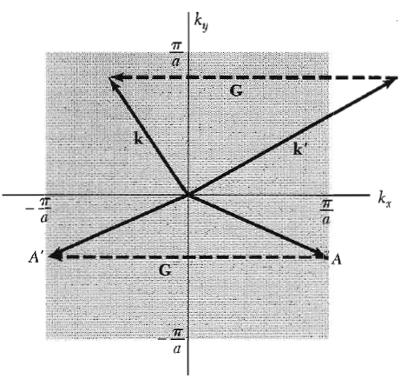


Fermi Surface

Slide 4
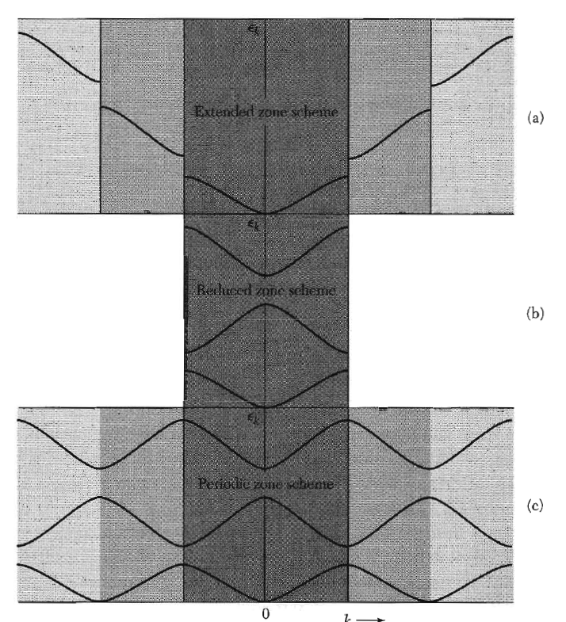


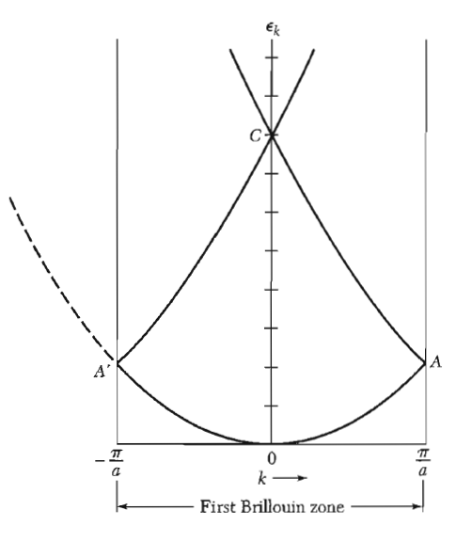


Fermi Surface

Slide 5

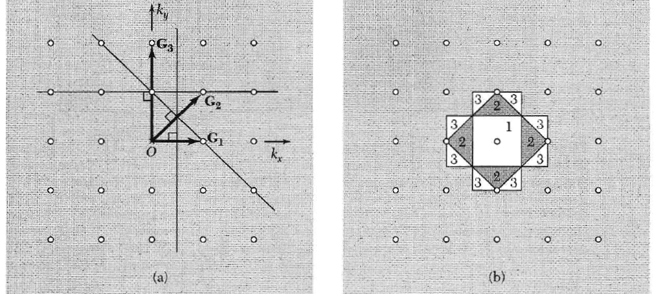
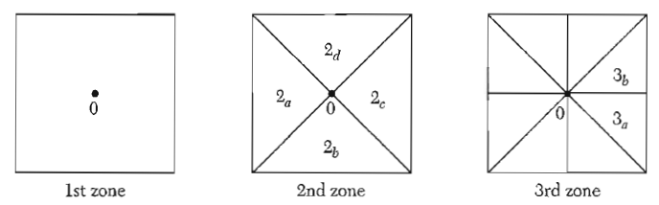
Fermi Surface
Construction of Fermi Surfaces
Condition of k on zone boundaries

Slide 6
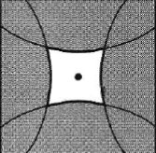
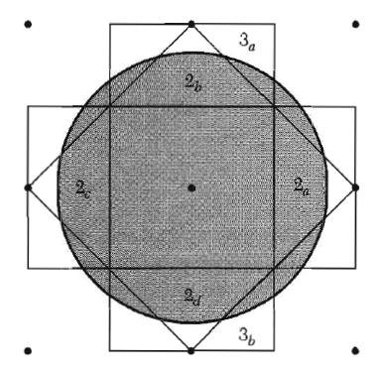
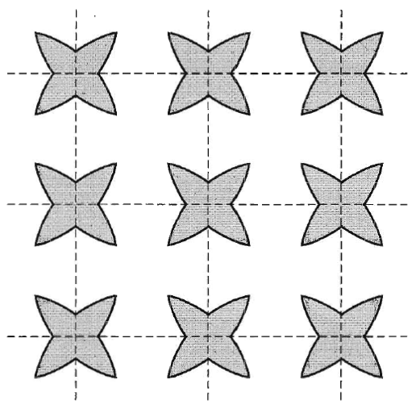
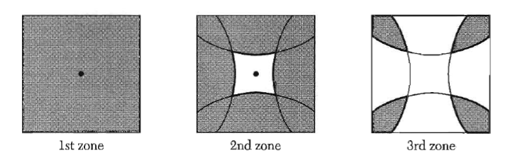
Fermi Surface
hole pocket
Construction of Fermi Surfaces
- Free electron
2nd zone
electron pocket
3rd zone

Slide 7
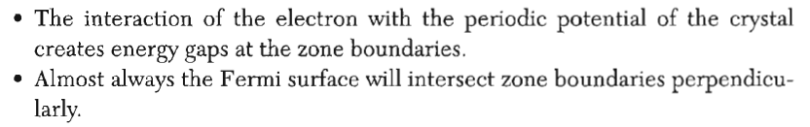
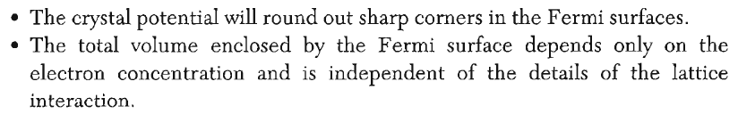
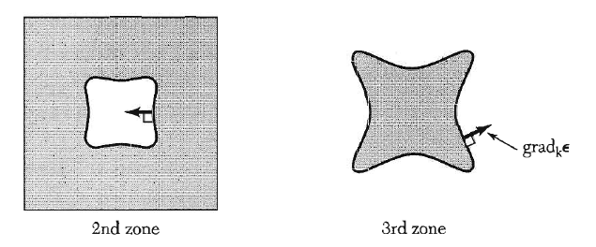
Fermi Surface
Construction of Fermi Surfaces - Nearly free electron
hole pocket
electron pocket
‘holelike’ FS
‘electronlike’ FS
2nd zone
3rd zone

Slide 8








Fermi Surface
: semi-classical
Equations of Motion (➔ Read Ch. 8 pp191-194)
In E-field
external force
In B-field :
An electron moves on a surface of constant energy
The motion in k space is on a plane normal to B.
intersection
“orbit”
in k space

Slide 9
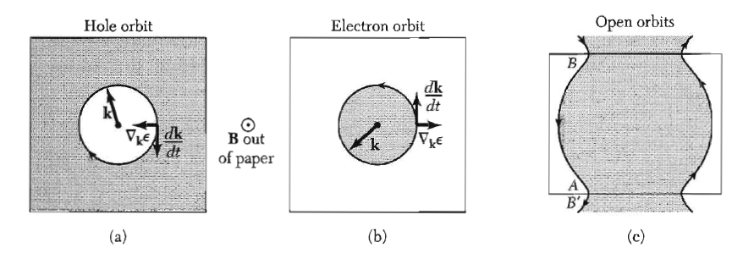
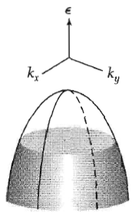
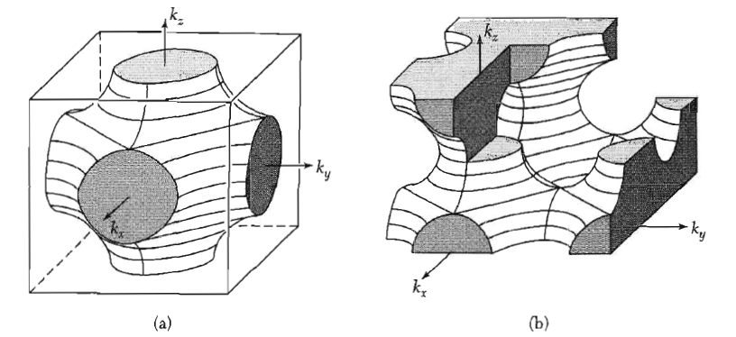
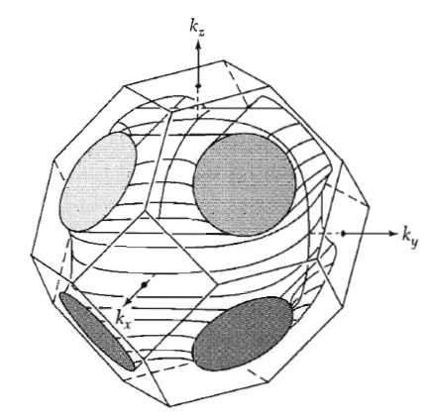
Fermi Surface
Three types of orbits in B-field
In 2D
In 3D
sc
fcc

Slide 11
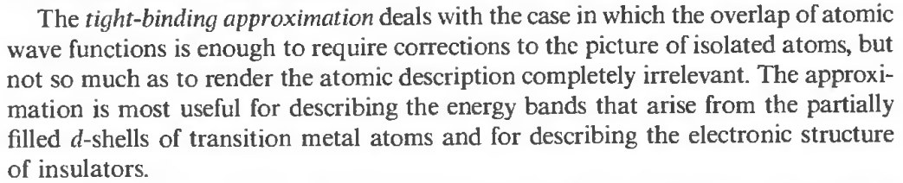
Two Approaches in Band Theory
Nearly Free-Electron Model
Tight Binding Model

Slide 12
Two Approaches in Band Theory
Nearly Free-Electron Model
Tight Binding Model
solid
(s-, p-metals)
solid
(insulators, d- & f-metals)
difficult & slow
confined electron
(atomic orbital)
free electron
(plane wave)
easy & fast
easy & fast
difficult & slow
Nearly Free-Electron Model
Tight Binding Model

Slide 13
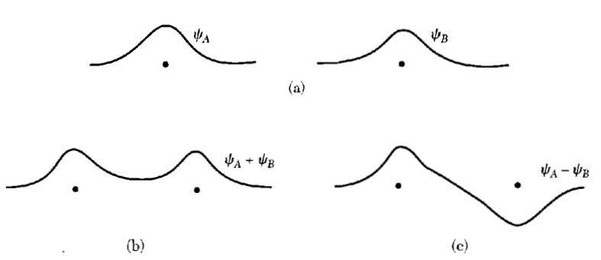
Calculation of Energy Bands
Tight Binding Method
(or LCAO (Linear Combination of Atomic Orbitals) approximation)
2 separate H atoms
(A and B at large separation)
A and B at close separation
(H₂ molecule)
H₂ (ground state)
H₂ (excited state)
→ will be dissociated into atoms

Slide 14
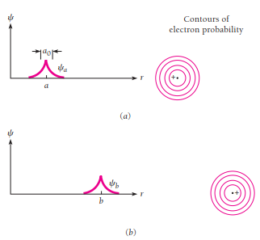
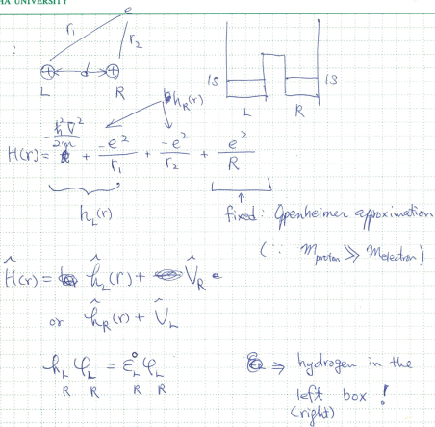
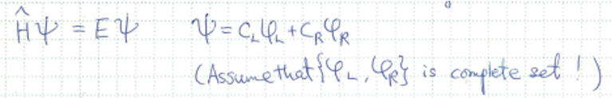
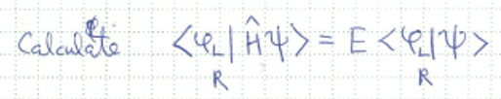
LCAO (Linear Combination of Atomic Orbitals) method to obtain molecular orbitals
c_{L}, c_{R}에 대한 연립방정식 (식 2개)
→ 2x2 matrix equation

Slide 15
Assumption:
(1) {φ_{L}, φ_{R}} is complete.
(2) φ_{L}, φ_{R} are orthonormal.
Ĥψ = Eψ
ψ = c_{L}φ_{L} + c_{R}φ_{R}
ψ_{AB}
ε₀
Δ
c_{L}
ε₀
ε₀
Ĥ =
ψ =
H(1s)
φ_{L}
φ_{R}
H(1s)
ε₀
Δ
c_{R}
O(2p)
ψ_{B}
O(2p)
(H₂, O₂, …..)
ε₀ = <φ_{L}|h_{L}|φ_{L} > = <φ_{R}|h_{R}|φ_{R} > (원자)
Δ = | <φ_{R}|V_{L}|φ_{R}> = | <φ_{R}|V_{R}|φ_{L}> |
V_{L(R)} = Coulomb potential from left (right) atom
숙제
(1) Ĥ에 대한 eigen-energies를 구하고 에너지 diagram을 그려서 표시하라.
(2) eigen-states를 구하라.
(3) 원자 두개가 결합하여 분자를 이룰 때, cohesive energy는 얼마인가?

Slide 16
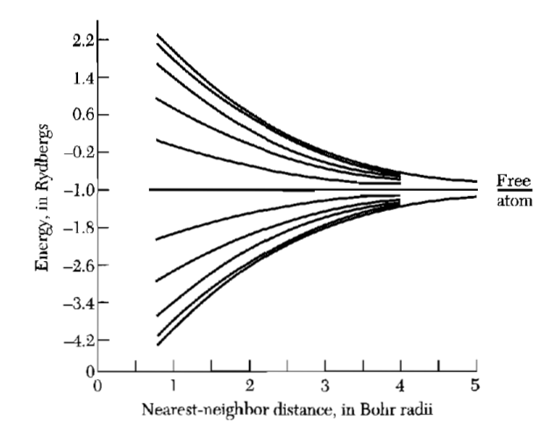
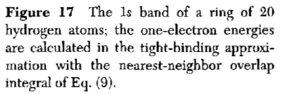
Calculation of Energy Bands
Tight Binding Method

Slide 17










Calculation of Energy Bands
Tight Binding Method
s-band
→ Confirm (prove) it
식 (9-6)
≈
(ρ = Δr vector between nearest neighbors)
m → only for nearest neighbors
“transfer” or “hopping” energy (integral)
“crystal-field” energy
γ
.
(Ex.) H 1s state

Slide 18
숙제:
Perturbation theory 정리
for non-degenerate cases
for degenerate case

Slide 19
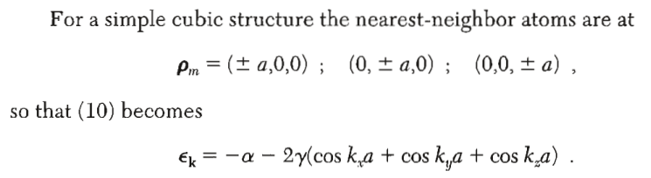


Calculation of Energy Bands
Tight Binding Method
Band width W : W(s) > W(p) > W(d) > W(f)
narrow bands → Mott ins.?

Slide 20
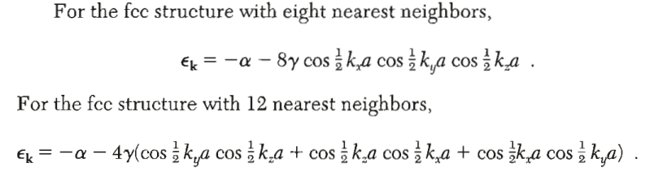
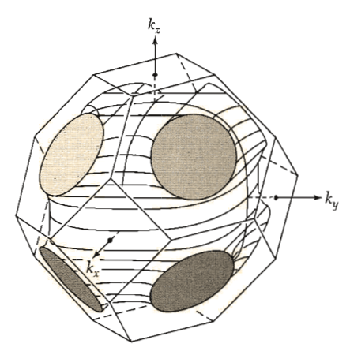

Calculation of Energy Bands
Tight Binding Method
숙제
Check these for fcc.
Calculate ε_{k} for bcc.

Slide 22
Calculation of Energy Bands
Tight Binding Method

Slide 23
Fermi Surface
Experimental Determination (Ex. De Hass-van Alphen Effect)

Slide 24

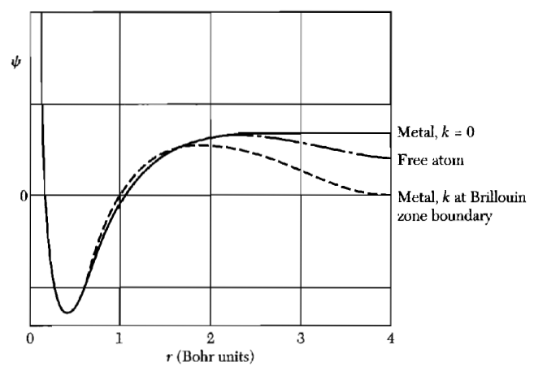





Cohesive Energy
Wigner-Seitz Method

Slide 25
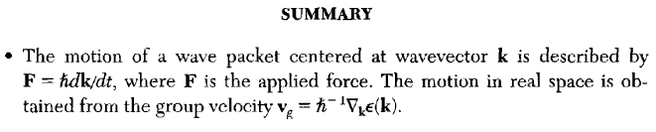
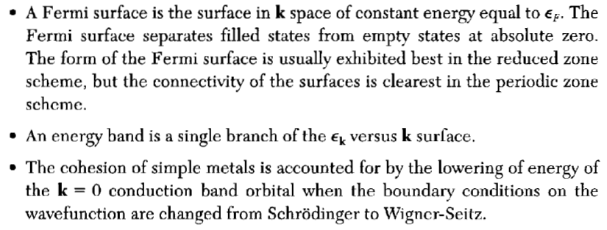
Summary & Homework
(from Ch. 8)
Problems 9.1-9.4

