Slide 1

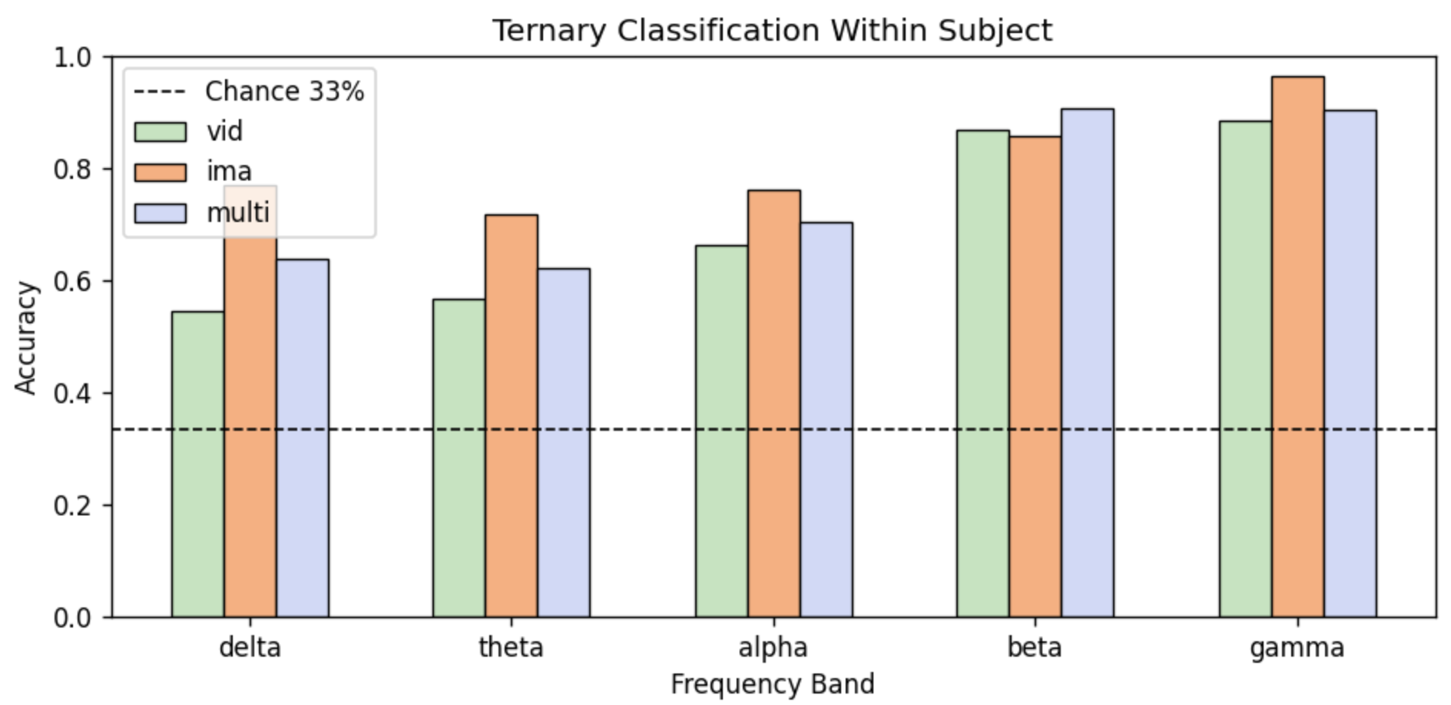
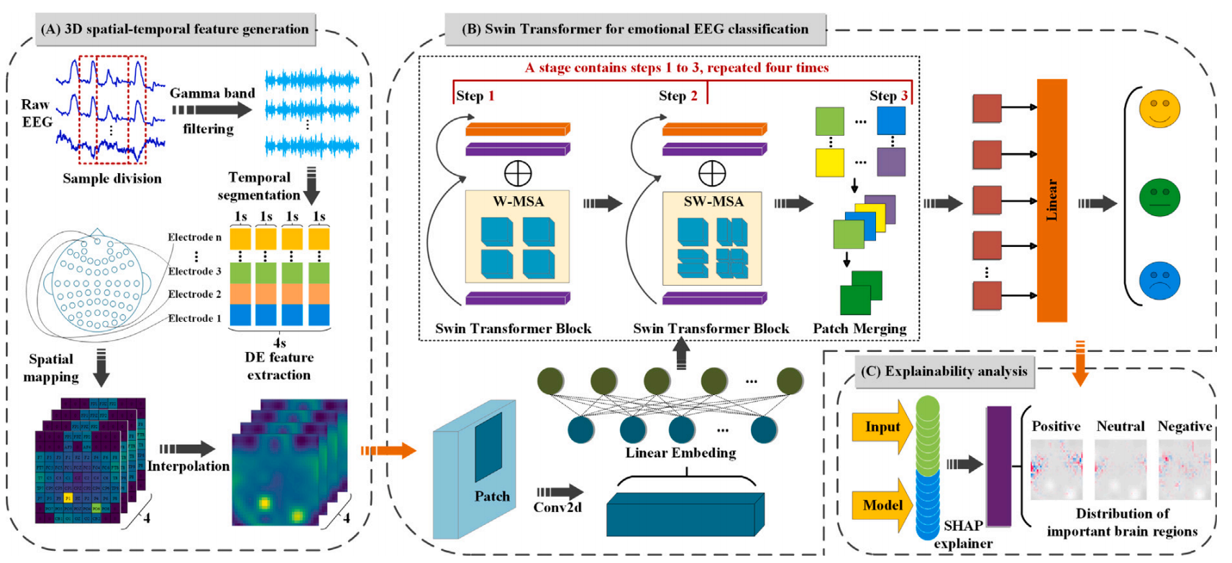
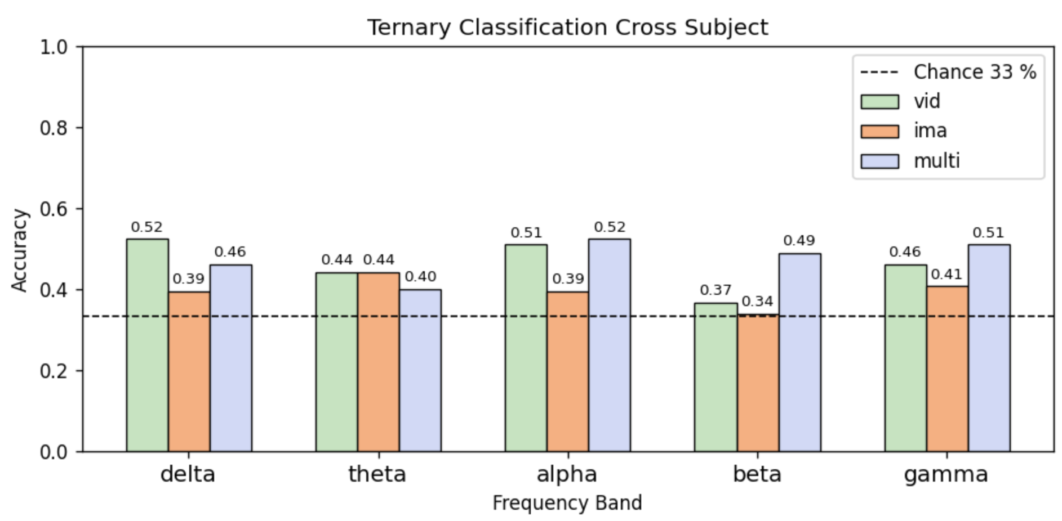

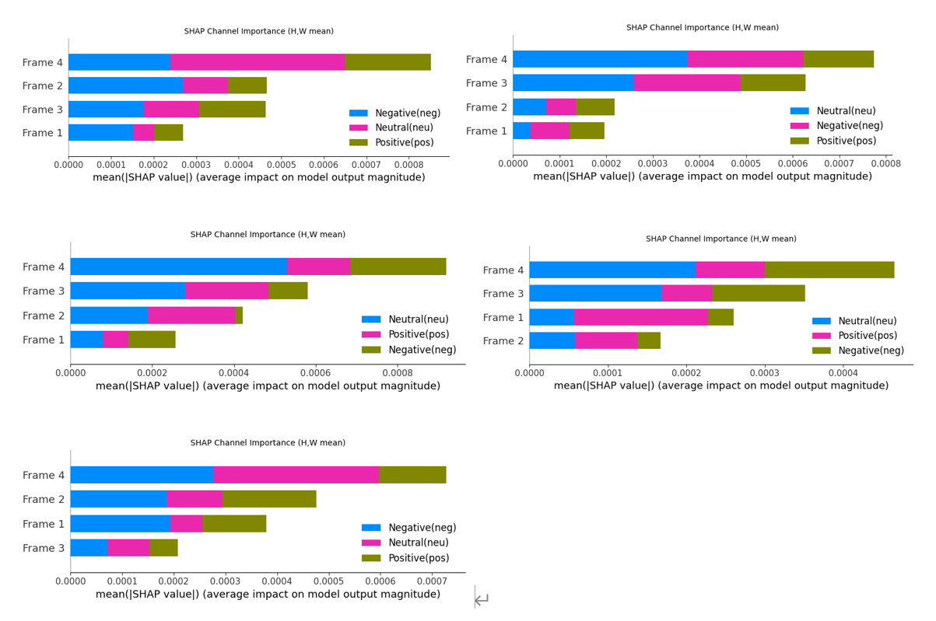
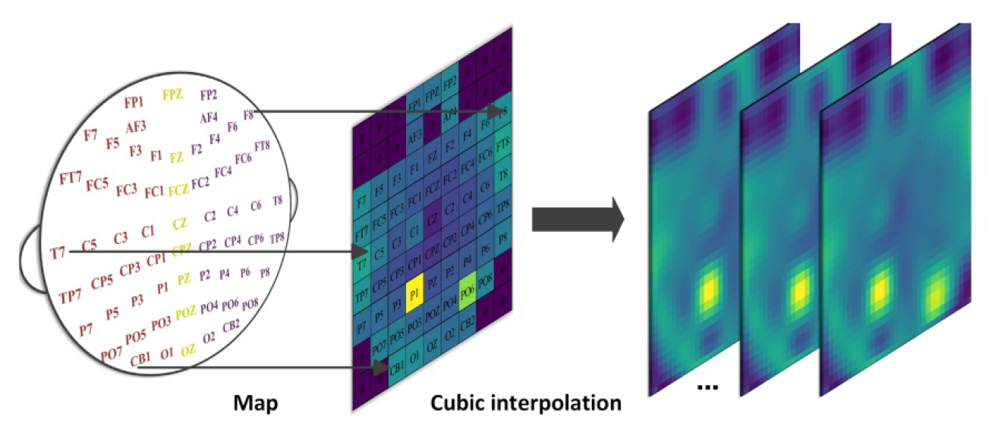
ST-SHAP: A Transformer-Based Framework for EEG Emotion Recognition with Explainability
BMEB215
机器学习与医学工程应用
ML&MEA (2025 spring)
Zhenghan Zhang, Hongjia Liu, Shuoshuo Yang, Jiandong Liu
Biomedical Engineering Dept., SUSTech
Introduction
Emotion recognition using EEG has gained increasing attention in affective computing due to its potential for objective emotion assessment. Building upon the hierarchical and explainable ST-SHAP model, our project adapted this framework to the EmoEEG-MC dataset. We investigated emotion classification performance across three experimental contexts and five frequency bands, aiming to evaluate the model’s generalizability and explore EEG-based emotional signatures under diverse scenarios.
Fig. 3. Classification accuracy of ST-SHAP under K-Fold validation (subject-dependent).
Fig. 1. A schematic illustration of ST-SHAP method. (A) 3D spatial–temporal feature generation (B) Swin Transformer for emotional EEG classification (C) Explainability
analysis based on SHAP
Fig. 4. Classification accuracy of ST-SHAP under LOSO validation (subject-independent).
Method
The SHAP summary plot reveals that the model relies most heavily on Frame 4 (latest time segment), followed by Frames 2 and 1, while Frame 3 contributes the least. This suggests that EEG features at the beginning and end of each trial are more informative for emotion classification. Notably, all frames show strong contributions in distinguishingnegative emotions, with Frame 4 playing a key role across all three categories. These findings highlight the temporal sensitivity of ST-SHAP and may inform future EEG data segmentation or feature design strategies.
We divided the EmoEEG-MC dataset into three emotional contexts: neutral, positive, and negative. Each participant experienced both imagery and video stimuli across seven discrete emotions. For each EEG segment, we extracted Differential Entropy (DE) features across five frequency bands (delta, theta, alpha, beta, gamma) and reshaped them into 3D spatial–temporal representations through topological mapping and cubic interpolation.We adapted the ST-SHAP model, a Swin Transformer-based hierarchical attention network, to our dataset. The model captures local and global spatial–temporal dependencies and enhances interpretability using SHAP analysis. Classification experiments were conducted under three context conditions (combined, imagery only, video only) and evaluated separately for each frequency band.
Fig4.SHAP
Fig. 2. Topological interpolation procedure
Results
As shown in Fig. 3, under K-Fold (within-subject) validation, ST-SHAP demonstrated clear frequency-dependent differences in classification performance. The beta and gamma bands consistently outperformed the others across all three emotional contexts—video,imagination, and multi-context—with accuracies approaching or exceeding 0.90, indicating strong discriminative power. In contrast, the delta and theta bands yielded noticeably lower performance, generally around 0.50–0.75, depending on context. Across contexts, the imagination-induced setting performed best in low-frequency bands, while multi-context training provided more stable performance across all bands. These results suggest that high-frequency EEG features are most informative for emotion classification within subjects.
As illustrated in Fig. 4, the leave-one-subject-out evaluation yields modest but consistent above-chance performance (≈ 0.34–0.52). Multi-context training is the most transferable, topping three of the five bands, while the imagination-only model performs worst across the spectrum. Alpha and gamma emerge as the most generalisable rhythms, whereas theta and beta degrade sharply when the model is applied to unseen participants. These results confirm that context diversity helps mitigate inter-individual variability, yet they also underline the remaining gap between within- and cross-subject emotion decoding.
Fig. 5.SHAP-based analysis of temporal frame contributions to emotion classification in thebetaband. Frame 4 shows the highest impact, highlighting the importance of later time segments.
Summary
This project utilizes the hierarchical and interpretable ST-SHAP model (based on Swin Transformer) to conduct three-category emotion recognition (neutral, positive, and negative) on the EmoEEG-MC dataset. The research aims to evaluate the generalization ability of the model in three experimental scenarios (combination, imagination only, video only) and five frequency bands (delta, theta, alpha, beta, gamma), exploring the emotional electroencephalogram characteristics in different scenarios. The experiment adopts the differential entropy (DE) feature and converts it into a three-dimensional spatiotemporal representation through topological mapping and cubic interpolation.
Reference
[1] M. Miao et al., "ET-SHAP: A hierarchical and explainable attention network for emotional EEG representation learning and decoding," Journal of Neuroscience Methods, vol. 414, p. 110317, 2025. doi: 10.1016/j.jneumeth.2024.110317.
[2] X. Xu et al., "EmoEEG-MC: A Multi-Context Emotional EEG Dataset for Cross-Context Emotion Decoding," OpenNeuro, 2024. doi: 10.18112/openneuro.ds005540.v1.0.3.

