Slide 1
JSST 2026
An Integrated CFD Workflow Platform
for In-House Solvers
Modular Architecture and AI-Assisted Implementation
Hsueh-Jui Lu, Sheng-Jer Chen, Fang-An Kuo
National Center for High-performance Computing
National Institutes of Applied Research, Taiwan
Notes:
Good morning. I'm Hsueh-Jui Lu, from the National Center for High-performance Computing in Taiwan.
This talk is about a problem that most groups running an in-house CFD solver know well: the solver is good, and almost nobody outside the group can use it. We built a platform that closes that gap, and we built it with an AI assistant in the loop — so the talk is really two stories, the platform and the method.
20 minutes. I'll leave time for questions.

Slide 2
MOTIVATION
In-house solvers are numerically mature — and rarely adopted
The barrier is the workflow, not the numerics.
— One simulation means coordinating five separate tools
— Manual file conversions and inter-tool data transfers at every stage
— Solver-specific configuration, with little or no GUI support
— Even for a well-validated solver, familiarization takes weeks
An Integrated CFD Workflow Platform for In-House Solvers
2
Notes:
Start with the observation that motivates everything.
In-house CFD solvers often reach high numerical maturity — they're validated, they're published, they produce good answers. And yet adoption stays low.
The reason is almost never the numerics. It's that using one requires coordinating five separate tools, converting files by hand between every stage, and writing solver-specific configuration with essentially no GUI support.
So the barrier is a workflow barrier. That's the thing we set out to remove.

Slide 3
THE REPRESENTATIVE CASE
UNICONES
A good solver with a familiarization cost measured in weeks.
— Compressible Euler / Navier–Stokes solver based on the CESE method
— Developed at NCHC — National Institutes of Applied Research, Taiwan
— Openly available academically, yet still requires weeks of guided effort
— High numerical maturity, limited adoption — exactly the gap this work targets
An Integrated CFD Workflow Platform for In-House Solvers
3
Notes:
UNICONES is our in-house solver, and it's the representative case for the paper.
It's a compressible Euler and Navier-Stokes solver built on the CESE method — the space-time conservation element and solution element framework.
It's openly available academically. And even so, becoming productive with it takes on the order of weeks of guided effort. That combination — a good solver, a high adoption cost — is the gap we're addressing.

Slide 4
CONTRIBUTIONS
This paper contributes three things
i
ii
iii
A modular solver-adapter interface
A human–AI development methodology
A generalizable design strategy
Lightweight integration of heterogeneous solvers — lowering the adoption barrier for new users.
Documented, with empirical observations on how the contribution was actually distributed.
Workflow integration for research groups maintaining in-house solvers with limited software-engineering resources.
An Integrated CFD Workflow Platform for In-House Solvers
4
Notes:
Three contributions, and I'll come back to each.
First, the solver adapter — a small interface that lets you integrate a new solver without touching anything upstream.
Second, the development methodology. We built this with an LLM assistant in agentic mode, and we kept enough records to say something concrete about what that was actually like — including where it helped least.
Third, the design strategy itself, which we think generalizes to other groups in the same position.

Slide 5
SYSTEM ARCHITECTURE
One environment, the whole pipeline
Four modules, a single PyQt6 GUI, and automatic hand-off between every stage.
PreProcessor
Mesh Generator
Core Solver
Results Visualization
Geometry & surface points
Hybrid mesh generation
Execution + monitoring
Tecplot parser
→ .dat / .csv
→ VTK + STAR-CD
→ Tecplot format
→ graph / contour
Solver Adapter
convert_mesh()
parse_stdout()
read_results()
Fig. 1 Data flow of the integrated CFD workflow platform.
An Integrated CFD Workflow Platform for In-House Solvers
5
Notes:
Here's the architecture. Four modules — PreProcessor, Mesh Generator, Core Solver, Results Visualization — inside one PyQt6 application.
The important detail is the bar underneath. The Solver Adapter spans the last three modules, and it's the only place solver-specific knowledge lives. That's what makes the rest of the platform reusable.
Every conversion between stages is automatic. The user never handles an intermediate file.

Slide 6
MODULE 1
PreProcessor — geometry preparation
— Interactive geometry canvas
— Multiple point-spacing strategies
— Automatic sharp-corner detection
— Per-segment resampling
— Standalone C++ backend
An Integrated CFD Workflow Platform for In-House Solvers
6
Notes:
Module one, the preprocessor.
It's an interactive canvas for building and editing geometry. You can choose among several point-spacing strategies, the tool detects sharp corners automatically, and you can resample individual segments rather than the whole curve.
The heavy lifting sits in a standalone C++ backend, so the GUI stays responsive.

Slide 7
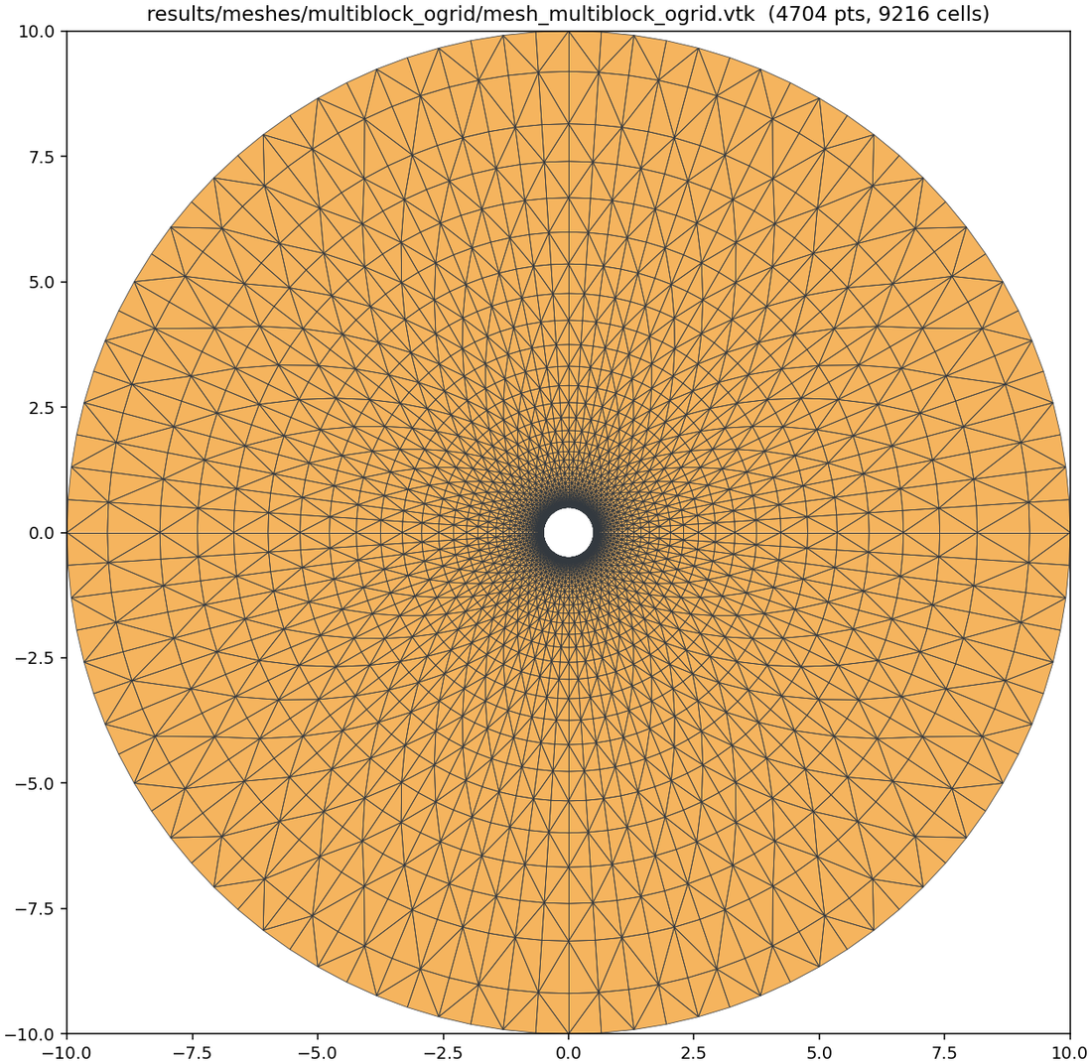
MODULE 2
Mesh Generator — 2D hybrid meshes
— Boundary-layer quads by node advancement
— Far-field triangles via Gmsh Frontal-Delaunay
— ~1,500 lines of C++
— Exports VTK and STAR-CD (.vrt/.cel/.bnd)
— Inter-stage conversions handled automatically
Structured boundary-layer quads growing from the body, unstructured triangles filling the far field.
An Integrated CFD Workflow Platform for In-House Solvers
7
Notes:
The mesh generator produces 2D hybrid meshes — about 1,500 lines of C++.
You can see the structure in the figure: a structured boundary layer of quadrilaterals growing outward from the body by node advancement, and unstructured triangles filling the far field using Gmsh's Frontal-Delaunay algorithm.
It exports both VTK and STAR-CD formats, and — this matters for the workflow claim — the conversions between stages are automatic.

Slide 8
MODULE 3
Core Solver — execution and monitoring
— Input format conversion
— Optional MPI domain decomposition
— Executes solvers distributed as shared libraries, via a built-in DLL call template
— A background worker parses stdout in real time for live convergence monitoring
An Integrated CFD Workflow Platform for In-House Solvers
8
Notes:
Module three drives the solver.
It handles input format conversion, optional MPI domain decomposition, and the execution itself — including solvers distributed as shared libraries, through a built-in DLL call template.
The part users notice is the background worker: it parses stdout as the solve runs, so convergence is monitored live rather than after the fact.

Slide 9
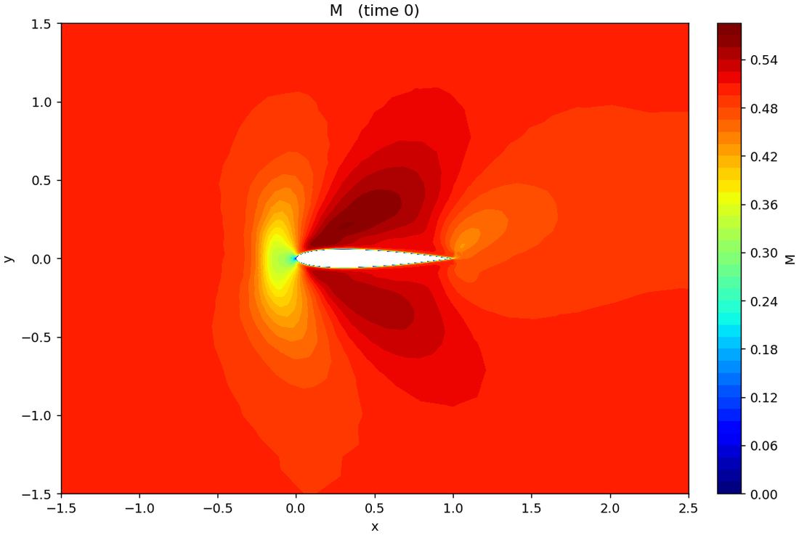
MODULE 4
Results Visualization
— Parses Tecplot-format output
— Cell-centred scalar fields on an embedded matplotlib canvas
— Contours, streamlines and vector glyphs
— Interactive colormap and field-variable controls
Cell-centred Mach number on a NACA 0012, rendered on the embedded canvas.
An Integrated CFD Workflow Platform for In-House Solvers
9
Notes:
And module four, visualization.
It parses Tecplot-format output and renders cell-centred scalar fields on an embedded matplotlib canvas — contours, streamlines, vector glyphs, with interactive control over the colormap and the field variable.
This is a Mach number contour on a NACA 0012, produced end to end by the pipeline.
The key design point: because it reads through the adapter, visualization is fully decoupled from any particular solver's output format.

Slide 10
THE KEY IDEA
The Solver Adapter
Each adapter implements three interface methods. Everything upstream stays unchanged.
3
<150
0
interface methods
lines of Python per new solver
changes to upstream modules
An Integrated CFD Workflow Platform for In-House Solvers
10
Notes:
Now the central design idea, and the one I'd like you to take away.
Integrating a new solver means implementing three methods. That's the whole contract. Everything upstream — the preprocessor, the mesher, the visualization — stays exactly as it is.
It comes to fewer than 150 lines of Python per new solver.

Slide 11
THE CONTRACT
Three methods, one interface
Method | Input | Output | Purpose
convert_mesh(src, dst) | VTK mesh path | Solver-format mesh file(s) | Converts the platform mesh to the solver's input format — e.g. STAR-CD .vrt/.cel/.bnd for UNICONES.
parse_stdout(line) → dict | One line of solver stdout | Convergence quantities, or None | Extracts iteration, CFL and residual for live monitoring; returns None for non-data lines.
read_results(path) → dataset | Solver result file path | Structured field dataset | Parses solver-specific output for the visualization module, fully decoupling it from the output format.
Table 1 Solver Adapter interface definition.
An Integrated CFD Workflow Platform for In-House Solvers
11
Notes:
Here is the contract in full.
convert_mesh takes the platform's VTK mesh and writes whatever the solver reads. For UNICONES that's the STAR-CD triplet.
parse_stdout takes one line of solver stdout and returns convergence quantities, or None if it's not a data line. That's what drives live monitoring.
read_results parses the solver's own output into a structured field dataset. Because visualization goes through this method, it never needs to know which solver ran.
Three methods, and the solver is integrated.

Slide 12
METHODOLOGY
How it was built
— LLM coding assistants in agentic mode — reading, writing and executing project files, not merely generating text
— Experts defined the pipeline architecture, the numerical algorithms, the format-compatibility chain, and physical validation
— AI generated GUI boilerplate, file parsers, and C++ routines from algorithmic descriptions
— Each feature converged in 2–5 rounds of describe → generate → execute → validate → correct
An Integrated CFD Workflow Platform for In-House Solvers
12
Notes:
Now the second half of the talk: how this was built.
We used LLM coding assistants in agentic mode — that means they could read, write and execute files in the project, not just produce text in a chat window. That distinction matters a great deal.
The division of labour: the domain expert defined the architecture, the numerical algorithms, the chain of format compatibility, and what counted as physically correct. The AI generated GUI boilerplate, parsers, and C++ routines from algorithmic descriptions.
Typically a feature took two to five rounds of describe, generate, execute, validate, correct.

Slide 13
METHODOLOGY — A CASE IN POINT
Text was not enough
— The expert described outward node advancement in natural language; the AI produced a first C++ implementation
— Text description alone could not resolve the geometric failures
— Actual runtime output was needed to find self-intersections at sharp trailing edges and wrong fan-node counts at convex corners
— More precise prompts consistently reduced the number of correction rounds
— Even a fix the AI reported as correct still needed physical validation, to catch discrepancies that appeared only in real use
An Integrated CFD Workflow Platform for In-House Solvers
13
Notes:
Let me make that concrete, because it's the most useful thing we learned.
The boundary-layer module. The expert described the outward node-advancement algorithm in natural language, and the AI wrote a first C++ implementation. It compiled. It ran.
And it was wrong in ways the description could not reach. Text alone could not resolve the geometric failures. What found them was actual runtime output — self-intersections at sharp trailing edges, incorrect fan-node counts at convex corners.
Two things helped. More carefully phrased prompts consistently reduced the number of correction rounds. And even when the AI confirmed a fix as correct, physical validation by the domain expert was still needed — because some discrepancies only appear in real use.

Slide 14
METHODOLOGY — THE RECORD
What the logs say
Reported as case-study observations, not controlled experimental results.
~70–80%
2–5
of code AI-generated, by line count
median correction rounds per feature
~4–6 weeks
1
total effort, vs. 3–6 months conventional
domain expert — no dedicated GUI engineer
An Integrated CFD Workflow Platform for In-House Solvers
14
Notes:
Some numbers, from the developer logs. I want to be careful here: these are case-study observations, not controlled experimental results. Treat them as indicative.
By line count, roughly 70 to 80 percent of the code was AI-generated.
The median feature took two to five correction rounds.
Total effort was around four to six weeks — against an estimated three to six months for conventional solo development of equivalent scope.
And it was one domain expert. There was no dedicated GUI software engineer on this project.

Slide 15
METHODOLOGY — WHERE IT HELPED
The contribution was unevenly distributed
GUI boilerplate, widget layouts, signal–slot wiring, file I/O
~80–90%
Cross-component integration and domain-specific numerical logic
~40–60%
The 69-file, 18,000-line PyQt6 GUI was highly AI-productive for boilerplate — but workflow-level decisions (mode switching, cross-panel consistency) needed explicit human specification. The IBM and non-IBM output modes were discovered, only in live testing, to produce different stdout structures.
An Integrated CFD Workflow Platform for In-House Solvers
15
Notes:
The most honest finding is that the contribution was uneven.
For GUI boilerplate — widget layouts, signal-slot wiring, stdout parsers — the AI was extremely productive, 80 to 90 percent.
For domain-specific numerical logic and cross-component integration, it was much lower — 40 to 60 percent — and those are exactly the parts that decide whether the software is right.
The 69-file, 18,000-line GUI reinforced the same pattern. Boilerplate: very productive. Workflow-level decisions — how modes switch, how panels stay consistent — needed explicit human specification. A good example: the IBM and non-IBM solver output modes turned out, only in live testing, to produce different stdout structures. No amount of prompt-writing would have surfaced that; running it did.

Slide 16
EVALUATION
Before and after
Eliminating manual format conversion and inter-tool transfer at every stage.
5 → 1
~20 → ~5
~2 weeks → ~2 days
separate tools required
manual steps per simulation
time for a new user to become familiar
Indicative figures from informal observation, not controlled experimental results.
An Integrated CFD Workflow Platform for In-House Solvers
16
Notes:
So what did it buy?
Against using UNICONES without a unified interface: five separate tools become one. Around twenty manual steps per simulation become around five.
And the time for a new user to become familiar with the full workflow drops from roughly two weeks to roughly two days.
Again — these are estimates from informal observation, not a controlled study. We say so in the paper. The mechanism behind them is concrete, though: it's the elimination of manual format conversion and inter-tool transfer at each stage.

Slide 17
DISCUSSION
The oversight that proved indispensable
Three layers, and the method fails without all three.
1
2
3
Precise problem description
Execution-based diagnosis
Physical validation
More careful phrasing consistently reduced correction rounds.
Runtime output found the edge cases that description could not.
An expert still had to catch discrepancies visible only in real use.
Without domain expertise at each layer, AI-assisted scientific software development risks producing plausible but incorrect implementations.
An Integrated CFD Workflow Platform for In-House Solvers
17
Notes:
Stepping back — the AI-assisted approach proved most effective for peripheral tooling: GUIs, data pipelines, visualization. That's where LLM strengths in well-established software patterns apply.
But effective collaboration required three layers of human oversight: precise problem description, execution-based diagnosis of edge cases, and physical validation.
And I'd underline the conclusion we draw: without domain expertise at each of those layers, this approach risks producing implementations that are plausible and incorrect. In CFD that's the worst possible failure mode, because it doesn't look like one.

Slide 18
CONCLUSION
What we take away
— A unified CFD workflow platform for in-house solvers, demonstrated with UNICONES — without modifying the solver core
— Tools reduced 5 → 1, workflow steps ~20 → ~5, onboarding ~2 weeks → ~2 days
— The Solver Adapter — under 150 lines of Python per new solver — decouples solver-specific logic from the platform core
— A generalizable strategy for groups maintaining in-house solvers with limited software-engineering resources
An Integrated CFD Workflow Platform for In-House Solvers
18
Notes:
To conclude.
We presented an integrated CFD workflow platform for in-house solvers, demonstrated with UNICONES, built without modifying the solver core.
It reduces the tools required from five to one, the workflow from around twenty steps to around five, and estimated onboarding from two weeks to two days.
The modular adapter — under 150 lines of Python per new solver — decouples solver-specific logic from the platform core. And we think that pattern is reproducible by domain-expert teams without dedicated software-engineering resources.

Slide 19
FUTURE WORK
Where this goes next
— Extend the platform to 3D mesh generation
— A formal user study with standardized usability metrics
— Web-based deployment, to further lower the barrier for CFD education and research
Thank you — questions welcome.
This work was made possible by the academic resources and advanced research infrastructure of the National Center for High-performance Computing, National Institutes of Applied Research, Taiwan, with partial funding from the fundamental R&D program of NSTC, Taiwan.
Notes:
Future work, briefly: extending to 3D mesh generation, a formal user study with standardized usability metrics — which is what our current estimates really need — and web-based deployment, to lower the barrier further for CFD education and research.
Thank you. I'm happy to take questions.

