Slide 1
Gesture Recognition
Sriram Raju Dandu

Slide 2
Pre-requisites
Android studio
Microsoft band
Android phone
USB cable (Phone - laptop)
Code (Available on collab)

Slide 3
What is gesture recognition?
Definition- “Mathematical interpretation of a human motion by a computing device.”
Purpose- To use simple gestures to control or interact with devices without physically touching them.
Gesture recognition can be seen as a way for computers to begin to understand human body language, thus building a richer bridge between machines and humans than primitive text user interfaces or even GUIs (graphical user interfaces), which still limit the majority of input to keyboard and mouse.

Slide 4
Applications
Virtual/augmented environment
Gaming
Accessibility for the physically-challenged
Consumer electronics
Notes:
Sensors – Camera, accel, gyroscope
Gaming – Nintendo V
Blind
Samsung screen shot

Slide 5
Accelerometer vs Gyroscope
Linear acceleration
Relative to gravity
Low SNR
Linear motion
Angular velocity
No absolute reference
High SNR
Rotation

Slide 6
Task 1
Identify the 6 different motions:
Moving right
Moving left
Moving up
Moving down
Rotate clockwise
Rotate anti-clockwise
Notes:
NOTE: Watch orientation

Slide 7
To-Do
Use accelerometer/ gyroscope axis
Choose a threshold/s for each motion

Slide 8
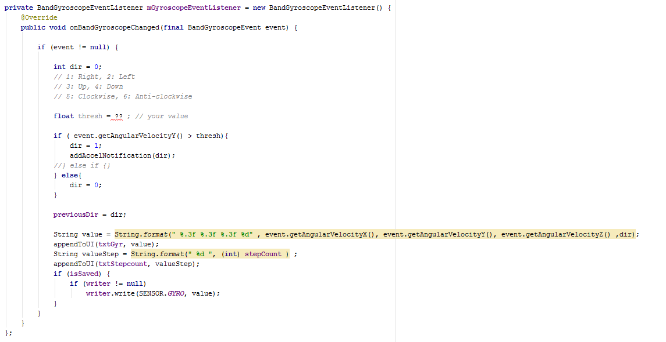

Slide 9
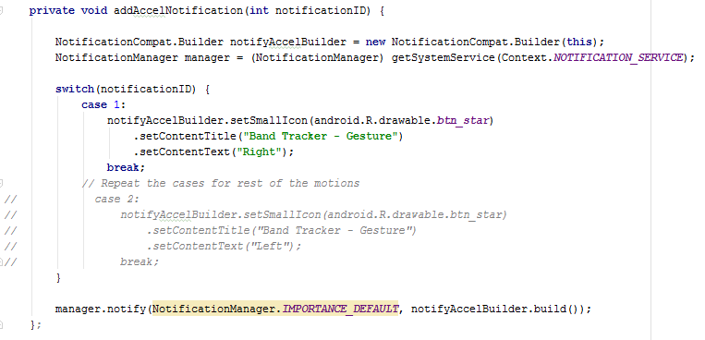
Just right

Slide 10
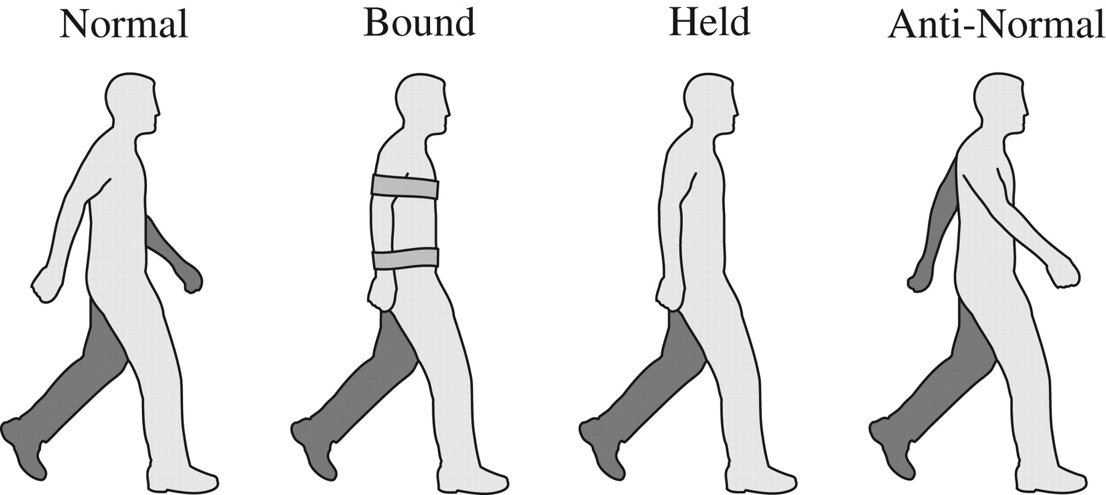
Task 2
Count the number of steps
Down
Idle
Up
One step

Slide 11
Hint
If previous motion was idle, and the current one is either “Up” or “Down” then increment the step count by 0.5

