Slide 1

SlugConnect
Elian Moreno (Product Owner)
Sam Jo (Scrum Master),
Tyler Weng,
Dean McCulloh,
Neha Hingorani

Slide 2
Project Scope
Problem Addressed:
  It’s often difficult for new students to find other students who share similar interests.
  We want to make it easier for both new and continuing students to connect with other students who have share the same interests.
Main Goals:
  Create a user profile and select your interests
  Give UCSC students the opportunity to connect with other UCSC students who have similar interests

Slide 3
Sprint 1
Main Goal: Stand up project infrastructure and allow UCSC students to sign up or log in
User stories
  ACCOUNT
    As a new student, I can create an account using my @ucsc.edu email so that only UCSC students can join
    As a returning user, I can log in securely so my profile data is saved
  AUTHENTICATION
    As a user I want to ensure that I am connecting with other UCSC students
Spikes
  Learn about user authentication (@ucsc)
  Learn about setting up user profiles and saving their information
  Learn about signing up and logging in
Infrastructure Tasks
  Set up development environment
  Gather tools needed for project

Slide 4
Sprint 2
Main Goal: Allow users to fill out their profiles and view other user’s profiles
User Stories
  PROFILE
    As a user, I need to be able to update my profile so that I can find others with similar interests (or majors or graduation year)
    As a user, I need to be able to view other user’s profiles so that I can find others with common interests
Spikes
  Saving user information to the database
  Handle visiting other students profiles
  Research on how to handle sorting interests (tags, categories, etc.)

Slide 5
Sprint 3
Main Goal: People can view suggested matches with groups sharing their interests, and connect with others through the platform
User stories
  As a user, I need to be able to see recommended students who share my interests
  As a user, I need to be able to send connection requests to other users
  As a user, I need to be able to accept or reject connection requests
Spikes
  Building recommendation system from shared interests
  Learning how to implement a system that handles friend requests and creates friend lists

Slide 6
Sprint 4
Main Goal: Manage interactions between users
User stories
  As a connected user, I need to be able to message my connections
  As a user, I need to be able to report or block other users
  As a user, I need to be able to join groups that I am interested in
Spikes
  Learn how to set up messaging between users
  Learn how to save messages long term
  Creating a deeper system for interactions, (messaging groups, blocking people)

Slide 7
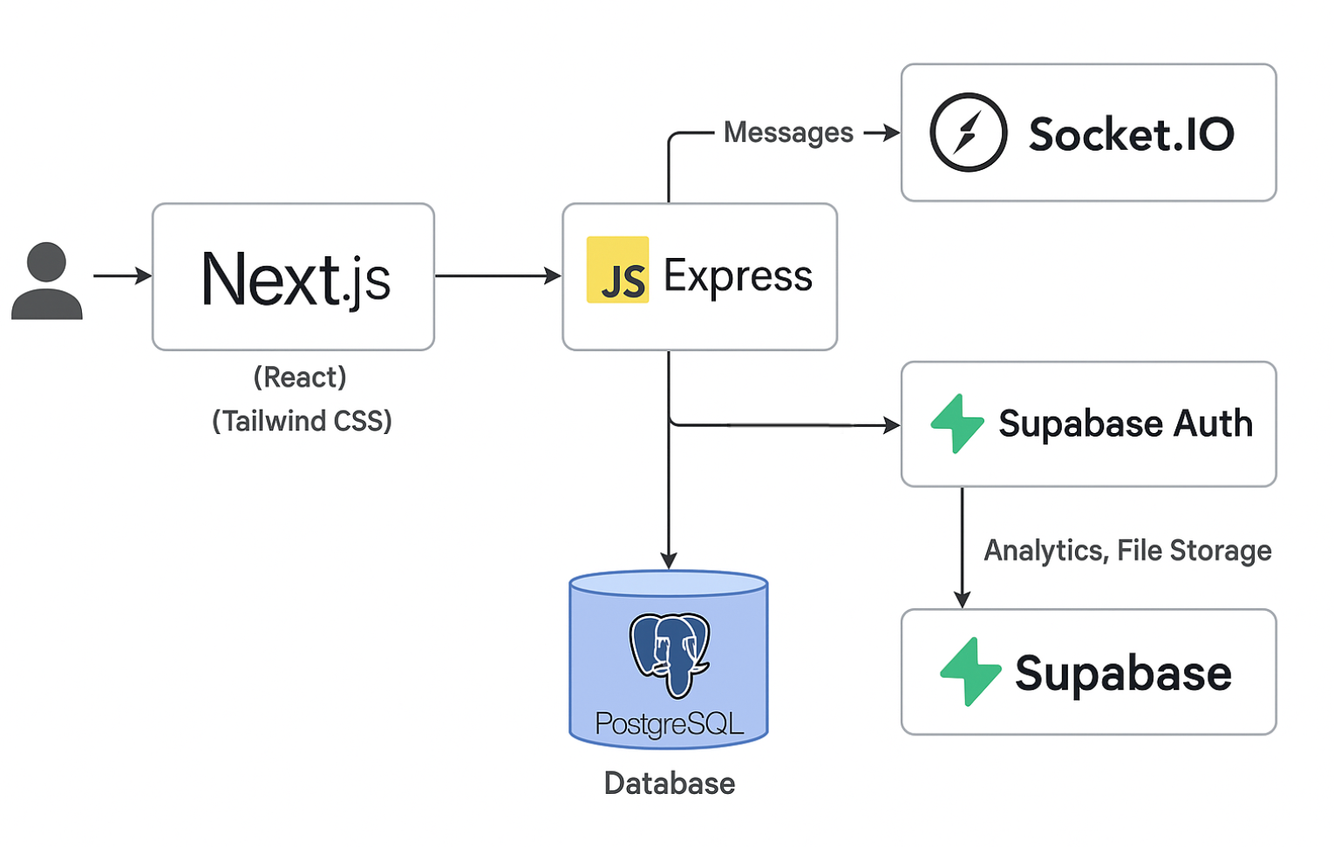
Architecture

Slide 8
Technologies (Tech Stack)
Front End
  React, Next.js
Back End
  Node + Express
Database
  PostgreSQL
Authentication
  Supabase Auth (token based authentication system)
Group/Collab
  Github
  Discord

Slide 9
Challenges/Risks
1. Technical
Ensuring smooth integration between frontend, backend, and database
Maintaining data security and user privacy
Handling scalability and performance as users increase
2. Design
Creating an intuitive, user-friendly interface
Avoiding feature overload early on
Ensuring accessibility across different devices and users
3. Project Management
Meeting deadlines within limited time and resources
Keeping clear communication and task distribution in the team
Maintaining focus on MVP goals
Notes:
Sam

Slide 10
Minimal Viable Product
Goal: To demonstrate that students can successfully connect based on shared interests using a simple web interface. The MVP should prove that there is engagement and that the interest-based connection system is valuable to the UCSC community.
Expected User Experience:
User logs in with UCSC email.
Fills out profile (major, year, interests).
Gets recommendations for people or groups.
Joins a few interest groups (i.e., “ Soccer Club”).
Sends a connection request or message to another user.
Attends an event shared in a group.
Notes:
Sam

Slide 11
Thank you!

