Slide 1
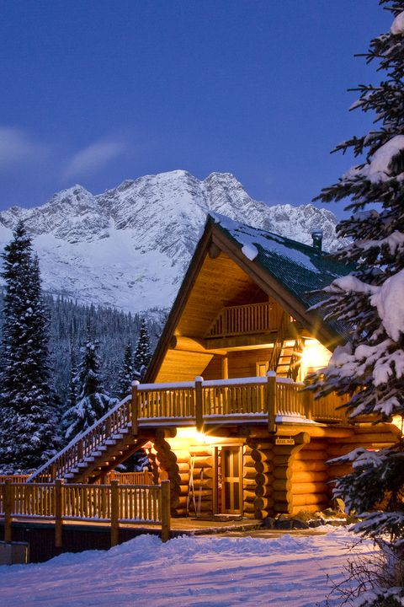
BED & BREAKFAST
WEB APP GROUP - EMILY, HEATHER, TYLER, JON

Slide 2
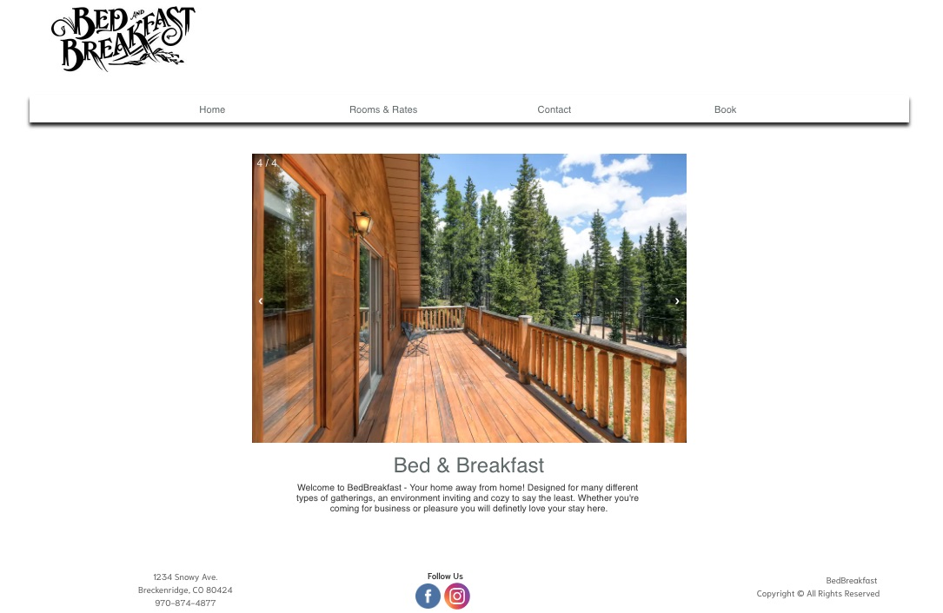
HOME PAGE
Go here to
view rooms!
Go here to
book a stay!
Slideshow of pictures
within the cabin

Slide 3
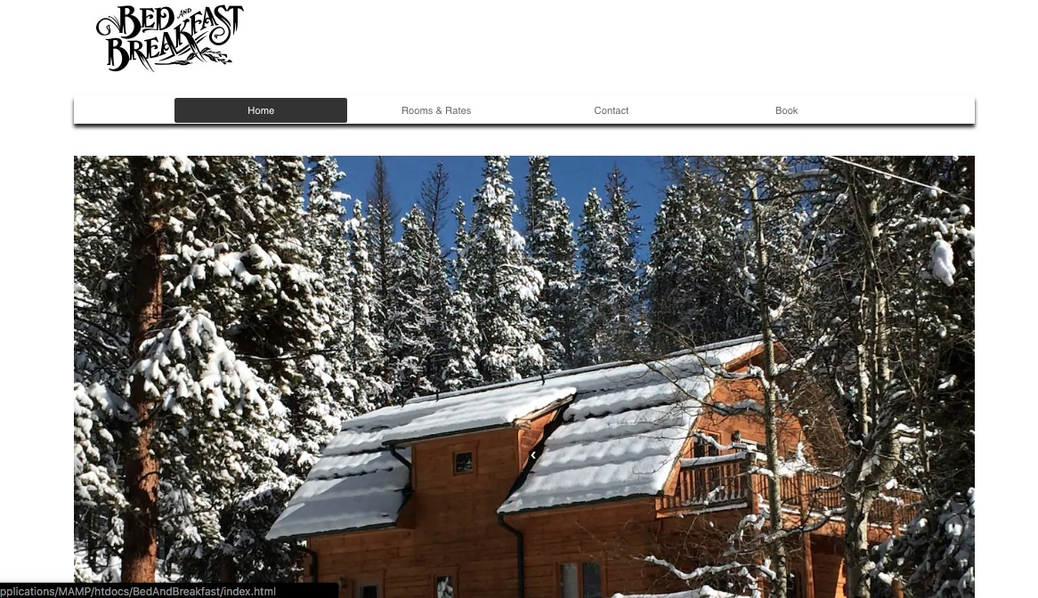
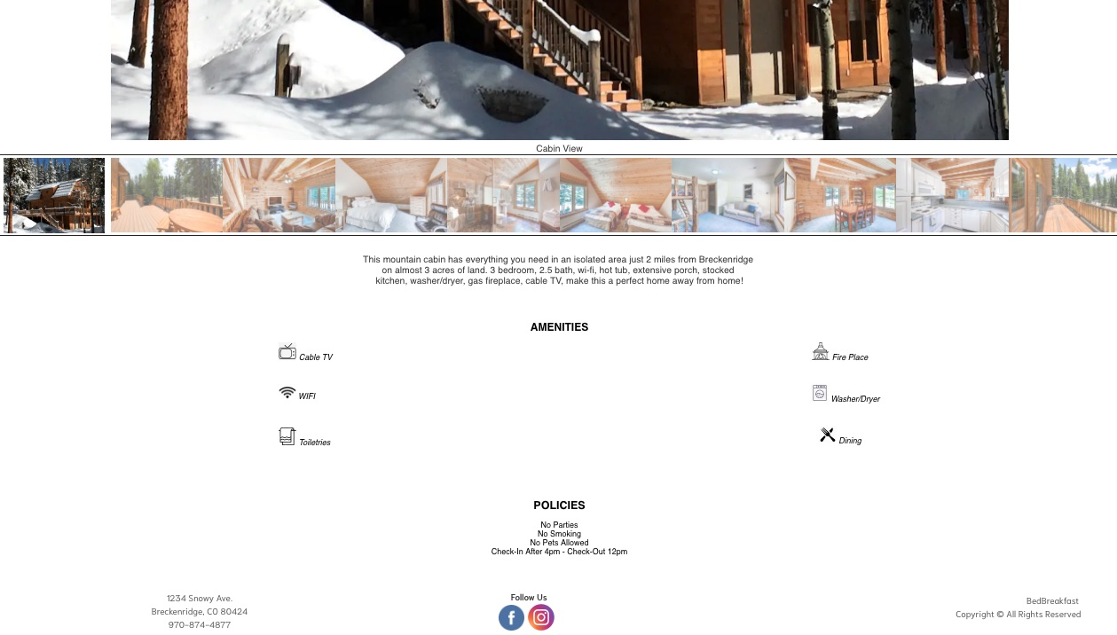
ROOMS & RATES
List of Amenities
included

Slide 4
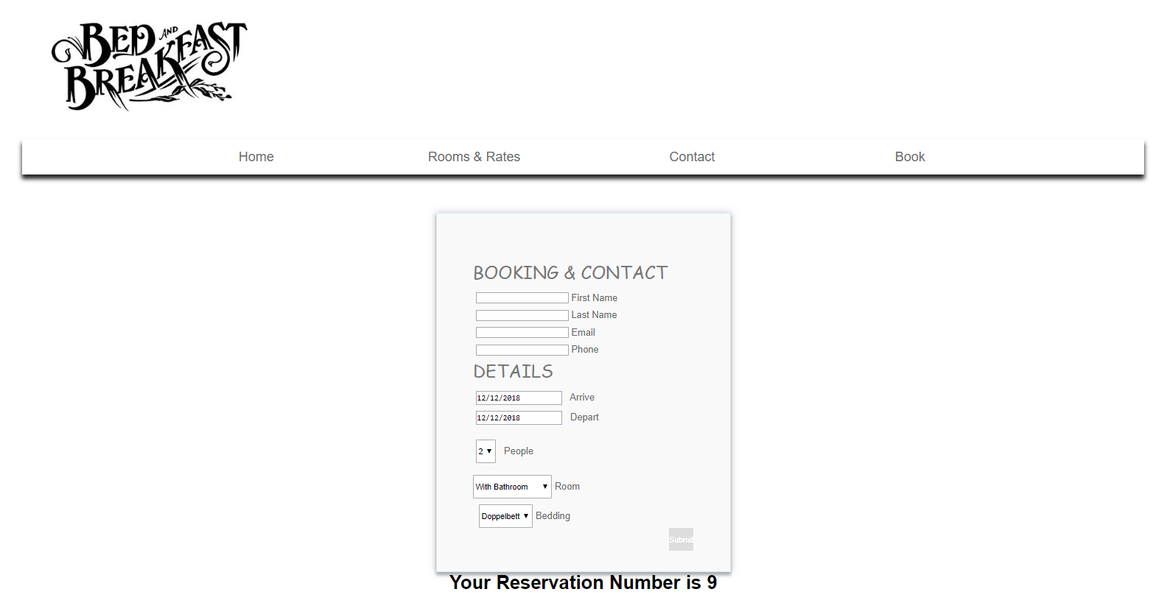
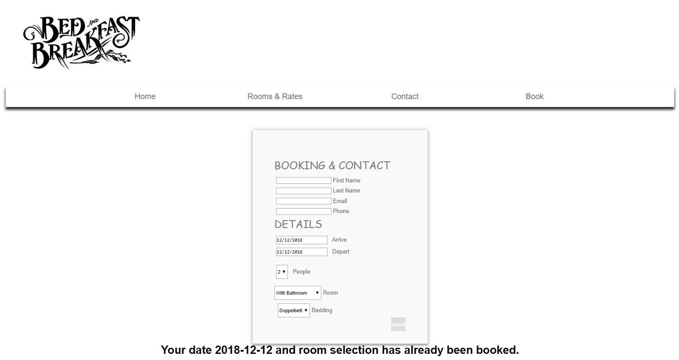
BOOKING A STAY
We use PHP to access and
update the database
where reservations are stored.
Reservation
made!
Already booked for
that day…

