Slide 1
T5
Text-to-Text Transfer Transformer
사전학습 모델
Prefix를 Text와 함께 Input으로 활용하여 단일 모델로 여러가지 NLP Task를 처리할 수 있는 것이 특징
이번 프로젝트에서는 감성분석과 주제분석을 수행할 예정

Slide 2
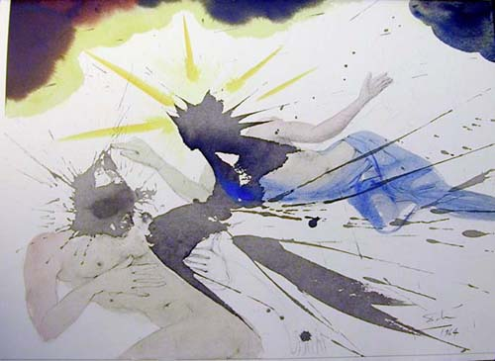
ArtEmis
Tertia die resurrexit
by Salvador Dali
FEAR :
The woman at first looks like an angel, but the ink splatter makes it look like she's a demon in disguise.
DISGUST :
Two men seem to be fighting with blood spilling from each other.
SOMETHING ELSE :
WEIRD BAINTING OF A MAN LYING DOWN WITH A GIRL NEXT TO HIM, THEY BOTH HAVE SOME BLACK SPOT ON THEIR HEADS.
DISGUST :
This does not appeal to me due to the fact that it appears to be a person in pain as he clutches his chest and stomach
FEAR :
The image looks harsh and stark and as if they are fighting.
Wikiart의 81,000개 예술품에 대한 439,000개의 감성 라벨링 존재
하나의 예술품에 대해서도 여러가지 감성이 존재 (Amusement, Awe, Contentment, Excitement, Anger, Disgust, Fear, Sadness, Something Else)

