Slide 1
Simple Text Editor
양준혁
오현주

Slide 2
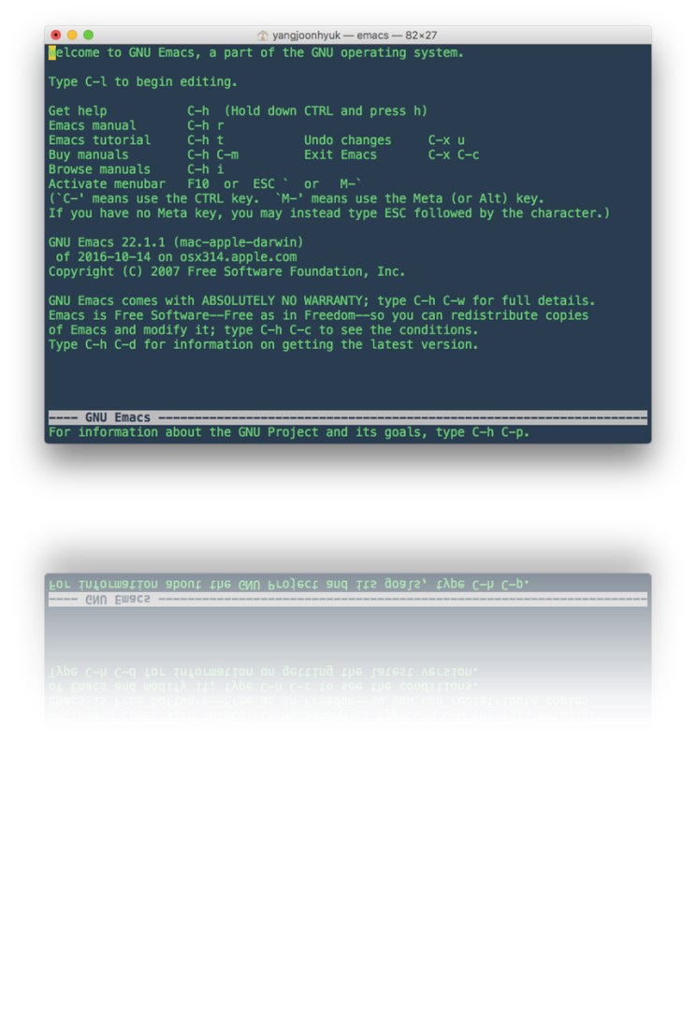
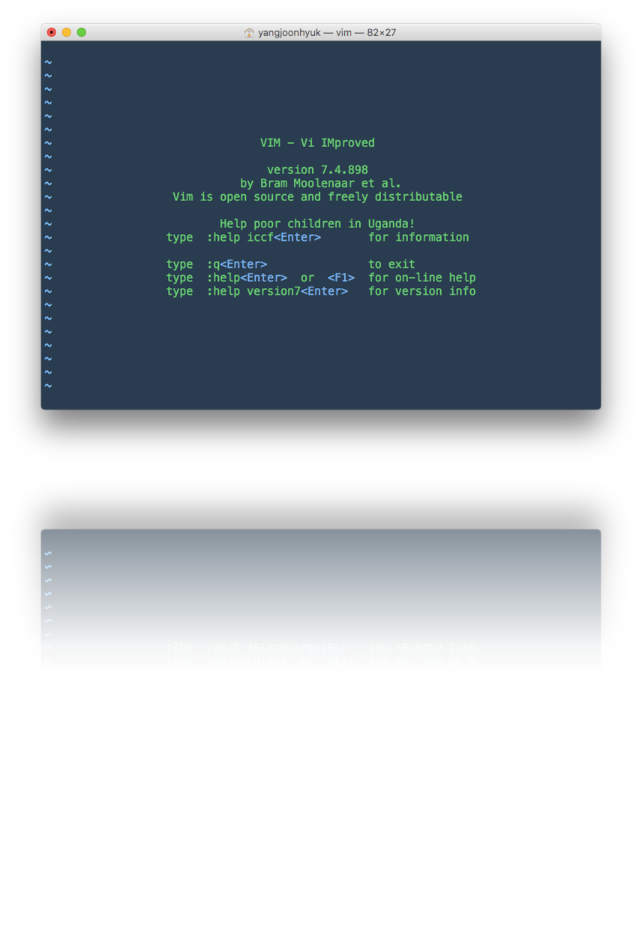
01 Prologue
INDEX
ERROR

Slide 3

INDEX
01 Prologue
Realloc?
Buffer?

Slide 4
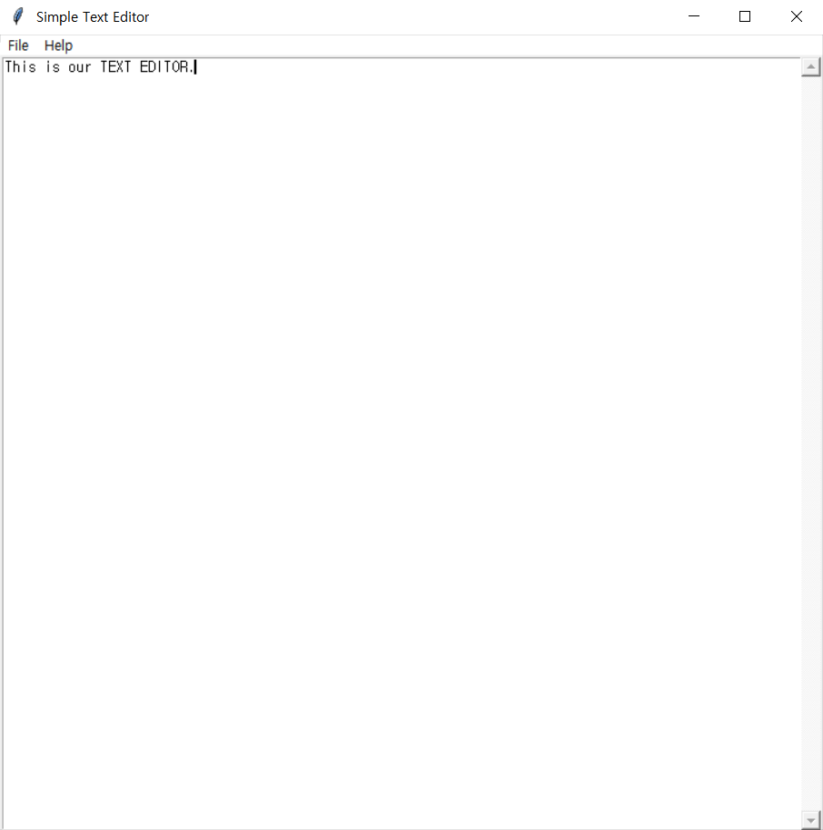
INDEX
01 Prologue
Python
TEXT
EDITOR
+
Tkinter

Slide 5

INDEX
01 Prologue
⋏ Theme
⋏ Window size
⋏ Font
⋏ Document

Slide 6
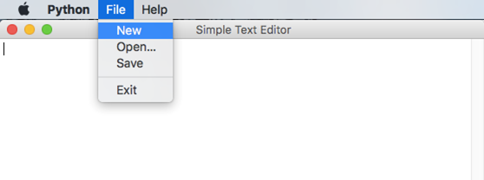
02 Functions
INDEX
New

Slide 7
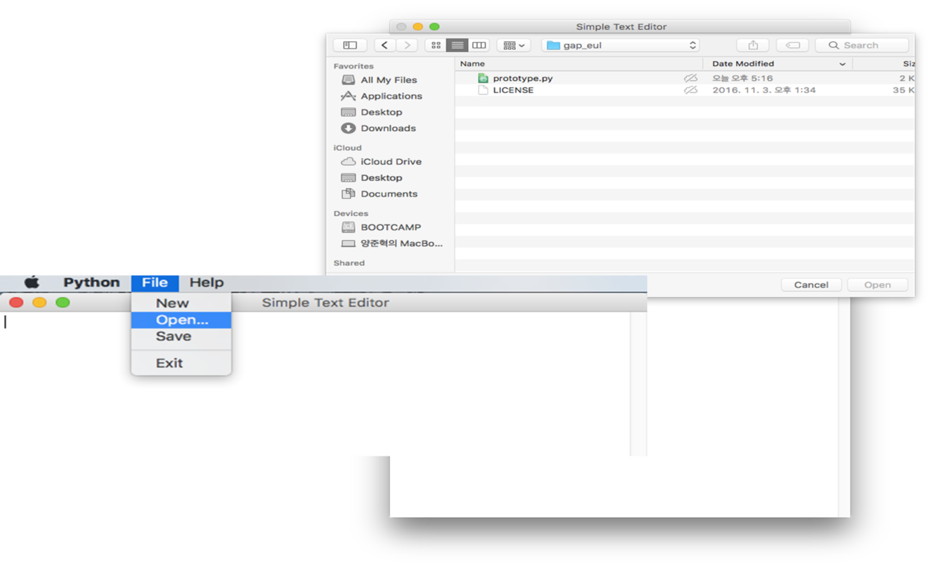
02 Functions
INDEX
Open

Slide 8
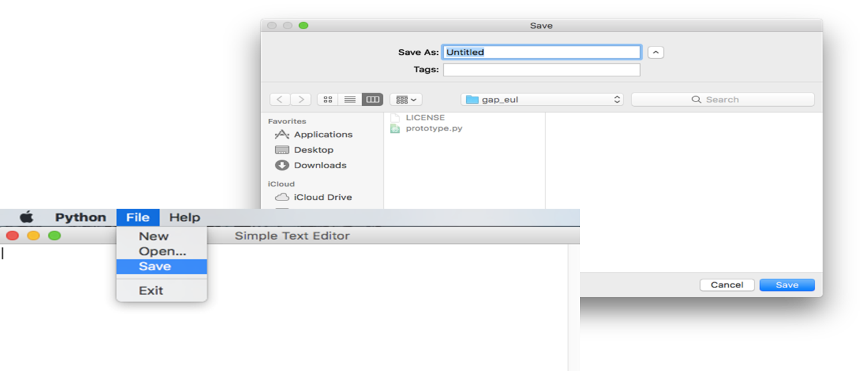
02 Functions
INDEX
Save

Slide 9
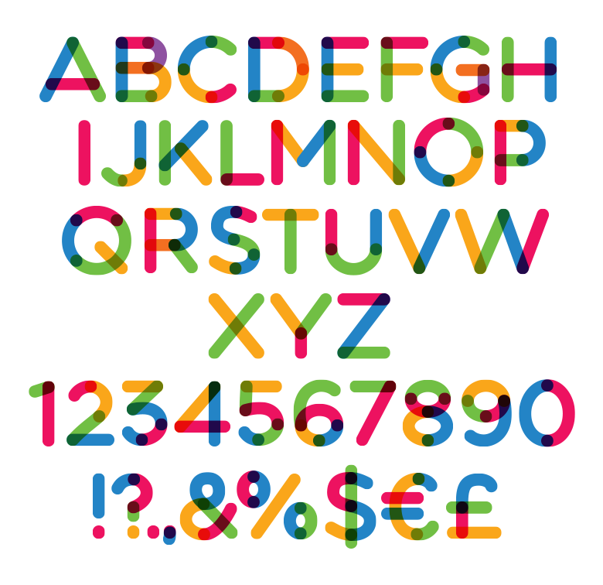
03 Target
INDEX

Slide 10
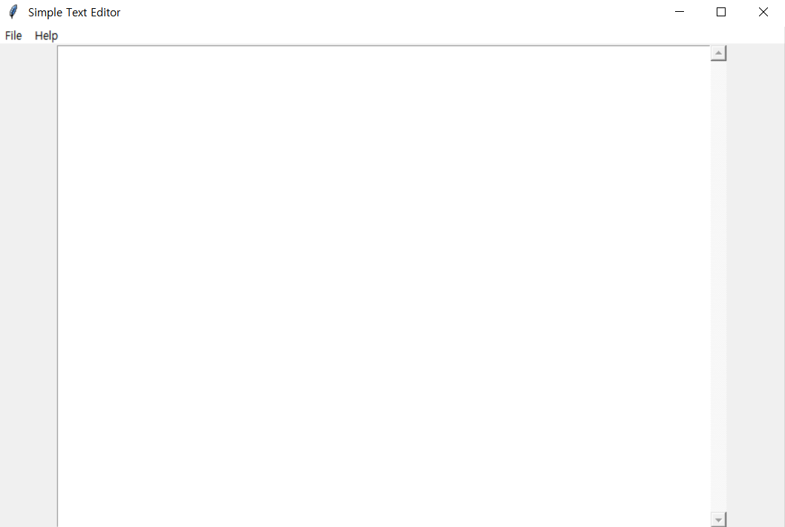
03 Target
INDEX

Slide 11


03 Target
INDEX

Slide 12
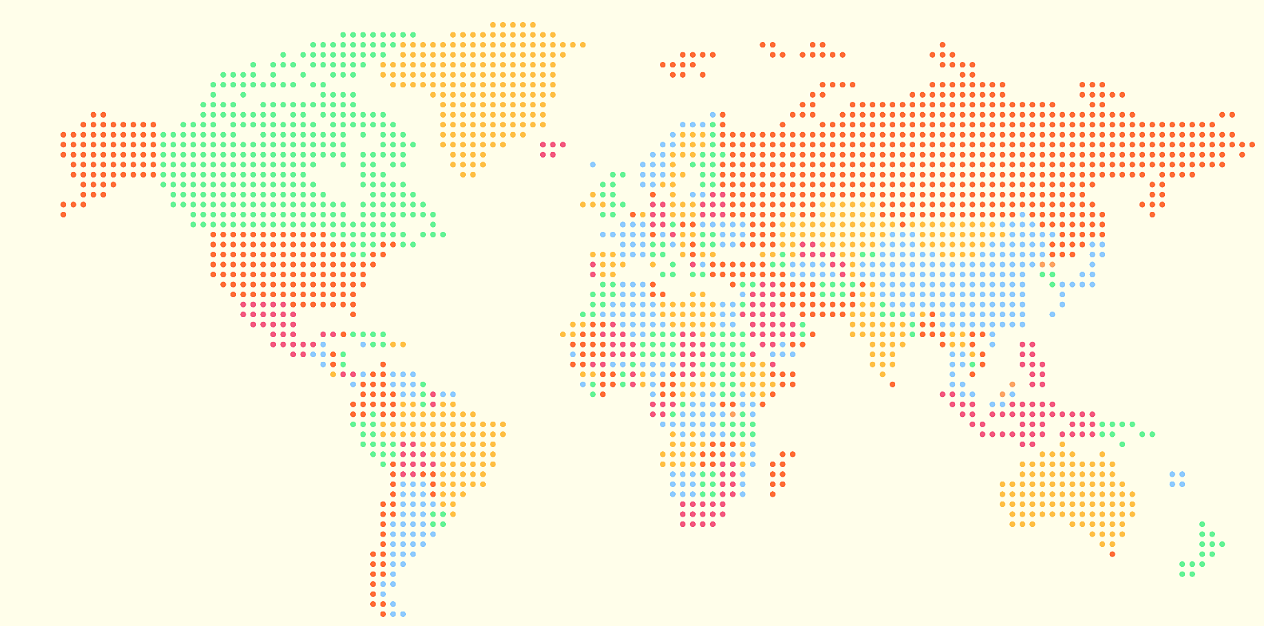

03 Target
INDEX

Slide 13
Thanks!

