Slide 1
SIMPLE
editor
2016003663 양준혁
2016003681 오현주

Slide 2
CONTENTS
Members
Features
Goals
Demonstration

Slide 3
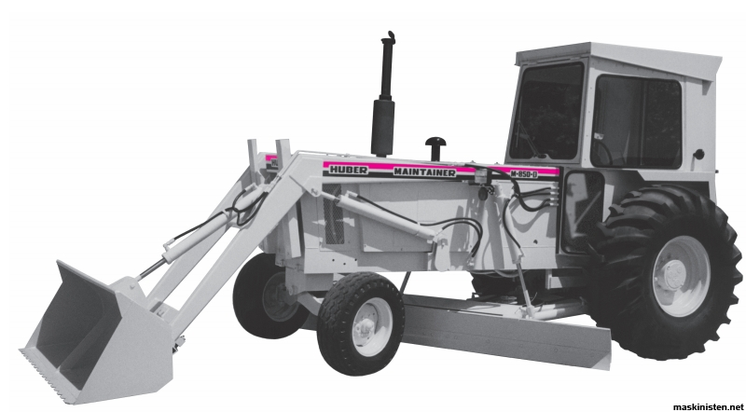

01
Members
Des gner
Joonhyuk Yang
Hyunjoo Oh

Slide 4

02
Features
Des gn

Slide 5
02
Features
+
Ctrl
Z
+
Ctrl
Y
+
Ctrl
F
Lots more..
+
Ctrl
D

Slide 6

03
Goals
Multi

Slide 7

03
Goals
AT M

Slide 8
03
Goals
Suplemon

Slide 9

03
Goals
Syntax

Slide 10
04
Demonstration
GO!

